Slide 1
Change Liaison Meeting
October 6th, 2021

Slide 2
Welcome!
Thank you for being here!
Thank you all for your flexibility during these unprecedented times!
Expectations:
Please give presenters your full attention.
Please utilize the chat functionality (bottom right) to ask questions, or wait until the end of the presentation to come off of mute and ask.
This meeting is being recorded and will be provided in the follow-up email.

Slide 3
Phase 1 Update
Phase 1 Activities
Phase 2 Update
Engagement Opportunities
Phase 1 & 2 Know Do Share Reports (K.D.S.R.)
AGENDA

Slide 4
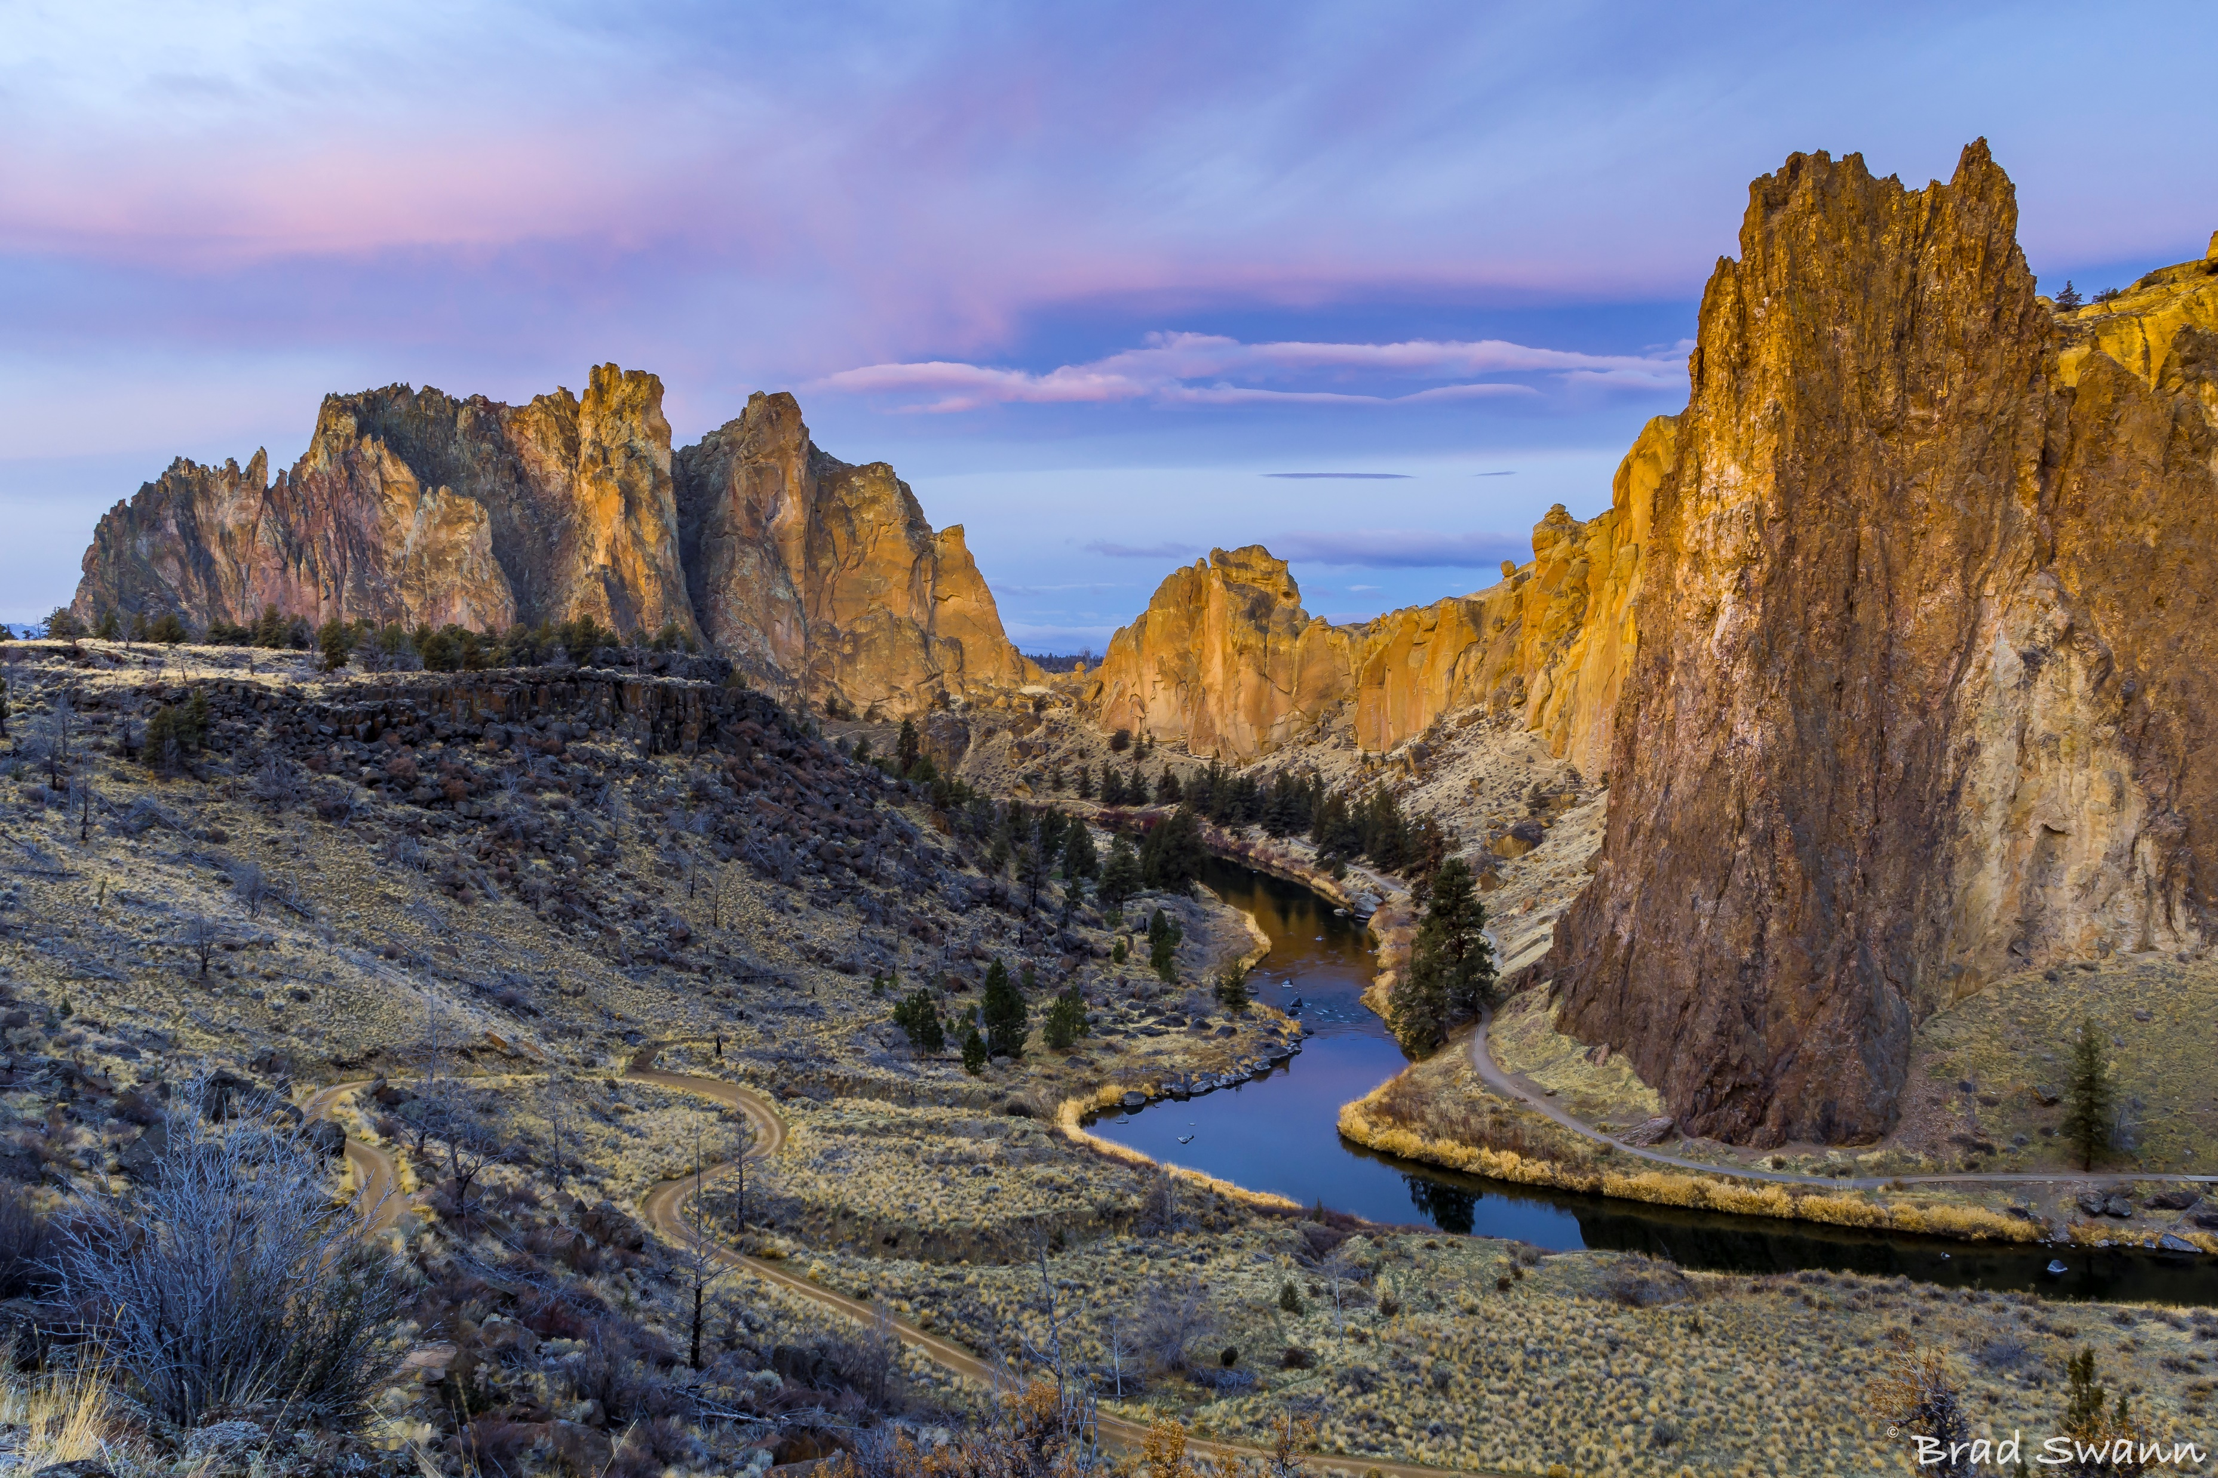
Luma Phase 1 Update

Slide 5
Activity Impact-o-meter: October - December
Activity
October |  |  |  | November |  |  |  |  | December
4 | 11 | 18 | 25 | 1 | 8 | 15 | 22 | 29 | 6 | 13 | 20 | 27
FRICE-W Functional Specs – Enhancements
Allocations Build
FRICE-W Development
Infor Enhancement Development (Trust Accounting 11/17)
SIT3 Prep
UAT Prep
Unit Testing for Enhancements
Identify Trainers
Learning & Development Set-up
Knowledge Transfer Execution
Mock Cutover
Sustainment Planning
Enterprise Design
FRICE-W Design & Build
Impact-o-meter: MEDIUM
*Measures the impact activities have on Agencies
Legend:
Phase 1
Phase 2

Slide 6
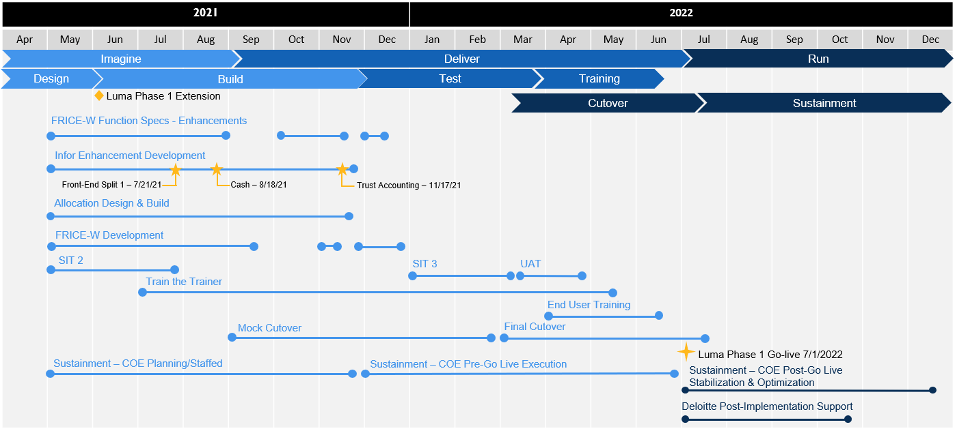
Phase 1 Timeline
Notes:
3 starting in January. We

Slide 7
Phase 1 – Approval Workflow
The Workflow Approval approach utilizes a T-shirt sizing model to provide agencies the flexibility they require for document routing, while maintaining a degree of standardization.
What is it?
Timeline
T-Shirt Features
Small
Medium
Large
Survey due: 10/8
Agency Workbook Completion:
Due 10/25
Routes based on dollar value amount.
Targets agencies with up to 50 employees and a budget managed/monitored by one or two individuals.
Easy to complete and maintain.
Routes based on dollar value amount and one other chart of account dimension.
Targets agencies with up to 250 employees and a budget managed/monitored by multiple individuals.
Enables enhanced distribution of responsibilities.
Routes based on dollar value amount and two other chart of account dimensions.
Targets agencies with more than 250 employees and multiple budgets managed/monitored by multiple individuals.
Greater flexibility, but onerous to complete and maintain.
Agencies will make a T-shirt selection, and be asked to complete the corresponding workbook, populating their employee names and routing personalized configurations.
Kickoff Meeting Video Recordings
9/27 Kickoff Meeting: https://youtu.be/aBYKEDNw8nc
9/29 Kickoff Meeting: https://youtu.be/ItdMvhy2NKM
Next Steps
Notes:
week to answer any questions you have

Slide 8
Phase 1 – Approval Workflow (cont.)
RECIEVED
DUE
53%
OCTOBER
Friday
8

Slide 9
Phase 1 – Luma Security Roles
Employee
Asset Analyst
Cardholder
XM Consumer
Luma Role
Luma Privileges

Slide 10
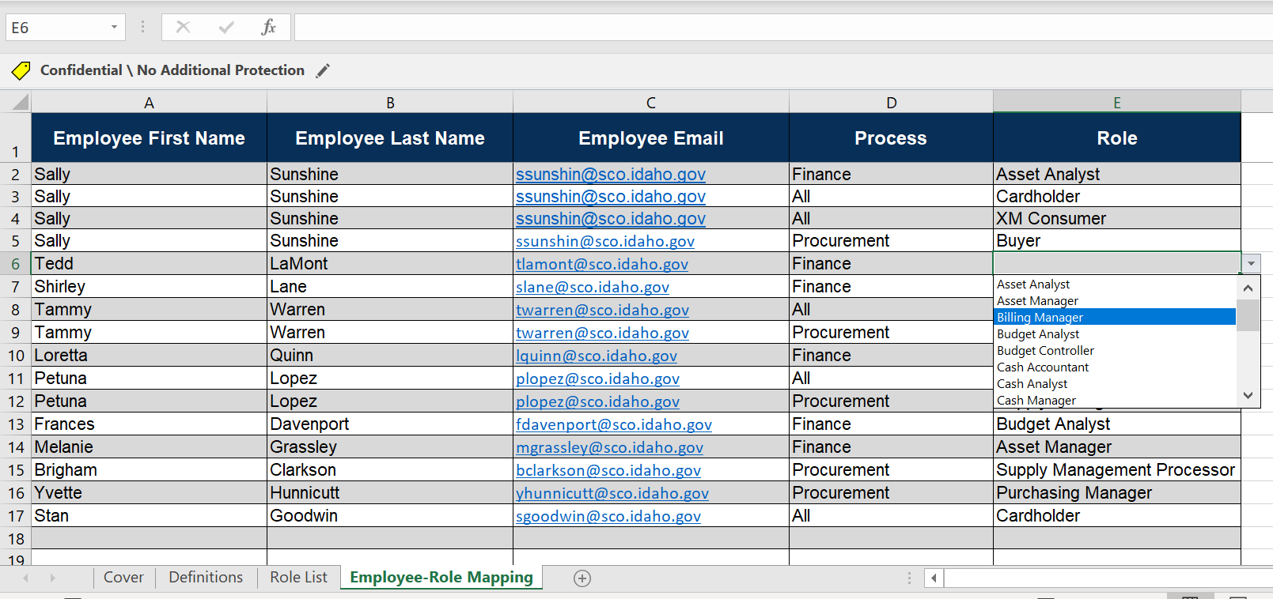
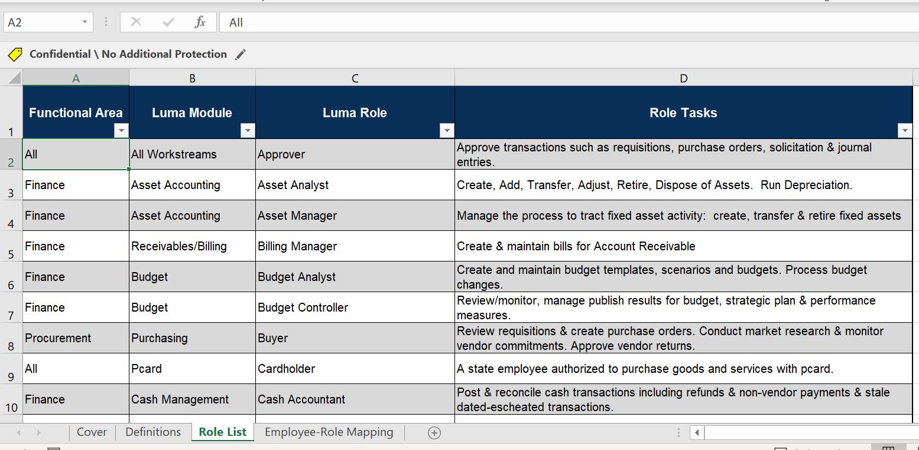
Phase 1 – Luma Security Roles (cont.)

Slide 11
Phase 1 Update – DSA Communication for STARS Clean-up

Slide 12
System Integration Testing 3
High Level Timeline

Slide 13
Projects & Grants
To counteract the challenge of standardization of Projects & Grants, the Luma Project and Grants team, along with the OCM team, will be facilitating communications and workshops with agencies to better assist them with the completion of workbooks in the near future.
Luma Projects and Grants Workshops:
What will these workshops be showing you?
These workshops will provide Agency subject matter experts with a deeper understanding of how projects & grants are managed and maintained in Luma.
Who needs to be in these workshops?
All agencies with just projects or projects and grants (about 63) will be invited to the workshops. We want the person responsible for completing the process for the agency.
When will these workshops be?
October 19th | 9 am - 11am & 2pm - 4pm
October 20th | 9 am - 11am & 2pm - 4pm
October 21st | 9 am – 12pm
Luma Projects and Grants Workbooks:
When will you get more detailed information about this?
We will be sending out a formal communication covering these workshops and workbooks on Thursday, October 7th.
What are the workbooks going to look like?
The workbooks will include current open projects that will need to be active and new projects for July 2022. The agencies will be provided with a process to update these workbooks for the next testing phases and Go-live of Phase 1.

Slide 14
Luma Phase 1 Activities

Slide 15
Phase 1 – Change Readiness Assessment: Measurement 3
When will CRA Measurement 3
be sent out?
What is a Change Readiness Assessment?
Change Readiness describes how ready and able impacted stakeholders are to adopt new business processes and system changes across several key areas. A Change Readiness Assessment (CRA) is an analysis designed to capture a snapshot, a moment in time, which identifies areas of readiness and addresses any gaps. CRAs are comprised of qualitative and quantitative questions, administered periodically throughout the project using an online survey tool.
Why are we doing another Change Readiness Assessment Measurement?
The purpose of the CRA is to identify areas of the State that need attention, prioritize and address those concerns, and report results to project leadership as needed. It provides opportunities to engage insights from the State’s Stakeholders multiple times to help meet the diverse needs of the Luma project.
What’s next?
The OCM team compiled a list of questions that were combined into six main change readiness categories: Envision, Engage, Expect, Commitment, Reinforce, and Culture. We have identified approximately 486 individuals at 68 agencies to complete this survey. These are the same individuals as CRA Measurement 1 & Measurement 2.
OCTOBER
Wednesday
6
When is CRA Measurement 3 due?
OCTOBER
Wednesday
27

Slide 16
Phase 1 – Super User Overview
What is a Super User?
A subject matter expert in specific business processes and the related Luma system functionality who can provide support on a voluntary basis to end users in home agencies. Super users will add Luma system knowledge capacity in their home agencies and assist in providing training and be that go-to person for end users that are in need of coaching , support, and guidance on how to conduct a business process.
Calling all
Super Users
Why do we need Super Users?
We need a better informed community of Luma end users to assist in increasing productivity, stimulate networking, and self-reliance when carrying out job duties involved in continual process improvement.
Agency Motivations
Complete system knowledge
Agency self-reliance
Inter/Intra agency connectedness
For any questions, please email LumaTraining@sco.idaho.gov

Slide 17
Luma Phase 2 Update

Slide 18
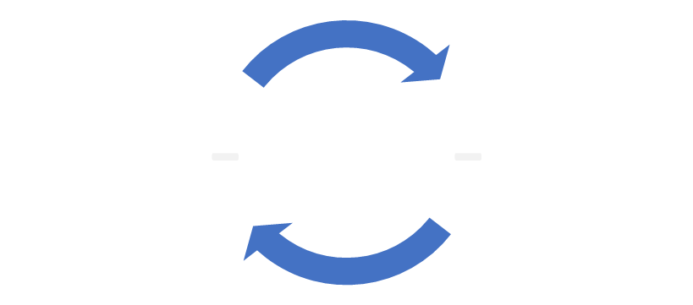
Phase 2 Timeline
2021 |  |  |  |  |  | 2022 |  |  |  |  |  |  |  |  |  |  |  | 2023
Jul | Aug | Sep | Oct | Nov | Dec | Jan | Feb | Mar | Apr | May | Jun | Jul | Aug | Sep | Oct | Nov | Dec | Jan | Feb | Mar | Apr | May | Jun
Plan
Architect
Configure & Prototype
Validate
Deploy
Support
Luma Phase 2 Kick-Off
Payroll/Time Compare
User Acceptance (UAT)
Discover & Prep Update
Config/Validation Sprints
1
2
3
Collect Business Requirements
1
2
3
Prepare Baseline System for Sprint 1
Scenario Testing (SIT)
Infor Orientation
1
2
Define
Finalize
Refine
Training Development
End User
Training
Practice Conversions
1
2
FRICE-W Design & Build
Time Go-Live
HR/Pay Go-Live
5 Milestones to Monitor:
59 Business Process Redesign (BPR) sessions
Baseline System Build
Phase 2 Imagine Phase Artifacts
FRICE-W Requirements/Initial Build
Sustainment

Slide 19
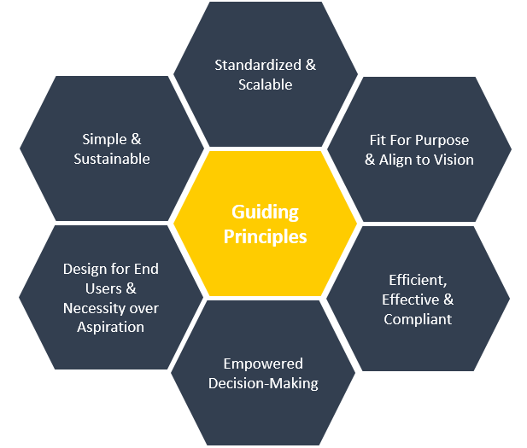
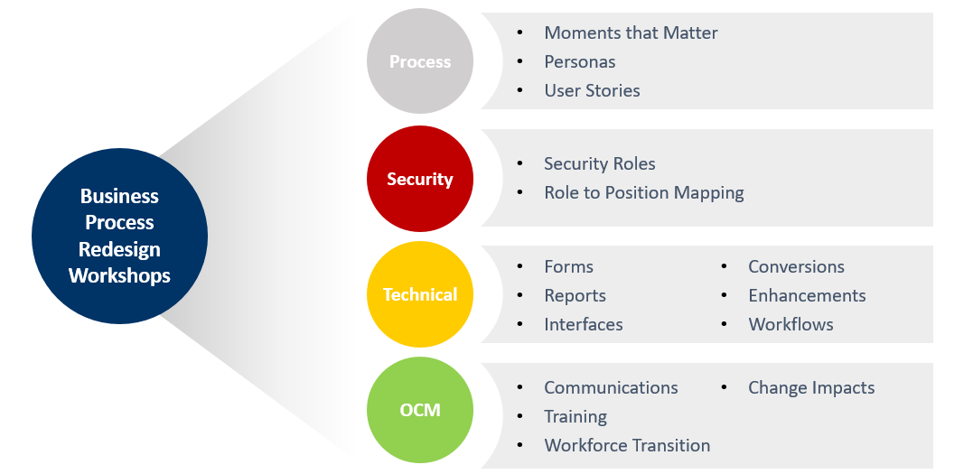
Phase 2 Business Process Redesign Sessions Update
Guiding Principles:
Expected Outcomes:

Slide 20
Phase 2 Business Process Redesign Sessions Update

Slide 21
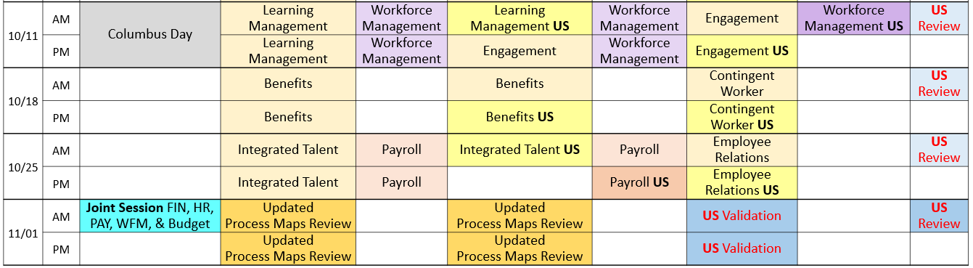
Phase 2 Business Process Redesign Sessions Update
17 of 59 sessions completed (28.81%)
Luma Phase 2 Business Process Redesign (idaho.gov)

Slide 22
Phase 2 Stakeholder Assessment Results

Slide 23
Phase 2 Stakeholder Assessment Results

Slide 24
Phase 2 Stakeholder Assessment Results

Slide 25
Phase 2 Ecosystem Survey Next Steps
Thank you to everyone who completed the Phase 2 Ecosystem Survey!
Next Steps:
The information provided in the survey is vital for us to plan Luma functions and conversions from our existing legacy systems. Work is currently underway using the information you provided.

Slide 26
Engagement Opportunities

Slide 27
Engagement Opportunities
Upcoming engagement opportunities to learn more about Luma. Please help us spread the word!
Type of Engagement | Date | Time | Topic
October Procurement Learning Lab | October 14th | 10:00 am | Requisitions, Purchase Orders, & Receiving
Statewide Showcase | October 21st | 1:00 pm | Security Roles
October Finance Learning Lab Option #1 | October 26th | 10:00 am | TBD
October Finance Learning Lab Option #2 | October 28th | 2:00 pm | TBD

Slide 28
Know Do Share Report
(K.D.S.R.)

Slide 29
Phase 1 K.D.S.R.
KNOW
DO
SHARE
REPORT
Read Luma Project news and updates in this column.
Meet with employees and leadership in your agency to discuss these messages or action items.
Please share this information or engagement opportunities with your Agency
Report feedback to the project team or complete action items the Luma project team is requesting from your agency.
Phase 1 Go-live: Phase 1 of the Luma Project will go live on July 1st, 2022 with the Finance and Procurement modules.
SIT 3 Prep: The Luma Project team is currently preparing for SIT3. A high level timeline is provided on slide 12 showing the preparation going until 11/5
If your agency is currently working with the Luma Project team on an interface or conversion, please maintain momentum to bring those to completion.
Approval Workflow: Agency Advocates sent out the survey for you to choose your T-shirt size. Those survey responses are due by Friday, October 8th.
Security Roles: The workbook for Security Roles will be sent out on October 13th and will be due on November 12th. The October Luma Showcase will focus on Security Roles.
Projects & Grants: The Luma Projects and Grants team will be hosting workshops on 10/19, 10/20, & 10/21. More information will be coming soon!
Change Readiness Assessment Measurement 3: As mentioned, we will be sending out the third CRA measurement today and that closes on 10/27.
Statewide Showcase:
What: Security Roles
When: October 21st | 1 – 2 pm
Where: Virtual meeting. Your Agency Advocate will send out a meeting invite!
Luma Learning Labs:
What: Requisitions, Purchase Orders, & Receiving
When: October 14th | 10 – 11 am
Where: Virtual meeting. Use the link below to RSVP!
Internal Meetings: Please let us know if you have an upcoming internal meetings that we can present to your staff! We want every state employee to know about the Luma, the changes coming, and exciting benefits of a modern system.
RSVP Here
October 6th, 2021

Slide 30
Phase 2 K.D.S.R.
KNOW
DO
SHARE
REPORT
Read Luma Project news and updates in this column.
Meet with employees and leadership in your agency to discuss these messages or action items.
Please share this information or engagement opportunities with your Agency
Report feedback to the project team or complete action items the Luma project team is requesting from your agency.
Phase 2 Go-live: Phase 2 of the Luma project will go live with Workforce Management/Time in December of 2022 and Payroll as well as Human Capital Management on January 1st, 2023.
Stakeholder Assessments:
Thank you to everyone who participated in the Stakeholder Assessment interviews. Your feedback is a valued part of Luma Change Management.
Luma Phase 2 Business Process Redesign (BPR) Update: Phase 2 team members have been conducting Business Process Redesign sessions alongside agency personnel over the past 2 weeks. These sessions will continue until 11/5.
Phase 2 Ecosystem Survey: Thank you to everyone who participated in the Ecosystem survey. The project team will be reaching out to agencies after the BPR sessions to discuss interfaces and conversions.
Luma Phase 2 BPR Sessions: HR and Payroll personnel from across the state will continue participating in the Luma Phase 2 BPR Sessions.
Phase 2 Luma Webpages:
Payroll: Luma Payroll Module (idaho.gov)
Human Capital Management: Luma Human Capital Management (idaho.gov)
Business Process Redesign: Luma Phase 2 Business Process Redesign (idaho.gov)
Internal Meetings: Please let us know if you have an upcoming internal meetings that we can present to your staff! We want every state employee to know about the Luma, the changes coming, and exciting benefits of a modern system.
October 6th, 2021

Slide 31
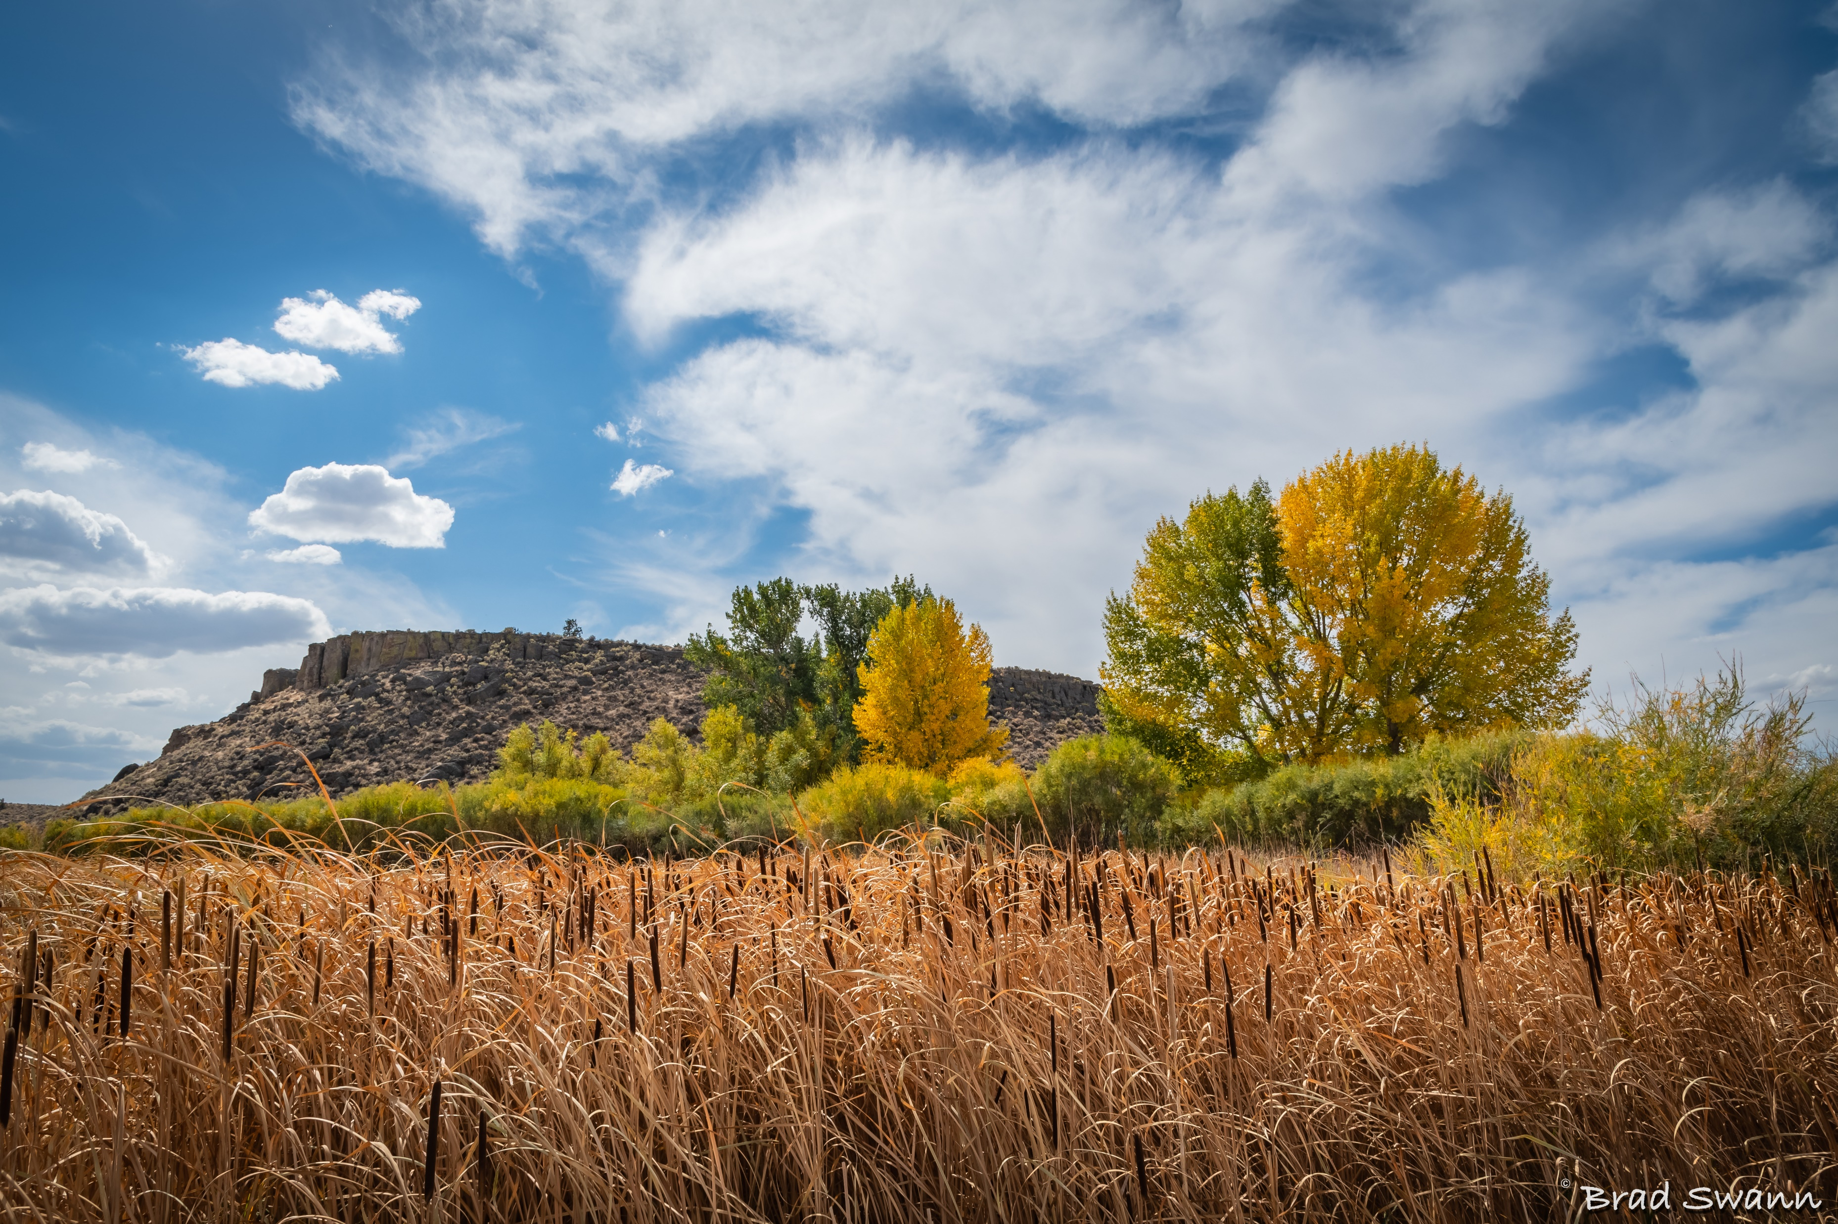
Questions

Slide 32
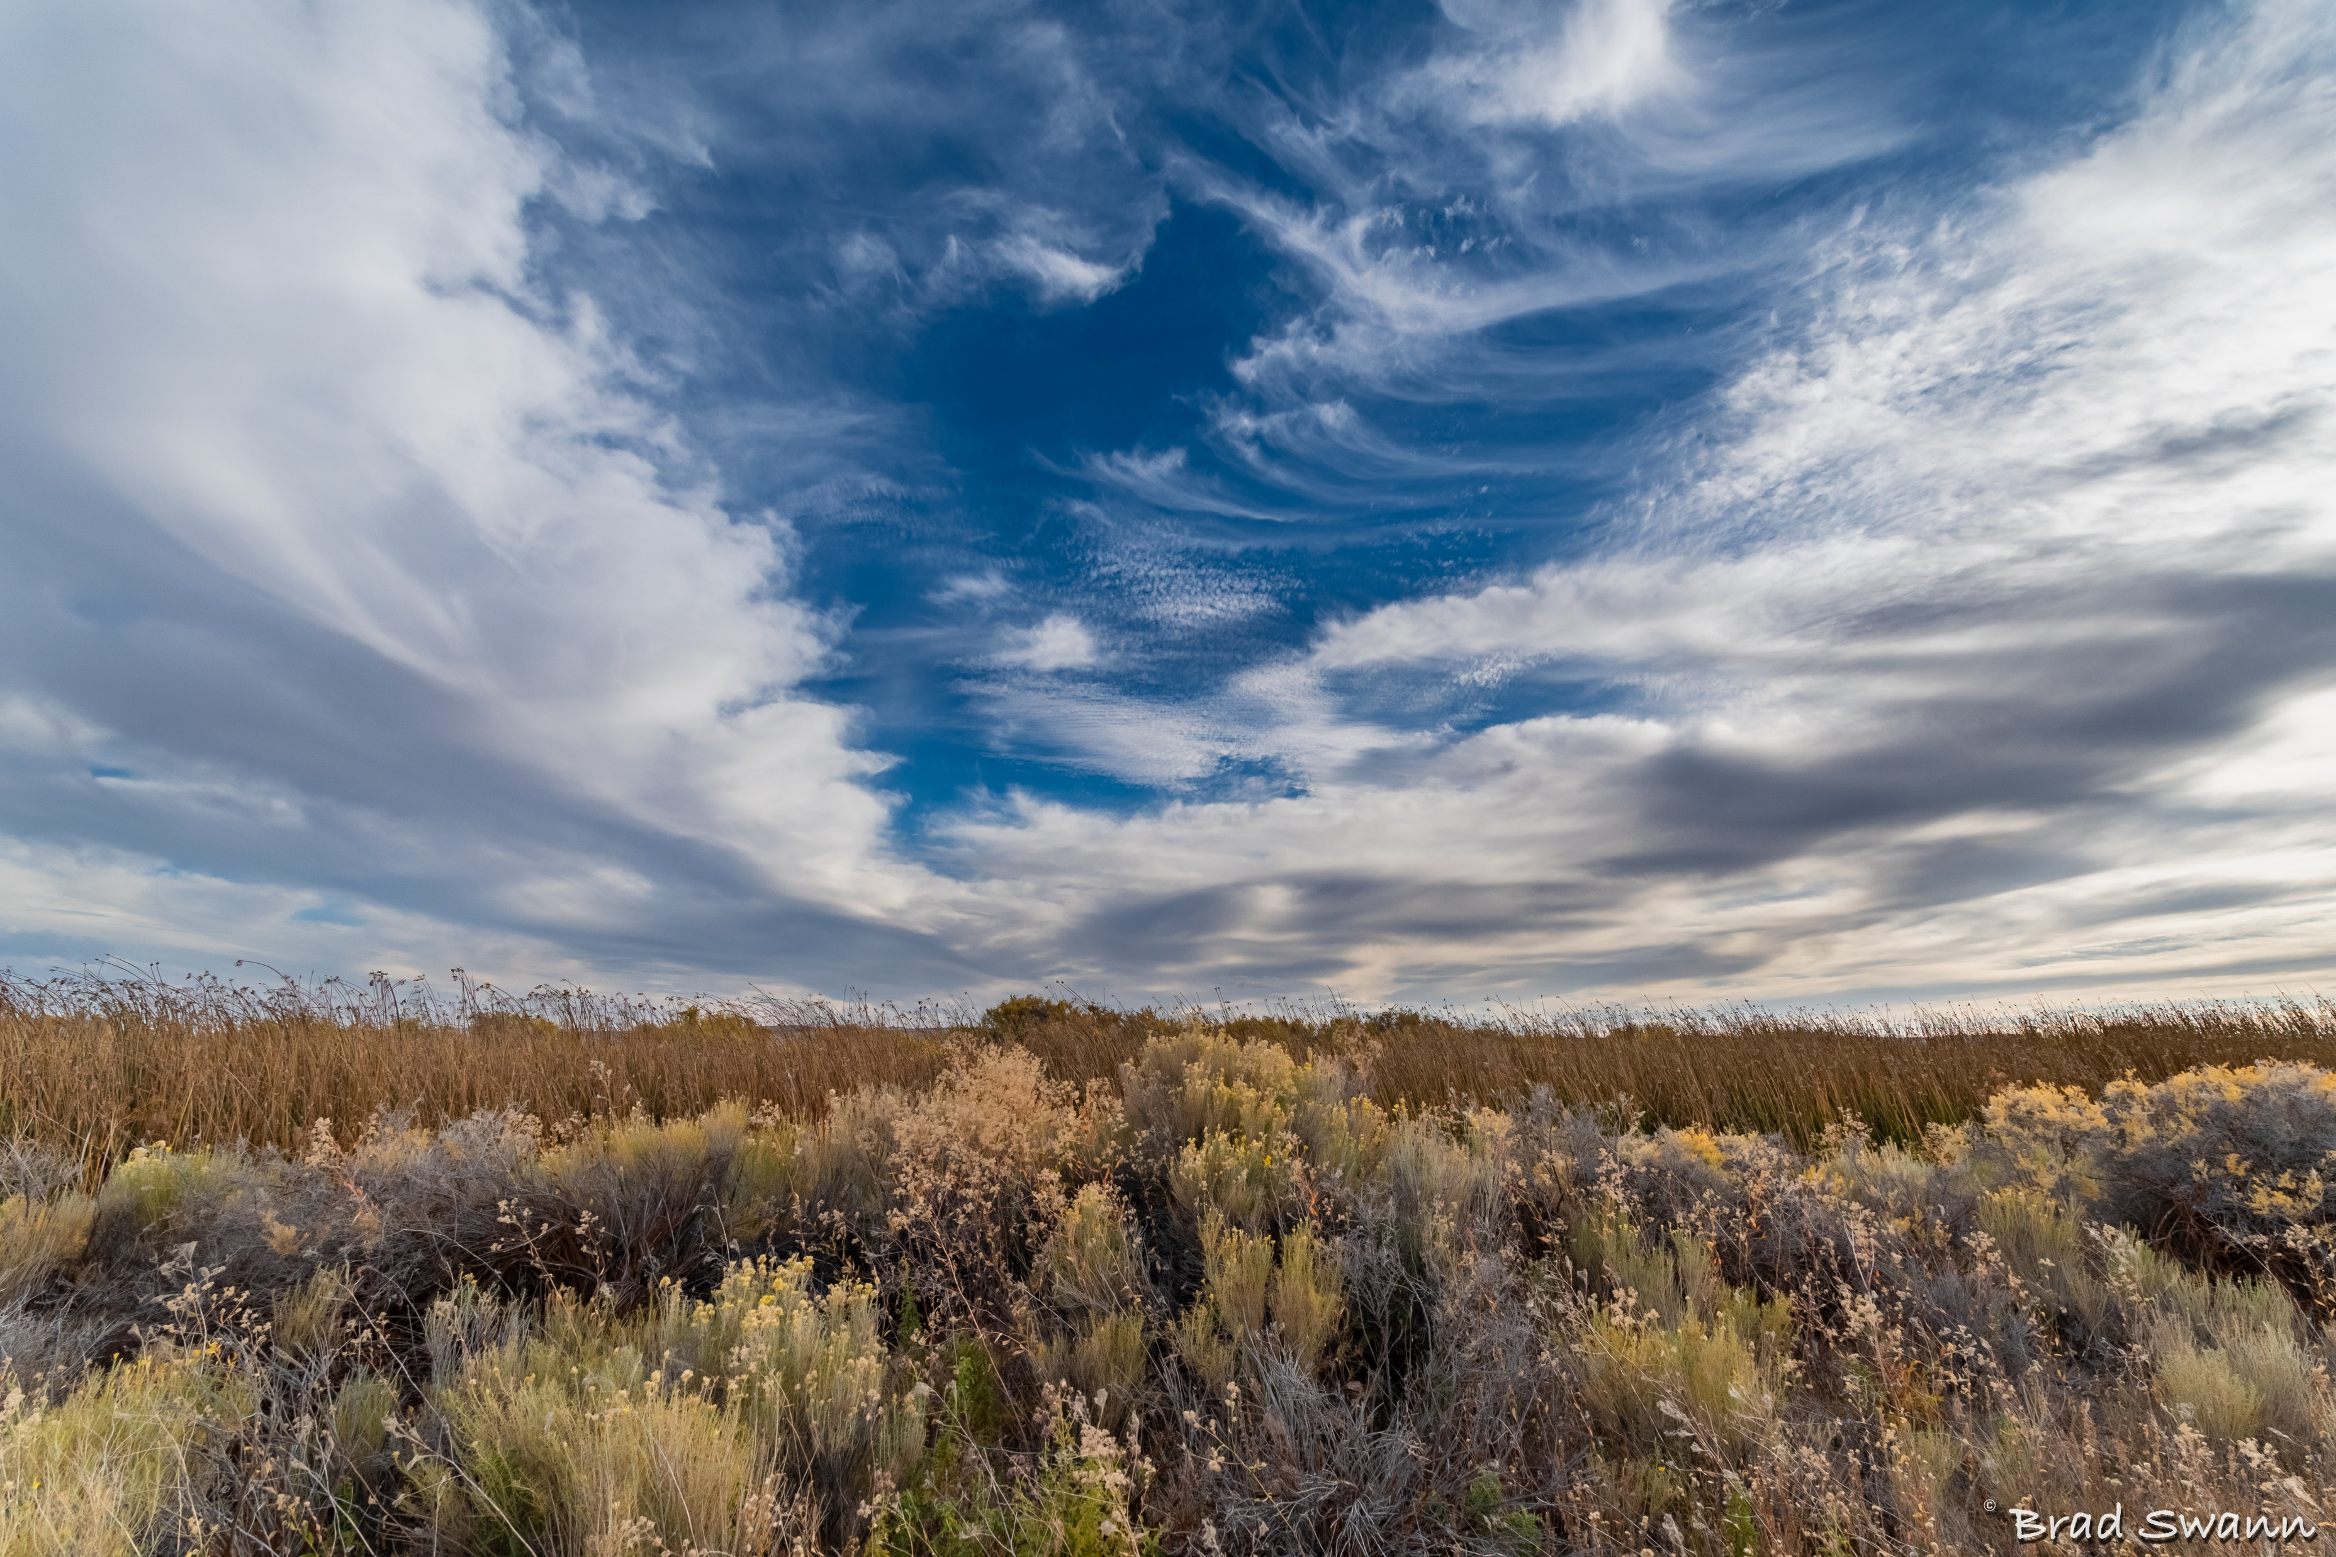
Thank You!
Sheena Coles
SColes@sco.Idaho.gov
208-334-3100
Alex Doench
adoench@sco.Idaho.gov
208-332-8841
Tina Fuller tfuller@sco.Idaho.gov 208-332-8867
Chris Lehosit clehosit@sco.Idaho.gov 208-332-8887
Elijah Stearns
estearns@sco.idaho.gov 208-332-8871
Danielle Blackmer dblackmer@sco.Idaho.gov
208-332-8868

