Slide 1
Change Liaison Meeting
October 5th, 2022

Slide 2
Welcome!
Thank you for being here!
Expectations:
Please give presenters your full attention.
Please utilize the chat functionality (bottom right) to ask questions, or wait until the end of the presentation to come off of mute and ask.
This meeting is being recorded and will be provided in the follow-up email.

Slide 3
Phase 1 Update
Phase 2 Update
Key Takeaways
AGENDA

Slide 4
Luma Phase 1 Update

Slide 5
Phase 1 Earliest Possible Go-Live
Go Live
January 1st will not be the earliest possible go-live for Phase 1.
The Project management team and governance board are currently assessing the viability of a “big bang” (phase 1 and phase 2) go-live in June/July.

Slide 6
Update | Phase 1 Schedule Planned
Phase 1 Roadmap through October (June 7, 2022)
DASHBOARD
Readiness for System Integration Testing (SIT)
mid-May to mid-August
Business Process Validation (unfinished and SIT critical)
Tenant setup and management
COA structure gathered and loaded
FRICE-W required
Scope / readiness
Agency Open Business Process Reviews
Gap and Enhancement Management
Projects and Grants Workbooks
Configuration Implementation Schedule
Agency Configuration Workbooks
Projects and Grants Workbooks
Agency Functional Workshops
APR
MAY
JUN
JUL
AUG
SEP
OCT
Initiatives Build
Phase1: Pre-SIT Initiatives
Pristine Build
Configuration
Internal SIT
Agency SIT
Cutover Plan
Mock CO
Dress Rehearsal
End User Training
Final Cutover
Go Live
Tenant Management Plan
Test Strategy
Agency Partnership Activities
We are here

Slide 7
Phase 1 October Schedule of Events
Luma Phase 1 Overarching Project Plan
System Preparation (Data and Configuration)
Oct 3-7
Oct 10-14
Oct 17-21
Oct 24-28
Agency Business Process Testing
Critical Enhancements***CU Testing
Testing of All Interfaces
Defect Remediation
Week 5 – Agency Participants
Week 6 – Agency Participants
Week 7 – Agency Participants
Week 8 – Remediation
Objective: Test All Interfaces, Conversions, and Business Processes
Go-Live Viable
System Ready
Testing Complete
Remediation Done

Slide 8
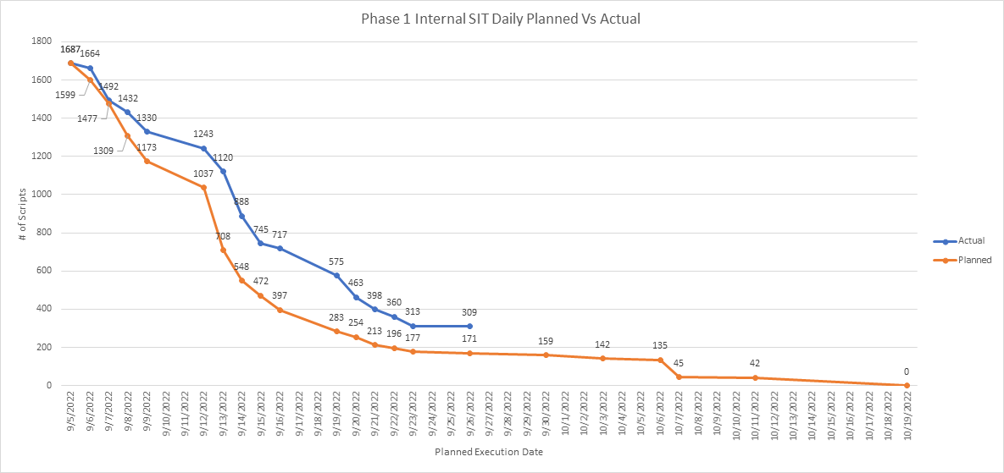
Phase 1 SIT Updates
Successfully completed three-week internal SIT
Engaged and Passed 82% of test scripts (1,367 out of 1,687)
P&G workbook response – 53 of 53 agencies – 100%
GL required workbooks – 83 agencies – 100%
Conversion records processed 98% success – 333k out of 340K
Remaining test scripts dedicated to interface testing over next 4 weeks
Resolved 75 out of 116 incidents – remediation next 4 weeks (58% security)
Scope lock valid – no new mission-critical functionality gaps
On track for Agency-Focused SIT – Started Monday, September 26th
P&G Agency SIT – In-Person Workshop and Testing- 9/26 – 9/30
Expanded Agency SIT – In Person - 10/3 – 10/21
Accomplishments
Revalidated Cash double entry enhancement (December)
Workbook delivery by agencies needs greater communication
P&G workbooks and balances are extremely time-consuming
Greater system performance testing required
Work Force transition and readiness – time for training materials
Challenges
Remaining enhancements need design, build, and test
Interface testing and validation requires greater collaboration
P&G balance collection action by agencies requires extra attention
Risks

Slide 9
Workforce transition
Prepare agency employees to understand the changes to roles, responsibilities, and tasks to successfully adopt Luma and realize the intended benefits.
COMPONENTS
KEY DATES
Leadership Accelerator
Targets senior management and influential stakeholders. Content focuses on statewide benefits, recommendations for how to become an effective catalyst for change.
Leadership Accelerator Workshops Start
End of Oct/Nov
Persona Workshops
Content-specific for employees based on their Persona. Details future state through “Day in the Life” storytelling, including future benefits, highlighting new tasks and important changes.
Luma Phase 2 Personas Workshops Start
November 2022
– Jan 2023
User Experience Simulations Available
Feb- March 2023
User Experience Simulations
Interactive simulations of common tasks (e.g. submitting a timecard, accessing paystubs, viewing assigned workflow items).

Slide 10
Luma Phase 2 Update

Slide 11
Phase 2 (HCM)
October 4, 2022
Schedule
We are here
Milestone #1
Start Testing
✓
#2 Complete
SIT 2 & Pay Compare 1
JUL
AUG
SEP
OCT
NOV
DEC
JAN
FEB
MAR
APR
MAY
JUN
11
18
25
1
8
15
22
29
5
12
19
26
3
10
17
24
31
7
14
21
28
5
12
19
26
2
9
16
23
30
6
13
20
27
6
13
20
27
3
6
13
20
✓
System Integration
Test 1
Additional Testing 2+
Scope Balancing
Pay/Time 1+
Go-Live
Readiness
✓
✓
Phase 1 Delivery:
>9 P&G/COA
finance structure
MC 1
Mock
CutOver
System Integration
Testing 2
Pay/Time
Compare 1

Slide 12
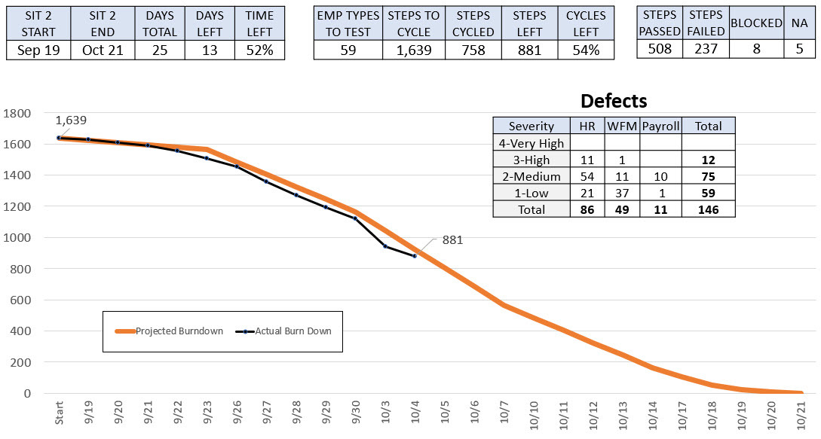
Phase 2 (HCM)
October 4, 2022
Performance Metrics

Slide 13
Key Takeaways

Slide 14
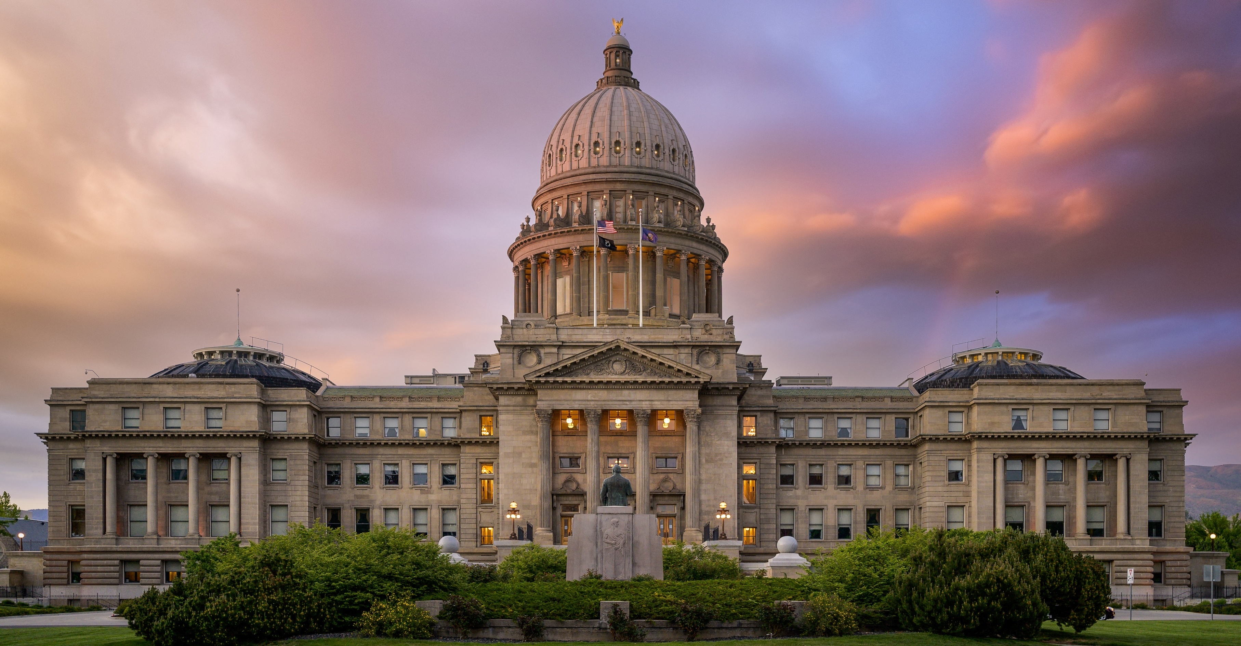
Thank You!
Sheena Coles
SColes@sco.Idaho.gov
208-334-3100
Alex Doench
adoench@sco.Idaho.gov
208-332-8841
Chris Lehosit clehosit@sco.Idaho.gov 208-332-8887
Danielle Stevens dstevens@sco.Idaho.gov
208-332-8868
Krystal Griffith
kgriffith@sco.Idaho.gov
208-332-8861

