Slide 1
Monthly Change Liaison Meeting
January 2023

Slide 2
Introduction
Thank you for being here!
Expectations:
Please give the presenters your full attention.
Please utilize the chat functionality (bottom right) to ask questions, or wait until the end of the presentation to come off of mute and ask.
This meeting is being recorded and will be provided in the follow-up email.
2

Slide 3
Agenda
Agency Accelerator Presentations
Current Project Activities
Change Readiness Assessment (CRA)
Items to Have On Your Radar
JSIT Workbook Completion
Agency Operational Readiness
January Change Liaison Communications Toolkit
Meeting Recap
3

Slide 4
Agency Accelerator
Presentations & Toolkits
4

Slide 5
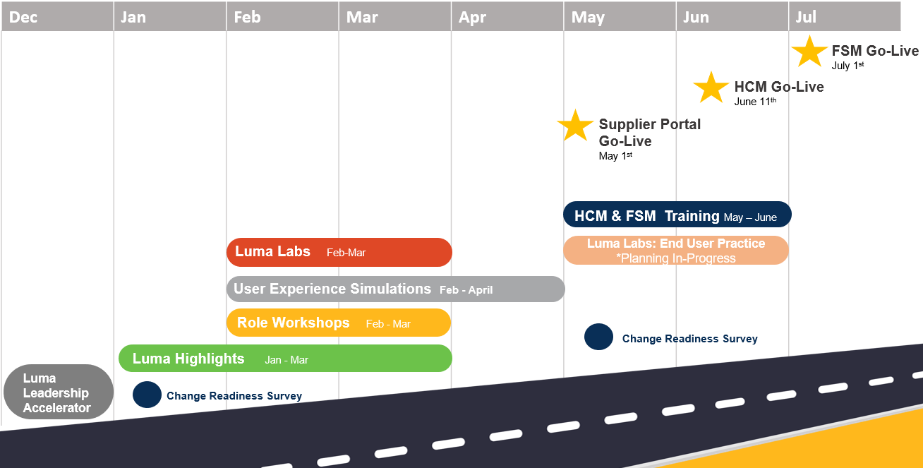
Agency Accelerators
We have created a Smartsheet form to gather numbers on what agencies have conducted Agency Accelerators and what agencies need assistance.
The link will be shared in the meeting recap from your AA.
5

Slide 6
Current Project Activities
6

Slide 7
Current Project Activities
Agency Interface Batch Schedules:
Due 1/13
Agency Inbound Interface Testing Input Files:
Due 1/17
Cash Allocation Code Workbook:
Due 1/13
PCard Data Conversion Edits:
Due 1/13
FSM Workflows Workbook:
Due 1/20
Project Balance Workbook:
Due 2/6
7

Slide 8
Change Readiness Assessment
8

Slide 9
Change Readiness Assessment
The Change Readiness Assessment (CRA) is a survey designed to capture how ready, willing, and able end users are to adopt business processes and system changes across several key metrics.
Audience
Objective
Timing
The CRA is a moment-in-time (snapshot) assessment conducted to identify areas of readiness and address any gaps.
The CRA will be distributed on Friday, January 6, and close on Friday, January 20.
The CRA will be sent to a sample of Luma stakeholders.
9

Slide 10
What to Have On Your Radar
10

Slide 11
What to Have On Your Radar
Internal Joint SIT:
January
Luma Roles Workbook:
January
Change Readiness Assessment:
January
Agency Joint SIT:
February
Luma Labs:
February
Agency Operational Readiness:
February
11

Slide 12
Outstanding Workbook Progress
12

Slide 13
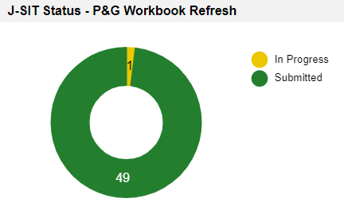
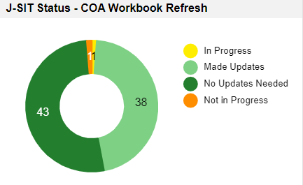
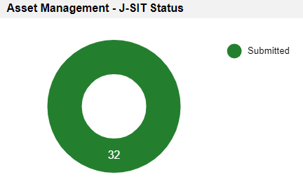
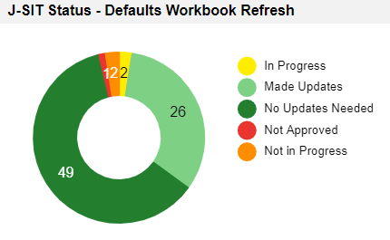
JSIT Workbook Completion
STO Receipt Batch & Distribution
Missing
Completed
13

Slide 14
January Change Liaison Communications Toolkit
14

Slide 15
January CL Comms Toolkit
Overview Reminder
What is this communications toolkit?
This communications toolkit is a package of communications materials and resources (template emails, presentations, flyers, graphics, etc.) to help Change Liaisons communicate consistently about important topics.
Why am I receiving this communications toolkit?
As each agency has unique communications practices and channels, you are encouraged to use the toolkit as it best fits your agency’s needs. We hope that this resource supports you in your role as a Change Liaison and helps champion Luma across the State.
How do I use this toolkit?
Each item in the toolkit is accompanied by guidance on how to share messages with agency personnel. However, you know your agency best and we encourage you to customize the language provided in the tools. Also, consider how information is disseminated at your agency. Do you use Slack? Newsletters? A private website? Any channel that facilitates employee awareness of Luma is appropriate.
15

Slide 16
Release Date:
January 9th
January CL Comms Toolkit
Table of Contents
Toolkit | Description
January Communications Toolkit focus: | Introduce activities and resources that will support your agency and employees as they transition to Luma. Provide additional information about upcoming resources.
What to accomplish with this Toolkit: | Familiarize and/or share components within this toolkit, which are designed to prepare agency employees to understand the change impacts to roles, responsibilities, and tasks.
Tool # | Description | Slide Numbers
1 | Joint System Integration Testing Information | 3-4
2 | Change Readiness Assessment Information | 5-6
3 | Agency Operational Readiness (AOR) Assessment Overview | 7-8
4 | Ask Luma: A centralized question submission form for Change Liaisons and Agency Leaders | 9-10
5 | Coming Soon - Media: Luma Website Updates | 11-12
6 | Coming Soon - Media: Luma Winter Employee Journey Map | 13-14
7 | Coming Soon - Media: Luma Highlight Videos | 15-16
8 | Appendix – Resources, Toolkit Instructions | 17-20
16

Slide 17
Agency Operational
Readiness Assessment
17

Slide 18
Agency Operational
Readiness Assessment
What is an Agency Operations Readiness assessment (AOR)?
We know work processes within agencies will change once Luma goes live.
An AOR assessment helps agencies to identify work process improvement opportunities. By using the tools provided by OCM, the agency is empowered to assess current processes, compare the Luma benefit/impact statements against the current process, and then identify where the agency can update their work processes to gain the most benefit from Luma.
How will the agency approach this Agency Operations Readiness assessment?
Agencies will have access to:
Tools and a model to guide their evaluation of status quo work processes,
Information on how the Luma benefits will impact the current processes, and
Guidance on how the agency may complete work processes after reviewing the Luma benefits and implications.
18

Slide 19
Agency Operational
Readiness Assessment
Who will participate in the Agency Operations Readiness assessment process?
Agency Leaders – Who will guide the conversation and support the agency assessment?
Bureau Chiefs, Leaders – Who will manage and guide the assessment process?
Select employees – Agency leaders will select employees to assist in the assessment process.
When and how will this process take place?
The process will be ongoing. Each month OCM will focus on specific proposed action items an agency can participate in to prepare for the Luma Go-Live dates.
Example:
January – AOR kick-off; begin to build a structure to assess current work processes.
February – Assess the current work processes and ensure you have documentation.
March – Receive and assess Luma impact statements.
19

Slide 20
Agency Operational
Readiness Assessment
January:
Kickoff
Begin assessing current processes and documentation
February:
Assess current processes
Review Luma change impacts
March-May:
Assess & document identified impacts on current processes
Recommend change plans
20

Slide 21
Meeting Recap
21

Slide 22
Meeting Recap
With more Luma activities on the horizon, we encourage you to consider your workload and the possible need for an additional Change Liaison.
Talk with your leadership about helping you make room for Luma activities like the Agency Accelerators.
Please reach out to your Agency Advocate if have questions or need assistance with any Luma-related activities.
22

Slide 23
Thank you!
Sheena Coles
SColes@sco.Idaho.gov
208-334-3100
Alex Doench
adoench@sco.Idaho.gov
208-332-8841
Danielle Stevens dstevens@sco.Idaho.gov
208-332-8868
Chris Lehosit clehosit@sco.Idaho.gov 208-332-8887
Krystal Griffith
kgriffith@sco.Idaho.gov
208-332-8861
Elijah Stearns
estearns@sco.Idaho.gov
208-332-8871
23

