Slide 1
Change Liaison Meeting
January 6th, 2021

Slide 2
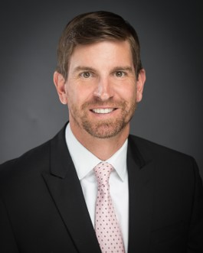
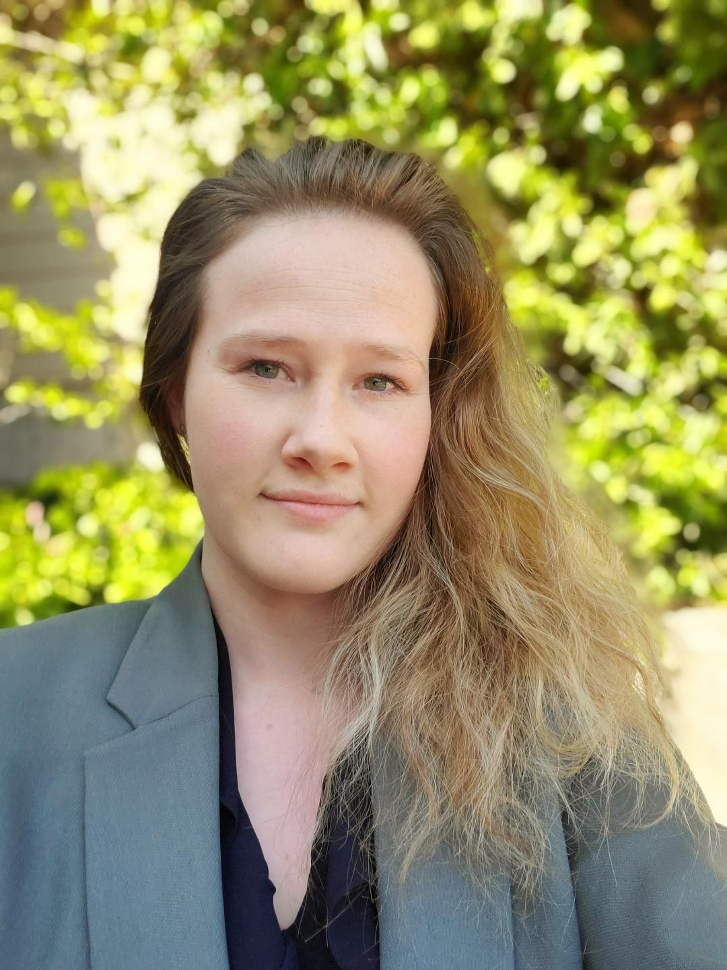
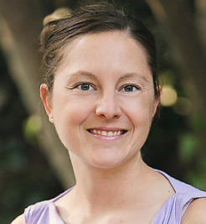
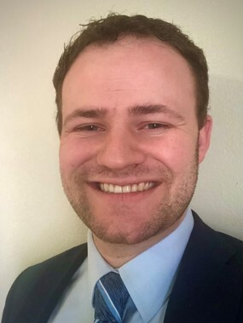
Introduction
Agency Advocates:
Heath Ribordy Danielle Blackmer Tina Fuller Chris Lehosit

Slide 3
Introduction (cont.)
Welcome!
Thank you for being here!
Thank you all for your flexibility during these unprecedented times!
Expectations:
Please give presenters your full attention.
Please utilize the chat functionality (bottom right) to ask questions, or wait until the end of the presentation to come off of mute and ask.
This meeting is being recorded and will be available at luma.sco.idaho.gov in the near future.

Slide 4
Change Liaison Spotlight Series
Project Timeline
System Integration Testing (SIT) 2 Update
Luma Statewide Engagement
What’s Coming Your Way?
Know Do Share Report (K.D.S.R.)
Change Liaison Key Responsibilities
A Year in Review
Resources
Q&A
AGENDA

Slide 5
Change Liaison
Spotlight
Michele Hanrahan, Central District Health
Managing Pandemic and Luma

Slide 6
Project Timeline

Slide 7
Luma Project Timeline
Luma Phase 1 – Finance, Budget, & Procurement
Luma Phase 2 – Human Capital Management & Payroll
2019 |  |  |  |  | 2020 |  |  |  |  |  |  |  |  |  |  |  | 2021 |  |  |  |  |  |  |  |  |  |  |  | 2022 |  |  |  |  |  |  |  |  |  |  |  | 2023
8 | 9 | 10 | 11 | 12 | 1 | 2 | 3 | 4 | 5 | 6 | 7 | 8 | 9 | 10 | 11 | 12 | 1 | 2 | 3 | 4 | 5 | 6 | 7 | 8 | 9 | 10 | 11 | 12 | 1 | 2 | 3 | 4 | 5 | 6 | 7 | 8 | 9 | 10 | 11 | 12 | 1 | 2 | 3 | 4 | 5 | 6
IMAGINE
DELIVER
RUN
IMAGINE
DELIVER
RUN
Plan
Architect
Configure & Prototype
Validate
Deploy
Support
Luma Phase 1 Kick-off
Plan
Architect
Configure & Prototype
Validate
Deploy
Support
Plan
Luma Phase 2 Kick-off
Discovery & Preparation
Project Team Training
Discovery & Preparation
Project Team Training
Enterprise Design
Enterprise Design Update
Technical Design (FRICE-W)
Technical Design (FRICE-W)
Sprint 1-3
Sprint 1-3
System Integration Testing 1 & 2 (SIT)
Parallel PR 1 – 3 (S.I.T.)
Mock Data Conv. 1 & 2
User Acceptance Testing
Mock Data Conv. 1 & 2
User Acceptance Testing
Design Updates
Design Updates
Training Dev.
Training
Training Dev.
Training
Budget Go-Live
Go-Live
WFM Go-Live
HR/PR Go-Live
7

Slide 8
System Integration Testing 2 (SIT 2)

Slide 9
Agency Participation in SIT 2
The intention of different testing cycles is to begin with testing of discrete functionality, then progress through to end-to-end business scenario testing.
Chris
Lehosit
Fish & Game
Health & Welfare
DEQ
Dept. Water Resources
Public Television
Commission for the Blind and Visually Impaired
Conservation, Soil, and Water Commission
Dept. of Insurance
Fish & Game
Health & Welfare
DEQ
Dept. Water Resources
Public Television
Commission for the Blind and Visually Impaired
Conservation, Soil, and Water Commission
Agencies were selected based on the following criteria:
Your agency’s Chart of Accounts (COA) build-out has been completed
System configuration for your agency has been completed.
Some interfaces and conversion have been completed for your agency
Agency complexity/size
Treasurer’s Office
Dept. of Admin.
Health District 3
Health District 6
Judicial Branch
Attorney General
Office of Species Conservation
Energy & Mineral Resources
Danielle
Blackmer
Dept. of Correction
Dept. of Juvenile Correction
ISP
IDOPL
Health District 2
Health District 7
Indep. Living Council
Dept. of Agriculture
Dept. of Education
Division of Career-Technical Education
Heath
Ribordy
Veterans Services
SCO
Dept. Lands
Division of Voc. Rehab.
Tina
Fuller
Dept. of Labor
IMD
Tax Commission
ITD
Comm. on the Arts
Lottery Commission
PERSI
Board of Education
Endow. Fund Investment Board
Public Utilities Commission
Secretary of State
Workforce Development Comm.

Slide 10
Luma Statewide Engagement

Slide 11
Statewide Showcases
An opportunity for an overview of Luma topics and demonstrations of modules. Each statewide showcase will be done twice a month from 1:00 – 2:00 PM. The link to RSVP for these showcases will be sent to agency change liaisons from distribution within the agencies as well as in upcoming newsletters. Each statewide engagement/showcase will be recorded. The materials from the meeting will be sent out to agency change liaisons for distribution.
Upcoming Statewide Engagements | Engagement Topics
January 19th & 21st | Budget Overview and Demonstration
February 16th & 18th | Luma Phase 1 Training Overview and Timeline
March 16th & 18th | Expense Management

Slide 12
What’s Coming Your Way?

Slide 13
Reporting Inquiry
The Luma platform provides Casual users to Power users with a wide range of reporting tools and capabilities to develop or customize reports. The reports inquiry process will collect statewide reporting needs to perform fit/gap analysis with available Luma reports. All identified reports will be developed and tested with Business Process Leads validating and signing-off.
Casual Users
Power Users
Secure roles-based access to all application information
Standard Application Reports
List Views & Embedded Reporting
Alerts & Notifications
Embedded Analytics (on OLAP & Columnar DB Star Schema)
Ad-hoc, Self Service, MS Excel add-in tools

Slide 14
Customer Conversion
The Luma Project team is requesting your participation in a survey to determine the best approach for standardizing the way the State of Idaho creates and manages customers.
Survey questions will be sent to agencies in early January to gain this information.
Notes:
Currently in STARS, subsidiary codes are used for customer identification with each agency having its own subsidiary list. Therefore, the same customer can be duplicated across multiple agencies with different subsidiary numbers. In Luma, a statewide customer list will be shared by all agencies. This is similar to how STARS currently use the statewide vendor list related to accounts payable.
Once a customer exists on the Luma statewide customer list, it is available for use by all agencies. When an agency selects a customer for use, that customer is assigned as a company (agency) customer in Luma. The company customer list is specific to each agency. By assigning the customer to the agency, company customers can then be maintained with agency specific payment terms, contacts, etc.

Slide 15
K.D.S.R.
Notes:
OK Couple of things for you all to note this month

Slide 16
Preparing Agencies for Success Before and After Infor CloudSuite Go-Live
KNOW
DO
SHARE
REPORT
Read Luma Project news and updates in this column.
Meet with employees and leadership in your agency to discuss these messages or action items.
Please share this information or engagement opportunities with your Agency
Report feedback to the project team or complete action items the Luma project team is requesting from your agency.
System Integration Testing 2 (SIT2):
Agencies will begin participating in SIT2 on January 19th
Phase 2 Staffing: Luma Project leadership has been meeting with Agency leadership from various agencies to request staff to participate on the Luma project team for Phase 2 project activities.
Reporting Inquiry: The Luma Project Team will be reaching out to agencies to gather a full collection of reporting needs at the agency level in order to ensure that all necessary reporting functionality is included in Luma.
COA Default and Payroll Crosswalk Kick-off: An information session will be held on Friday, January 15th to provide greater insight into the Chart of Accounts Default workbook and Payroll Crosswalk workbook for Cohorts 5-7. The workbooks for Cohorts 1-4 are due by January 8th. A meeting recording will be made available on the Luma YouTube Channel.
Newsletter: Please share the monthly newsletter with your colleagues!
Luma Showcases:
Welcome to Luma: Please distribute the Welcome to Luma infographics to your agency staff! Infographics can also be found here:
Luma YouTube Channel:
Can’t make it to a Luma meeting? Down worry! Check out the Luma YouTube Channel
Agency Leases Workbook: The deadline for leases from Cohorts 1-4 to be uploaded is Friday, January 8th. The Luma Lease Kickoff for Cohorts 5-7 will be Monday, February 1st with an upload due date of March 19th.
Agency Asset Workbook: The deadline for this information to be submitted via the SFTP is Friday, January 8th.
Customer Clean-Up: The Luma Project team is requesting your agency‘s participation in a survey to determine the best approach for standardizing the way the State of Idaho creates and manages customers. Survey questions will be sent to agencies in early January to better gauge this information.
Budget Personnel Contact Information: Please provide your Agency Advocate with the contact information of your Budget Personnel.
Communications Manager: As we get closer to go-live we want to ensure we are getting messages out to every state employee. To this end, please send contact information for any communications personnel within your agency.
Internal Meetings: Please let us know if you have an upcoming internal meetings that we can present to your staff! We want every state employee to know about the Luma, the changes coming, and exciting benefits of a modern system.
Luma Newsletter #22
January RSVP
Infographics
Luma YouTube Channel
January 6th, 2021
Notes:
Know –
Danielle gave us the run down on SIT2 earlier.
Just a quick reminder that your agency may be hearing from the Luma Team as we start looking for project staffing for Luma Phase 2 - HCM and payroll.
Chris gave us the heads up on the upcoming report inquiry
The last one under ‘know’ is just a quick reminder – the team is hoping to the optional Chart of account Default and Payroll Crosswalk workbooks back from cohort 1-4 agencies by this Friday. If you are planning to submit either or both workbooks and don’t think they will be done by Friday, please just let your Agency Advocate know and we can work with the team on this side. Cohort 5-7 folks – you should have already received the calendar invite (or you will be seeing it shortly) for the kick off meeting to go over the workbooks. The kick-off will be next Friday January 15th from 1:30-2:30.
Do –
Lease workbooks. Much like the Chart of account Default and Payroll Crosswalk workbooks we are hoping to get these back from the cohort 1-4 agencies who have leases by this Friday the 8th – again if this isn’t going to happen just reach out to your Agency Advocate and we’ll work with the team. Cohort 5 to 7 you should have or will receive shortly and meeting invite for the kickoff meeting to go over the workbooks Monday, February 1st from 2:00-3:00. Then we will be looking to get those back from you all by Friday March 19th.
Asset Management workbooks – we are seeing these rolling back in – thank you and please keep them coming! Again, we are asking for those back by this Friday the 8th – and again at the risk of sounding like a broken record – if that isn’t in the realm of possibility please just let your Agency Advocate know.
Customer clean-up – Chris just went over that one that you will be seeing in the near future.
Share –
You all know how much Chris, Danielle, Heath and I love to share. We will email you all of these links. Those blue tiles are also active links. The Luma YouTube Channel is a really exciting one - we are starting to have quite the library of recordings.
Just a quick note here - if there is ever anything you can’t find or don’t want to scour your inboxes for – just reach out to Chris, Danielle, Heath of me and we will happily send on along any links or meeting invites, or workbooks or anything you are looking for.
Report –
Budget Personnel Contact Information – this is probably one of the most important asks we have for you today. Please write it down, highlight it and pop it on the to do list. As Danielle said the budget module will be the first to go live. We need your help to gather the list of people we will need to make sure have the training that they will need. Please send us the names and contacts for these people in your agencies! The sooner we have that list the better we can prepare for and deliver training.
Communications Manager - The OCM Team is working to ensure communications are reaching our stakeholders. As we prepare for go-live getting messages to end users will become increasingly important. To aid in this effort, if your agency has communication personnel please send their contact information to Heath, Danielle, Chris or me.
And for the last one – if you have any sort of regularly scheduled staff meeting - or if you want to call a meeting, we would love to come and give you all a presentation that could be customized to what your Agencies interests and needs are.

Slide 17
Change Liaison
Key Responsibilities

Slide 18
Change Liaison Key Responsibilities
Change Facilitator
Is passionate about
facilitating change
through the process
Translator
Is able to translate the messages in a way that is understandable
c
c
Change Driver
Has a sense of urgency
to make and drive the change
Communicator
Promotes proactive
two-way project communications
Agency resources whose actions & behavior result in organizational, social, cultural, and/or behavioral change.
Connector
Connects and links up people, resources, activities, etc.
Knowledge Sharer
Shares information, lessons learned, and provides feedback
Notes:
We just wanted to take a moment to look back at all of the activities and things that we are asking of you, our truly top rate Change Liaisons. You are all terrific translators, crack communicators, superb sharers (and gatherers of information), critical connectors, champion change drivers, and fantastic facilitators of change. But in this last year, you have done and helped the team do SO much more!

Slide 19
A Year in Review
110 Business Redesign Sessions
299 Business Process Maps
10 Chart of Accounts Redesign Sessions
12 Chart of Accounts Dimensions Selected
2020
467 Agency Specific COA Dimensions Built
52 Cost Allocation Survey Agency Responses
67 Procurement Survey Agency Responses
70 Budget Survey Agency Responses
28 Conversions
171 Interfaces
33 Infor Spreadsheet Designer (ISD) Loads
Notes:
Maybe animate these to populate individually once we land on the topics?

Slide 20
Resources
Luma Newsletter:
http://mailchi.mp/e32b7d2748b6/luma-a-year-in-review
Welcome to Luma Series:
https://www.sco.idaho.gov/LivePages/luma_-welcome-to-luma-series.aspx
January Showcase RSVP: https://app.smartsheet.com/b/form/4bef523f2e4342ffaf6cb1b3009e8904
Feedback Survey: https://app.smartsheet.com/b/form/3b21e2733f934927af0794abcf641bf0
Notes:
Danielle, Chris, Heath or I will be sending you the link to this recording and this presentation. Like I said we love to share resources with you. Please feel free to re-share as far and wide and you can!
Last note, we will also be sending the link to a short survey. We are trying to make sure that these meetings are getting you the information and resources you need and are a good use of everyone’s time.

Slide 21
Thank you for Coming!
Mackenzie Reathaford
mreathaford@sco.Idaho.gov
208-334-3100
Alex Doench
adoench@sco.Idaho.gov
208-332-8841
Chris Lehosit clehosit@sco.Idaho.gov 208-332-8887
Danielle Blackmer dblackmer@sco.Idaho.gov
208-332-8868
Heath Ribordy hribordy@sco.Idaho.gov 208-332-8871
Tina Fuller tfuller@sco.Idaho.gov 208-332-8867
Luma: luma@sco.idaho.gov
Notes:
One last Thank you – truly can’t say it enough. You really are rocking it folks.

Slide 22
Questions?

