Slide 1
Luma Change Liaison Meeting
February 2023

Slide 2
Introduction
Thank you for being here!
Expectations:
Please give the presenters your full attention.
Please utilize the chat functionality (bottom right) to ask questions, or wait until the end of the presentation to come off of mute and ask.
This meeting is being recorded and will be provided in the follow-up email.

Slide 3
Agenda
Agenda
Agency Accelerator Office Hours
Change Readiness Assessment Results
Joint System Integration Testing (JSIT)
Upcoming activities
Training Update
Change Liaison Communications Toolkit
Luma Cutover

Slide 4
Agency Accelerator Office Hours

Slide 5
Agency Accelerator Office Hours
After soliciting feedback via the Luma Agency Accelerator Follow-up Form, it has come to our attention that many Change Liaisons would like additional guidance on how to deliver this presentation to their colleagues and recommendations on how to best utilize the Leadership Toolkit that was shared in December.
Feb 03
@ 1pm
Please join us on Friday, February 3rd from 1-2 pm for a detailed walk-through of the Agency Accelerator presentation (30-40 minutes) which will be followed by a Q&A session.

Slide 6
Change Readiness Assessment Results

Slide 7
Change Readiness
Assessment Results
Of the 463 recipients, we received 342 responses!
That is a 74%
response rate!
Thank you for your support!

Slide 8
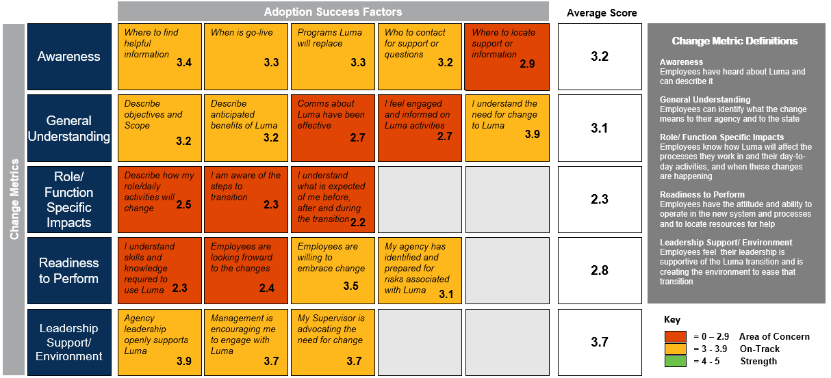
Change Readiness
Assessment Results

Slide 9
Joint System Integration Testing (JSIT)

Slide 10
JSIT Timeline
Jan 23 JSIT Kickoff
Jan 30 Week 2
Feb 6 Week 3
Feb 13 Week 4
Feb 20 Week 5
Feb 27 Week 6
Mar 6 Week 7
Mar 13 Week 8
Large Payroll to FSM
Payroll 21 lifecycles
2nd Payroll 21 lifecycles
3rd Payroll 21 lifecycles

Slide 11
JSIT Considerations
The objective of JSIT is to confirm that the business processes perform as designed across the integrated modules in Finance & Supply Chain Management & Human Capital Management and verify they will meet critical state business requirements at go-live.
As testers are provided and onboarded, they will receive an email from the training team with basic navigational training to complete prior to testing.
If you would like to attend testing in person, please note that we will not be able to provide a parking pass due to Legislative Session.
A WebEx option will be available for those testing remotely in the testing invitation.
If you are unable to attend your testing session for any reason, please reach out to your AA. If someone is replacing you in testing, let us know as soon as possible, as they need to be onboarded into the system to successfully test.

Slide 12
Roles & Responsibilities
Execute test scripts in-person or on the meeting Webex, per the JSIT schedules.
You will receive meeting invites for Testing events.
Track if the intended result of the test is the result that occurred in testing.
The script you are working through will indicate the expected results.
Agency Tester
Report the testing results.
When you complete a test script, let your Luma functional lead know, and they will update the testing results accordingly.
Log & Retest defects as needed.
Defects will be logged through the SCO Service Desk.

Slide 13
Upcoming Activities

Slide 14
Upcoming Activities
Feb 8
Feb 23
Feb 27
Feb 20-March 31
Operations Readiness
Assessment
Luma Role Workbooks
Luma Labs
Luma Role Workshops

Slide 15
Luma Role Workbooks
Who: The Luma Roles workbook will need collaboration across your agency to fill out. Include your Leadership, Division Administrators, Bureau Chiefs where appropriate.
What: The Luma Roles Workbook lists the FSM security roles. The workbook will include descriptions to help determine who at your agency to assign the role to.
Employee and Manager roles are derived from the work agencies have already done in the HR Org Workbooks, Thank you!
Payroll and HR and roles are being tested and will be reviewed and provided to agencies at a later date.
Why: The Roles workbook will be used by the Luma Training team to help plan and map out the training schedule and registration. The roles workbook will also be used by the technical team to help prepare the onboard actions at go-live. This workbook will also help agency plan for the future for your staff!
Feb 8
Luma Role Workbooks

Slide 16
Operations Readiness Assessment
Feb 23
The Operations Readiness Assessment helps prepare agencies for the impacts the Luma implementation may have on agency operations by providing tools and guidance to analyze an agency's systems, tools, and workflows.
Operations Readiness
Assessment

Slide 17
Luma Labs
Feb 27
Luma Labs provide selected Idaho Finance & Supply Chain Management (FSM) and Human Capital Management (HCM) employees the opportunity to see a sample of basic processes in the future state of Luma prior to go-live.
Luma Labs

Slide 18
Luma Role Workshops
Luma Role Workshops are content-specific presentations for employees based on their current jobs and activities, and how those will change with Luma.
Delivery Method:
Virtual WebEx Sessions
Virtual Recordings
Duration:
Procurement, Recruiter, and HR Generalist role workshops will be scheduled for 1 hour.
Finance, Employee, and Manager role workshops will be scheduled for 90 minutes.
After attending the workshops, participants will understand:
Persona-specific changes
Activities performed in Luma
Key dates and activities between now and Go-live
Overview of where to find relevant information about Luma
Feb 20 –Mar 31
Luma Role Workshops

Slide 19
Luma Training Update

Slide 20
Training Update
Luma Training Showcase Coming Soon!
This Training Showcase is expected to cover the following topics:
Welcome to Luma Training
When is Luma Training?
Who is the training for?
How will Luma Training be facilitated?
The importance of Training
Early
March

Slide 21
Change Liaison
Communications Toolkit

Slide 22
February Communications Toolkit
Release Date: Monday, February 6th
1. JSIT Dashboard
2. Winter Employee Journey Map
3. Operations Readiness Assessment Overview
4. Luma Highlights Poster
5. Coming Soon! Luma Role Workshops
6. Coming Soon! Luma Labs

Slide 23
Luma Cutover

Slide 24
Timeline
Timeline for Mock Cutover, Dress rehearsal, and Production Cutover execution along with corresponding test events.
Go-Live
Mock Cutover
Joint SIT/Luma Labs
Dress Rehearsal
Production Cutover Execution
Freeze Dates:
High-level overview with all objects that have a freeze Date and timeline – End of Feb 27th to send to agencies
Communication blast with follow-up on the change liaison meeting.
Specific freeze procedures for each data point – Feb 27th
FYE Memo with DFM and DSA
How will teams transact or update systems with new data (downtime procedures)
Inventory Stock up
60-day reminder
30-day reminder
Week of reminder
Cutover Event | Start Date | End Date
Mock Cutover | 11/1/2022 | 1/23/2023
Dress Rehearsal | 3/24/2023 | 5/15/2023
Production Cutover | 4/1/2023 | 8/30/2023

Slide 25
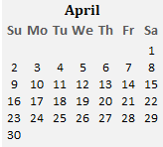
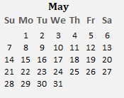
Production Supplier Portal Cutover
Calendar
May 1st, 2023
Go-Live
April 19th – April 21st, 2023
Supplier Portal Live
Communication
April 17th– April 18th, 2023
Communicate Supplier Portal URL to DOP (Division Of Purchasing) team
OCM/DOP send out the communication to Existing Suppliers
Send a communication to SCO to publish the URL
Validate the Supplier Portal
April 4th– April 14th, 2023
Validate Supplier portal related configuration
Validate Supplier Portal security
Validate Supplier Portal URL
Setup Production Tenant
***Perform activities related to setting up Production tenant from Pristine in readiness for Luma Cutover
Complete functional configurations
Complete FRICE-W migration
Complete security configurations
*** On April 1st, the Pristine tenant will be copied over to production after that any changes to Pristine must go through change control process and those fixes needs to be applied to production tenant.

Slide 26
Production HCM/WFM Cutover
Calendar
June 11th – July 7th, 2023
Go-Live
May 22nd – June 10nd, 2023
Luma is open for business on June 11th
All agency systems integrations/interfaces will begin
Pay Period 6/11/2023 - 6/24/2023
Payroll Processing 6/26 to 6/30
Pay date 7/7
Validate and Load Data
April 21^{nd***}– June 10th, 2023
Prepare interfaces in Luma for first Payroll processing
Manual Conversions
Termed Employee processing
Load Org Data 5/29 - 6/2
Load Employee Data 6/10
Legacy Systems Freeze
May 15^{th***}– May 19^{th***}, 2023
Begin conversion of in-scope Master Data to Luma
Reconciliation of converted master data to be completed by - 5/26
Org Transactions Freeze - 4/21-6/2
Employee Transaction freeze 6/3-6/10
Future dated Transactions
During freeze period, When essential there are ability to enter in data in both STARs and Luma
Setup Production Tenant
Perform activities related to setting up Production tenant from Pristine in readiness for Luma Cutover
Complete functional configurations
Complete FRICE-W migration
Complete security configurations
Freeze updates to Master Data
***: Date subject to change

Slide 27
Production FSM Cutover
Calendar
July 1st – July 13th, 2023
Go-Live
June 26th – July 2nd, 2023
Luma is open for business on July 1st
All agency systems integrations/interfaces will begin
Proposed changes or adjustments to converted financial data prior to July-23 are reviewed, documented, approved, and implemented in Luma
Hard freeze & Data Catchup
June 19th– June 23rd, 2023
STARS is open for transactions till 6/30. All accounting entries till 6/30 to be entered into the System by 6/30.
Run YE processes on 6/30 and prepare preliminary balances from STARS for conversion into Luma
Begin conversion of all in scope data to Luma on 6/30. Execute automated & semi-automated conversions 6/30 – 7/2.
Data catchup activities are performed for Master Data converted into Luma as of 6/16/2023
Core Team finalizes system prep including manual conversions such as Purchase Orders by 7/3
Soft freeze
June 5th– June 16th, 2023
Begin conversion of in-scope Master Data to Luma
Reconciliation of converted master data to be completed by 6/23
During freeze period, When essential there are ability to enter in data in both STARs and Luma
Setup Production Tenant
Perform activities related to setting up Production tenant from Pristine in readiness for Luma Cutover
Complete functional configurations
Complete FRICE-W migration
Complete security configurations
Freeze updates to Master Data(Customers, Suppliers, Employees) as of 06/16

Slide 28
Thank you!
Sheena Coles
SColes@sco.Idaho.gov
208-334-3100
Alex Doench
adoench@sco.Idaho.gov
208-332-8841
Danielle Stevens dstevens@sco.Idaho.gov
208-332-8868
Chris Lehosit clehosit@sco.Idaho.gov 208-332-8887
Krystal Griffith
kgriffith@sco.Idaho.gov
208-332-8861
Elijah Stearns
estearns@sco.Idaho.gov
208-332-8871

