Slide 1
Monthly Change Liaison Meeting
November 2022

Slide 2
Introduction
Thank you for being here!
Expectations:
  Please give the presenters your full attention.
  Please utilize the chat functionality (bottom right) to ask questions, or wait until the end of the presentation to come off of mute and ask.
  This meeting is being recorded and will be provided in the follow-up email.
2

Slide 3

Agenda
Agency Advocate Assignment
Luma Project Timeline
Chart of Accounts Review
Service Now
Update on Requests
Luma Training
Change Liaison Update
3

Slide 4

Agency Advocate
Agency Assignment
4

Slide 5


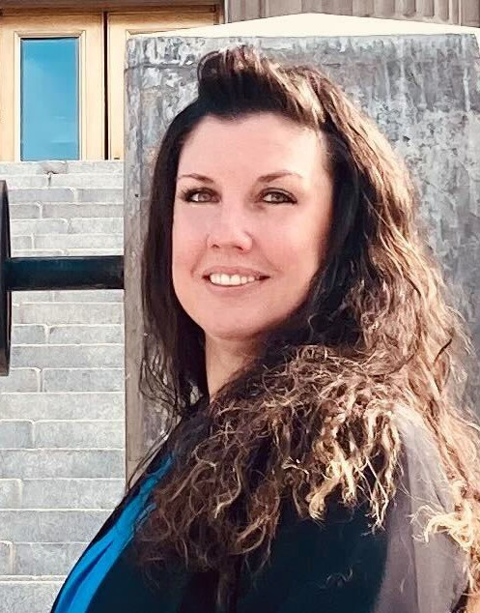
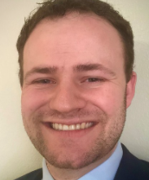
AA Agency Assignment
We are welcoming Elijah Stearns back to our Agency Advocate team!
Our Agency Advocate team is now made up of the following team members:
Danielle Stevens
dstevens@sco.Idaho.gov
208-332-8868
Elijah Stearns
estearns@sco.Idaho.gov
208-332-8861
Krystal Griffith
kgriffith@sco.Idaho.gov
208-332-8861
Chris Lehosit
clehosit@sco.Idaho.gov
208-332-8887
5

Slide 6
AA Agency Assignment
Krystal Griffith
Danielle Stevens
Elijah Stearns
Chris Lehosit
Attorney General, Office Of The
Workforce Development Council
Insurance Fund, State
Aging, Commission On
Blind And Visually Impaired, Commission For The
Human Resources, Division Of
Energy And Mineral Resources, Office Of
Conservation, Soil And Water Commission
Labor, Department Of
Environmental Quality, Department Of
Finance, Department Of
Insurance, Department Of
Industrial Commission
Lava Hot Springs Foundation
Tax Appeals, Board Of
Tax Commission, Idaho State
Public Television
Vocational Rehabilitation, Idaho Division Of
Catastrophic Health Care
Independent Living Council
State Public Defense Commission
State Appellate Public Defender's Office
Administrative Hearings, Office Of
Drug Policy, Office Of
Financial Management, Division Of
Governor, Office Of The
Lieutenant Governor, Office Of The
Senate, Idaho
House Of Representatives
Judicial Branch
Controller, Office Of The State
Treasurer, State Office Of The
Information Technology Services, Office Of
Military Division
Administration, Department Of
Agriculture, Department Of
Commerce, Department Of
Correction, Department Of
Correctional Industries
Pardons And Parole, Commission Of
Juvenile Corrections, Department Of
Police, Idaho State
Brand Inspector, State
Racing, State Commission
Occupational Licenses, Division Of
Hispanic Affairs, Idaho Commission On - Admin
Historical Society, Idaho State
Health District 1 (Panhandle)
Health District 2 (North Central)
Health District 3 (Southwest)
Health District 4 (Central)
Health District 5 (South Central)
Health District 6 (Southeastern)
Health District 7 (Eastern)
Transportation, Department Of
Secretary Of State, Office Of The
Commission On Uniform Laws - SOS
Code Commission - SOS
Education, State Department Of
Stem Action Center
PERSI
Liquor Division, Idaho State
Arts, Idaho Commission On The
Fish & Game, Department Of
Endowment Fund Investment Board
Parks And Recreation, Department Of
Veterans Services
Public Schools - SDE
Education, State Board Of
Career-technical Education, Division Of
Lewis-clark State College
Boise State University
Idaho State University
University Of Idaho
Public Charter Schools
Water Resources, Department Of
Lottery Commission, Idaho State
Libraries, Idaho Commission For
Public Utilities Commission
Conservation, Office Of Species
Performance Evaluations, Office Of
Legislative Services Office
Health And Welfare, Department Of
Lands, Department Of
6

Slide 7

Luma Project Timeline
7

Slide 8
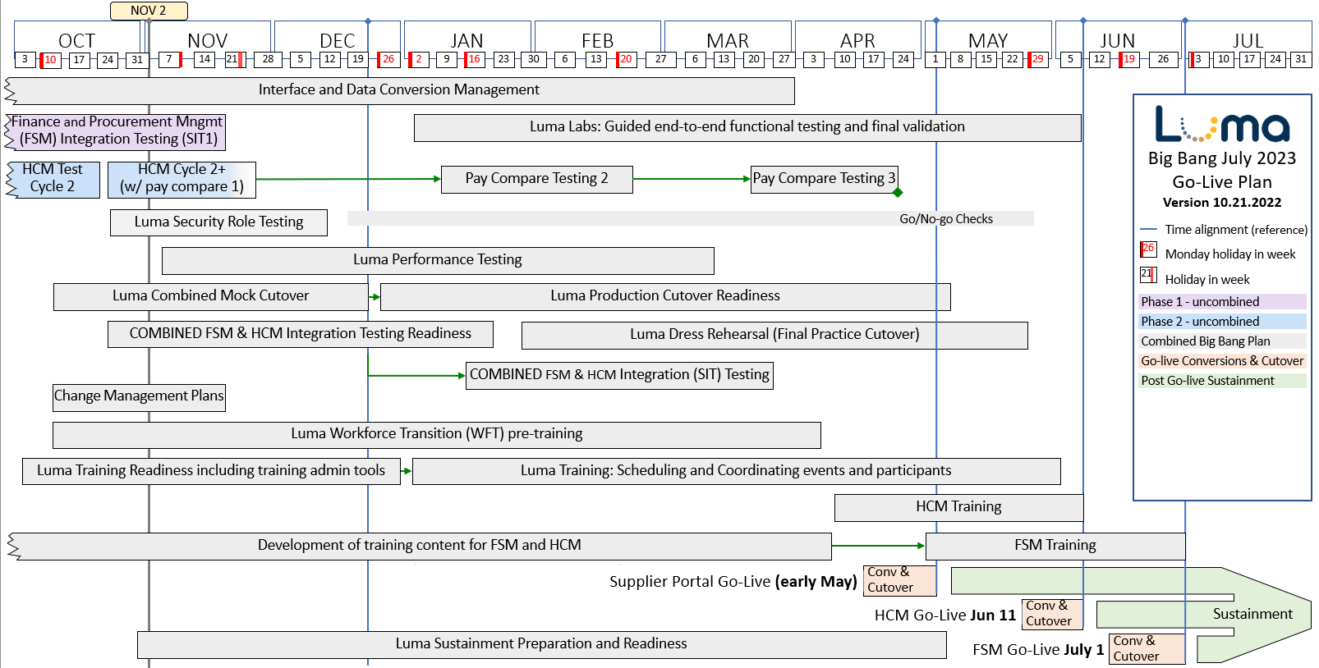
Luma Project Timeline
8

Slide 9
Luma Project Timeline
The Benefits of the New Timeline
Fully embrace system functionality of FSM to HCM/WFM//Payroll
  Maximize efficiencies associated with an integrated system
  Remove legacy payroll interfaces and bridge processes
  Reduces actual workload associated with transition processes
Clean cutover alignment with Fiscal Year End
  One focused, exhaustive event for the state instead of two similarly focused, untested, exhaustive events
Unified project – unified agency focus
  One Go-Live effort instead of multiple efforts
Enterprise model – consolidation of resources and prioritization of activities
  Resources aligned under a singular goal
9

Slide 10

Chart of Accounts
Workbook Review
10

Slide 11

COA Workbook Review
In order to ensure we have the most up-to-date and accurate information; we are requesting each agency review and/or update the Chart of Account workbooks found in your Agency’s SFTP folder.
Important information to remember when completing this request:
Workbook naming convention update: Agency code_workbook name_date updated (ex: 150_addtl reporting_08-12-2022).
If you have not already done so, please update your Org Unit file name to Org Cost Center.
Please fill out this form as you complete your review/updates: https://app.smartsheet.com/b/form/1ab4c60e9cdf44e8b488e12347cdd4df
Nov 10
Chart of Accounts
Workbook
Due
Note any items that need to be deleted by highlighting the cells in orange.
Note any additions by highlighting the cells in yellow.
Note any changes to coding or naming by highlighting the cells in blue.
11

Slide 12

Service Now
12

Slide 13
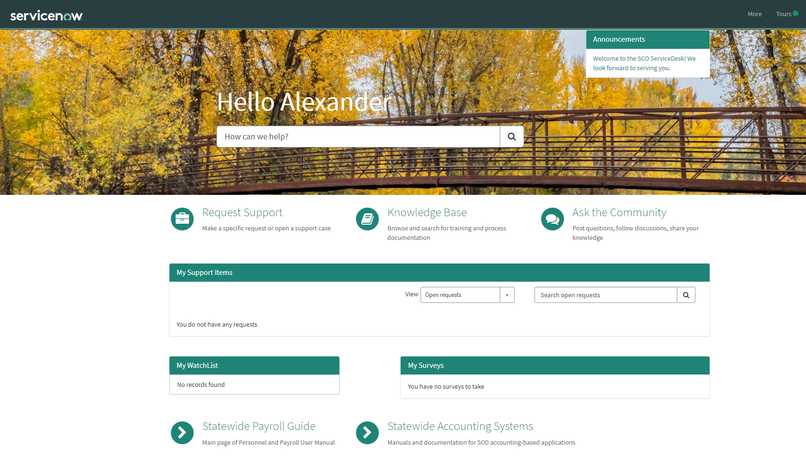
Service Now
Coming soon, all necessary changes to the Agency Chart of Account dimensions will need to be requested via service ticket through Service Now.
13

Slide 14

Update on Requests
14

Slide 15
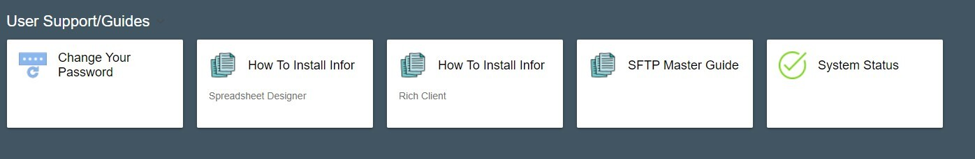
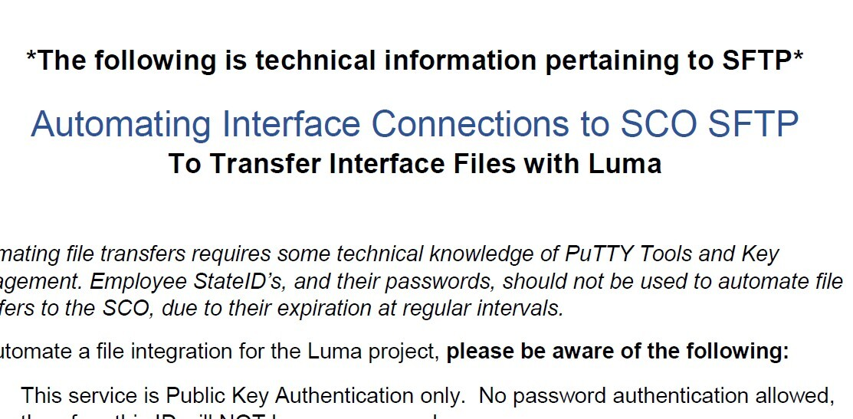
Automated Interface Files
Now is the time to start automating your automated interfaces. This will create efficiency as we move through testing and at go-live. If you have not already automated your interfaces and need instructions on how to do so, please log into the Enterprise dashboard and click on the "SFTP Master guide" in the User Support/Guides section at the bottom.
Page 6 of this guide will walk you through how to automate. This does contain some very technical information and may require some of your agency's IT support to complete.
*We understand some agencies are not able to fully automate their interfaces at this point in time due to some nuances.
Your Agency Advocate will be in contact if you are one of the agencies that we need updated interface files from by November 7th.
You should see the highlighted tile on the Enterprise Dashboard.
Please refer to page 6 in the master guide.
15

Slide 16
Interface File Requests
ID + Name | Agency
IFS416 - CMP2000 Child Meal Program | 170 - Department of Education
IFS460 - Retiree Payments | 183 - PERSI (Public Employees Retirement System of Idaho)
IFS560 - Inbound GL Journal entries from ACCPAC to Luma | 185 - Idaho State Liquor Division
IFS435 - Inter-Agency Billing | 231 - Correctional Industries
IFS345 - GL Transaction Data | 231 - Correctional Industries
IFS457 - Non-State Billing | 231 - Correctional Industries
IFS290 - Social Security Administration (SSA) case management system | 240 - Department of Labor
IFS504 - Social Security Administration (SSA) case management system - AP | 240 - Department of Labor
IFS428 - UST Database | 245 - Department of Environmental Quality
IFS483 - SDWIS Inbound Customer Interface | 245 - Department of Environmental Quality
IFS431 - SDWIS | 245 - Department of Environmental Quality
16

Slide 17
Interface File Requests (cont.)
ID + Name | Agency
IFS299 - Loan Service Plus | 245 - Department of Environmental Quality
IFS482 - UST Inbound Customer Interface | 245 - Department of Environmental Quality
IFS430 - CRB System - Inbound Billing | 245 - Department of Environmental Quality
IFS125 - BA-4 (Monthly Fleet Rent) | 260 - Department of Fish & Game
IFS570 - | 330 - Idaho State Police
IFS190 - ABC Licensing Program | 330 - Idaho State Police
IFS302 - FBI Fingerprints | 330 - Idaho State Police
IFS453 - CPI Fingerprints | 330 - Idaho State Police
IFS503 - Non-Benefited Payroll Reimbursement | 512 - Boise State University
IFS488 - Payroll | 514 - University of Idaho
IFS240 - OECO Reimbursement | 514 - University of Idaho
17

Slide 18
Payroll Crosswalk
With Phase 1 & 2 now running jointly as Finance & Supply Chain Management and Human Capital Management, there is no longer a need for the Payroll Crosswalk.
18

Slide 19
Projects & Grants
As part of the cutover process to a new test tenant, we are requesting agencies review and update their current Project and Funding Source setup. To ensure we have the most up-to-date and accurate information, please update the following attached Project workbooks:
Project: mandatory for all projects.
Funding Source: mandatory for billable projects.
Please observe the following instructions as you complete this task:
Observe the workbook naming convention: Agency code_workbook name_date updated (ex: 150_Projects_08-12-2022).
Please remove all projects and funding sources that will be closed as of June 30, 2023 and add any new ones that will need to be in the Luma system as of July 1, 2023.
Budgets are no longer required for front-end split/billable projects but can still be used at summary, posting level, or funding source levels.
Confirm that project contract amounts, funded amounts, and funding source amounts reconcile across workbooks.
Dec 02
P&G
Update
Due
19

Slide 20

Luma Training
20

Slide 21
Luma Training
Beta Testing Luma Training Materials
The Luma Training team has been working hard on developing training materials. We are seeking training professionals from across the state who might be interested in Beta testing training materials through the system.
They will be testing Quick Reference Guides, or job aids, via persona access in the training environment and relay their experience and edit suggestions back to us. Testing the materials will start in November and testers can expect to spend around 5 hours a week testing materials.
If you have agency personnel that may be interested in getting a sneak peek into the Luma system by beta testing training materials, please have them complete this form by November 4th to get more information:
https://app.smartsheet.com/b/form/b11234bac07142caa7b01a26a13daed3
21

Slide 22

Change Liaisons
22

Slide 23

Change Liaisons
Now that the project is running jointly as Finance & Supply Chain Management (FSM) and Human Capital Management (HCM), all communications should be going to agency personnel for both FSM and HCM.
23

Slide 24

Thank you!
Sheena Coles
SColes@sco.Idaho.gov
208-334-3100
Alex Doench
adoench@sco.Idaho.gov
208-332-8841
Danielle Stevens
dstevens@sco.Idaho.gov
208-332-8868
Chris Lehosit
clehosit@sco.Idaho.gov
208-332-8887
Krystal Griffith
kgriffith@sco.Idaho.gov
208-332-8861
Elijah Stearns
estearns@sco.Idaho.gov
208-332-8871
24

