Slide 1





Change Liaison Meeting
November 3rd, 2021

Slide 2
Welcome!
Thank you for being here!
Expectations:
  Please give presenters your full attention.
  Please utilize the chat functionality (bottom right) to ask questions, or wait until the end of the presentation to come off of mute and ask.
  This meeting is being recorded and will be provided in the follow-up email.

Slide 3

Phase 1 Update
Phase 1 Activities
Phase 2 Update
Phase 2 Activities
Engagement Opportunities
Luma Event Calendar
Phase 1 & 2 Know Do Share Reports (K.D.S.R.)
AGENDA

Slide 4

Luma Phase 1 Update

Slide 5

Phase 1 Timeline
2019
2021
2020
2021 |  |  |  |  |  | 2022
Jul | Aug | Sep | Oct | Nov | Dec | Jan | Feb | Mar | Apr | May | Jun | Jul | Aug | Sep | Oct | Nov | Dec
Oct-Dec
Jan-Dec
May
Jun
Plan
Architect
Configure & Prototype
Validate
Deploy
Support
Luma Phase 1 Kick-Off
Training Development
End User
Training
Sherpa Budget Management Go-Live
Luma Phase 1 FSCM Reset
Collect Business Requirements
Phase 1: Finance & Procurement
User Acceptance (UAT)
Finance Go-Live
FRICE-W Design & Build
Sprints, SIT1 and SIT2
Scenario Testing (SIT) 3
Supply Chain Go-Live
Infor Enhancement Testing
Cutover Activities
We are here

Slide 6
Activity Impact-o-meter: October - December
Activity
October |  |  |  | November |  |  |  |  | December
4 | 11 | 18 | 25 | 1 | 8 | 15 | 22 | 29 | 6 | 13 | 20 | 27
FRICE-W Functional Specs – Enhancements
Allocations Build
FRICE-W Development
Infor Enhancement Development (Trust Accounting 11/17)
SIT3 Prep
UAT Prep
Unit Testing for Enhancements
Identify Trainers
Learning & Development Set-up
Knowledge Transfer Execution
Mock Cutover
Sustainment Planning
Enterprise Design
FRICE-W Design & Build
Impact-o-meter: MEDIUM
*Measures the impact activities have on Agencies
Legend:
Phase 1
Phase 2

Slide 7
Budget Update
All revised budgets were submitted by the deadline of October 22nd.
  Statutorily driven exception budgets are due Nov 15th.
With our smaller team, over 20 major revision issues addressed in the final week before revision submission.
Further review and training will happen November 5th for DFM analysts to increase familiarity of the bifurcation process and using their specific commenting features.
The team is continuing engagement with the budget management functions of the Luma Finance modules.
Finalizing steps of last outstanding interfaces and digging into data requirements for the final two.
Sharing lessons learned from Luma Budget go live, training, and first cycle operation as appropriate with other Luma Teams.
The project team is currently working on creating a Feedback Survey for the Budget module.

Slide 8
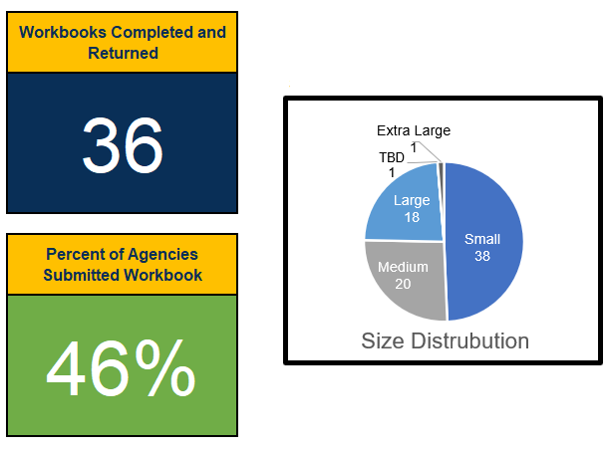
Approval Workflow
Timeline
Kick-off sessions:
9/27 & 9/29
Agency Workbook Completion:
Due 11/1
Size Distribution

Slide 9
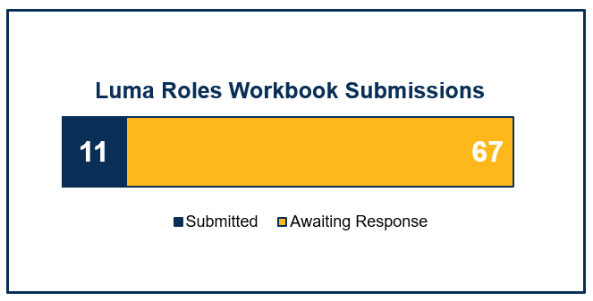



Luma (Security) Roles
36
Luma Roles
All
Finance
Timeline
Workbooks sent:
10/13
Luma Roles Showcase:
10/21
Agency Workbook Due Date:
11/12
Procurement

Slide 10
Projects & Grants
Thank you to everyone who attended the Projects & Grants Workshop!
Next Office Hours session is on November 4th
@ 11 am
Q&A is posted on the Luma P&G webpage here
Workbooks due by November 15th.
Thank you to those that submitted Customer List workbooks by October 29th. Keep them coming!

Slide 11
Interfaces

Slide 12

Luma Phase 1 Activities

Slide 13
System Integration Testing (SIT) 3
Objective:
Confirms that business processes work as designed across all modules, FRICE-W components, and 3rd party integrated applications.
Testing with “final” security configuration in place
Scope:
All Functional Scenarios identified by Project team including End to End Scenarios
Re-execution of all FRICE-W Testing Scenarios
Simulation of a production business environment
  Fully converted data set – real/live data
Functional teams will identify which agencies to test by scenarios

Slide 14
System Integration Testing (SIT) 3
Goals:
  Project team and agencies confident that Luma will enable the State of Idaho to support business operations.
  Project team confident that Luma is working as designed and configured.
  Agencies understand SIT purpose and agree to expectations.
Success Factors:
  No critical or high defects. (view exit criteria #3)
  Go-live required FRICE-W tested successfully.
  Roles and permissions tested and support the business operation requirements.
  Core State business processes required for Go-live be tested. (Detail List with exceptions identified)
  Timely and proper execution of the Testing Execution plan.
  Agencies complete assigned test scenarios.

Slide 15
System Integration Testing (SIT) 3
Entry Criteria
Integration test scenarios are approved, set up in ALM (test management tool), and assigned to the testing team.
Exit criteria for SIT 2 is met.
All test data has been created and made available for execution.
Testing Environment is fully built, and data conversions have been executed and validated.
All required FRICE-W objects have been migrated and made available for execution.
Required access is provided to team members.
The defect management tool is set up and ready to use. (ServiceNow)
All defects from SIT 1 & 2 that still require resolution have been documented and communicated to key stakeholders.
Exit Criteria
All executable integration test cases have been executed.
Non-executable (non-testable) test cases have been listed and provided with reasons of non-execution. A further action plan is created.
No severity “High” or “Critical” defects are present, or an approved remediation plan is in place.
All known remaining severity defects still requiring resolution for testing have been documented and communicated to the key stakeholders.

Slide 16
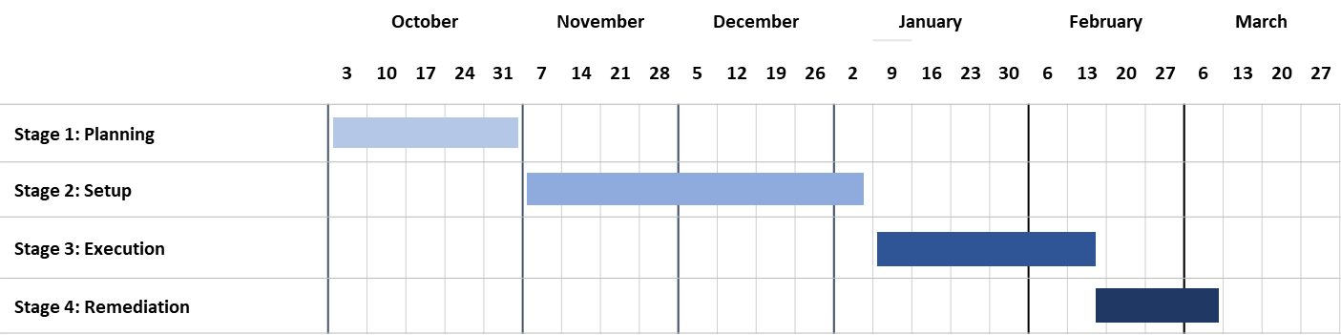
System Integration Testing (SIT) 3
Timeline
SIT 3
 | Start Date | End Date
Planning | 10/4/2021 | 11/5/2021
Setup | 11/8/2021 | 1/3/2022
Execution | 1/3/2022 | 2/18/2022
Remediation | 2/21/2022 | 3/11/2022

Slide 17
System Integration Testing (SIT) 3
0. Planning
1. Test Scenario Build Out
Engage Agencies during Monthly Change Liaison Meeting (10/6)
Complete SIT 3 planning (11/5)
Request Agencies SIT 3 Files (11/5)
Complete Updates to Pristine (11/10)
Identify Agency Participation (11/5)
Identify SIT 3 Scenarios (11/19)
Copy PRISTINE to DEM (11/19)
Updates to Agency Workbooks (11/19)
Agencies provide SIT 3 Data Files (11/19)
We are here!
2. Finalizing Testing
Meet with Agencies to identify Testers (12/3)
Update Scripts/scenarios in ALM (12/3)
Finalize Security Roles for SIT 3 (12/3)
Agencies Identify Tester (12/10)
Complete FRICE-W Testing (12/15)
Finalize Testing Schedule (12/17)
Complete Testing Data Sheets (12/17)
3. Finalize Build and Send out Invites
4. SIT 3 Kick off and Execution
Complete DEM Build/Configuration (12/17)
Send Agency Meeting Invites (12/17)
Complete SIT 3 Security Roles Setup (1/5)
SIT 3 Agency Kick off (1/3-1/7)
SIT 3 Execution (1/3)

Slide 18
System Integration Testing (SIT) 3
Notify Participants
Calendar Invites
SIT 3 Execution
  Provide list of agencies selected for participation, including explanation based on criteria.
  Agencies will receive for SIT 3 calendar invites
  SIT 3 agency involvement will begin the week of 1/3 for FRICE-W and 1/14 for functional scenarios
Nov 5
Dec 17
Jan 3 - Feb 18
Nov 3
Dec 10
Jan 3-7
SIT 3 Overview
Identify Agency Tester
SIT 3 Kick Off
Provide SIT 3 Introduction at monthly Change Liaison meeting.
  Agencies to provide list of Agency Testers to Luma Project Team

Slide 19
System Integration Testing (SIT) 3
Utilize 11 Core End-to-End Business Scenarios identified by Luma Team Members during SIT planning
Another pass with functional teams to gather test scenarios for SIT 3 (align to lvl 3 BPR’s to complete end-to-end testing)
All FRICE-W objects will be tested in SIT 3 once more

Slide 20
System Integration Testing (SIT) 3
FRICE-W Testing
First 2 weeks: (Jan 3 – Jan 14)
FRICE-W: Conversion/Inbound interfaces
Middle 4 weeks: (Jan 17 – Feb 11)
FRICE-W: Workflows/approvals
Last 2 weeks: (Feb 7 – Feb 18)
FRICE-W: Outbound/Reports
Functional/Other Testing
Middle 4 weeks: (Jan 17 – Feb 11)
End to End Scenarios (10-20 agencies max)
Any additional functional scenarios identified by workstreams
Last 2 weeks: (Feb 7 – Feb 18)
Additional Security Testing
  Security will be tested throughout the entirety of SIT 3 not just the last two weeks. The last two weeks will focus on any additional agency specific or negative security testing.

Slide 21
System Integration Testing (SIT) 3
  The Test Management Team will host an all-day SIT Testing Support Line (WebEx Meeting)
    Attendance is optional and SIT testers should only join if they have questions or issues regarding SIT Testing.
    The Meeting Moderator will reach out to Test Management, Functional, or Technical Teams if they need additional help resolving an issue
  Schedule:
    Monday – Thursday
      8:45 AM MT - 11AM MT
      1:45 PM MT – 4:00 PM MT
    Friday
      9AM MT – 11 AM MT
Roles | Responsibilities | Staffing
Test Management Team (Meeting Moderators) | Field SIT Testing Questions/Issues and triage to support teams as necessary Be ready to answer any questions regarding ALM or Reporting | Minimum of 1 person always while meeting is in session
Functional Team Members | Be available to answer any questions regarding Infor, Scripts, or Data | On Call
Technical Team Members | Be available to answer any questions regarding Security/Access or FRICE-W defects | On Call

Slide 22

Luma Phase 2 Update

Slide 23
JUL
AUG
SEP
OCT
NOV
DEC
JAN
FEB
MAR
APR
MAY
JUN
JUL
AUG
SEP
OCT
NOV
DEC
→
Infor Orientations
Schedule
Go Live
P2 Scope
Defined
Payroll/Time
Compare 1
2
3
50+ BPR sessions
infor 7.2 WFM
Multi-Tenant Government
Phase 2 Luma Base Configure
Using requirements, process maps, user stories and functional roles, Deloitte will build the three Phase 2 components of Luma (HR, Payroll, and Time (WFM)) with input from
Amber’s Core Team (Payroll and Time (WFM)) and
Ashleigh’s Core Team (HR)
No Showstoppers
Create Workarounds
infor 7.2 WFM Multi- Tenant Commercial
✓
Jan 13, 2022
Monitor
Configuration
Workshops
Finished six BPR weeks
+ 105 Process Maps
> 161 Change Impacts
+ 100 State SME’s
~ 50 BPR sessions
Nearly 10,000 people hours
Configuration Architects
“Knowledge
Transfer”
Sprint 1
Sprint 2
Sprint 3
Scenario Testing
User Story Integration
End to End
Agency Life Cycles
Employee Life Cycles
User Acceptance Testing
End
User
Training
User Validation of Luma Functions
Early Phase 1, technical information
gathering, surveys, and analysis
Practice Conversion
Conversion Building
Interface Building
Interface Testing
Get End User Needs/Change Impacts
End User Training Developed
Training Tested
SCOPE MANAGEMENT
QUALITY ASSURANCE
IMPLEMENTATION READINESS
OPERATE →

Slide 24
Luma Phase 2 Activities

Slide 25
Payroll/HR Survey
The Luma Project team is working on a survey to gather more information for Payroll & HR.
As of today, this survey can be expected no later than November 15th.

Slide 26

Engagement Opportunities

Slide 27
Engagement Opportunities
Upcoming engagement opportunities to learn more about Luma. Please help us spread the word!
Type of Engagement | Date | Time | Topic
November Procurement Learning Lab Option # 1 | November 16th | 10:00 am | Sourcing Events & Supplier Portal
November Procurement Learning Lab Option # 2 | November 18th | 2:00 pm | Sourcing Events & Supplier Portal
Statewide Showcase | November | 1:00 pm | None

Slide 28

Event Calendar
State of Idaho Controller's Office Website

Slide 29

Know Do Share Report
(K.D.S.R.)

Slide 30





Phase 1 K.D.S.R.
KNOW
DO
SHARE
REPORT
Read Luma Project news and updates in this column.
Meet with employees and leadership in your agency to discuss these messages or action items.
Please share this information or engagement opportunities with your Agency
Report feedback to the project team or complete action items the Luma project team is requesting from your agency.
Phase 1 Go-live: Phase 1 of the Luma Project will go live on July 1st, 2022 with the Finance and Procurement modules.
SIT 3 Prep: The project team will be notifying SIT 3 participants on 11/5.
Change Readiness Assessment - Measurement 3: Thank you to everyone who completed our third CRA measurement!
If your agency is currently working with the Luma Project team on an interface or conversion, please maintain momentum to bring those to completion.
Approval Workflow: Keep submitting workbooks if you have not already.
Security Roles: This workbook is due back to your Agency Advocate by November 12th.
Projects & Grants: The Luma P&G team will be holding another office hours session tomorrow at 11 am. The workbooks are due by November 15th.
Custodial Accounts/Allocation Workbooks: The Luma Project team is currently meeting with a select group of agencies to update and validate these workbooks.
Luma Learning Labs:
What: Sourcing Events & Supplier Portal
When: November 16th | 10 - 11am
November 18th | 2 - 3 pm
Where: Virtual meeting. Use the link below to RSVP!
Webpage Links:
Change Liaison Dashboard (idaho.gov)
EventsCalendar (idaho.gov)
Internal Meetings: Please let us know if you have an upcoming internal meetings that we can present to your staff! We want every state employee to know about the Luma, the changes coming, and exciting benefits of a modern system.
RSVP Here
November 3rd, 2021

Slide 31
Phase 2 K.D.S.R.
KNOW
DO
SHARE
REPORT
Read Luma Project news and updates in this column.
Meet with employees and leadership in your agency to discuss these messages or action items.
Please share this information or engagement opportunities with your Agency
Report feedback to the project team or complete action items the Luma project team is requesting from your agency.
Phase 2 Go-live: Phase 2 of the Luma project will go live with Workforce Management/Time in December of 2022 and Payroll as well as Human Capital Management on January 1st, 2023.
BPR Update: Thank you to everyone who participated in the Phase 2 BPR sessions!
Payroll/HR Surveys: The Phase 2 project team is working on a survey to gather more information from agencies. This can be expected no later than November 15th. More information to come!
Nothing this month!
Phase 2 Luma Webpages:
EventsCalendar (idaho.gov)
BPR Webpage: Luma Phase 2 Business Process Redesign (idaho.gov)
Payroll: Luma Payroll Module (idaho.gov)
Human Capital Management: Luma Human Capital Management (idaho.gov)
Internal Meetings: Please let us know if you have an upcoming internal meetings that we can present to your staff! We want every state employee to know about the Luma, the changes coming, and exciting benefits of a modern system.
November 3rd, 2021

Slide 32

Questions

Slide 33
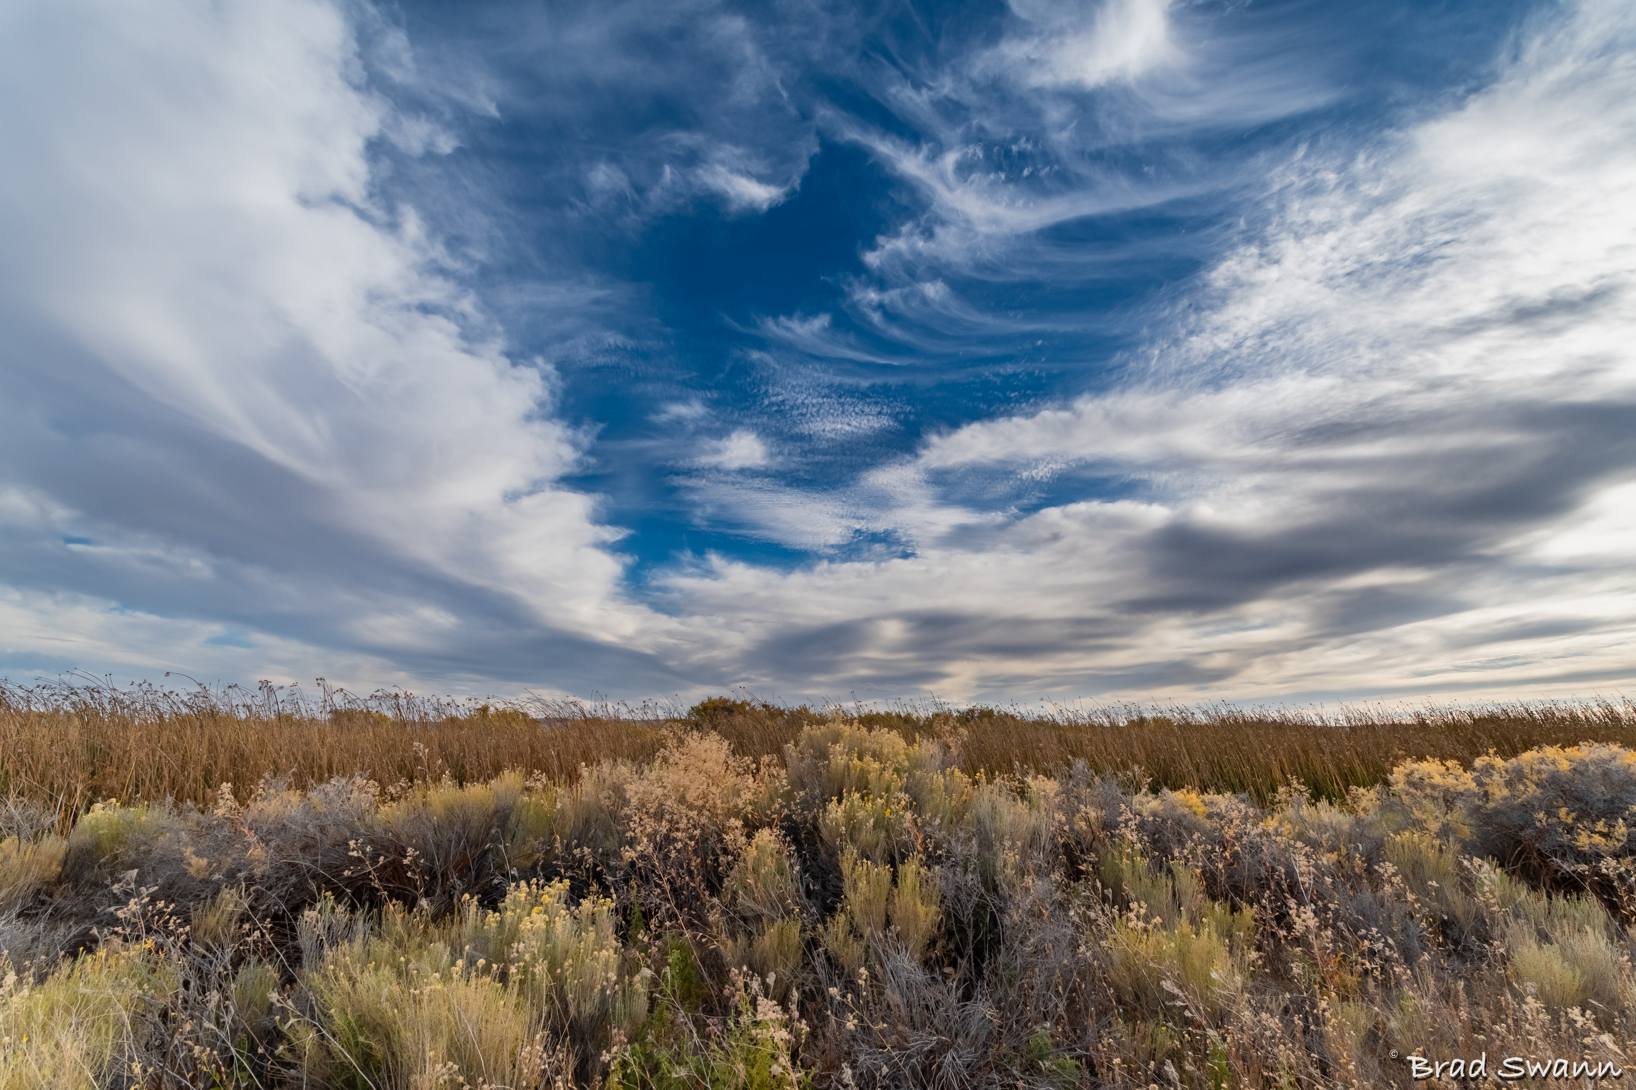
Thank You!
Sheena Coles
SColes@sco.Idaho.gov
208-334-3100
Alex Doench
adoench@sco.Idaho.gov
208-332-8841
Tina Fuller
tfuller@sco.Idaho.gov
208-332-8867
Chris Lehosit
clehosit@sco.Idaho.gov
208-332-8887
Elijah Stearns
estearns@sco.idaho.gov
208-332-8871
Danielle Blackmer
dblackmer@sco.Idaho.gov
208-332-8868

