Slide 1





Change Liaison Meeting
November 5th, 2020

Slide 2

AGENDA
  Introduce new Communications Manager
  Change Liaison Spotlight Series
  Project Timeline
  SIT 1 Update
  Finance Team Update
  What’s Coming Your Way?
  KDSR
  Lunch & Learns/Roadshows
  Leases
  Q&A
  Survey
Notes:
Hold for Intro:
Thanks again Liaison’s for your time today but more importantly for all of your efforts to ensure Luma is successful statewide. It has become clear during the project that certainly the state agencies have many, yet few similarities. Therefore, it is impossible to create a cookie-cutter model for you to implement in your agency. However, we have come across example after example of seeing you liaisons cater your efforts based on your knowledge of you agency to gain Luma awareness and support. Because of the array of needs and efforts we would like to introduce you to the Liaison Spotlight Series. Our goal is to hear directly from you in a casual setting to spark ideas and future conversations.

Slide 3
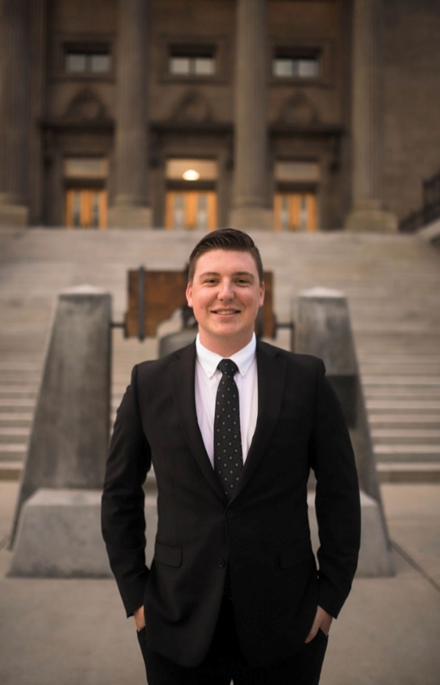
Alex Doench
Idaho State Controller’s Office
Functional Team: OCM – Project Communications Manager
Contact Number: (208) 332-8841
Email: adoench@sco.Idaho.gov
Favorite Way to Spend a Saturday: Going hiking with my friends or girlfriend!
Fun Fact: I have a food-stagram (@eatsbyalex) to post pictures of different meals I make.

Slide 4
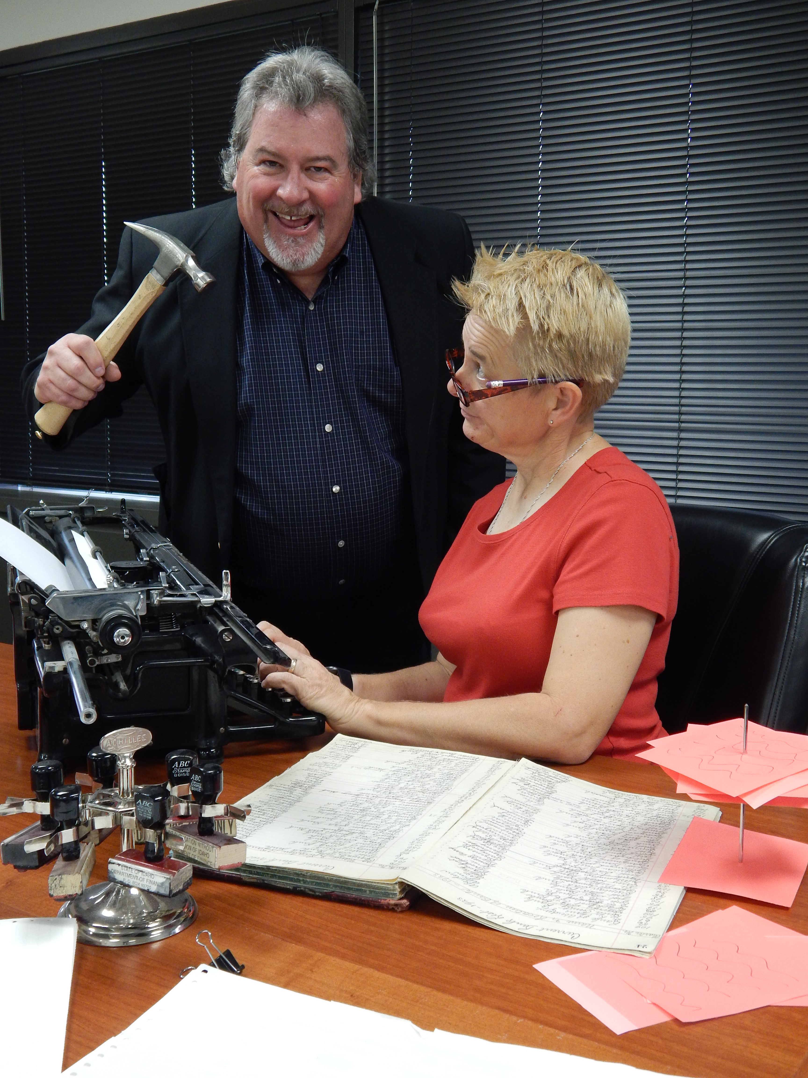
Change Liaison Spotlight
Dave Jensen & Jill Peterson-Pate Department of Finance
Notes:
Thanks Sheena, we received positive feedback after last month’s Liaison Spotlight with Kean Miller at Vocational Rehabilitation. Therefore, we wanted to drive the Spotlight series forward we now have the pleasure of Spotlighting the Department of Finance. Please help me “virtually” welcome both, Dave Jensen and Jill Peterson-Pate. As you can see, Dave and Jill are the critical tandem liaisons for their agency and they are responsible for pushing the message of “out with the old and in with the new”
Question 1. Morning Dave and Jill, please tell us about your position at the Dept. of Finance and your longevity with the state.
Question 2. Thanks, I thought we could jump back into a previous conversation you and I had in regards to your approach as the Liaison. Specifically, the joint role that you and Jill have taken on. Could you tell us more about this tandem strategy?
Question 3. Other than the tandem liaison approach what else has been successful for you guys to drive change?
Question 4. Please tell us more about promoting staff-wide awareness?
Question 5. Not all of our efforts yield success, have you failed or found specific approaches to avoid within your agency?
Question 6. If you were around other change liaisons what would you ask them?

Slide 5
Project Timeline

Slide 6
Luma Project Timeline
Luma Phase 1 – Finance, Budget, & Procurement
Luma Phase 2 – Human Capital Management & Payroll
2019 |  |  |  |  | 2020 |  |  |  |  |  |  |  |  |  |  |  | 2021 |  |  |  |  |  |  |  |  |  |  |  | 2022 |  |  |  |  |  |  |  |  |  |  |  | 2023
8 | 9 | 10 | 11 | 12 | 1 | 2 | 3 | 4 | 5 | 6 | 7 | 8 | 9 | 10 | 11 | 12 | 1 | 2 | 3 | 4 | 5 | 6 | 7 | 8 | 9 | 10 | 11 | 12 | 1 | 2 | 3 | 4 | 5 | 6 | 7 | 8 | 9 | 10 | 11 | 12 | 1 | 2 | 3 | 4 | 5 | 6
IMAGINE
DELIVER
RUN
IMAGINE
DELIVER
RUN
Plan
Architect
Configure & Prototype
Validate
Deploy
Support
Luma Phase 1 Kick-off
Plan
Architect
Configure & Prototype
Validate
Deploy
Support
Plan
Luma Phase 2 Kick-off
Discovery & Preparation
Project Team Training
Discovery & Preparation
Project Team Training
Enterprise Design
Enterprise Design Update
Technical Design (FRICE-W)
Technical Design (FRICE-W)
Sprint 1-3
Sprint 1-3
System Integration Testing 1 & 2 (SIT)
Parallel PR 1 – 3 (S.I.T.)
Mock Data Conv. 1 & 2
User Acceptance Testing
Mock Data Conv. 1 & 2
User Acceptance Testing
Design Updates
Design Updates
Training Dev.
Training
Training Dev.
Training
Budget Go-Live
Go-Live
WFM Go-Live
HR/PR Go-Live
6

Slide 7
Where are we now?
The intention of different testing cycles is to begin with testing of discrete functionality, then progress through to end-to-end business scenario testing.
Phase 1 Test Cycles
Sprint 1
Sprint 2
Sprint 3
System Integration
Testing (SIT 1)
System Integration
Testing (SIT 2)
User Acceptance
Testing (UAT)
Objective
Validates that baseline configuration functions as designed and yields expected results.
Validate that configuration for year end close function as designed and yield expected results.
Validate any configuration adjustments as a result of Sprint review/retrospective (week 4 of Sprint 2).
Confirms that business processes work as designed across an integrated set of modules and applicable FRICE-W components.
Involves a second execution of the integration test plan with a second run of conversions, additional FRICE-W components, and additional configurations identified in SIT1.
User simulation confirms that individuals can perform their jobs and provides a “day-in-a-life” experience to the user before production go-live.
Duration
June 2020
July 2020
Aug – Sept 2020
Sept – Nov 2020
Nov 2020 – Feb 2021
Feb – Apr 2021

Slide 8
System Integration Testing (SIT)
8

Slide 9
Engagement for System Integration Testing
Agency Testers will not see a perfect system. Luma is still under construction and being designed. Agency testers will help the project team find configuration issues early.
System testing is agile and iterative. We are working with agency testers now so we can build towards a solid, clean system for User Acceptance Testing.
SIT 1 will follow a structured format. Agency testers are assigned a role and will follow step by step scripts and enter sample data into the software. That sample data will be picked up by other testers in different roles.
The SIT 1 schedule could change. Testing scenarios could pass, fail, or hit roadblocks that impact downstream testing scenarios which will require testers to be flexible to rapid changes in the schedule.
SIT 1 will be a learning experience. As testers experience Luma for the first time, please keep an open mind, enjoy the experience, actively participate, and raise issues to the Luma team.
System testing will be in a remote work environment. The team will use zoom and zoom breakout rooms to execute testing.

Slide 10
What’s Coming Your Way?

Slide 11
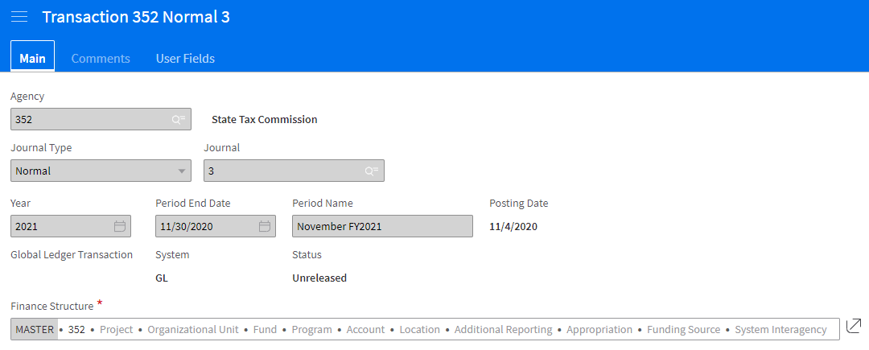
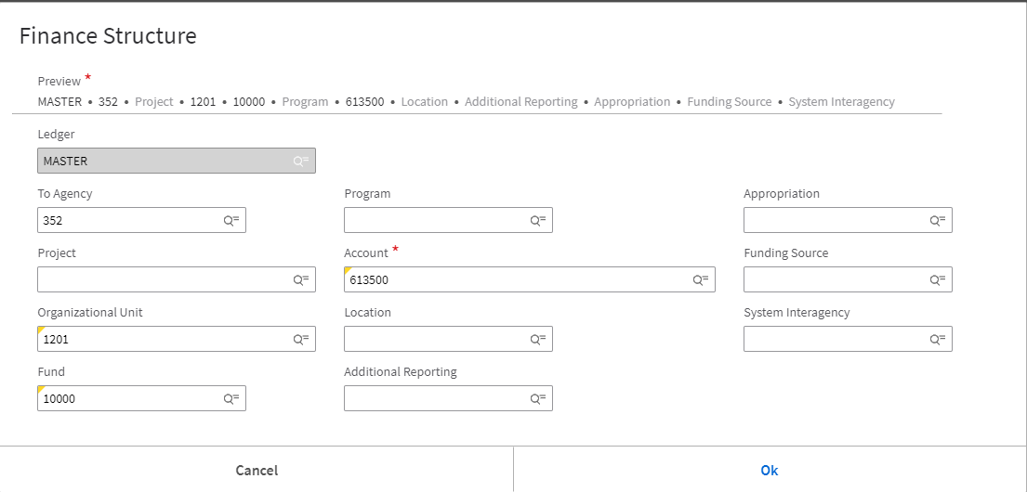
Default Chart of Accounts and Payroll Crosswalk
COA Default and Payroll Crosswalk Kick-off for Cohorts 1-4
Tuesday, November 17, 2020
Cohorts 1-4 Workbooks Due
Friday, January 8, 2021
COA Default and Payroll Crosswalk Kick-off for Cohorts 5-7
Tuesday, January 5, 2021
Payroll Interface Testing Begins
- Monday, January 11, 2021
Cohorts 5-7 Workbooks Due
Friday, February 26, 2021
Partial Payroll Testing Begins
- March – April 2021

Slide 12
Agency Leases
The Luma Project Finance team will be asking Agencies to complete a workbook to capture all of the information required for leases, which will then be uploaded a tool in Luma called LeaseQuery.
The email with the upload template can be expected by Mid-November and is requested to be returned by Mid-December. You will likely need assistance of someone that is familiar with you Luma Chart of Account buildout.
The team estimates to have leases from approximately 50% of all Agencies uploaded to LeaseQuery by System Integration Testing 2, taking place in January 2021.

Slide 13
Cost-Allocation Survey
The Luma Project Team will be gathering information from Agencies on any cost allocations that they currently do.
They will be gathering a detailed list of allocation and brief description of each, so that the team can have a complete detailed inventory of Agency needs.
The team estimates to have this workbook out to you around the end of November.

Slide 14
Lunch & Learns

Slide 15
Luma Lunch & Learns
An opportunity for a a quick overview of Luma topics and demos of modules. These will be from 12:00-1:00 PM 2x a month. The link to register for these Lunch and Learns will be distributed via Agency Advocate or in Monthly Newsletters. Invitations for the Lunch and Learn will be sent to those who register as well as agency directors and Change Liaisons for distribution.
Upcoming Lunch & Learn Dates | Lunch & Learn Topics
November 17th & 19th | High-Level Chart of Accounts Overview and Luma Introduction
December 15th & 17th | New Terminology in Luma
January 19th & 21st | Expense Management
February 16th & 18th | Budget & Upcoming Training
March 16th & 18th | Open

Slide 16
Roadshows

Slide 17
Luma Roadshows
A series of Roadshows will facilitate awareness, understanding and familiarity with the Luma System and benefits for Agencies and users.
Date & Time | Topic
Friday, December 11th | 1:00-2:00 PM | High-Level Overview and Demonstration of Navigation in Luma
Monday, December 14th | 1:00-2:00 PM | High-Level Overview and Demonstration of Navigation in Luma

Slide 18
Questions
18

Slide 19
Resources
November Lunch & Learn RSVP:
https://app.smartsheet.com/b/form/883c6dcb6a1a421ba6128390dcd0dceb
December Roadshow Registration:
https://app.smartsheet.com/b/form/8b59381b30d24a4182a423a91851789a
Luma Newsletter:
https://mailchi.mp/071eb6dc1040/luma-interfaces-building-connections
Welcome to Luma Series:
https://www.sco.idaho.gov/LivePages/luma_-welcome-to-luma-series.aspx
Post-Change Liaison Meeting Survey:
https://app.smartsheet.com/b/form/2d9b750ab38d488b9c9cab37de90b98d

Slide 20
Thank You for Coming!
Sheena Coles
scoles@sco.Idaho.gov
208-332-8703
Alex Doench
adoench@sco.Idaho.gov
208-332-8841
Chris Lehosit
clehosit@sco.Idaho.gov
Danielle Blackmer
dblackmer@sco.Idaho.gov
Heath Ribordy
hribordy@sco.Idaho.gov
Tina Fuller
tfuller@sco.Idaho.gov
Luma: luma@sco.idaho.gov
20

