Slide 1
Change Liaison Meeting
May 11th, 2022

Slide 2
Welcome!
Thank you for being here!
Expectations:
Please give presenters your full attention.
Please utilize the chat functionality (bottom right) to ask questions, or wait until the end of the presentation to come off of mute and ask.
This meeting is being recorded and will be provided in the follow-up email.

Slide 3
Phase 1 Update
Phase 1 Activities
Phase 2 Update
Phase 2 Activities
Training
Engagement
Key Takeaways
AGENDA
Notes:
Welcome Slide – Tina
Phase 1 Update
Timeline Options – Josh or Sheena
Phase 1 Activities
Pre-testing Process Validation – Sheena
Phase 2 Update
Timeline (Phase 1 impact on Phase 2) – Greg
Phase 2 Activities
Upcoming Phase 2 Workbooks
Training
Budget Training – Sara
Engagement
“Get Ready for Luma!” Webpage – Sara
Key Takeaways – Sheena

Slide 4
Luma Phase 1 Update

Slide 5
Path Forward Framework
Stable Environment(s) (Technically sound configured solution)
Scope
Testing (Internal & Agency Cross Functional)
Validate
Configure
Path Forward
Deployment Options (Risk & Confidence)
Realistic
Additional Activity (Scope of Work and Timeline)
Organization Changes (State, Infor, Deloitte, ISG)
Risk
Mitigation
Readiness (Awareness to Training to Support)
Impacts
Agency Confidence (Clear Expectations)
Training
Support

Slide 6
Methodology to create a revised Luma Deployment Plan
Document Potential
Deployment Approaches
Evaluate
High Level
Deployment Approach Combinations
Develop
Short List
Scenarios for Further Evaluation
Prioritize
and Select
Scenarios
Develop
Detailed
Analysis
for Selected
Scenarios
Complete
Complete
Complete

Slide 7
Deployment Option Analysis Variables
Each option was assessed to understand the impact the State’s risk profile for go-live.
Staffing | Agency Readiness | Business Impact | Technical Configuration | Executive Support | Cost Factors
Retention of current staff - Will current staff capacity and assignment be at risk? Additional Staffing - Can subject matter expertise be made available if incremental staff is required? | Testing Support - Can the Agency complete all required testing? Training - Can the Agencies complete all required training? Deployment - Will Agencies be able to support deployment activities within the option’s timeframe? | Business Continuity - Will the day-to-day operations of the State/Agencies be disrupted? Interim Solution Implementation - Can the design & development of temporary business processes be completed as required by the option? Meet Prerequisites - Can all critical functional pre-requisites be met? | Tenant Requirements - Can the number of tenants required for development and testing be provided? Core Technical Build - Can all technical development and end-user configuration be completed to support the option? Temporary Technical Build - Can the implementation of temporary technical objects be completed within the timeline? | Organizational Alignment - Do we have support - Governance board, legislative & other stakeholder parties? | Project Implementation Costs – What is the impact of the total program implementation cost Interim Support Costs – What is the impact on cost for support between initial go live and final go live
Notes:
Add rationale of what is driving each of these.

Slide 8
Luma Implementation Options
# | Luma Implementation Options (Post July 2022) |  | Implementation Dates
 |  |  | Oct 2022 | Jan 2023 | Apr 2023 | Jul 2023 | Jan 2024
1 | Phased: Finance First |  | Finance | HR/Pay/Time
2 | Phased: Finance First |  |  | Finance | HR/Pay/Time
3 | Phased: Finance First |  |  | Finance |  | HR/Pay/Time
4 | Phased: Finance First |  |  |  |  | Finance | HR/Pay/Time
5 | Big Bang (all functions at once) |  |  | Finance + HR/Pay/Time
6 | Big Bang (all functions at once) |  |  |  |  | Finance + HR/Pay/Time
7 | Phased: HR/Pay/Time First |  |  | HR/Pay/Time |  | Finance
8 | Phased: Split & Recombine |  |  | HR only |  | Finance + Pay/Time

Slide 9
Luma Phase 1 Activities

Slide 10
Major Project Activities – Luma Phase 1
Tenant Strategy
The new Agency Partnership Strategy creates an opportunity for agencies to review and comment on business processes in a controlled and managed approach to accomplish and support State critical business requirements.
Test Strategy
Cutover Strategy/
Planning
Mock Cutover 1
Project SIT Plan
Mock Cutover 2
Agency SIT Plan
Mock Cutover 3
UAT Plan
Go-Live
Pre-Test Activities
Project Team
SIT
Agency
SIT
User Acceptance Testing
Cutover Execution
Training Strategy
Training Development
Training Content Validation
End-User Training

Slide 11
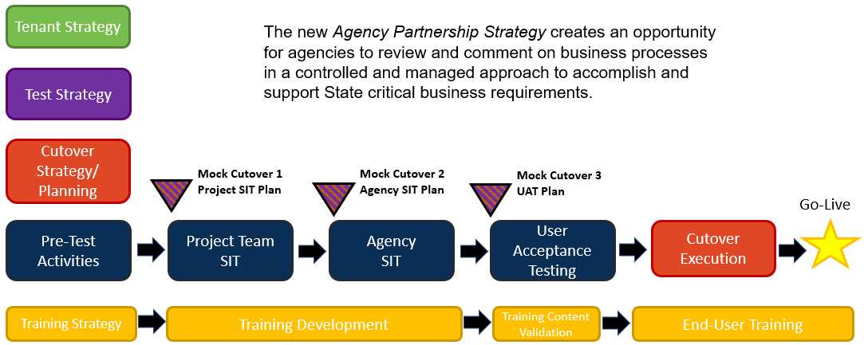
Agency Partnership Strategy
Pre-Test Activities
Business Process Confirmation
FRICE-W Completion
Agency Functional Confirmation
All workstreams will complete the following before we conduct the Agency Functional Confirmation activity:
Critical Go-Live business processes are defined, configured, and unit tested
All required Configuration Workbooks are up-to-date and complete
Critical Go-Live business processes are confirmed by Agency Stakeholder Groups

Slide 12
Stakeholder Groups
Luma project workstreams will have an agency stakeholder group that supports workstream business process design/validation.
Each comprises 5 to 9 subject matter experts who represent one or more State agencies.
Review system and business processes
Confirm business requirements are met
Identify potential gaps
Act as a sounding board and not decision-makers
Business Process Maps
Configurations
Design/
Reqmts
Configure
Unit Test
Document
FRICE-W
Scope Lock
Agency Data and Set-up
Business Process Validation
Cycle
Testing
Scenarios and Scripts
Stakeholder Group Input
System Knowledge

Slide 13
Luma Phase 2 Update

Slide 14
Phase 2 May 2022 Updated Roadmap through October
Phase 2 Start July 1 2021
APR
MAY
JUN
JUL
AUG
SEP
OCT
WFM 7.2 – Multi Tenant Gov Cloud
Infor Orientations
End User Training Developed & Validated
We are here
May 31
(now 5 weeks)
50+ BPR sessions
User Acceptance Testing
Base Configuration
SIT Readiness
Tenant Build
User Stories
Test Scripts
Mitigations
System Integration
Test 1
System Integration
Testing 2
Sprint 1: Build & Test
Pay/Time
Compare 1
Pay/Time
Compare 2
Pay/Time
Compare 3
Sprint 2: Build & Test
Mock Cutover1
Mock Cutover2
Mock Cutover3
Sprint 3: Build & Test
(FRICE-W): Identify, Document, and Build (testing started in March)
FRICE-W Mitigations/Scoping to Go Live

Slide 15
Luma Phase 2 Activities

Slide 16
Upcoming Phase 2 Workbooks
Learning Management System Workbook for the Luma Learning and Development Module
Performance Management Workbook

Slide 17
^{Training}

Slide 18
Luma Budget
Luma Budget Team is preparing the system for the Budget FY 2024 submission.
Key points:
Rollover of Luma Budget for FY ‘24 is anticipated in the next several weeks
Emails will be forth coming with further details
A showcase of Luma Budget FY ‘24 will be scheduled prior to opening with important information to be aware of
Training will be available for:
New Luma Budget users
Refresher training for existing users, if desired

Slide 19
Engagement

Slide 20
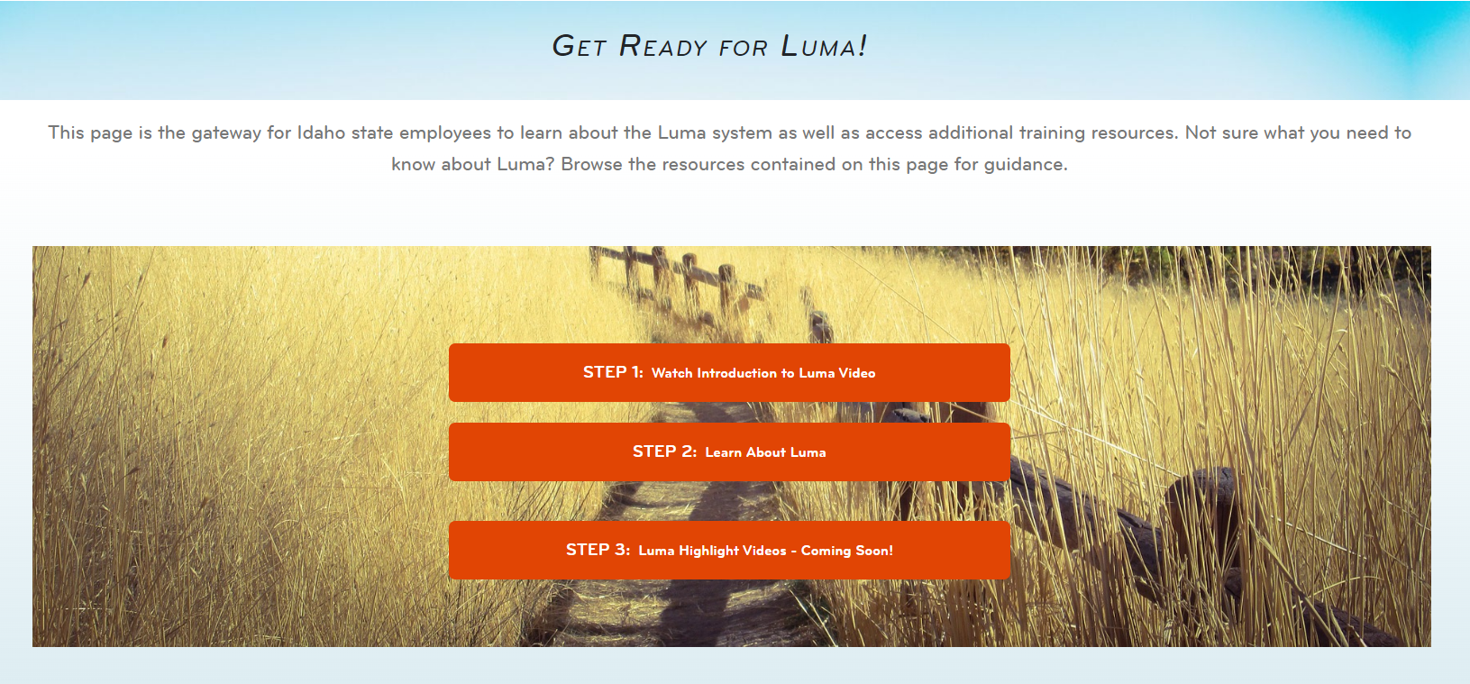
Screenshot of Get Ready for Luma

Slide 21
Key Takeaways

Slide 22
Thank You!
Sheena Coles
SColes@sco.Idaho.gov
208-334-3100
Alex Doench
adoench@sco.Idaho.gov
208-332-8841
Tina Fuller tfuller@sco.Idaho.gov 208-332-8867
Chris Lehosit clehosit@sco.Idaho.gov 208-332-8887
Elijah Stearns
estearns@sco.idaho.gov 208-332-8871
Danielle Stevens dstevens@sco.Idaho.gov
208-332-8868

