Slide 1
Change Liaison Meeting
May 5th, 2021
Notes:
Good afternoon everyone!
We glad to that you were able to join us.
Housekeeping
Mute if not speaking
Feel free to pop questions or comments in the chat or come off mute and vocalize if you are comfortable
Emojis
Now that we have housekeeping done – lets dive right in!

Slide 2

OCM Team Update
Luma Budget Module Training and Launch
Luma Finance & Procurement Modules Update
Luma Webpage Resources
Ongoing Activities
Upcoming Activities
Engagement Opportunities
Know Do Share Report (K.D.S.R.)
Resources
Q&A
AGENDA
Notes:
Welcome our new AA Elijah Stearns! - TINA
Luma Budget Module Training and Launch – SARA OR ALEX
Luma Finance & Procurement Modules Update - SHEENA
Luma Webpage Resources - ALEX
Ongoing Activities - CHRIS
Upcoming Activities - CHRIS
Engagement Opportunities - DANIELLE
Know Do Share Report (K.D.S.R.) - DANIELLE
Resources - DANIELLE
Q&A - TINA

Slide 3
OCM Team
Update
Welcome our New Agency Advocate Elijah Stearns!

Slide 4
Luma Budget Module
Training & Launch
Notes:
Alex

Slide 5
Luma Budget Module Training Timeline
Training April 12-May 7th – Virtual Instructor Led Training (Budget Analysts/Budget Officer)
  During this time anyone can be in the Luma Budget System entering their FY ‘22 data and testing the system.
  Please verify the provided crosswalks (B11 & B12) information is uploaded correctly. If not please let the Budget Team know.
Web Based Training – May 2021
  This training is for everyone participating in the budget process that are not in the stages Budget Analysts or Budget Controller for your agency.
May 7th – May 17th
  Luma Budget System will be “cleaned of all training data” in preparation for the launch.
May 17th
  Launch of Luma Budget System

Slide 6
Luma Budget Module SRA Training
What is an SRA?
SRA stands for Security Request Administrator. A Security Request Administrator is the individual at an agency that submits a security form for Agency personnel to gain security access into various statewide systems.
Agency budget personnel will need proper security access for the Luma Budget system which is why a tab has been added to the security request form titled “Luma”. Please see the below timeline for the Luma security request form:
Week of April 26th – May 7th
Please complete the security forms for Luma Budget.
Agency Directors will also need to approve the security forms as part of submission back to the Computer Service Center.
Please have access for your budget personnel entered on the SCO Security form no later than May 7th. If it is not completed, any users without the appropriate security documentation at this time will have their access frozen until their agency submits the necessary documentation.
Notes:
Project team is considering other ways to do security request forms for the other modules.

Slide 7
Luma Budget Module Training Timeline
Post Launch Timeline:
Q&A with the Luma Budget team – June 2021
September 2021
  Budget Submission via Luma Budget

Slide 8
Luma budget module training resources
Luma Budget Troubleshooting Guide (Living Document)
Luma Budget Reference Guide
Budget Forms PowerPoint, Video and Quick Reference Guide
Luma Budget End Users Training Manual (Forth Coming)
Stages Agency T-Shirt Reference
Luma Budget Accounts with STARS Summary Accounts (Living Document)
Fund Appropriation Agency Crosswalk (Living Document)
Budget Forms DU Crosswalk
Birst Reporting (May have more training on this in the future.)

Slide 9
Questions about the Luma Budget Module
Should you have questions about the Luma Budget system please contact the Budget team at Lumabudget@sco.Idaho.gov
For questions regarding Luma Budget training, please contact the Luma Training team at LumaTraining@sco.Idaho.gov

Slide 10
Luma Finance & Procurement
Modules Update

Slide 11
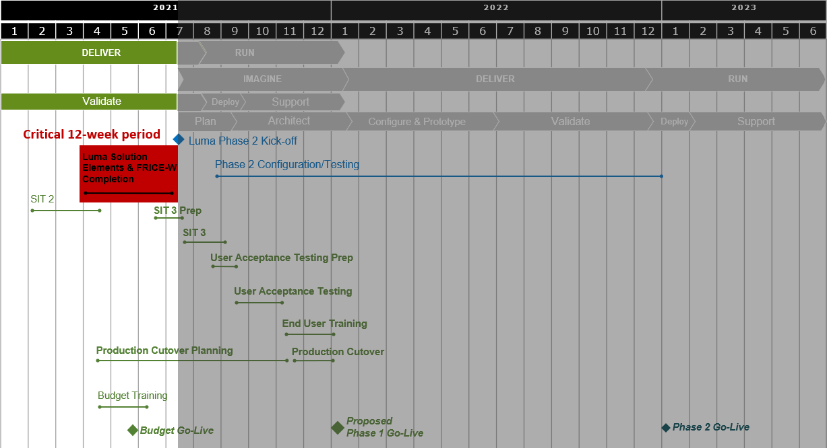
Phase 1 Timeline

Slide 12
Redefined efforts & Focus areas
Resolution of functionality disparities with current State of Idaho business processes.
Cash Management / Cash Edit - Idaho requirement and design documents ready for Infor.
Interfaces development and testing.
The goal is to have all interfaces and conversions working in the system before SIT3
Finish all the necessary crosswalks
Agency-specific system setup and configurations based on workbook completion.
Projects & Grants
July 9th, 2021

Slide 13
Luma Webpage
Resources

Slide 14
On-going Activities

Slide 15
On-going Activities
Luma Project Activity
Projects & Grants Workbooks
COA Default Workbook
Payroll Crosswalk Workbook
Agency Leases Workbook
MHC Workbook
Asset Clean-up & Certification
Workforce Transition Manager Nomination Workbook – Due 5/7
*All highlighted activities are past due and need to be completed as soon as possible.
Some are very close and only have a few left to be completed!
Notes:
Danielle

Slide 16
Upcoming Activities

Slide 17
Upcoming Activities
Workforce Transition – Manager’s Awareness Sessions
  Planned for June (Finance and Procurement).
Workforce Transition – Role Mapping Activity
  Anticipated in June 2021.
Agency Approval Workflow Workbooks
  On the horizon.
Luma Budget Module Launch
  May 17th, 2021

Slide 18
Engagement Opportunities

Slide 19
Statewide Showcases
An opportunity for an overview of Luma topics and demonstrations of modules. Each statewide showcase will be done twice a month from 1:00 – 2:00 PM. The link to RSVP for these showcases will be sent to agency change liaisons from distribution within the agencies as well as in upcoming newsletters. Each statewide engagement/showcase will be recorded. The materials from the meeting will be sent out to agency change liaisons for distribution.
Upcoming Statewide Showcases | Engagement Topics
May 11th & 13th | Expense Management
June 15th & 17th | TBD
Notes:
The Luma Showcases are intended to provide an opportunity for anyone and everyone to get some exposure to the Luma system. The Luma Showcases are intended to be intended for a higher level and less technical in nature so that any State Employee could benefit from attending and getting the information. Hopefully you will be able to help us get the work out so that anyone interested in the topic for the month will know they are happening and how to get signed up to attend!This month the Procurement Team will show off some of the procurement or purchasing related functionality in Luma. The procurement module includes things like requisitions, a really exciting punch out system that is almost like a Amazon- ish tool that State Employees can use to purchase or order or request things like office supplies. It won’t be a free for all ordering system, but it will make a purchasing and requesting items state employees need pretty slick. Agencies will have the ability to set up how this will work – who will be able to use it, the approval process and the like to fit their needs. We might also hear about strategic sourcing, contract management, the supplier portal and inventory control.In April there are two topics that we are hoping there will be a lot of interest in. The Reports Team will be showing some of the reports and reporting capabilities in the Luma System. We will also hear from the Luma Team members working on the plan for when the rubber hits the road and share some of the plans and activities that will be taking place to help us make the cut over on July first turning the lights off on STARs and the lights on in Luma!In May the Expense Management Team will be sharing some or showing off some of the exciting tools, and features related to the XM Module in Luma. XM is the Luma module that will handle things like P-Cards, and Employee Travel – planning, reimbursements, approval processing – all that fun stuff!Lots of fun and exciting things on the horizon – please please please help us get the word out and get as many people as possible on!

Slide 20




K.D.S.R.
Notes:
Danielle

Slide 21




Preparing Agencies for Success Before and After Infor CloudSuite Go-Live
KNOW
DO
SHARE
REPORT
Read Luma Project news and updates in this column.
Meet with employees and leadership in your agency to discuss these messages or action items.
Please share this information or engagement opportunities with your Agency
Report feedback to the project team or complete action items the Luma project team is requesting from your agency.
Luma Finance & Procurement Modules Update:
Newsletter: Please share the monthly newsletter with your colleagues!
Welcome to Luma: Please distribute the Welcome to Luma infographics to your agency staff. Find them here:
Luma YouTube Channel:
Can’t make it to a Luma meeting? Don’t worry! Check out the Luma YouTube Channel!
Luma Webpage:
Luma Budget Module Launch: The Luma Budget Module is launching as expected on May 17th, 2021.
Projects & Grants Workbooks
COA Default & Payroll Crosswalk
Workbooks
Agency Leases Workbook
MHC Workbook
Asset Clean-up & Certification
P-card Clean-up
Workforce Transition Manager
Nomination Workbook
Agency Approval Workflow Workbook
Workforce Transition Plan – Manager’s Awareness Sessions: We are looking for directors, managers, or other department supervisors who supervise teams to have a minimum of one person from each workstream below join us for the Manager’s Awareness Sessions :
Finance
Procurement
Internal Meetings: Please let us know if you have an upcoming internal meetings that we can present to your staff! We want every state employee to know about the Luma, the changes coming, and exciting benefits of a modern system.
Luma Newsletter #24
Statewide Showcase:
This month’s showcase will provide a live demonstration of Luma Expense Management.
Infographics
Luma YouTube Channel
Luma Webpage
May 5th, 2021
Notes:
Danielle

Slide 22
Resources
Luma Newsletter:
https://mailchi.mp/0f598f6296ee/luma-system-testing-update
Welcome to Luma Series:
https://www.sco.idaho.gov/LivePages/luma_-welcome-to-luma-series.aspx

Slide 23
Questions

Slide 24
Thank You for Coming!
Sheena Coles
SColes@sco.Idaho.gov
208-334-3100
Alex Doench
adoench@sco.Idaho.gov
208-332-8841
Danielle Blackmer
dblackmer@sco.Idaho.gov
Chris Lehosit
clehosit@sco.Idaho.gov
Tina Fuller
tfuller@sco.Idaho.gov
Luma
luma@sco.idaho.gov

