Slide 1
Change Liaison Meeting
March 3rd, 2021

Slide 2

Project Timeline Update
Testing Update
What’s Coming Your Way?
Showcases
Frequently Asked Questions about Luma
Luma Glossary
Reminders
Know Do Share Report (K.D.S.R.)
Resources
Q&A
AGENDA
Notes:
Spotlight:Heath
Timeline: Alex
SIT2: Sheena
UAT: Sheena
Coming your way: Chris
Showcase: Tina
FAQ: Tina
Glossary: Alex
KDSR: Danielle
Reminders: Danielle

Slide 3
Project Timeline
Update
Notes:
Alex

Slide 4
Luma Project Timeline
Luma Phase 1 – Budget, Finance, & Procurement
Luma Phase 2 – Human Capital Management & Payroll
2019 |  |  |  |  | 2020 |  |  |  |  |  |  |  |  |  |  |  | 2021 |  |  |  |  |  |  |  |  |  |  |  | 2022 |  |  |  |  |  |  |  |  |  |  |  | 2023
8 | 9 | 10 | 11 | 12 | 1 | 2 | 3 | 4 | 5 | 6 | 7 | 8 | 9 | 10 | 11 | 12 | 1 | 2 | 3 | 4 | 5 | 6 | 7 | 8 | 9 | 10 | 11 | 12 | 1 | 2 | 3 | 4 | 5 | 6 | 7 | 8 | 9 | 10 | 11 | 12 | 1 | 2 | 3 | 4 | 5 | 6
IMAGINE
DELIVER
RUN
IMAGINE
DELIVER
RUN
Plan
Architect
Configure & Prototype
Validate
Deploy
Support
Luma Phase 1 Kick-off
Plan
Architect
Configure & Prototype
Validate
Deploy
Support
Plan
Luma Phase 2 Kick-off
Discovery & Preparation
Project Team Training
Discovery & Preparation
Project Team Training
Enterprise Design
Enterprise Design Update
Technical Design (FRICE-W)
Technical Design (FRICE-W)
Sprint 1-3
Sprint 1-3
System Integration Testing 1 & 2 (SIT)
Parallel PR 1 – 3 (S.I.T.)
Mock Data Conv. 1 & 2
User Acceptance Testing
Mock Data Conv. 1 & 2
User Acceptance Testing
Design Updates
Design Updates
Training Dev.
Training
Training Dev.
Training
Budget Go-Live
Go-Live
WFM Go-Live
HR/PR Go-Live
Notes:
Alex

Slide 5
Testing Update

Slide 6
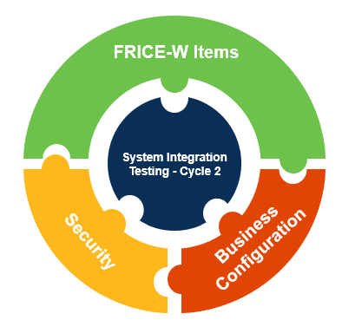
SIT 2 Update
System Integration Testing Cycle 2 has provided a more comprehensive, end-to-end testing for the Forms, Reports, Interfaces, Conversions, Enhancements, and Workflow that were still being developed and unable to be tested in SIT1.
The overall goal of System Integration Testing is to validate the functionality of Luma end-to-end with agency-specific data. This process ensures operational readiness for User Acceptance Testing.
While the current priority of SIT 2 is FRICE-W items, State employees can expect to receive further exposure in User Acceptance testing and end-user training to familiarize themselves with Luma.

Slide 7
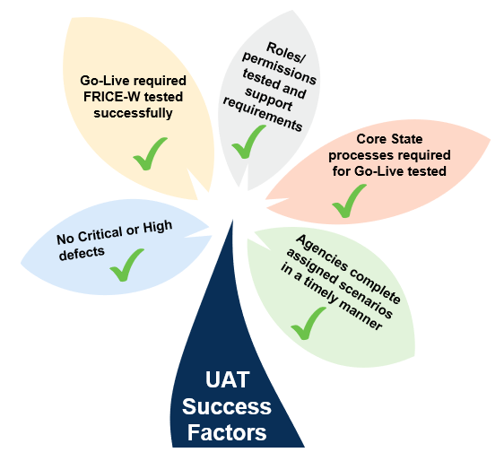
User Acceptance Testing (UAT) Update
In User Acceptance Testing, a broader group of state agency users will follow scenarios to test the functionality of the Luma system.
This is such an integral part of our project timeline because UAT is the system "dress rehearsal" and will confirm if the State is ready to move the ERP into the production environment and go-live.
The Luma Project team has been preparing for UAT and it is planned to begin following SIT2 completion.

Slide 8
What’s Coming Your Way?
Notes:
Chris

Slide 9
Workforce Transition Plan
Host Manager Awareness Workshop series to communicate changes and associated benefits.
Provide Manager’s Toolkit to increase leadership’s role in disseminating information.
Communicate Luma system roles and gather personnel information in preparation for training.
Host virtual informational sessions for end users (Luma Learning Labs) mirroring the Manager’s Workshop.
Notes:
Chris

Slide 10

Duo – Multi Factor Authentication
Who:
All state employees can benefit from the statewide contract for Mutli-Factor Authentication.
What:
The Luma Project identified various MFA contracts as an area for improvement from both a cost savings and security prospective.
Cisco DUO Mobile will be utilized as the statewide MFA tool on a statewide contract.
When:
The DUO enrollment period will follow a phased approach spanning throughout Spring 2021.
Cisco DUO Mobile
With the integration of Cisco DUO Mobile into the SCO Enterprise Dashboard sign-in, state employees will now have an additional factor of authentication beyond their State ID and password to access Luma applications. This form of authentication requires you to perform an action on something you posses such as a personal or office phone.
Notes:
Chris

Slide 11


Budget Staging & Workflow Workbook
The first of two Budget Staging and Workflow launches was held yesterday, and the second is tomorrow from 2-3pm.
These meetings provide a walkthrough of staging and how to choose the right T-shirt for your agency.
The workbook is due by COB on Tuesday, March 16th.
Notes:
Chris

Slide 12
Agency Interfaces & Conversions
Thank you for participating in the Interface file development iterative process! Please continue to work with the Luma Technical Team on getting your Interface files ready for Go-Live!
Once we have the new files and our Functional Teams have reviewed them, the Luma team will set up a personalized testing session to validate that your Interface files work correctly! This is a great opportunity to ensure that your interface works properly and to continue working on finalizing your files.
Please be on the look out for technical validation sign-off sheets as your testing sessions are completed.
Also, please touch base with the technical personnel at your agency and develop a plan for setting up Interface Automation prior to Production. We recommend having that set up during UAT so you have ample opportunity to test it.
Notes:
Chris

Slide 13
Luma
Showcases
Notes:
Tina

Slide 14
Statewide Showcases
An opportunity for an overview of Luma topics and demonstrations of modules. Each statewide showcase will be done twice a month from 1:00 – 2:00 PM. The link to RSVP for these showcases will be sent to agency change liaisons from distribution within the agencies as well as in upcoming newsletters. Each statewide engagement/showcase will be recorded. The materials from the meeting will be sent out to agency change liaisons for distribution.
Upcoming Statewide Engagements | Engagement Topics
March 16th & 18th | Procurement
April 13th & 15th | Reporting & Cutover Plan
May 11th & 13th | Expense Management
Notes:
The Luma Showcases are intended to provide an opportunity for anyone and everyone to get some exposure to the Luma system. The Luma Showcases are intended to be intended for a higher level and less technical in nature so that any State Employee could benefit from attending and getting the information. Hopefully you will be able to help us get the work out so that anyone interested in the topic for the month will know they are happening and how to get signed up to attend!This month the Procurement Team will show off some of the procurement or purchasing related functionality in Luma. The procurement module includes things like requisitions, a really exciting punch out system that is almost like a Amazon- ish tool that State Employees can use to purchase or order or request things like office supplies. It won’t be a free for all ordering system, but it will make a purchasing and requesting items state employees need pretty slick. Agencies will have the ability to set up how this will work – who will be able to use it, the approval process and the like to fit their needs. We might also hear about strategic sourcing, contract management, the supplier portal and inventory control.In April there are two topics that we are hoping there will be a lot of interest in. The Reports Team will be showing some of the reports and reporting capabilities in the Luma System. We will also hear from the Luma Team members working on the plan for when the rubber hits the road and share some of the plans and activities that will be taking place to help us make the cut over on July first turning the lights off on STARs and the lights on in Luma!In May the Expense Management Team will be sharing some or showing off some of the exciting tools, and features related to the XM Module in Luma. XM is the Luma module that will handle things like P-Cards, and Employee Travel – planning, reimbursements, approval processing – all that fun stuff!Lots of fun and exciting things on the horizon – please please please help us get the word out and get as many people as possible on!

Slide 15

Luma Frequently Asked Questions
Notes:
Tina

Slide 16
Luma Frequently Asked Questions
When do our Luma Activity Submissions need to be updated with Production level data?
Please refer to the Freeze Date slide for "drop dead" dates!
When does the first round of Luma training start?
How do I get my State ID?
We include step-by-step instructions following this meeting to assist you in getting your State ID.
Budget training starts April 5th!
Notes:
Tina
"No joke, April 1st"

Slide 17

Introduction
of the
Luma Glossary
Notes:
The Luma Glossary has not been made available quite yet but we wanted to provide our liaisons a sneak peek as it has been a work in progress and is nearing completion. I’ll hand it over to Alex in a second for an unveiling, but I want to point out the structure of the document. Similar to some of the Chart of Account efforts in which we all used the term to “cross walking” referring to getting data from current applications into Luma, you’ll see this same approach in which a term that is used in current applications will be “cross walked” or mapped side-by-side to the new Luma term. Once this tool is finalized we will send this out to you, we’ll also uploaded this in the Change Liaison dashboard, we’ll attach it in future communications, you’ll also be seeing more and more of this as we transition into statewide training. I foresee this tool being of great value even after go-live as we’re getting more and more fluid in Luma. So with that, I will hand it over to Alex for a quick look…

Slide 18
Reminders
Notes:
Danielle

Slide 19
Reminders
Name of Request | Due Date
Office Depot Procurement Punchout | February 26th, 2021
COA Default & Payroll Crosswalk Workbooks for Cohorts 5-7 | March 1st, 2021
Projects & Grants Workbooks | March 9th, 2021
Budget B11 & B12 Crosswalk Workbook | March 12th, 2021
Budget Staging and Workflow Workbook | March 16th, 2021
Agency Leases Workbook for Cohorts 5-7 | March 19th, 2021
Notes:
Danielle

Slide 20




KDSR
Notes:
Danielle

Slide 21

Preparing Agencies for Success Before and After Infor CloudSuite Go-Live
KNOW
DO
SHARE
REPORT
Read Luma Project news and updates in this column.
Meet with employees and leadership in your agency to discuss these messages or action items.
Please share this information or engagement opportunities with your Agency
Report feedback to the project team or complete action items the Luma project team is requesting from your agency.
Statewide Showcase:
Join us for the upcoming March Showcase to learn about some exciting aspects of Expense Management in Luma
Newsletter: Please share the monthly newsletter with your colleagues!
Welcome to Luma: Please distribute the Welcome to Luma infographics to your agency staff. Find them here:
Luma YouTube Channel:
Can’t make it to a Luma meeting? Don’t worry! Check out the Luma YouTube Channel!
Luma Common Reports Submissions & Sign offs: Following the Reports Analysis Workbook Submission, the Luma Reports Team is sending out Sign-off forms.
Chart of Accounts Default Workbooks & Payroll Crosswalk Workbooks: Workbooks was due March 1st for any Cohort 5-7 agencies.
Budget B11 & B12 Crosswalk workbook: Workbooks are due by March 12th.
Budget Staging and Workflow Workbook: Workbooks are due by March 16th
Agency Lease Workbook: Workbooks are due March 19th for Cohort 5-7 agencies
Communications Manager: As we get closer to go-live we want to ensure we are getting messages out to every state employee. To this end, please send contact information for any communications personnel within your agency.
Internal Meetings: Please let us know if you have an upcoming internal meetings that we can present to your staff! We want every state employee to know about the Luma, the changes coming, and exciting benefits of a modern system.
Luma Newsletter #23
RSVP HERE
Luma Budget Module Training: Training for the Luma Budget Module will begin April 5th.
Infographics
Luma YouTube Channel
March 3rd, 2021
Notes:
Danielle

Slide 22
Resources
March Showcase RSVP: https://app.smartsheet.com/b/form/8cc2a90b887d4771b5e25c10989ce91a
Luma Newsletter: Luma Budget Module: Overview of Upcoming Training (mailchi.mp)
Welcome to Luma Series:
https://www.sco.idaho.gov/LivePages/luma_-welcome-to-luma-series.aspx

Slide 23
Thank You for Coming!
Sheena Coles
SColes@sco.Idaho.gov
208-334-3100
Alex Doench
adoench@sco.Idaho.gov
208-332-8841
Chris Lehosit
clehosit@sco.Idaho.gov
Danielle Blackmer
dblackmer@sco.Idaho.gov
Heath Ribordy
hribordy@sco.Idaho.gov
Tina Fuller
tfuller@sco.Idaho.gov
Luma: luma@sco.idaho.gov

Slide 24
Questions

