Slide 1
Change Liaison Meeting
January 12th, 2021

Slide 2
Welcome!
Thank you for being here!
Expectations:
Please give presenters your full attention.
Please utilize the chat functionality (bottom right) to ask questions, or wait until the end of the presentation to come off of mute and ask.
This meeting is being recorded and will be provided in the follow-up email.

Slide 3
Phase 1 Update
Phase 1 Activities
Phase 2 Update
Phase 2 Activities
Leadership Alignment
Engagement Opportunities
Phase 1 & 2 Know Do Share Reports (K.D.S.R.)
Key Takeaways
AGENDA

Slide 4
Luma Phase 1 Update

Slide 5
Phase 1 Timeline
 | 2021 |  | 2022 |  |  |  |  |  |  |  |  |  |  |  |  |  | 2023
Project Parts | NOV | DEC | JAN | FEB | MAR |  | APR | MAY |  | JUN | JUL | AUG | SEP | OCT | NOV | DEC | JAN | FEB-JUN
Phase 1 | Validate |  |  |  |  |  |  |  |  | Deploy |  | Support |  |  |  |  | Support
Design/Build | FRICE-W
Testing | Infor Enhancements |  | SIT 3
Testing |  |  |  |  | UAT
Training |  |  | P&G Training |  |  |  | End-Users Trained
 |  |  | Training Development
Go Live |  |  |  |  |  |  |  | Cutover Tasks THEN Go Live |  |  |  | Deloitte Support |  |  |  |  | State Operations
Important dates:
SIT 3 Functional Testing – 1/24-3/11
SIT 3 Projects & Grants In-person – 1/31-2/2
SIT 3 FRICE-W Validation – 1/3-3/11
Projects & Grants Training – 2/1-2/18
Idaho Legislative Session – 1/10-TBD

Slide 6
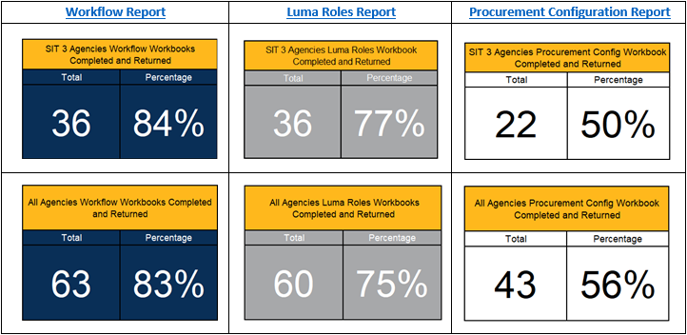
Outstanding Workbooks
*As of 1/11/21

Slide 7
Luma Phase 1 Activities

Slide 8
SIT 3 - Testing Schedule
As you may know, to provide more time for the Luma project team to rehearse the test scripts before they are distributed to agency testers and to better schedule around the Jan 17th holiday, we have made the following adjustments to the SIT3 schedule:
SIT 3 Agency Kickoff: Tuesday, January 11th
Agency Functional End-to-End Testing: Monday, January 24th – Friday, March 11th
SIT 3 Projects & Grants Testing: Monday, January 31st – Wednesday, February 2nd
We appreciate your flexibility to these schedule changes and look forward to testing with your agency!

Slide 9
SIT 3 - Path for Agency Testers
Identified as a tester - 12/15
SRA Security Request form for security access
Basic Training offered
via Moodle (Welcome to Luma, Basic Navigation, Accounting Overview, Overview of Reporting)
Participate in Kickoff
Access DEM environment
Execute testing
Receive test scripts and scenarios

Slide 10
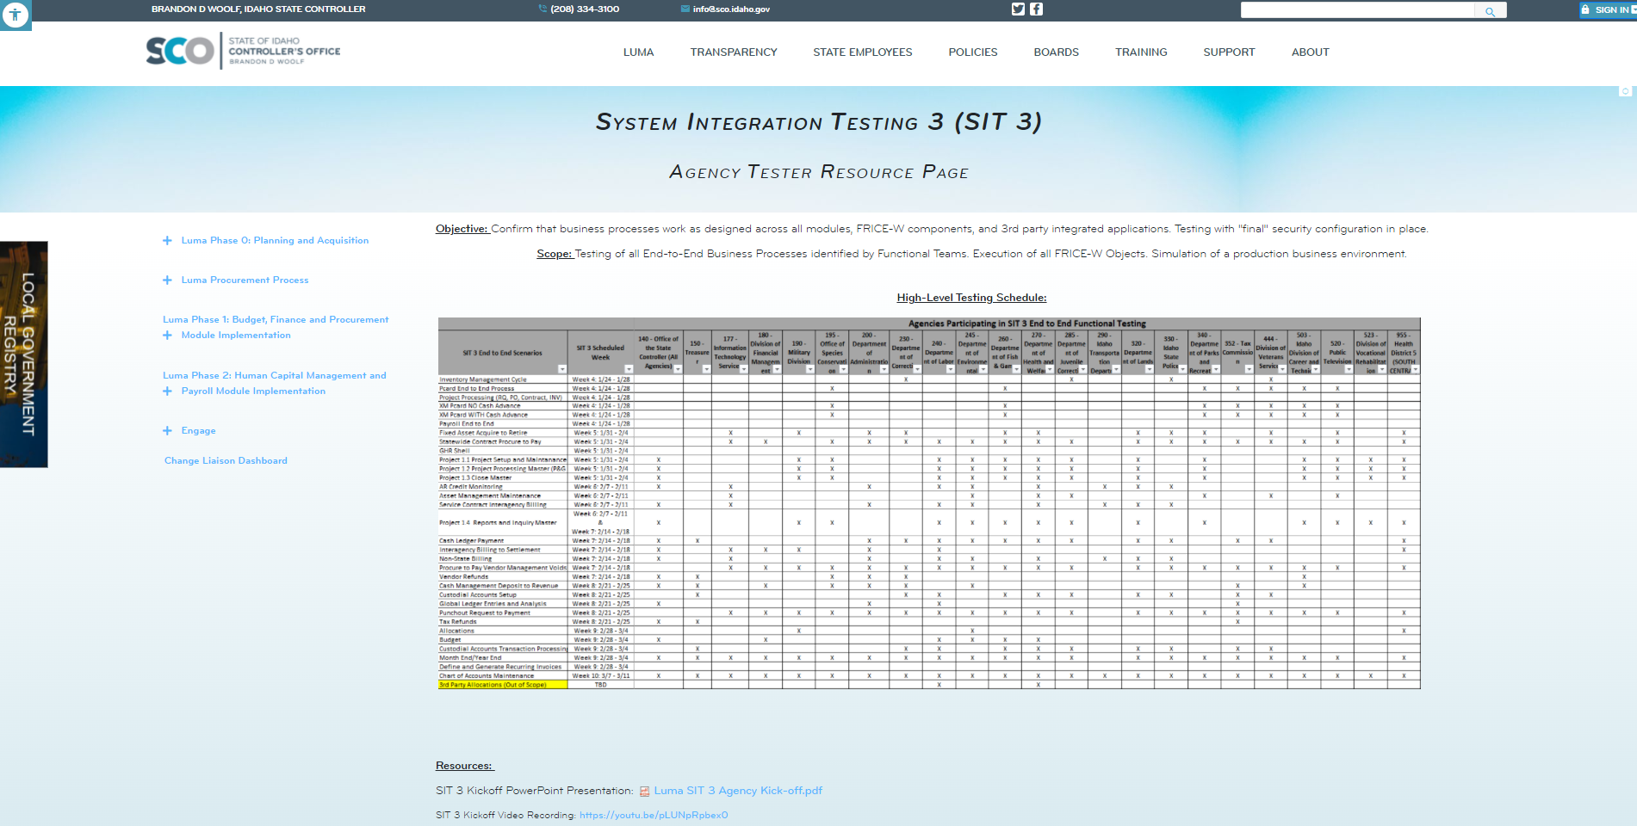
SIT 3 Webpage
System Integration Testing 3 (idaho.gov)

Slide 11
Training on the Horizon
Projects & Grants
Training
Training Instructors

Slide 12
Training on the Horizon
Projects & Grants
Training
Training is under development and will begin February 1st and will run until February 18th for agencies that will use Luma Projects and Grants functionality.
Training sessions will be conducted virtually and we intend to run sessions concurrently.

Slide 13
Training on the Horizon
Projects & Grants
Training
Training Instructors

Slide 14
Training on the Horizon
Training Instructors
Job Functions:
Deliver training of the Luma System to Finance and/or Procurement employees within the State of Idaho
Educate end-users on system applications
Educate end-users on laws, rules, and policies that pertain to the Luma system modules
Maintain accuracy of data in the training environment
Review developed training materials
Keep apprised of system enhancements requiring training or documentation updates
Minimum Qualifications:
Prior training knowledge or experience
Excellent Customer Service Skills
Ability to present information in a clear and concise manner for individual and group trainings
Strong problem-solving skills to resolve issues that come up during training sessions
Excellent written and verbal communication skills
Luma Training Instructor | Job Details tab | Career Pages (governmentjobs.com)

Slide 15
Luma Phase 2 Update

Slide 16
JUL
AUG
SEP
OCT
NOV
DEC
JAN
FEB
MAR
APR
MAY
JUN
JUL
AUG
SEP
OCT
NOV
DEC
→
Infor Orientations
50+ BPR sessions
P2 Scope
Defined
Go Live
Infor 7.2 WFM
Multi-Tenant
Government
Payroll/Time
Compare 1
2
3
Jan 10
Phase 2
Schedule
Phase 2 Luma Base Configure
Using requirements, process maps, user stories and functional roles, Deloitte will build the three Phase 2 components of Luma (HR, Payroll, and Time (WFM)) with input from
Amber’s Core Team (Payroll and Time (WFM)) and
Ashleigh’s Core Team (HR)
No Showstoppers
Create Workarounds
Jan 18, 2022
Monitor
Configuration Architects
“Knowledge Transfer”
Configuration
Workshops
2,482
User Stories
(current count)
Sprint 1
Sprint 2
Sprint 3
Scenario Testing
User Story Integration
End to End
Agency Life Cycles
Employee Life Cycles
User Acceptance Testing
End
User
Training
User Validation of Luma Functions
Early Phase 1, technical information
gathering, surveys, and analysis
Practice Conversion
Conversion Building
Interface Building
Interface Testing
Get End User Needs/Change Impacts
End User Training Developed
Training Tested
SCOPE MANAGEMENT
QUALITY ASSURANCE
IMPLEMENTATION READINESS
OPERATE →

Slide 17
Luma Phase 2 Activities

Slide 18
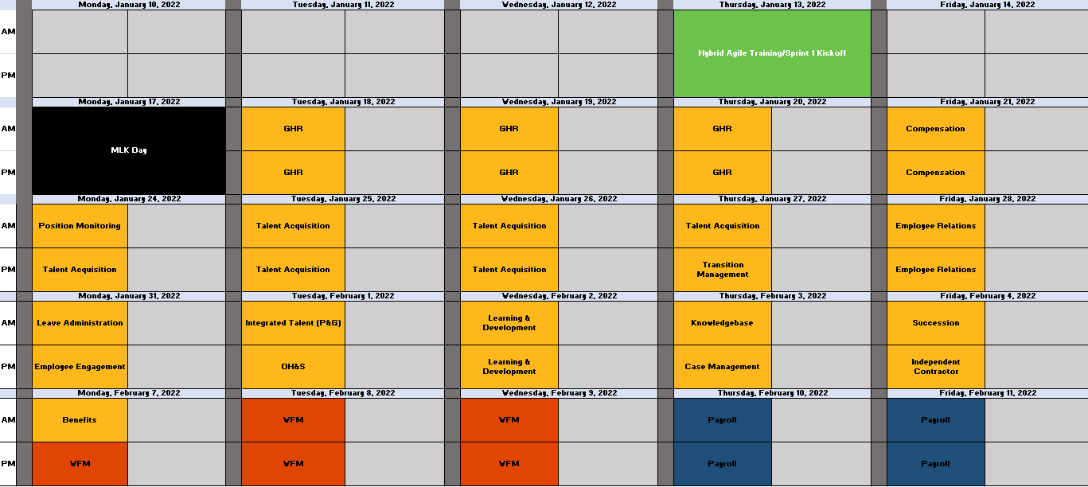
Sprints
Sprints are time-boxed, iterative, unit tests of software functionality to confirm it supports future state business processes defined in Luma Print.

Slide 19
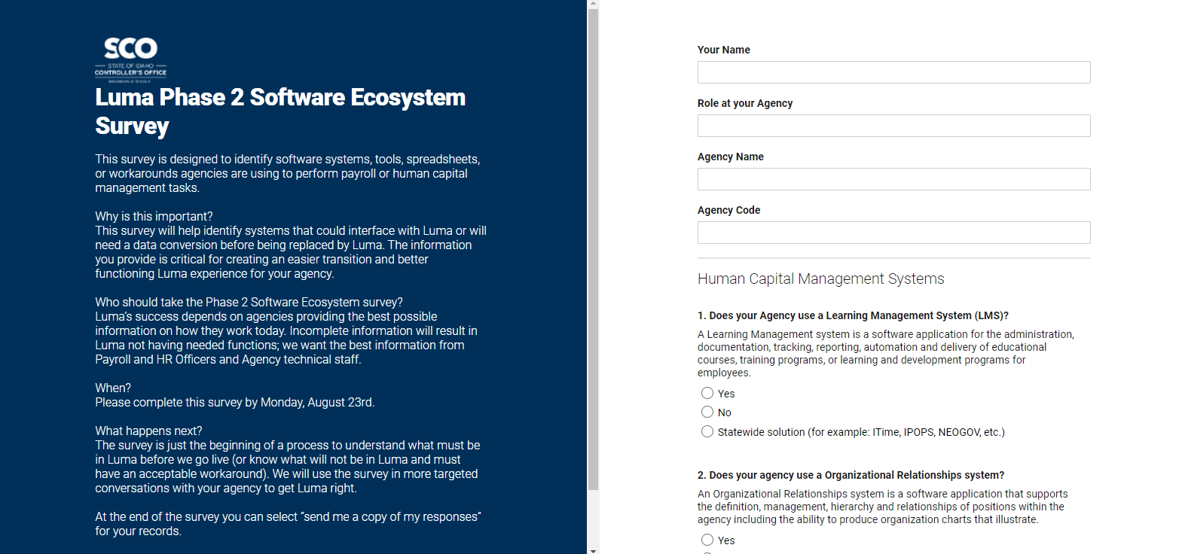
Ecosystem
The Luma Phase 2 team has gone through and consolidated the responses from the Ecosystem Survey and our internal FRICE list into one list. Your Agency Advocate will begin reaching out in the coming weeks to schedule meetings with your agency for these FRICE items.

Slide 20
Change Readiness Assessment
Change Readiness describes how ready and able impacted stakeholders are to adopt new business processes and system changes across several key areas.
A Change Readiness Assessment (CRA) is an analysis designed to capture a snapshot, a moment in time, which identifies areas of readiness and addresses any gaps.
Execution:
A random selection of state employees will receive a request to complete a survey with questions targeting the readiness for Luma. The same survey questions will be administered two additional times prior to go-live.
The OCM team will analyze the results from survey-to-survey to identify areas of the State that need attention, prioritize and address those concerns, and report results to project leadership as needed. The surveys provide opportunities to engage insights from the State’s Stakeholders multiple times to help meet the diverse needs of the Luma project.

Slide 21
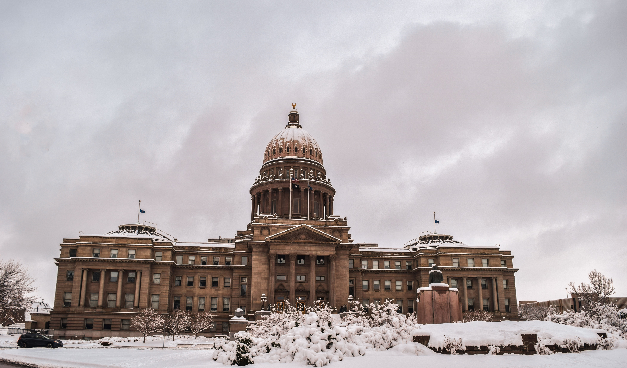
Leadership Alignment Meetings

Slide 22
Leadership Alignment Meetings
Controller Woolf, Chief Deputy Controller Josh Whitworth, and the Agency Advocates have been conducting one on one meetings with Agency Directors to discuss the relationship between their agency and the Luma Project as well as a path forward to go-live.
Agencies that have been met with:
DEQ
DHW
IDFG
IIC
Tax
PERSI
IDJC

Slide 23
Engagement Opportunities

Slide 24
Engagement Opportunities
Upcoming engagement opportunities to learn more about Luma. Please help us spread the word!
Type of Engagement | Date | Time | Topic
January Procurement Learning Lab Option # 1 | January 11th | 2:00 pm | Contract Concepts
January Procurement Learning Lab Option # 2 | January 13th | 10:00 am | Contract Concepts
Luma Showcase | January 18th | 10:00 am | Overview of Sustainment & End-User Training
Luma Showcase | January 20th | 1:00 pm | Overview of Sustainment & End-User Training
January Finance Learning Lab Option # 1 | January 25th | 2:00 pm | Asset Management
January Finance Learning Lab Option # 2 | January 27th | 10:00 am | Asset Management
Luma Module Showcase #1 | February 2nd | 10:00 am | Accounts Payable
Luma Module Showcase #2 | February 2nd | 1:00 pm | Contract Management

Slide 25
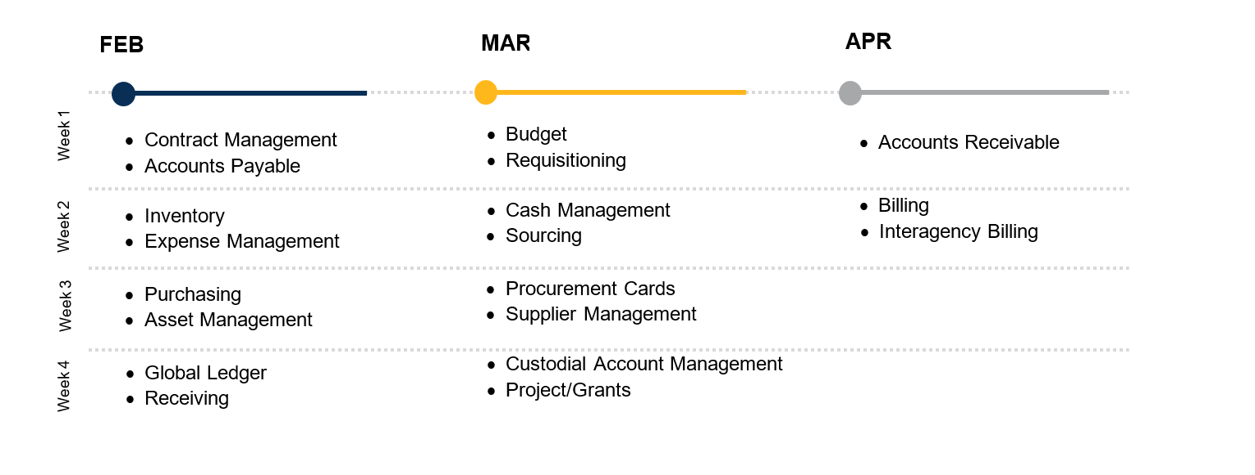
Luma Module Showcases
The Luma Module Showcases are module-specific (e.g. asset management, accounts payable, sourcing). The showcases drill down into changes from current state to the future state, discussing the changes, benefits, and future process flows.

Slide 26
Know Do Share Report
(K.D.S.R.)

Slide 27
Phase 1 K.D.S.R.
KNOW
DO
SHARE
REPORT
Read Luma Project news and updates in this column.
Meet with employees and leadership in your agency to discuss these messages or action items.
Please share this information or engagement opportunities with your Agency
Report feedback to the project team or complete action items the Luma project team is requesting from your agency.
Phase 1 Go-live: Phase 1 of the Luma Project will go live on July 1st, 2022 with the Finance and Procurement modules.
SIT 3: We held our SIT 3 kickoff with agencies on 1/11. Full testing schedules for agencies will be posted to the SIT 3 webpage on 1/18.
Projects & Grants Training: This training will begin on 2/1 and run until 2/18.
FRICE-W Validation Session
Luma Roles
Approval Workflows
Procurement Configuration Workbook Update & Validation
Custodial Account Management (CAM) Setup
Payroll Crosswalk & Default Workbook Updates (Ongoing)
Projects & Grants Training & Sandbox
All Upcoming Engagement Opportunities:
Luma Procurement Learning Lab
Luma Showcase
Luma Finance Learning Lab
Luma Module Showcase
Luma YouTube Channel: Luma - YouTube
Webpage Links:
Change Liaison Dashboard (idaho.gov)
EventsCalendar (idaho.gov)
System Integration Testing 3 (idaho.gov)
Internal Meetings: Please let us know if you have upcoming internal meetings that we can present to your staff! We want every state employee to know about the Luma, the changes coming, and the exciting benefits of a modern system.
Projects & Grants Training: If you have not already done so, let your Agency Advocate know who will be in the upcoming training.
January 12th, 2021

Slide 28
Phase 2 K.D.S.R.
KNOW
DO
SHARE
REPORT
Read Luma Project news and updates in this column.
Meet with employees and leadership in your agency to discuss these messages or action items.
Please share this information or engagement opportunities with your Agency
Report feedback to the project team or complete action items the Luma project team is requesting from your agency.
Phase 2 Go-live: Phase 2 of the Luma project will go live with Workforce Management/Time in December of 2022 and Payroll as well as Human Capital Management on January 1st, 2023.
Sprints:
Sprints are time-boxed, iterative, unit tests of software functionality to confirm it supports future state business processes defined in Luma Print. Sprint 1 sessions will run from 1/18 to 2/11.
Phase 2 CRA Measurement 1: Agency HR & Payroll personnel should be on the lookout for communication from our team conducting the first Change Readiness Assessment Measurement for Phase 2.
Ecosystem Survey Follow-up: Please be on the lookout for meeting requests from your Agency Advocate.
Phase 2 Luma Webpages:
EventsCalendar (idaho.gov)
BPR Webpage: Luma Phase 2 Business Process Redesign (idaho.gov)
Payroll: Luma Payroll Module (idaho.gov)
Human Capital Management: Luma Human Capital Management (idaho.gov)
Internal Meetings: Please let us know if you have an upcoming internal meetings that we can present to your staff! We want every state employee to know about the Luma, the changes coming, and exciting benefits of a modern system.
January 12th, 2021

Slide 29
Key Takeaways

Slide 30
Thank You!
Sheena Coles
SColes@sco.Idaho.gov
208-334-3100
Alex Doench
adoench@sco.Idaho.gov
208-332-8841
Tina Fuller tfuller@sco.Idaho.gov 208-332-8867
Chris Lehosit clehosit@sco.Idaho.gov 208-332-8887
Elijah Stearns
estearns@sco.idaho.gov 208-332-8871
Danielle Blackmer dblackmer@sco.Idaho.gov
208-332-8868

