Slide 1





Change Liaison Meeting
February 2nd, 2021

Slide 2
Welcome!
Thank you for being here!
Expectations:
  Please give presenters your full attention.
  Please utilize the chat functionality (bottom right) to ask questions, or wait until the end of the presentation to come off of mute and ask.
  This meeting is being recorded and will be provided in the follow-up email.

Slide 3

Phase 1 Update and Timeline
Phase 1 Activities
  SIT 3
  Agency Dossier
Phase 2 Update and Timeline
Phase 2 Activities
  Change Readiness Assessment 1
  Interface / Conversion Meetings
Engagement Opportunities
Training Instructors
Key Takeaways
AGENDA

Slide 4
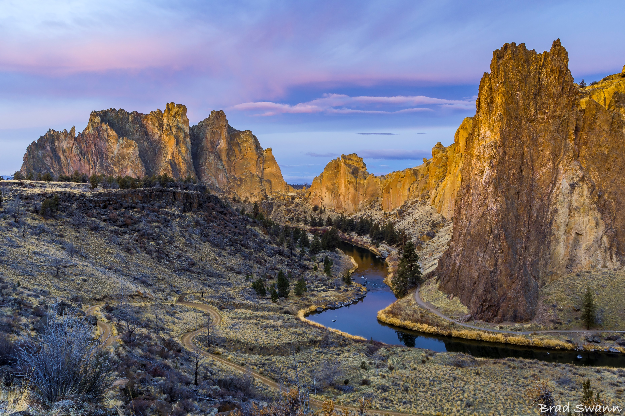
Luma Phase 1 Update

Slide 5
Phase 1 Enhanced Timeline (1 of 2)
Activities / Tasks | 2022
 | Jan |  |  |  | Feb | Feb |  |  | Mar | Mar |  |  | Apr | Apr |  |  |  | May |  |  |  | Jun | Jun |  |  | Jul
 | 3 | 10 | 17 | 24 | 31 | 7 | 14 | 21 | 28 | 7 | 14 | 21 | 28 | 4 | 11 | 18 | 25 | 2 | 9 | 16 | 23 | 30 | 6 | 13 | 20 | 27
SIT 3 (End to End Testing)
SIT 3 Base Testing
SIT 3 Open Business Process Issues
SIT 3 P&G
Non-SIT 3 Agency General P&G Education
Agency Project Balances
Agency Education Effort on Project Balance Definition
Agency Calculation of Project Balances
Agency Project Balances loaded
Script Execution
SIT 3 CAM
General CAM Education
Agency CAM Balances
Agency CAM Balances Education
Agency CAM Balances Calculated
Agency CAM Balances Loaded
Script Execution
SIT 3 FRICE Outliers
Outstanding FRICE Item Identified
FRICE Functional and Technical Specs
FRICE Items Unit Tested
Script Execution
SIT 3 Allocations (SSG)
DHW and DOL FRICE Items Identified
DHW and DOL FRICE Functional and Technical Specs
DHW and DOL FRICE Items Unit Tested
Script Execution
SIT 3 Month-End and Year-End Close Process
Year-End Requirements
Year-End Processes Documented
Year-End Testing Environment Prep
Year-End Test Execution
SIT3 Testing Extended
Prioritized and sequenced System Integration Test 3 scenarios to comprehensively test critical functionality, end-to-end.
Enhanced to include multiple cycles of SIT 3 to incrementally cover functionality, just-in-time, applicable to:
Project & Grants (P&G)
Custodial Account Management (CAM)
FRICE-W objects
Month-End and Year-End Processing
Allocations (SSG)

Slide 6
Phase 1 Enhanced Timeline (2 of 2)
Activities / Tasks | 2022
 | Jan |  |  |  |  | Feb |  |  |  | Mar |  |  |  | Apr |  |  |  | May |  |  |  |  | Jun
 | 3 | 10 | 17 | 24 | 31 | 7 | 14 | 21 | 28 | 7 | 14 | 21 | 28 | 4 | 11 | 18 | 25 | 2 | 9 | 16 | 23 | 30 | 6 | 13 | 20 | 27
UAT Testing
Planning
Execution
Cutover
Cutover Planning / Design
Mock Cutovers
Mock Cutover #1
Mock Cutover #2
Go-Live Cutover Execution
End User Training
Training Material Development
Training Logistics / End-User Enrollment
Recruitment of Trainers
Trainer Onboarding
Train the Trainer
Training Execution
Organizational Change Management
Agency Communications
The Luma team is working through a plan to make UAT meaningful for agencies to test the Luma ERP.
The SIT3 extension will not impact End-User Training execution.

Slide 7

Luma Phase 1 Activities

Slide 8
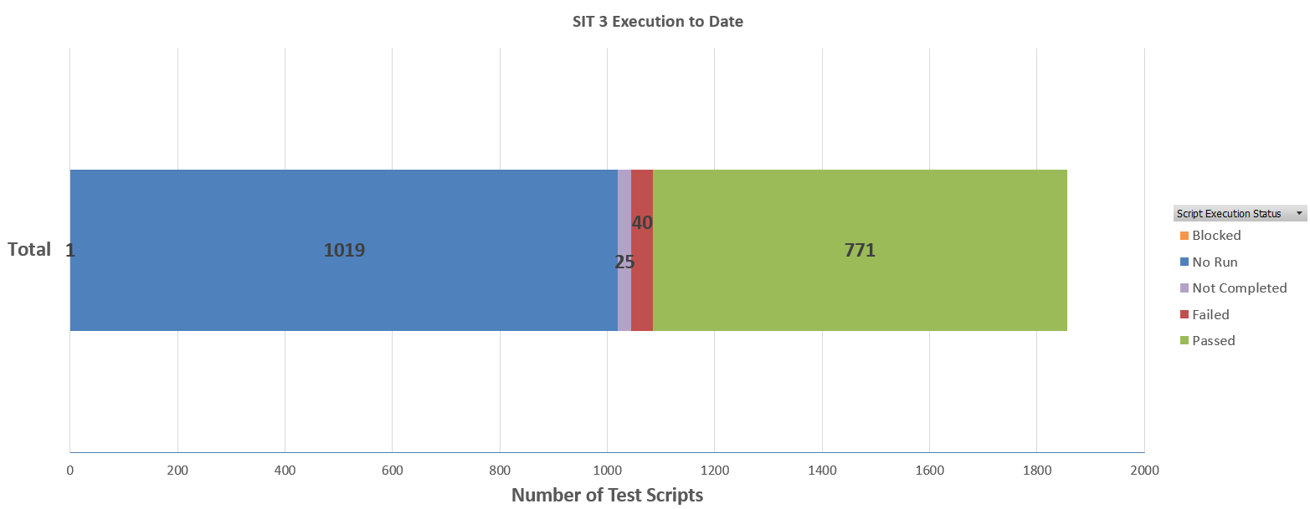
SIT3
Thank you all SIT3 Agency Testers!
Testing has allowed us to find functional and technical issues and fixes, which it why we test. Please continue to be on the look-out for any changes or schedule adjustments.

Slide 9
Agency Dossier
The Phase 1 dossier will be a regularly updated, agency-specific document that:
Lists any outstanding items to be completed by the agency.
Their achievements to date.
Agency identified issues or barriers to go-live.
The Luma OCM team is getting close to finalizing the Dossier Template and will role them out to agencies as we complete them.
As the Luma project is constantly evolving and activities by the project team or other agencies may required adjustments to timelines, we ask for your understanding that this document will be constantly evolving and currently defined timelines may require adjustment.

Slide 10

Luma Phase 2 Update

Slide 11
JUL
AUG
SEP
OCT
NOV
DEC
JAN
FEB
MAR
APR
MAY
JUN
JUL
AUG
SEP
OCT
NOV
DEC
→
Infor Orientations
50+ BPR sessions
P2 Scope
Defined
Go Live
Infor 7.2 WFM
Multi-Tenant
Government
Feb 1, 2022
Payroll/Time
Compare 1
2
3
Phase 2 Schedule
Update: Feb 1, 2022
Sprints
started
1/18
Phase 2 Luma Base Configure
Using requirements, process maps, user stories and functional roles, Deloitte will build the three Phase 2 components of Luma (HR, Payroll, and Time (WFM)) with input from
Amber’s Core Team (Payroll and Time (WFM)) and
Ashleigh’s Core Team (HR)
No Showstoppers
Create Workarounds
Monitor
Configuration
Workshops
Sprint 1
Sprint 2
Sprint 3
Scenario Testing
User Story Integration
End to End
Agency Life Cycles
Employee Life Cycles
User Acceptance Testing
End
User
Training
User Validation of Luma Functions
Early Phase 1, technical information
gathering, surveys, and analysis
Delays
Conversion Building
Practice Conversion
Interface Building
Interface Testing
Get End User Needs/Change Impacts
End User Training Developed
Training Tested
SCOPE MANAGEMENT
QUALITY ASSURANCE
IMPLEMENTATION READINESS
OPERATE →

Slide 12

Phase 2 Sprint 1
Phase 2 Sprints are recorded and can be viewed on the Luma YouTube Channel.
HERE

Slide 13
Luma Phase 2 Activities

Slide 14
Change Readiness Assessment – Measurement 1
Change Readiness describes how ready and able impacted stakeholders are to adopt new business processes and system changes across several key areas.
A Change Readiness Assessment (CRA) is an analysis designed to capture a snapshot, a moment in time, which identifies areas of readiness and addresses any gaps.
Execution:
A random selection of state employees will receive a request to complete a survey with questions targeting the readiness for Luma. The same survey questions will be administered two additional times prior to go-live.
The OCM team will analyze the results from survey-to-survey to identify areas of the State that need attention, prioritize and address those concerns, and report results to project leadership as needed. The surveys provide opportunities to engage insights from the State’s Stakeholders multiple times to help meet the diverse needs of the Luma project.

Slide 15
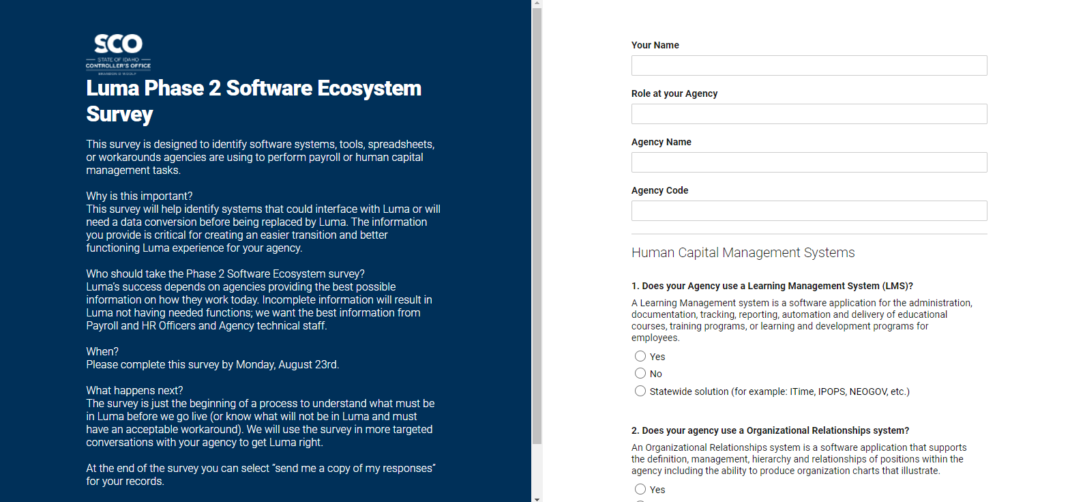
Phase 2 Interface and Data Conversion Meetings
The Luma Phase 2 team has gone through and consolidated the responses from the Ecosystem Survey and our internal FRICE list into one list. Your Agency Advocate will begin reaching out in the coming weeks to schedule meetings with your agency for these FRICE items.

Slide 16

Engagement Opportunities

Slide 17
Engagement Opportunities
Upcoming engagement opportunities to learn more about Luma. Please help us spread the word!
Type of Engagement | Date | Time | Topic
Training Learning Lab | February 8th | 2:00 pm | Procurement Training Program Overview
Training Learning Lab | February 10th | 10:00 am | Finance Training Program Overview
Luma Showcase Option #1 | February 15th | 1:00pm | Reporting
Luma Showcase Option #2 | February 17th | 1:00pm | Reporting
Finance Learning Lab | February 22nd | 2:00 pm | Accounts Receivable & Billing
Finance Learning Lab | February 24th | 10:00 am | Accounts Payable
Procurement Learning Lab Option # 1 | March 8th | 2:00 pm | Contract Demonstration
Procurement Learning Lab Option # 2 | March 10th | 10:00 am | Contract Demonstration

Slide 18
Luma Training Instructors

Slide 19


Training Instructors
Job Functions:
Deliver training of the Luma System to Finance and/or Procurement employees within the State of Idaho
Educate end-users on system applications
Educate end-users on laws, rules, and policies that pertain to the Luma system modules
Maintain accuracy of data in the training environment
Review developed training materials
Keep apprised of system enhancements requiring training or documentation updates
Minimum Qualifications:
Prior training knowledge or experience
Excellent Customer Service Skills
Ability to present information in a clear and concise manner for individual and group trainings
Strong problem-solving skills to resolve issues that come up during training sessions
Excellent written and verbal communication skills
Please email cover letter and resume to lumatraining@sco.Idaho.gov

Slide 20
How does PERSI Retirement work?
They are rendering a service in the capacity of an independent business, trade or profession. This is because they would not be an “employee.” I.C. § 59-1302(14)(B)(a).
They can continue to receive their PERSI benefit, and work less than 20 hours a week. They can work for as long as they want as long as it is less than 20 hours a week.
They can continue to receive their PERSI benefit, and work full-time as long as they work less than 5 months. Just before 5 months they must stop and have a 30 days (1 month) break in service. After the 30 days break they can be re-hired again under these same rules.
They can suspend their PERSI benefit prior to starting work, and work as many hours and as long as needed. They can then reinstate their PERSI benefit after separation without any penalty.
This is also a link for further information from PERSI. https://www.persi.idaho.gov/docs/retirees/Working-After-Retirement.pdf

Slide 21
Luma Training Timeline
2022
JAN | FEB | MAR | APR | MAY | JUN | JUL | AUG | SEP | OCT | NOV | DEC
Training Instructor Hiring
Instructor Training
End User Training
Phase 2
End User Training
Phase 1
Sustainment Activities

Slide 22
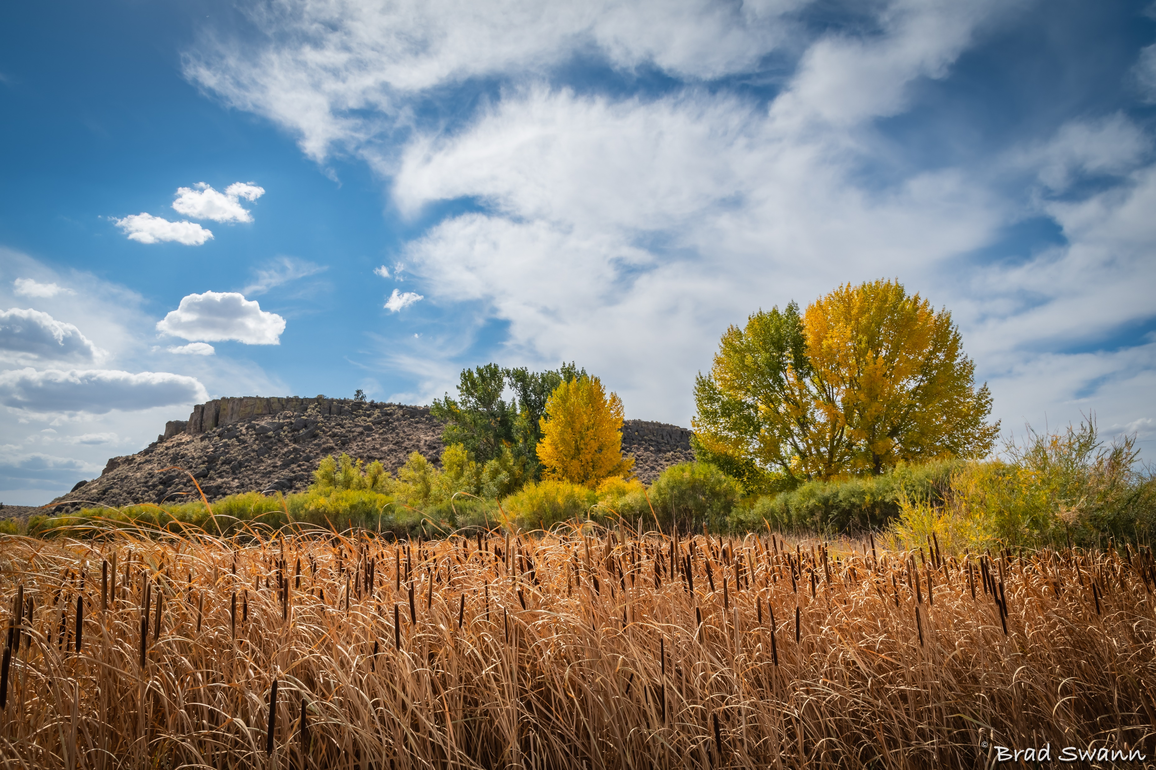
Key Takeaways

Slide 23
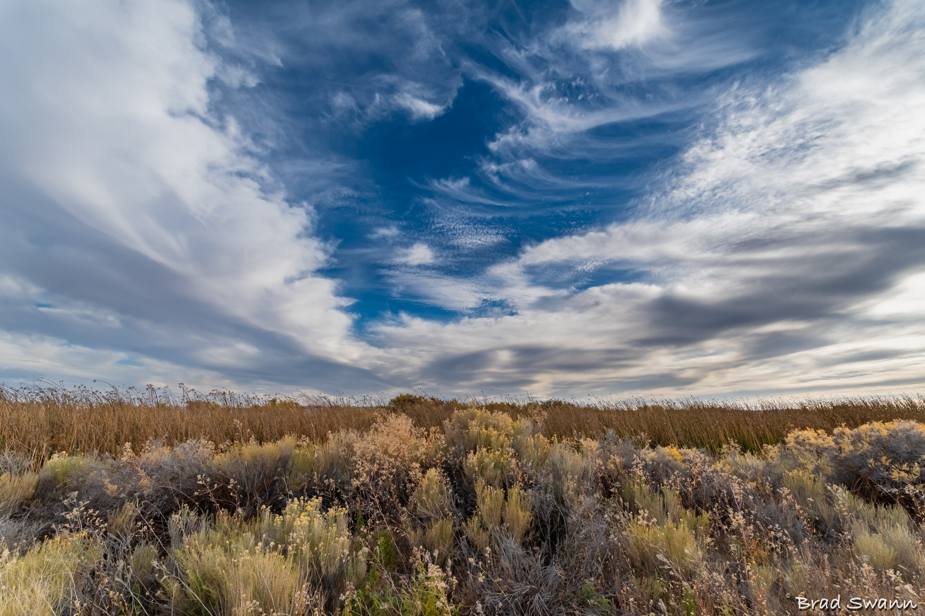
Thank You!
Sheena Coles
SColes@sco.Idaho.gov
208-334-3100
Alex Doench
adoench@sco.Idaho.gov
208-332-8841
Tina Fuller
tfuller@sco.Idaho.gov
208-332-8867
Chris Lehosit
clehosit@sco.Idaho.gov
208-332-8887
Elijah Stearns
estearns@sco.idaho.gov
208-332-8871
Danielle Stevens
dstevens@sco.Idaho.gov
208-332-8868

