Slide 1

Monthly Change Liaison Meeting
December 2022

Slide 2
Introduction
Thank you for being here!
Expectations:
  Please give the presenters your full attention.
  Please utilize the chat functionality (bottom right) to ask questions, or wait until the end of the presentation to come off of mute and ask.
  This meeting is being recorded and will be provided in the follow-up email.
2

Slide 3

Agenda
Leadership Accelerator Recap
Introduction of Change Liaison Communications Toolkit
Outstanding Workbook Requests
What to Have On Your Radar
Luma Training Update
3

Slide 4

Leadership Accelerator Recap
4

Slide 5

Our Journey Today (and Beyond)
01
Revisiting Luma and the Case for Change
Overview of Luma’s case for change, and associated benefits for the State of Idaho.
02
Luma is Happening
Review of proposed pathway to Go-Live and how we are going to support you and your employees along the journey.
03
Together…Is the Only Way to Success
What support looks like and why your visible actions are critical for success.
04
Conclusion
Highlights next steps, including post-session materials and delivery of Agency Luma updates.

Slide 6



Road to Go-Live (Leaders)
Dec | Jan | Feb | Mar | Apr | May | Jun | Jul
FSM Go-Live
July 1st
HCM Go-Live
June 11th
Supplier Portal Go-Live
May 1st
Monitor and Support Training
Participation
Incorporate Luma Labs into Your Planning
Engage with Operational Readiness Toolkit & Go-Live Checklist
Plan Quarterly Schedules to Prepare for Training Registration
Encourage Participation in Engagement Activities
Encourage Change Readiness Survey Completion Jan
Encourage Change Readiness Survey Completion May
Present Luma Accelerator to Agencies Dec
* Dates subject to change
* Dates subject to change

Slide 7

How You Can Help
1 2 3 4 5 6
Encourage the sharing of change information.
Discuss “hidden” improvements.
Build confidence in the change process.
Level set expectations with your teams.
Champion the ‘One Idaho’ message.
Share and encourage use of available support resources.

Slide 8

“Change cannot be put on people. The best way to instill change is to do it with them. Create it with them.”
- Lisa Bodell, Author

Slide 9

Next Steps
01
Deliver Agency Accelerator; Deliver and Model the Message
After this meeting, a Leadership Accelerator toolkit with materials and instructions will be shared. Use these to provide a Luma Accelerator update to your employees.
02
Change Liaisons to Follow Agency Accelerator: Please Coordinate
Change Liaisons will be equipped with a communications toolkit, which will contain materials designed to reinforce and add to the Agency Update (#01 above). Please coordinate with them accordingly.
03
Details Coming Soon: Role Workshops, User Experience Simulations, and Luma Labs
Stay tuned of upcoming opportunities for employees to gain familiarity with the Luma system and encourage them to proactively engage with offerings to increase buy-in.
.

Slide 10




Resources
Have questions? Please contact or refer to the following:
Joshua Whitworth
Please contact directly with any questions, concerns and/or feedback.
Change Liaison
Each agency has an assigned Change Liaison who supports the project’s implementation.
Luma Leadership Accelerator Toolkit
Read and engage with the toolkit that is being released following this presentation and plan your individual agency Luma Accelerators.

Slide 11


Leadership Toolkit
What is the Leadership Toolkit?
All leaders who were invited to the Luma Leadership Accelerator received a toolkit. This toolkit was intended to support leaders in the asks that were requested of them during the Accelerator.
Why is this important to me as a Change Liaison?
You, our Change Liaisons were frequently referenced during the Accelerator as a resource to your agency leadership. Your familiarity with the tools in the toolkit can help your agency in spreading Luma project messaging.
How do I support my leader with their toolkit?
Like the Change Liaison toolkit, each item in the toolkit is accompanied with guidance on how to use it. Familiarize yourself with the toolkit and be proactive in reaching out to your agency leadership to spread messaging. Utilize your agency knowledge and consider how information is disseminated at your agency. That knowledge is powerful in growing Luma awareness.
2

Slide 12
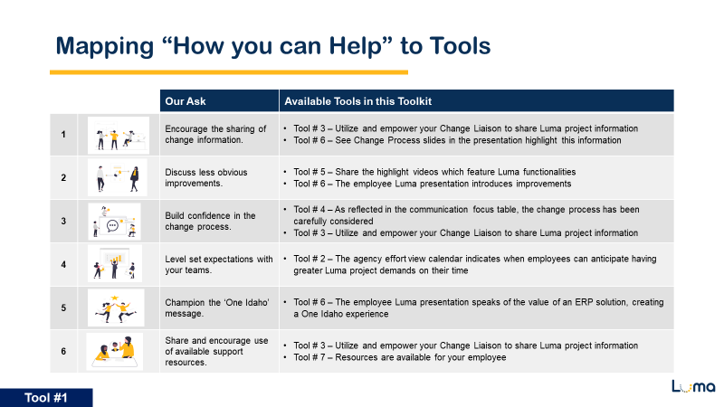
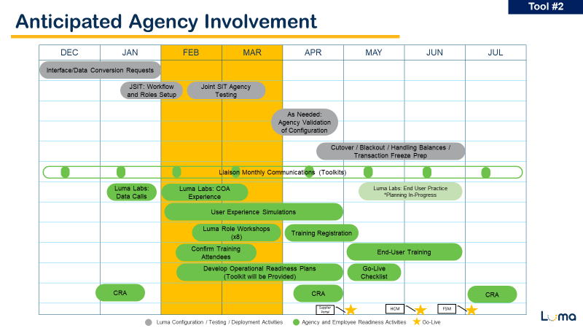
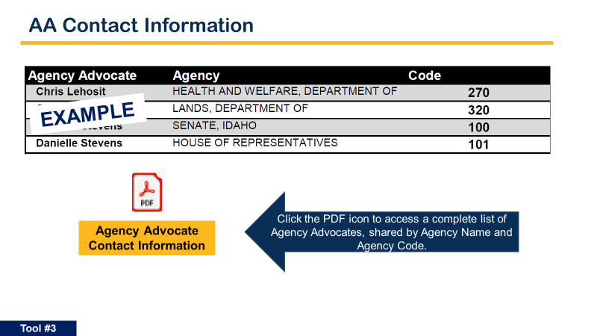
Reviewing Tools
1. Mapping “How you can Help” to Tools
Joshua Whitworth shared six asks to the leaders for their help in sharing about Luma to their agencies.
This tool maps those asks to particular tools in the Leadership toolkit that are helpful in completing those asks.
Please make yourself familiar with this information in case your leadership has questions. It is likely you’re aware of most of it already!
2. Anticipated Agency Involvement
This tool was shared with agency leaders to help in their planning efforts.
If you receive any questions or feedback from this schedule, please share it with your Agency Advocate.
3. Anticipated Agency Involvement
This tool was shared with agency leaders to help them connect with their Agency Advocate/Change Liaison in case they did not know who those individuals were.
If you have not introduced yourself to your agency as their Change Liaison, please introduce yourself ASAP!

Slide 13
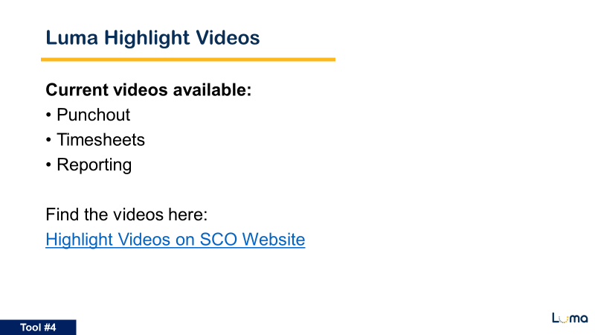

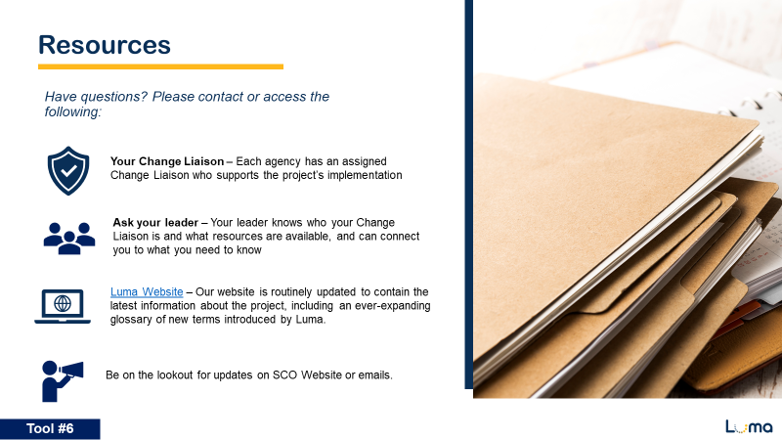
Reviewing Tools
4. Luma Highlight Videos
This tool amplifies the Highlight videos, which is also in the Change Liaison toolkit.
Please work with your agency leadership in making sure your colleagues are aware of these videos.
5. Luma Accelerator
This is the Employee Accelerator presentation your leadership has been asked to share with your agency.
As appropriate, please work with your leadership to schedule and facilitate this presentation to your colleagues.
6. Resources
This tool highlights the available resources.
Note that you are a very important resource!

Slide 14

Change Liaison
Communications Toolkit
9

Slide 15

Active/Outstanding
Workbook Requests
10

Slide 16
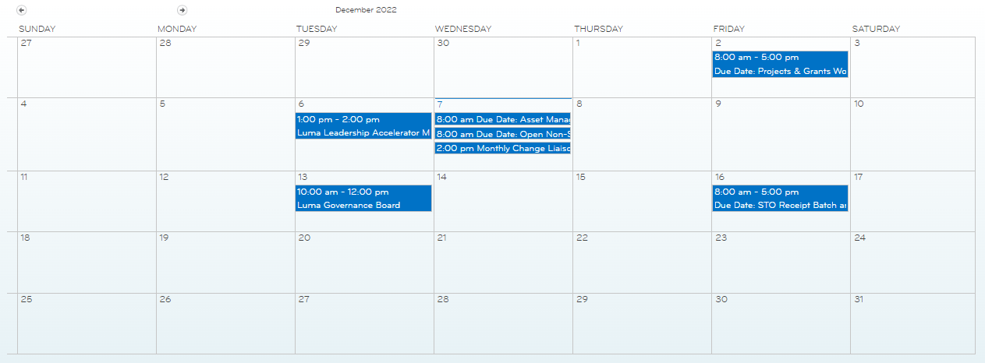
Active/Outstanding
Workbook Requests
Workbooks:
Asset Management Configuration – Due 11/16
Projects & Grants
- Due 12/2
Asset Management Conversion File Request – Due 12/7
Open Non-State Accounts Receivable Workbook – Due 12/7
STO Receipt Batch & Distribution Workbook
– Due 12/16
Change Liaison Dashboard (idaho.gov)
11

Slide 17

What to Have On Your Radar
12

Slide 18


What to Have On Your Radar
Conversion File Requests:
December 2022
Interface File Requests:
December 2022
Cash Allocation Code Workbook:
December 2022
Security Role/Workflow
Workbooks:
January 2023
Change Readiness Assessment:
January 2023
13

Slide 19

Luma Training
14

Slide 20
Thank You Beta Testers!
We wanted to take the time to thank everyone who has participated in the Beta Testing of our Training materials.
Since our kickoff on November 16th, agency Beta Testers have tested 23 reference guides.
Please continue to be on the lookout for the weekly updates from our Training team.
15

Slide 21

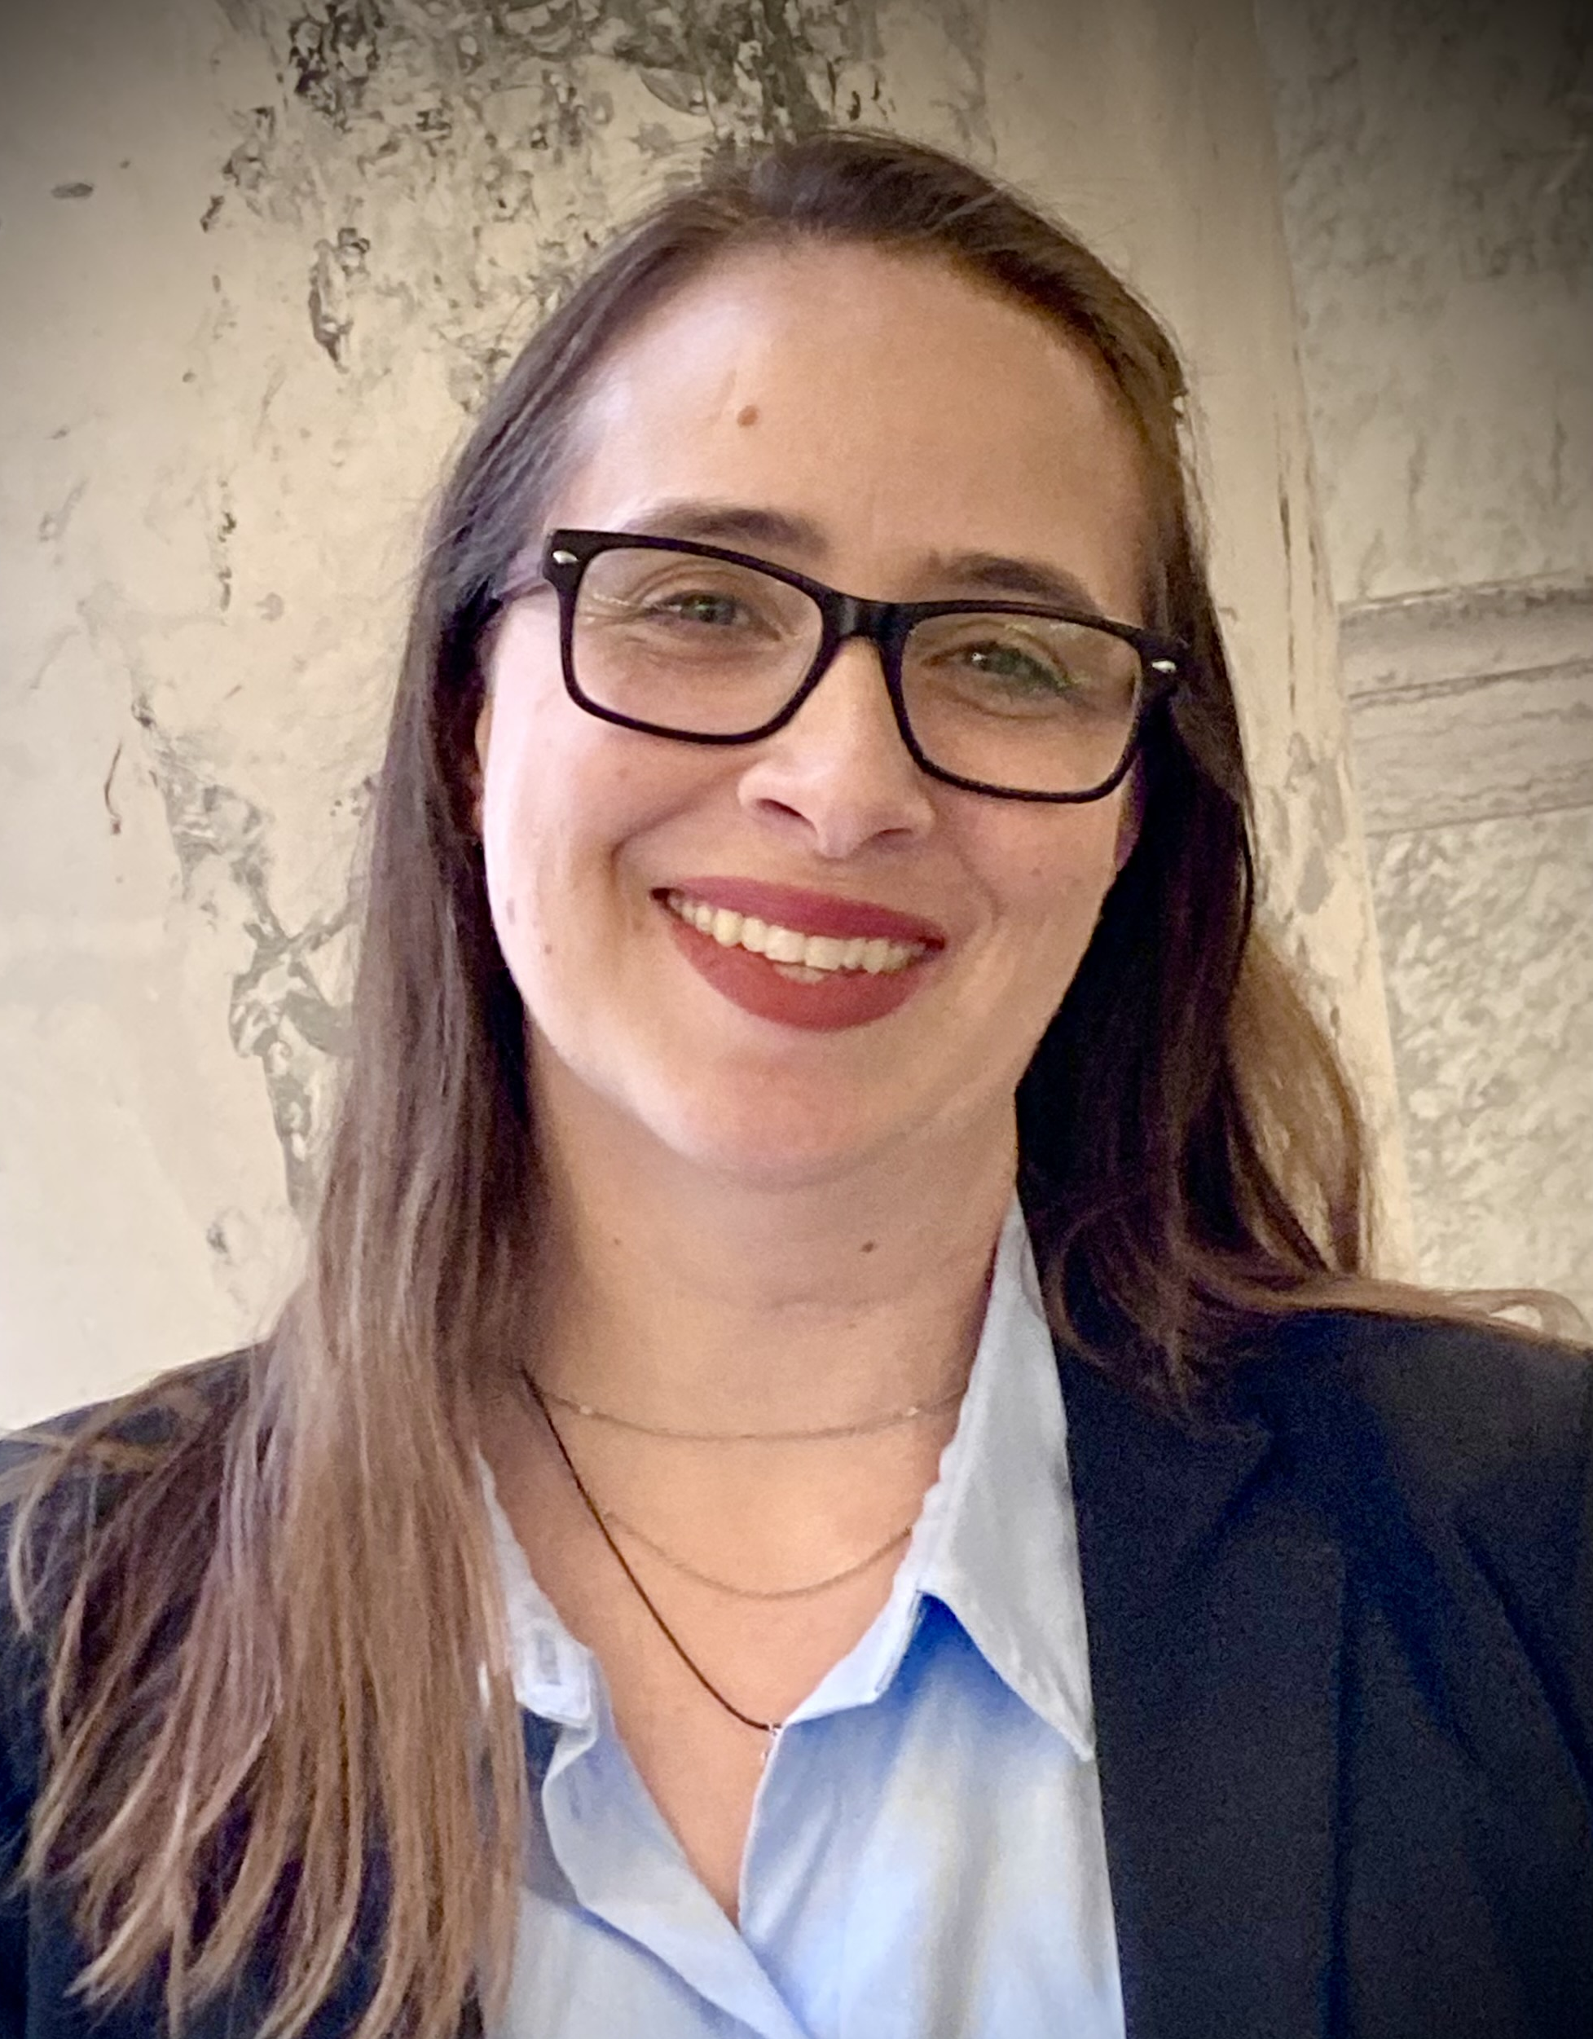


New Training Instructors
Leah Smith
Chere Hoover
Nick Busbee
Julie Hawk
16

Slide 22

Thank you!
Sheena Coles
SColes@sco.Idaho.gov
208-334-3100
Alex Doench
adoench@sco.Idaho.gov
208-332-8841
Danielle Stevens
dstevens@sco.Idaho.gov
208-332-8868
Chris Lehosit
clehosit@sco.Idaho.gov
208-332-8887
Krystal Griffith
kgriffith@sco.Idaho.gov
208-332-8861
Elijah Stearns
estearns@sco.Idaho.gov
208-332-8871
17

