Slide 1
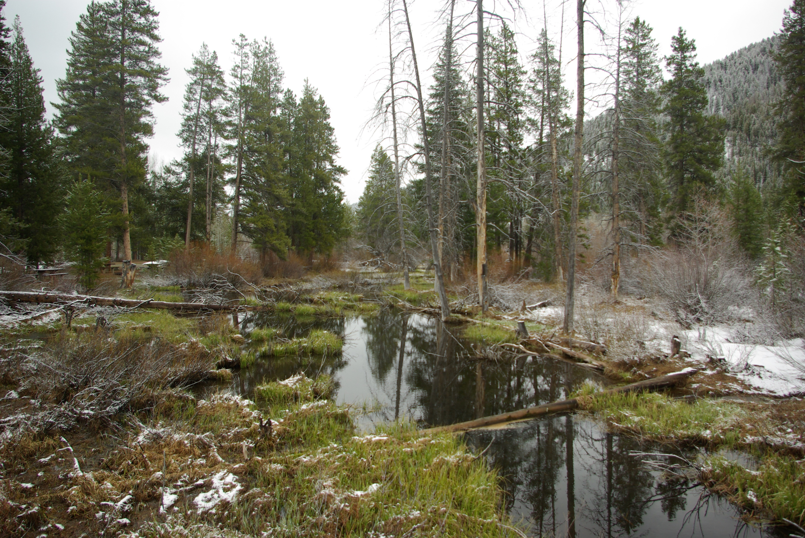
Change Liaison Meeting
December 1st, 2021

Slide 2
Welcome!
Thank you for being here!
Expectations:
Please give presenters your full attention.
Please utilize the chat functionality (bottom right) to ask questions, or wait until the end of the presentation to come off of mute and ask.
This meeting is being recorded and will be provided in the follow-up email.

Slide 3
Phase 1 Update
Phase 1 Activities
Phase 2 Update
Phase 2 Activities
Engagement Opportunities
Testimonials
Calendar
Phase 1 & 2 Know Do Share Reports (K.D.S.R.)
Key Takeaways
AGENDA

Slide 4
Luma Phase 1 Update

Slide 5
Phase 1 Timeline

Slide 6
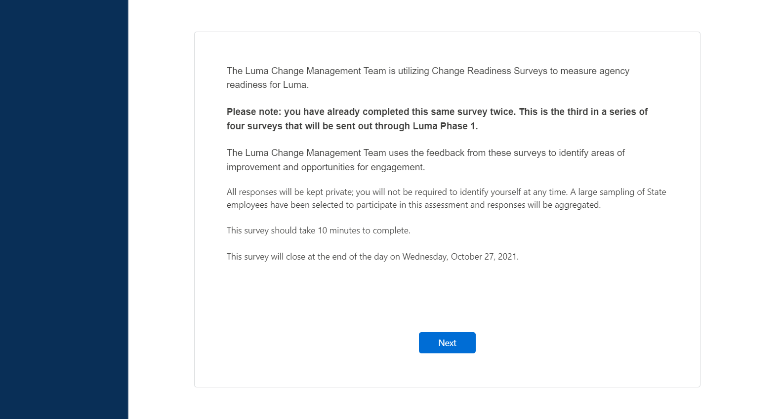
Change Readiness Assessment – Measurement 3 Results

Slide 7
Change Readiness Assessment – Measurement 3 Results
67%
Do not understand when the key milestones are happening.

Slide 8
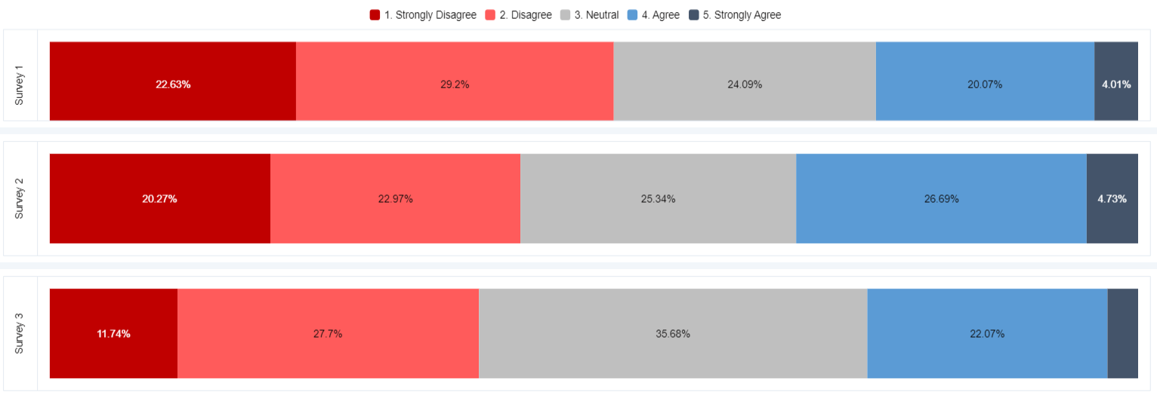
Change Readiness Assessment – Measurement 3 Results
75%
Are not aware of the steps needed to take to transition to the Luma project.

Slide 9
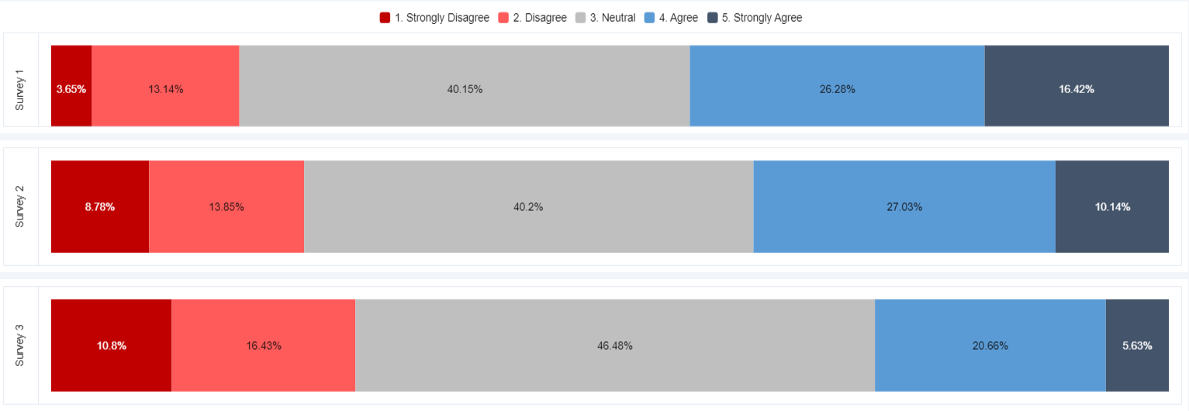
Change Readiness Assessment – Measurement 3 Results
74%
Do not agree that employees in their agencies are looking forward to using the Luma system.

Slide 10
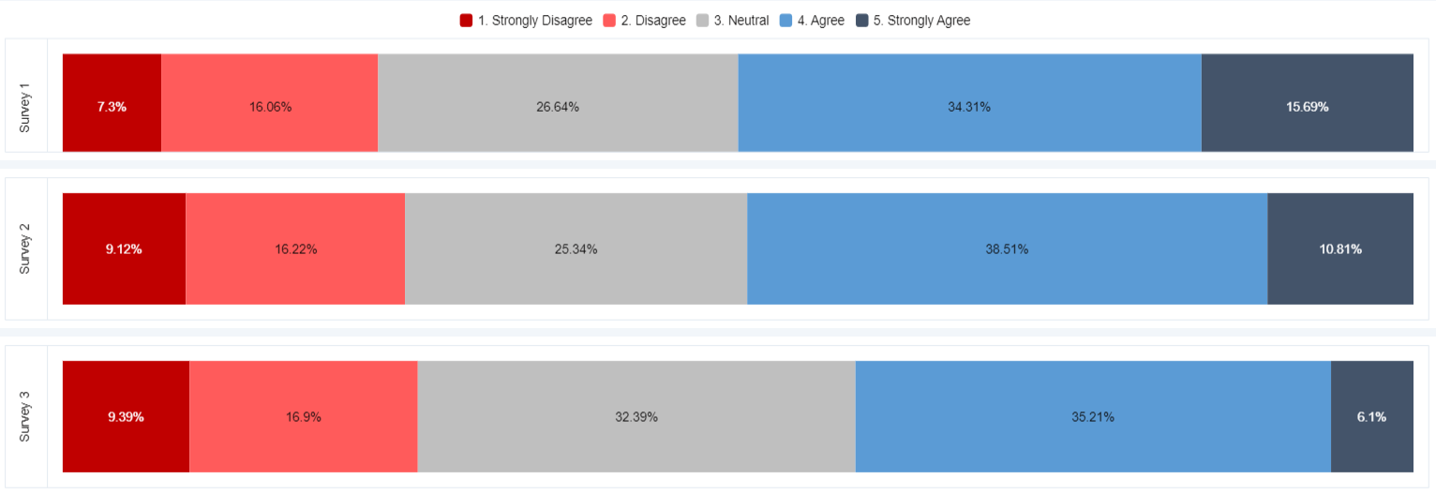
Change Readiness Assessment – Measurement 3 Results
59%
Do not think the communications about the Luma project have been effective, and easy to understand.

Slide 11
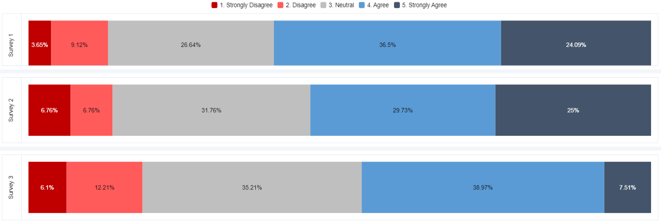
Change Readiness Assessment – Measurement 3 Results
54%
Do not believe the Luma project is transparent and inclusive.

Slide 12
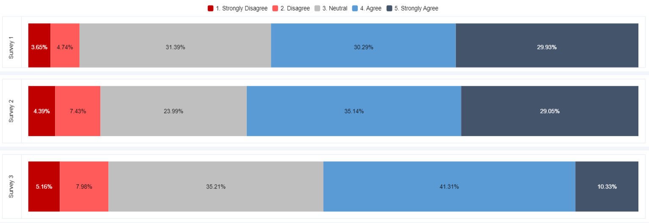
Change Readiness Assessment – Measurement 3 Results
48%
Do not think their agency’s perspectives have been considered in the design of the Luma project.

Slide 13
OCM Response to Feedback
Improve clarity and effectiveness of communications.
Build trust with the Luma team and decisions.
Understanding milestones.
Understanding steps needed to transition.
Understanding steps needed to transition.
Broadcasting benefits of Luma.

Slide 14
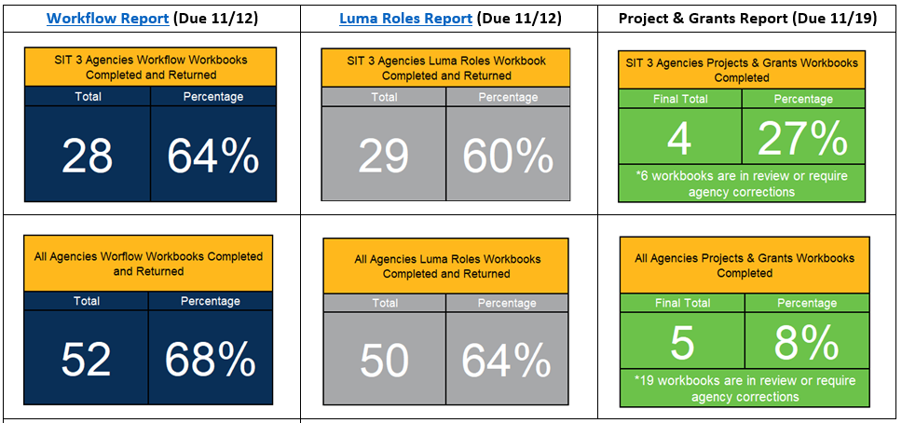
Outstanding Workbooks
All Outstanding Workbooks:
Approval Workflow
Luma Security Roles
Projects & Grants
COA Updates for SIT 3
Due by 12/3:
Default Workbook
Payroll Crosswalk Updates
System Default Strings

Slide 15
Update on Projects & Grants
The following is our plan to better educate agencies on Luma Projects and Grants between now and UAT:
Creation of a State resourced P&G SWAT team as an extension of the current Luma projects and grants team to support State agencies in the adoption of the projects and grants solution.
Development of an agency education program that teaches agencies the framework of the Luma projects and grants solution and the transactional business processes and reporting.
Creation of a project and grants “Sandbox” environment so agency personnel can expand their knowledge, skills, and abilities with the project and grants solution in a practice environment by entering projects, transacting against those projects, and creating reports based on project reporting requirements. The P&G SWAT team will support agencies as they use the “Sandbox” environment.
Agencies who will use Luma projects and grants functionality will need to do the following:
Identify the universe of projects and grants within their agency. This includes identifying personnel who have current project and grants roles, identification of current approval paths and associated business processes, etc.
Attend training courses that will foster an increased understanding of how the projects and grants solution will work and provide agency personnel with the knowledge of how to conduct daily business in Luma.
Assist the project team in the compilation of open project data for testing purposes, cut-over, and Go-Live.

Slide 16
Luma Phase 1 Activities

Slide 17
Agencies in SIT 3
100 - Senate
102 - Legislative Services Office
110 - Judicial Department
140 - Office of the State Controller
150 - Treasurer
177 - Information Technology Services
180 - Division of Financial Management
183 - PERSI (Public Employees Retirement System of Idaho)
185 - Idaho State Liquor Division
186 - State Insurance Fund
187 - Idaho Commission on Aging
189 - Commission for the Blind and Visually Impaired
190 - Military Division
195 - Office of Species Conservation
200 - Department of Administration
210 - Department of Agriculture
230 - Department of Correction
231 - Correctional Industries
240 - Department of Labor
245 - Department of Environmental Quality
260 - Department of Fish & Game
270 - Department of Health and Welfare
280 - Department of Insurance
285 - Department of Juvenile Corrections
290 - Idaho Transportation Department
300 - Industrial Commission
320 - Department of Lands
330 - Idaho State Police
340 - Department of Parks and Recreation
352 - Tax Commission
427 - Division of Occupational and Professional Licenses
440 - Idaho State Lottery Commission
444 - Division of Veterans Services
503 - Idaho Division of Career and Technical Education
512 - Boise State University
513 - Idaho State University
514 - University of Idaho
520 - Public Television
522 - Idaho State Historical Society
523 - Division of Vocational Rehabilitation
951 - Health District 1 (Panhandle)
952 - Health District 2 (NORTH CENTRAL)
953 - Health District 3
954 - Health District 4
955 - Health District 5 (SOUTH CENTRAL)
956 - Health District 6
957 - Health District 7

Slide 18
Upcoming SIT 3 Communications
Communication | Send Date
Email to Directors | Week of 11/29/21
SRA Save the Date | Week of 11/29/21
SIT 3 Roles & Identification of Testers | Week of 12/6/21
Identification of Testers | Week of 12/13/21
SRA Role Request | Week of 12/13/21
SIT 3 Pre-Training | Week of 12/13/21
SIT 3 Kickoff Invitations | Week of 12/13/21
Testing Schedule | Week of 12/20/21
Office Hours – Access to testing environment | Week of 1/3/22

Slide 19
Testing Sessions – Testing Support Line
The Test Management Team will host an all-day SIT Testing Support Line (WebEx Meeting)
Attendance is optional and SIT testers should only join if they have questions or issues regarding SIT Testing.
The Meeting Moderator will reach out to Test Management, Functional, or Technical Teams if they need additional help resolving an issue
Schedule:
Monday – Thursday
8:45 AM MT – 4:00 PM MT
Friday
9AM MT – 11 AM MT
Roles | Responsibilities | Staffing
Test Management Team (Meeting Moderators) | Field SIT Testing Questions/Issues and triage to support teams as necessary Be ready to answer any questions regarding ALM or Reporting | Minimum of 1 person always while meeting is in session
Functional Team Members | Be available to answer any questions regarding Infor, Scripts, or Data | On Call
Technical Team Members | Be available to answer any questions regarding Security/Access or FRICE-W defects | On Call

Slide 20
Testing Sessions – Additional Info
Testing will take place Monday – Friday Weekly
There will be no weekend testing unless planned with functional and technical support teams to provide coverage
All testing results are required to be turned in via email (see template on next slide) to the Deloitte and State Functional Teams and entered in to ALM by the end of each testing day.
Script Packaging, Testing Data, and Testing Instructions for the week will be sent out no later than EOD Friday prior to the start of each new testing week

Slide 21
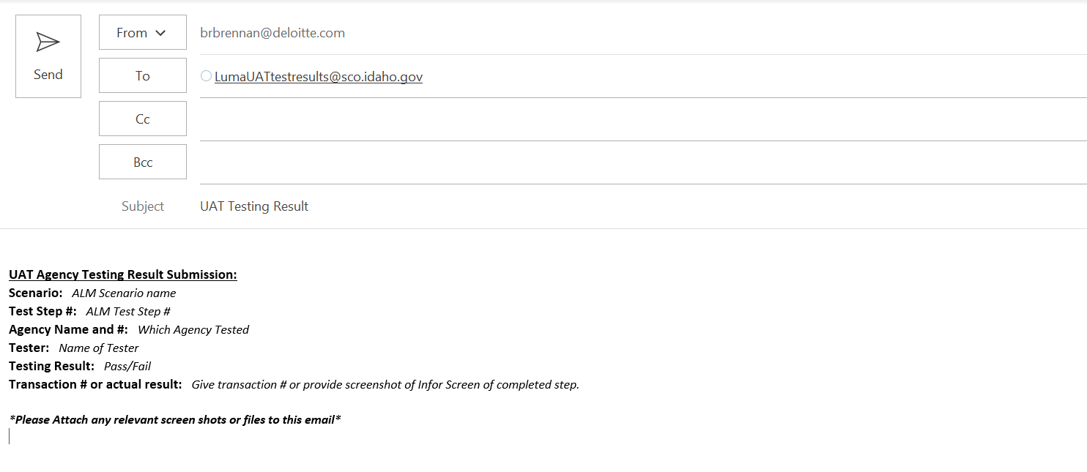
Testing Sessions – SIT 3 Results Submission Email
* Need to update for SIT 3

Slide 22
Upcoming Luma Module Understanding Sessions
The Luma Module Understanding sessions will describe:
Upcoming changes based per Luma module
Explain the benefits of changes
Provide recommendations
Participate in the Luma Module Understanding Sessions starting in January 2022
Support your agency staff with any Luma questions.
Your agency advocate will be supporting you during the journey!
Luma team to invite participants to the sessions based on their Luma Roles

Slide 23
Luma Phase 2 Update

Slide 24
Phase 2 Timeline

Slide 25
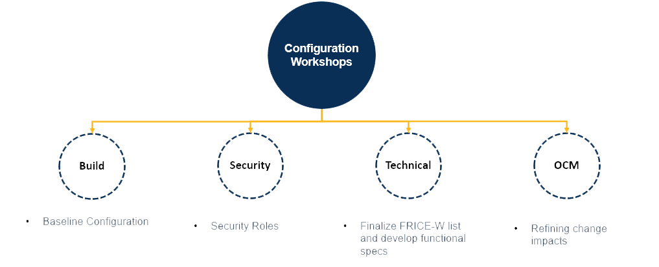
Configuration Workshops
​The ​Luma Phase 2 project team kicked off Configuration workshops on November 10th that will run until December 17th. These workshops will provide the team with a baseline configuration, configure security roles, finalize the FRICE-W list as well developing functional specs, and refine change impacts.
Expected Outcomes for the Luma Project Team:

Slide 26
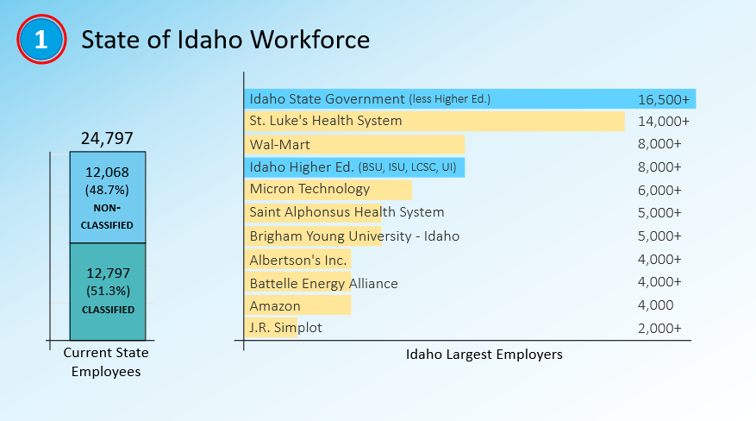
State of Idaho Employee Fact Sheet

Slide 27
Luma Phase 2 Activities

Slide 28
Engagement Opportunities

Slide 29
Engagement Opportunities
Upcoming engagement opportunities to learn more about Luma. Please help us spread the word!
Type of Engagement | Date | Time | Topic
December Procurement Learning Lab Option # 1 | December 14th | 10:00 am | Sourcing Events & Supplier Portal
December Procurement Learning Lab Option # 2 | December 16th | 2:00 pm | Sourcing Events & Supplier Portal

Slide 30
Event Calendar
State of Idaho Controller's Office Website

Slide 31
Testimonials

Slide 32
Know Do Share Report
(K.D.S.R.)

Slide 33
Phase 1 K.D.S.R.
KNOW
DO
SHARE
REPORT
Read Luma Project news and updates in this column.
Meet with employees and leadership in your agency to discuss these messages or action items.
Please share this information or engagement opportunities with your Agency
Report feedback to the project team or complete action items the Luma project team is requesting from your agency.
Phase 1 Go-live: Phase 1 of the Luma Project will go live on July 1st, 2022 with the Finance and Procurement modules.
SIT 3 Prep: The project team will be reaching out to agencies to identify SIT 3 testers next week.
If your agency is currently working with the Luma Project team on an interface or conversion, please maintain momentum to bring those to completion.
Outstanding Workbooks:
Approval Workflow
Security Roles
Projects & Grants
Custodial Accounts/Allocation Workbooks
Workbook Updates for SIT 3 due by 12/3:
Default Workbook
Payroll Crosswalk Updates
System Default Strings
Luma Learning Labs:
What: Sourcing Events & Supplier Portal
When: December 14th | 10 - 11am
December 16th | 2 - 3 pm
Where: Virtual meeting. Be on the look out for calendar invites from your Agency Advocate and feel free to forward along
Webpage Links:
Change Liaison Dashboard (idaho.gov)
EventsCalendar (idaho.gov)
Internal Meetings: Please let us know if you have an upcoming internal meetings that we can present to your staff! We want every state employee to know about the Luma, the changes coming, and exciting benefits of a modern system.
December 1st, 2021

Slide 34
Phase 2 K.D.S.R.
KNOW
DO
SHARE
REPORT
Read Luma Project news and updates in this column.
Meet with employees and leadership in your agency to discuss these messages or action items.
Please share this information or engagement opportunities with your Agency
Report feedback to the project team or complete action items the Luma project team is requesting from your agency.
Phase 2 Go-live: Phase 2 of the Luma project will go live with Workforce Management/Time in December of 2022 and Payroll as well as Human Capital Management on January 1st, 2023.
Configuration Workshops:
​The ​Luma Phase 2 project team kicked off Configuration workshops on November 10th that will run until December 17th.
Nothing this month!
Phase 2 Luma Webpages:
EventsCalendar (idaho.gov)
BPR Webpage: Luma Phase 2 Business Process Redesign (idaho.gov)
Payroll: Luma Payroll Module (idaho.gov)
Human Capital Management: Luma Human Capital Management (idaho.gov)
Internal Meetings: Please let us know if you have an upcoming internal meetings that we can present to your staff! We want every state employee to know about the Luma, the changes coming, and exciting benefits of a modern system.
December 1st, 2021

Slide 35
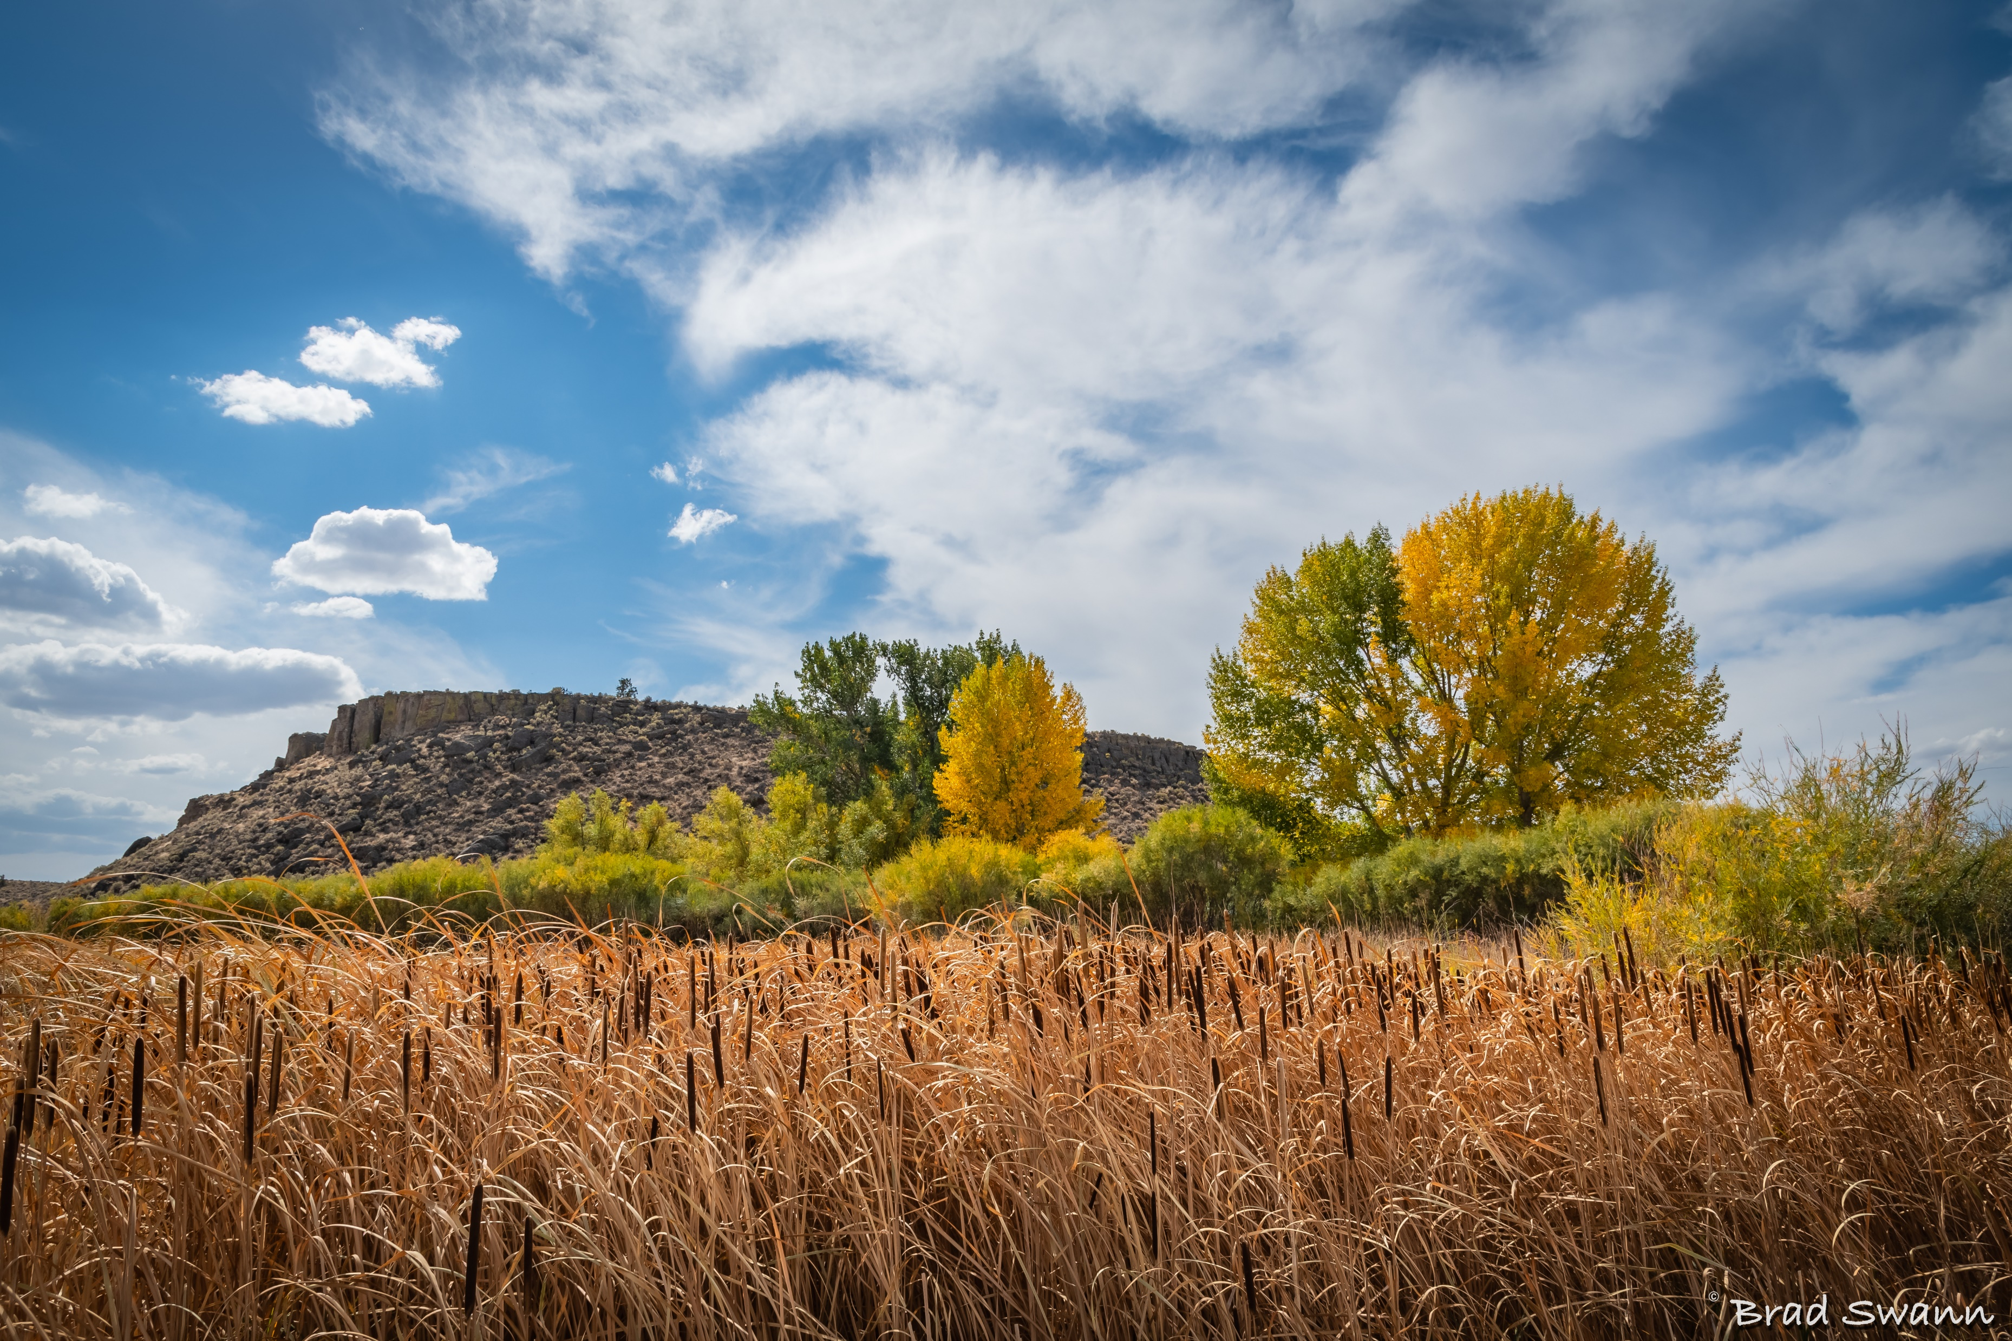
Key Takeaways

Slide 36
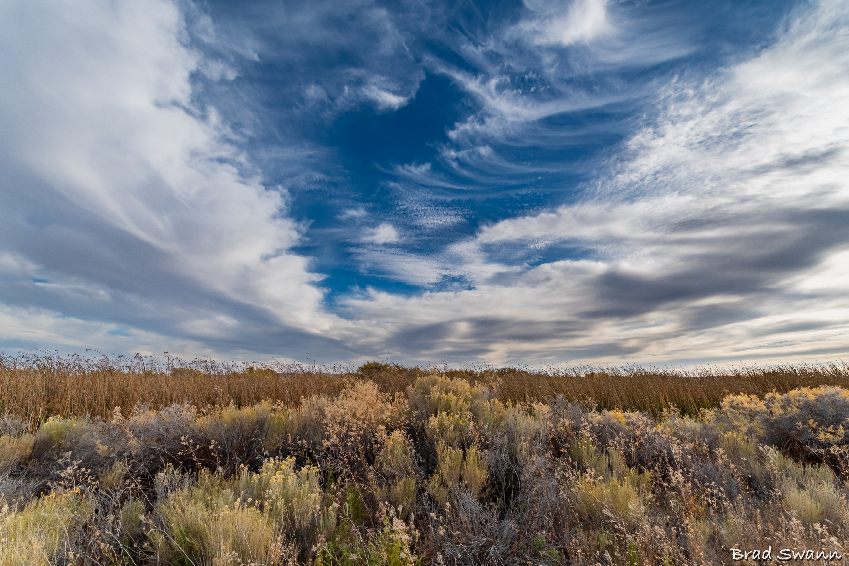
Thank You!
Sheena Coles
SColes@sco.Idaho.gov
208-334-3100
Alex Doench
adoench@sco.Idaho.gov
208-332-8841
Tina Fuller tfuller@sco.Idaho.gov 208-332-8867
Chris Lehosit clehosit@sco.Idaho.gov 208-332-8887
Elijah Stearns
estearns@sco.idaho.gov 208-332-8871
Danielle Blackmer dblackmer@sco.Idaho.gov
208-332-8868

