Slide 1
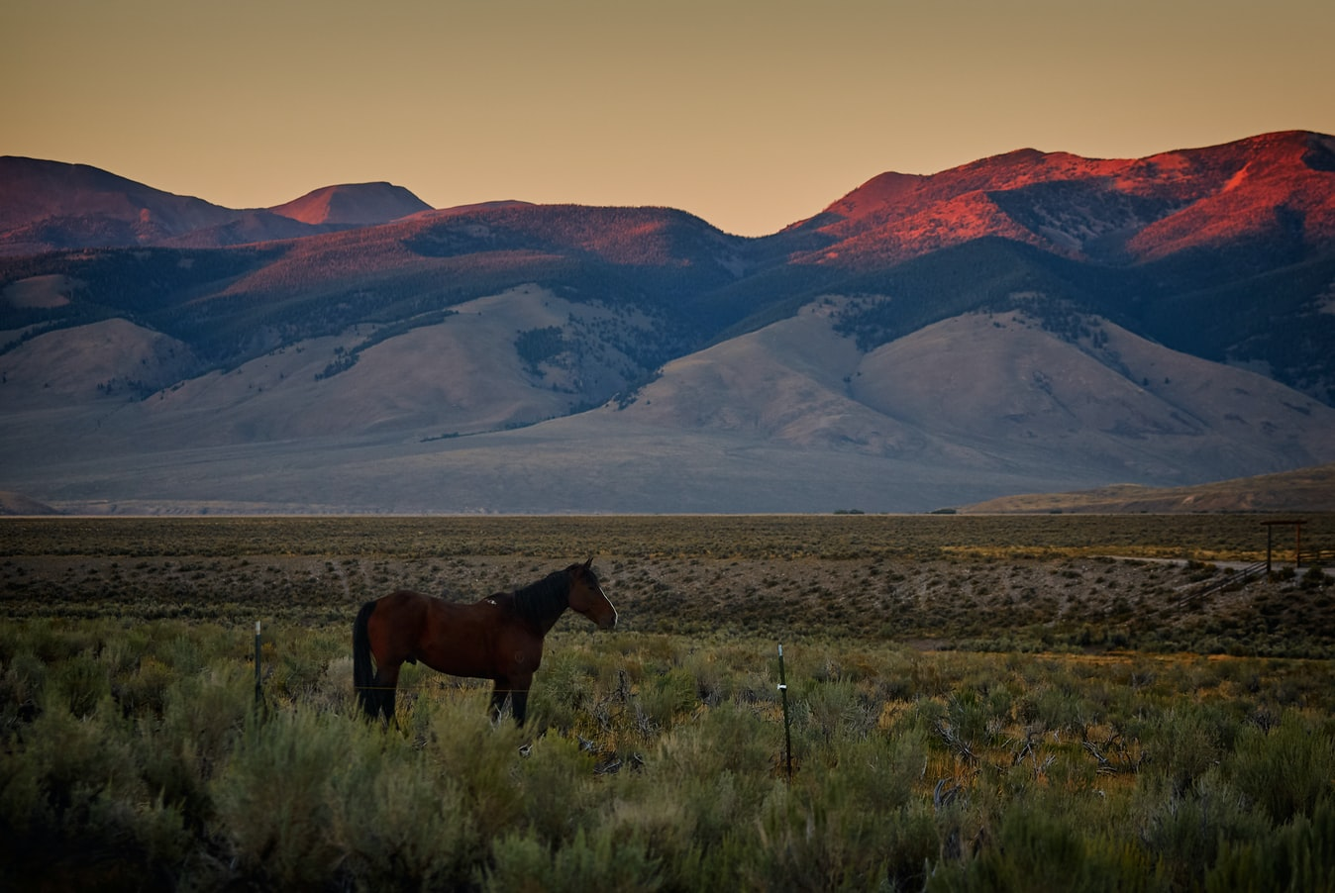
Change Liaison Meeting
August 6th, 2021

Slide 2
Budget Training Update
Phase 1 Update
Phase 1 Activities
Phase 2 Update
Phase 2 Activities
Engagement Opportunities
Phase 1 & 2 Know Do Share Reports (K.D.S.R.)
AGENDA

Slide 3
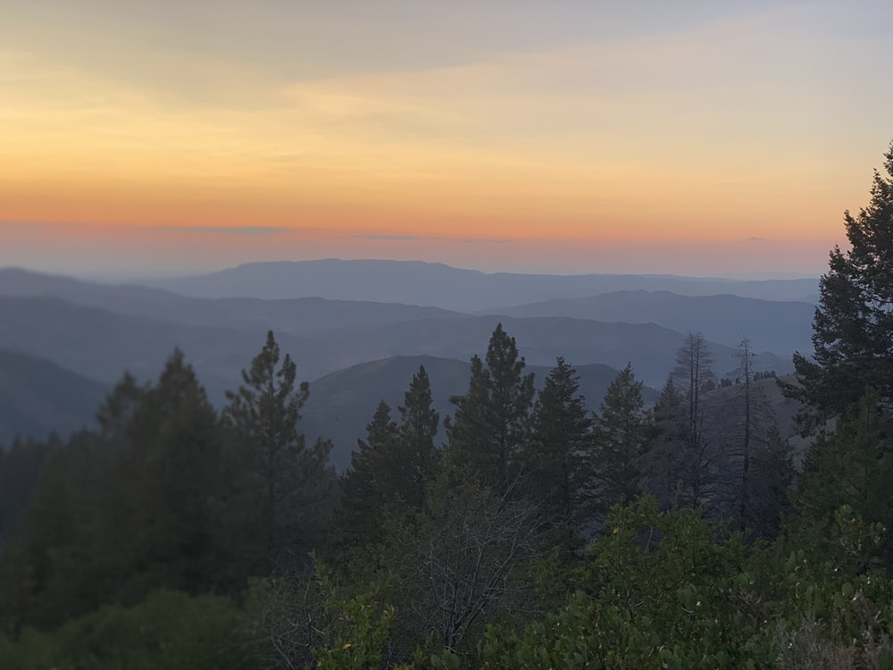
Luma Budget Update

Slide 4
Budget Update
Please start logging into the system now to avoid future issues.
Has your Agency Director or Administrator completed the “Budget Reviewer/Approver/Submitter” training?
The Budget team released the Analysis of Fund form (B-12) and the Agency/Appropriation Revenue Estimate forms (4800 and 4900) earlier this week.
Important Note:
AX2 is only for testing.
PROD is used for Luma Budget because it is live.
The training showcase on the B-6 Report and Personnel Cost Forecasting functions was delivered on July 27th & 29th.

Slide 5
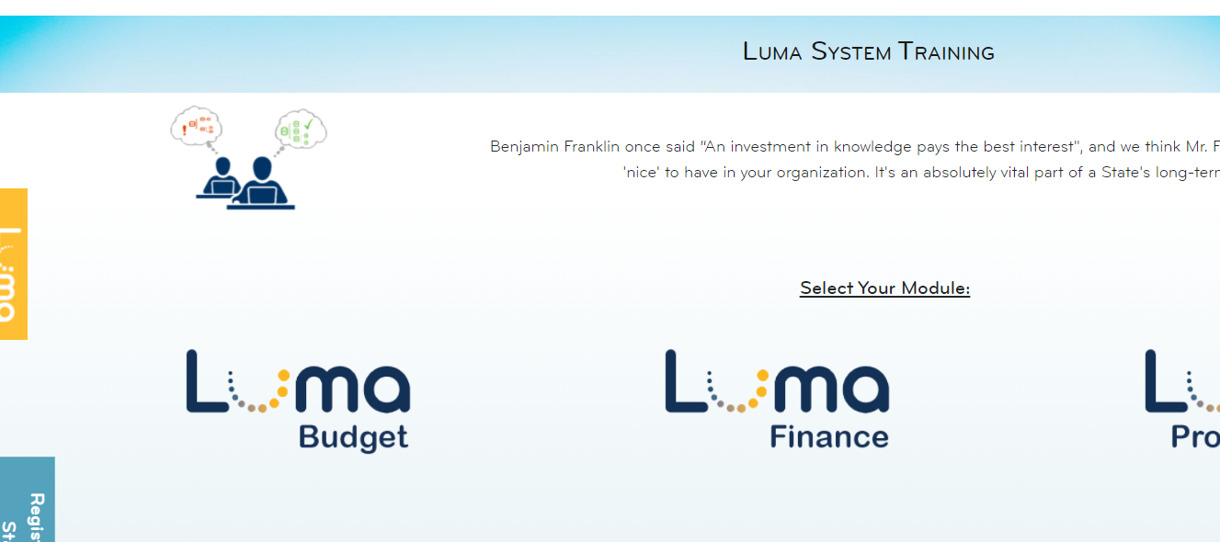
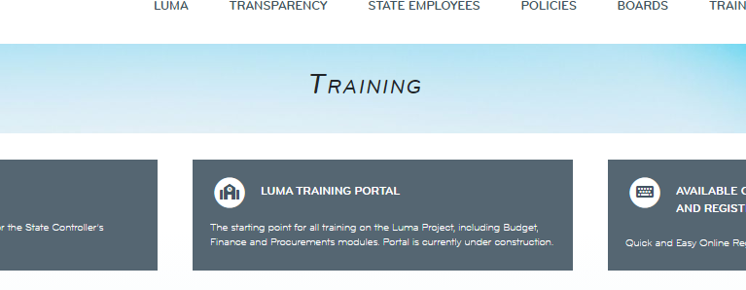
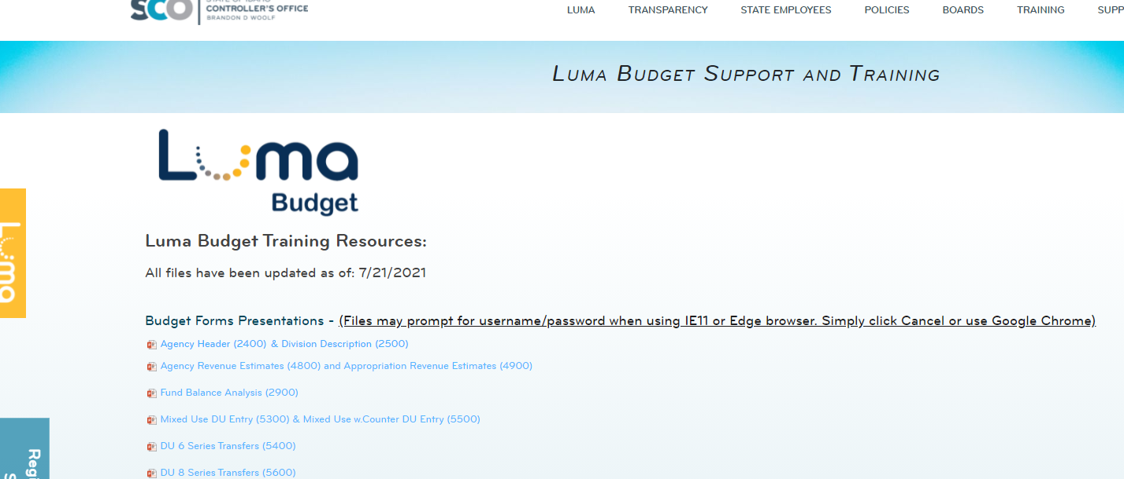
Budget Update – How to get to the Budget Training portal
Step 1: SCO Homepage
Step 3: Luma System Training Page
Step 2: SCO Training page
Step 4: Luma Budget Support and Training

Slide 6
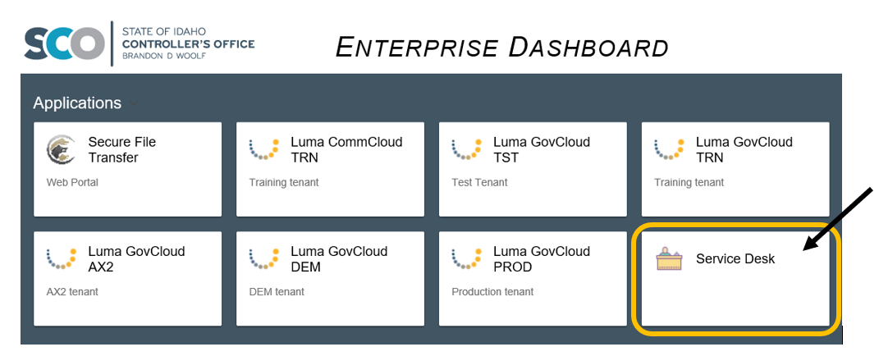
Service Desk Tickets for Luma Budget
If there is a problem in Luma Budget or if you have a Luma Budget related question, please enter a service desk ticket via the Service Desk tile on the SCO Enterprise Dashboard.
When entering a service desk ticket, please include the following:
Name
Agency
Screenshot if needed/possible
Please note, once the ticket is emailed pressing reply all will just create a new ticket.

Slide 7
Luma Phase 1 Update

Slide 8
Phase 1 Timeline
2021 |  |  |  |  |  |  |  |  | 2022
Apr | May | Jun | Jul | Aug | Sep | Oct | Nov | Dec | Jan | Feb | Mar | Apr | May | Jun | Jul | Aug | Sep | Oct | Nov | Dec
Imagine
Deliver
Run
Design
Build
Test
Training
Luma Phase 1 Extension
Cutover
Sustainment
FRICE-W Function Specs - Enhancements
Infor Enhancement Development
Front-End Split 1 – 7/21/21
Cash – 8/18/21
Trust Accounting – 11/17/21
Allocation Design & Build
FRICE-W Development
SIT 2
SIT 3
UAT
Train the Trainer
End User Training
Mock Cutover
Final Cutover
Sustainment – COE Planning/Staffed
Sustainment – COE Pre-Go Live Execution
Luma Phase 1 Go-live 7/1/2022
Sustainment – COE Post-Go Live
Stabilization & Optimization
Deloitte Post-Implementation Support

Slide 9
Luma Phase 1 Activities

Slide 10
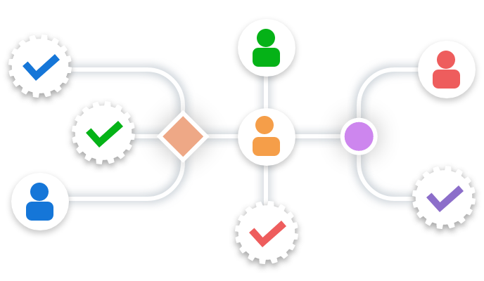
Phase 1 Approval Workflows
The workflow determines how a document flows, or routes, through the system by showing who must complete a task, make a decision, or approve a document.
Agencies will populate the fields in the Approval Workflows Workbook which then be used to inform Luma on who/where to route tasks.
Example: purchase requisition under $25k go to Sam Jones and over $25k to Leslie Smith.

Slide 11
Phase 1 Approval Workflows
Change Liaisons forward the virtual calendar invite meeting to their agency’s stakeholders.
Change Liaisons/Agency assigners attend a Workflow Approval instructional session.
Complete the Workflow Approval Workbooks and submit them back to your Agency Advocate.
2 weeks
1 week
1 month
8/13-8/26
8/27-9/2
9/3-10/6

Slide 12
Phase 1 Approval Workflows
In addition to the virtual instructional sessions, agency assigners/Change Liaisons can also drop into virtual office hours for individualized support.
September 2021
Mon
Tues
Wed
Thurs
Fri
1
2
3
6
7
8
9
10
Office Hours
13
14
15
16
17
20
21
22
23
24
25
26
30
31

Slide 13
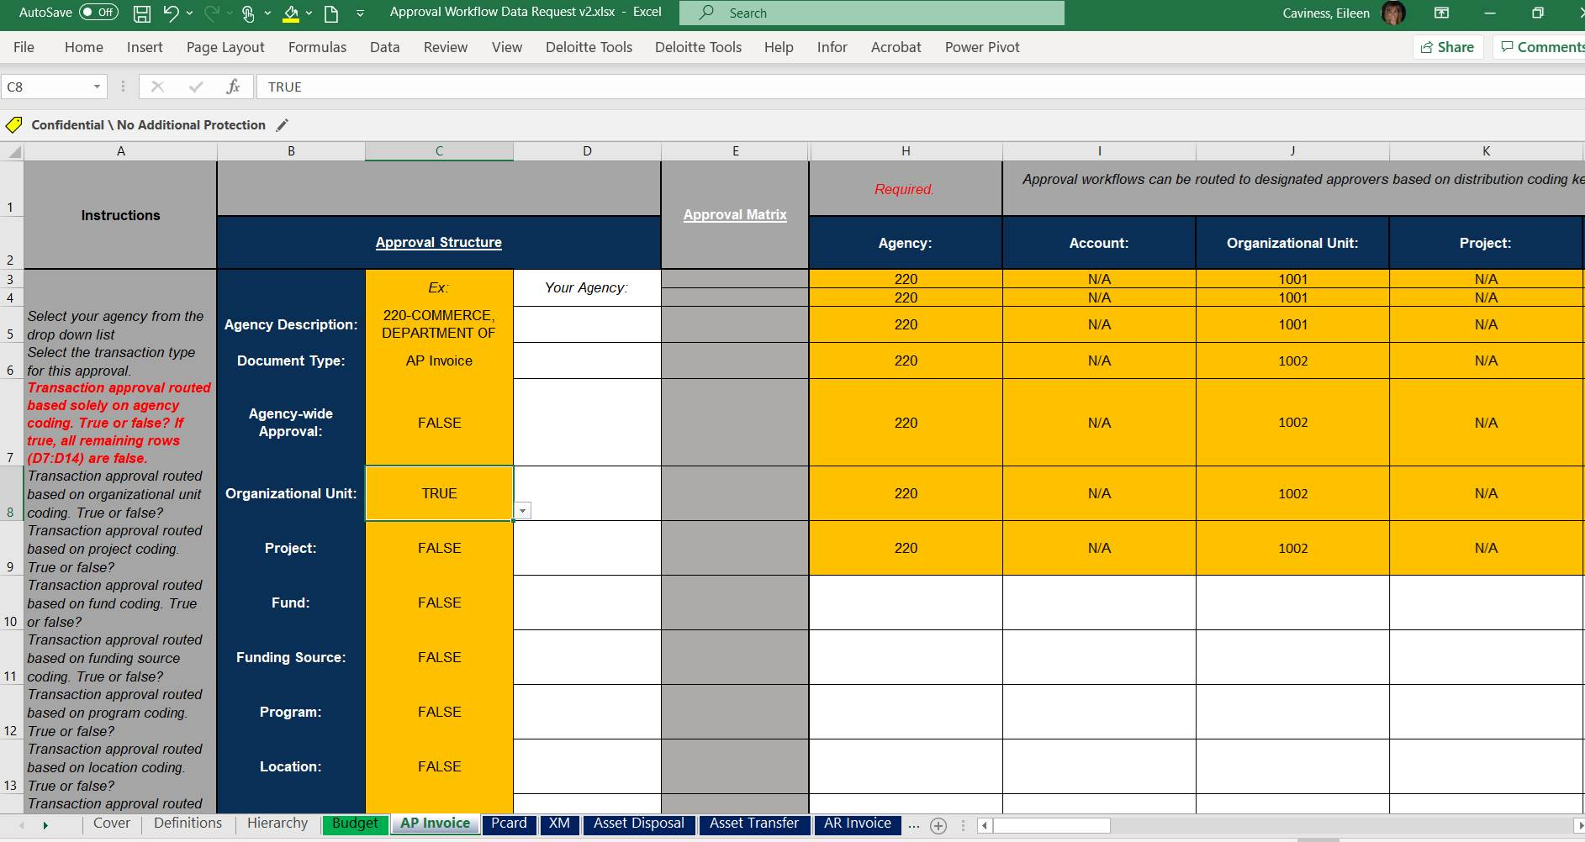
Phase 1 Approval Workflows

Slide 14
Luma Phase 2 Update

Slide 15
2021 |  |  |  |  |  | 2022 |  |  |  |  |  |  |  |  |  |  |  | 2023
Jul | Aug | Sep | Oct | Nov | Dec | Jan | Feb | Mar | Apr | May | Jun | Jul | Aug | Sep | Oct | Nov | Dec | Jan | Feb | Mar | Apr | May | Jun
Plan
Architect
Configure & Prototype
Validate
Deploy
Support
Luma Phase 2 Kick-Off
Payroll/Time Compare
User Acceptance (UAT)
Discover & Prep Update
Config/Validation Sprints
1
2
3
Collect Business Requirements
1
2
3
Prepare Baseline System for Sprint 1
Scenario Testing (SIT)
Infor Orientation
1
2
Define
Finalize
Refine
Training Development
End User
Training
Practice Conversions
1
2
FRICE-W Design & Build
Time Go-Live
HR/Pay Go-Live
Continuous Activities: Project Management / Change Management / Knowledge Transfers
Sustainment (after the project)
High Level Idaho Technical & Business Activities
Idaho Technical Teams: Coordination and Review in Development Phase
Technical Teams: Ongoing Product Support
Third-party products – GAP filling – Scope clarification
Business Teams: Ongoing Product Support
Idaho Technical & Business Expertise
Infor
Orientation
Sprint Validation:
Review Component builds
Unit testing
Review System functions
Business Process Review
Scenario Testing:
Test Execution
Defect Identification
Retesting (as needed)
User Acceptance Testing:
Test Execution
Defect identification
Retesting (as needed)
Cutover:
Data Validation
Business cutover
Smoke testing
Deloitte
Gone
✓
✓
Functional & Technical Specs
Systems
Data
Interfaces
Reports
Practice (data) Conversions:
Cleansing
Validation
Training:
Training feedback
Train the trainer
Training
Support:
Sustainment
Super user network
Ongoing Training
Technology Survey
✗
Engagement Points with Stakeholders (such as what is expected, how we want to do it, why we are doing it)

Slide 16
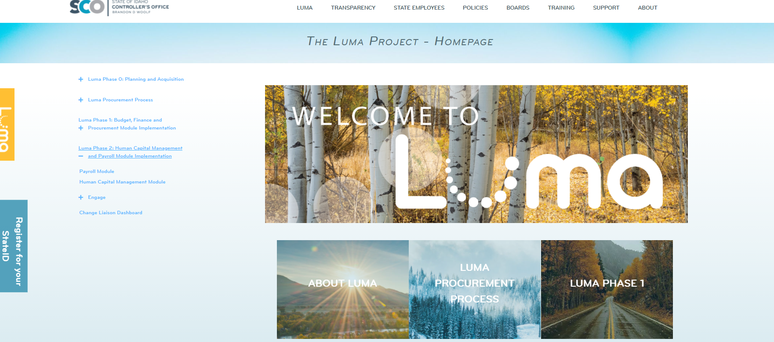
Phase 2 Webpage

Slide 17
Luma Phase 2 Activities

Slide 18
Phase 2 Software Ecosystem Survey
This survey is designed to identify software systems, tools, spreadsheets, or workarounds agencies are using to perform payroll or human capital management tasks.
Why is this important?
This survey will help identify systems that could interface with Luma or will need a data conversion before being replaced by Luma. The information you provide is critical for creating an easier transition and better functioning Luma experience for your agency.
Who should take the Phase 2 Software Ecosystem survey?
Luma’s success depends on agencies providing the best possible information on how they work today. Incomplete information will result in Luma not having needed functions; we want the best information from Payroll and HR Officers and Agency technical staff.
When?
Please complete this survey by Monday, August 23rd.
What happens next?
The survey is just the beginning of a process to understand what must be in Luma before we go live (or know what will not be in Luma and must have an acceptable workaround). We will use the survey in more targeted conversations with your agency to get Luma right.

Slide 19
Engagement Opportunities

Slide 20
Engagement Opportunities
Upcoming engagement opportunities to learn more about Luma. Please help us spread the word!
Type of Engagement | Date | Time | Topic
Statewide Showcase | August 17th & 19th | 1:00 PM | Help Tool & Functionality in Luma

Slide 21
Know Do Share Report
(K.D.S.R.)

Slide 22
Phase 1 K.D.S.R.
KNOW
DO
SHARE
REPORT
Read Luma Project news and updates in this column.
Meet with employees and leadership in your agency to discuss these messages or action items.
Please share this information or engagement opportunities with your Agency
Report feedback to the project team or complete action items the Luma project team is requesting from your agency.
Phase 1 Go-live: Phase 1 of the Luma Project will go live on July 1st, 2022 with the Finance and Procurement modules.
Statewide Showcase:
What: Help Tool & Functionality in Luma
When: August 17th & 19th 1 – 2 pm
Where: Virtual meeting. Your Agency Advocate will send out a meeting invite!
Budget Training Portal: Please use and share the link below with your agency personnel for the Luma Budget Training Portal.
Agency Approval Workflow:
Agencies will populate the fields in the Approval Workflows Workbook which then be used to inform Luma on who/where to route tasks.
B11 & B12 Validation:
Please check in with your budget personnel to ensure they have completed your agency’s validation of the B11 & B12 information
If your agency is currently working with the Luma Project team on an interface or conversion, please maintain momentum to bring those to completion.
Service Desk Tickets for Luma Budget: If there is a problem in Luma Budget or if you have a Luma Budget related question, please enter a service desk ticket via the Service Desk tile on the SCO Enterprise Dashboard.
Internal Meetings: Please let us know if you have an upcoming internal meetings that we can present to your staff! We want every state employee to know about the Luma, the changes coming, and exciting benefits of a modern system.
Click Here
August 6th, 2021

Slide 23
Phase 2 K.D.S.R.
KNOW
DO
SHARE
REPORT
Read Luma Project news and updates in this column.
Meet with employees and leadership in your agency to discuss these messages or action items.
Please share this information or engagement opportunities with your Agency
Report feedback to the project team or complete action items the Luma project team is requesting from your agency.
Change Liaison for Phase 2:
If your Agency would like to have a Phase 2 specific Change Liaison, please contact your Agency Advocate!
Phase 2 Go-live: Phase 2 of the Luma project will go live with Workforce Management/Time in December of 2022 and Payroll as well as Human Capital Management on January 1st, 2023.
Phase 2 Luma Webpage:
Payroll: Luma Payroll Module (idaho.gov)
Human Capital Management: Luma Human Capital Management (idaho.gov)
Internal Meetings: Please let us know if you have an upcoming internal meetings that we can present to your staff! We want every state employee to know about the Luma, the changes coming, and exciting benefits of a modern system.
Phase 2 Software Ecosystem Survey:
This survey will help identify systems that could interface with Luma or will need a data conversion before being replaced by Luma. The information you provide is critical for creating an easier transition and better functioning Luma experience for your agency.
The survey will be sent out to Change Liaisons as well as HR & Payroll personnel on Monday, August 9th with a deadline of Monday, August 23rd.
August 6th, 2021

Slide 24
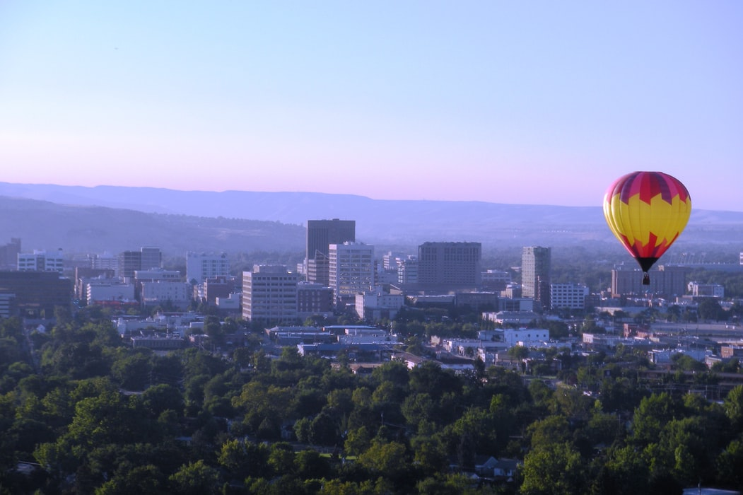
Thank You!
Sheena Coles
SColes@sco.Idaho.gov
208-334-3100
Alex Doench
adoench@sco.Idaho.gov
208-332-8841
Tina Fuller tfuller@sco.Idaho.gov 208-332-8867
Chris Lehosit clehosit@sco.Idaho.gov 208-332-8887
Elijah Stearns
estearns@sco.idaho.gov 208-332-8871
Danielle Blackmer dblackmer@sco.Idaho.gov
208-332-8868

