Slide 1





Change Liaison Meeting
August 10th, 2022

Slide 2
Welcome!
Thank you for being here!
Expectations:
  Please give presenters your full attention.
  Please utilize the chat functionality (bottom right) to ask questions, or wait until the end of the presentation to come off of mute and ask.
  This meeting is being recorded and will be provided in the follow-up email.

Slide 3

Phase 1
Timeline
August Calendar
  Project Upload
  Customer Conversions
  Freeze Communications
Phase 2
Timeline
SIT Update
HR Org Unit workbook – Due Aug 17th
Training
Training Approach
Key Takeaways
AGENDA
Notes:
Intro - Elijah
Phase 1 Update – Sheena/Scott
Phase 2 Update - Greg
Phase 2 Activities - Greg
Training – Krystal/Sara
Key Takeaways - Sheena

Slide 4

Luma Phase 1 Update

Slide 5
Luma Phase 1 Project Plan
Configured Operating System
System Testing
Launch Readiness
Aug 1
Aug 8
Aug 15
Aug 22
Aug 29
Sep 5
Sep 12
Sep 19
Cont. …
Finalize BPIs
System Integration Test
160+ Interfaces
250+ Scenarios
Testing (Unit)
Configuration & Build
Cutover/Conversions
Workbooks & Data Files Due
Workbooks Due
System Preparation
(Data and Configuration)
Milestone 1
Operating System Complete & Test Initiation
NOW
Key
System Ready
BPI’s
FRICE-W
Workbooks
PAST
FUTURE

Slide 6
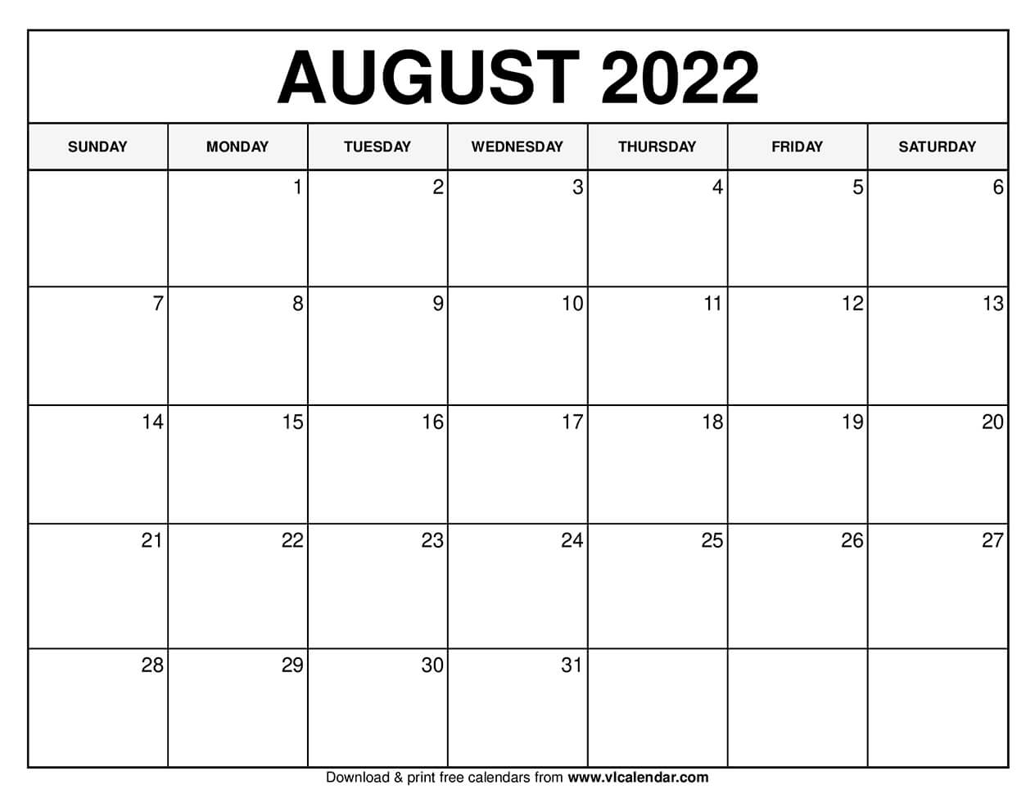
Workbooks:
COA Workbooks
Payroll Crosswalk
Project & Funding Source
AP Default
AR Configuration
AM Configuration
Cost Allocation
Request Agency Conversion files
3
5
Conversion Files due
Request Cost Allocation Workbook
10
Target Date: Request Agency SIT testers
15
Customer conversion files due
18
16
Upload Project Workbooks
Cutover Task Calendar sent to agencies
Target Date: SIT Session Meeting Invites Sent
23
Target Date Freeze Communications sent to agencies
Due Date: Agency Interface
30
31
Holiday
Action for Cutover
Action for SIT
*Project Activities for Awareness

Slide 7
Upload Project Workbooks
NOTE: There were several agencies that received feedback from the Luma Projects and Grants team regarding corrections needed to the workbook. We ask for your attention to these corrections prior to this coming Friday. The risk of not submitting workbooks or not submitted the corrections is that the system will not be loaded and the information will not be available for testing. Your agency projects will not be tested during System Integration Testing (SIT).
We will start uploading Project workbooks on Monday (8/15) in order to continue building the core configuration of the Luma system. We have received tremendous response to date and I wanted to pass along a “Thank you”. Your submissions not only makes it possible for Phase 1 (Finance and Procurement) to progress successfully, but the Project workbooks also have a direct impact on Phase 2 (Human Capital Management and Payroll).

Slide 8
Workbooks:
COA Workbooks
Payroll Crosswalk
Project & Funding Source
AP Default
AR Configuration
AM Configuration
Cost Allocation
Readiness Survey:
In August the communication team will roll out a readiness survey to you.
Request Agency Conversion files
3
5
Conversion Files due
Request Cost Allocation Workbook
10
Target Date: Request Agency SIT testers
15
Customer conversion files due
18
16
Upload Project Workbooks
Cutover Task Calendar sent to agencies
SIT Session Meeting Invites Sent
23
Freeze Communications sent to agencies
Target Date Freeze Communications sent to agencies
Due Date: Agency Interface
30
31
30
Holiday
Action for Cutover
Action for SIT
*Project Activities for Awareness

Slide 9
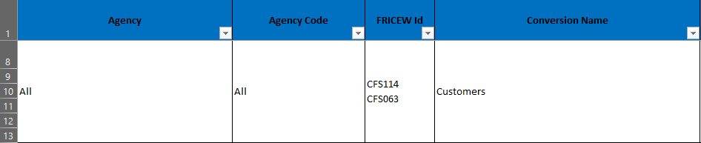
Customer conversion files due
IDAHO JUDICIAL BRANCH
OFFICE OF THE ATTORNEY GENERAL
SUPERINTENDENT OF PUBLIC INSTRUCTION
OFFICE OF INFORMATION TECHNOLOGY SERVICES
DIVISION OF FINANCIAL MANAGEMENT
IDAHO COMMISSION ON AGING
MILITARY DIVISION
OFFICE OF SPECIES CONSERVATION
DEPARTMENT OF ADMINISTRATION
DEPARTMENT OF AGRICULTURE
DEPARTMENT OF CORRECTION
CORRECTIONAL INDUSTRIES
DEPARTMENT OF LABOR
DEPARTMENT OF ENVIRONMENTAL QUALITY
DEPARTMENT OF FINANCE
DEPARTMENT OF FISH AND GAME
DEPARTMENT OF HEALTH AND WELFARE
DEPARTMENT OF JUVENILE CORRECTIONS
IDAHO TRANSPORTATION DEPARTMENT
INDUSTRIAL COMMISSION
DEPARTMENT OF LANDS
IDAHO STATE POLICE
STATE BRAND INSPECTOR
DEPARTMENT OF PARKS AND RECREATION
LAVA HOT SPRINGS FOUNDATION
DEPARTMENT OF WATER RESOURCES
DIVISION OF VETERANS SERVICES
IDAHO DIVISION OF CAREER AND TECHNICAL EDUCATION
IDAHO COMMISSION FOR LIBRARIES
IDAHO STATE HISTORICAL SOCIETY
DIVISION OF VOCATIONAL REHABILITATION
PUBLIC UTILITIES COMMISSION
IDAHO STATE INDEPENDENT LIVING COUNCIL
PANHANDLE HEALTH DISTRICT I
NORTH CENTRAL HEALTH DISTRICT II
SOUTHWEST HEALTH DISTRICT III
CENTRAL HEALTH DISTRICT IV
SOUTH CENTRAL PUBLIC HEALTH DISTRICT V
SOUTHEAST HEALTH DISTRICT VI
EASTERN IDAHO HEALTH DISTRICT VII
In the Automated and Semiautomated conversion request sent out last week, there was a confusing line. We will be reaching out today/tomorrow to the Agencies with customer conversions, these will be due August 16th so the Luma Team can run the customer conversion on the 17^{th.}

Slide 10
Workbooks:
COA Workbooks
Payroll Crosswalk
Project & Funding Source
AP Default
AR Configuration
AM Configuration
Cost Allocation
Request Agency Conversion files
3
5
Conversion Files due
Request Cost Allocation Workbook
10
Target Date: Request Agency SIT testers
15
Customer conversion files due
18
16
Upload Project Workbooks
Cutover Task Calendar sent to agencies
SIT Session Meeting Invites Sent
23
Freeze Communications sent to agencies
Target Date Freeze Communications sent to agencies
Due Date: Agency Interface
30
31
30
Holiday
Action for Cutover
Action for SIT
*Project Activities for Awareness

Slide 11
Freeze Communications sent to agencies
Mid-Fiscal Year Go-Live
This will feel like an end of year close of STARS for agencies.
Run YE processes and prepare preliminary balances from STARS for conversion into Luma
Begin conversion of all in scope data to Luma. Execute automated & semi-automated conversions.
Data catchup activities are performed for Master Data converted into Luma
Core Team finalizes system prep including manual conversions such as Purchase Orders.
Cutover Strategy / Planning
Mock Cutover # 1
SIT
Dress Rehearsal
UAT Plan
Go-Live
Pre-Test Activities
SIT
UAT
Production Cutover Execution
Freeze dates are part of the transition from our current siloed systems to Luma.
Freeze dates indicate the last day to enter information into our current systems.
Each system (or in some cases sub-processes within one system) will have a designated freeze date, after which we will pause entering transactions/data into that system.
In other words, it’s a time when you tell your data to stop, put its hands up and freeze! No new records. No changes to existing records. No updates of any kind.
All future transactions/data will be entered and edited directly in Luma.
These freeze dates vary by system and process but will occur between October and December 2022.

Slide 12

Luma Phase 2 Update

Slide 13

Phase 2 (HCM)
Complete
SIT 2 & First Pay Compare
Performance Milestone #2 (time dependent Phase 1)
Execution of Phase 1 inclusion
Confirmation of SIT 2
Pay Compare 1 start/end dates
August 2, 2022
Phase1: Pre-SIT Initiatives
Phase 1 integration with Phase 2 functionality must start in SIT 2 and Pay/Time Compare 1
Stable Operations (June)
Validated
HCM Build
Decision!
GO Training / Go Live
Pristine Build
Mock CO 1
Training Development
User Training
MAY
JUN
JUL
AUG
SEP
OCT
NOV
DEC
JAN
FEB
MAR
APR
11
18
25
1
8
15
22
29
5
12
19
26
3
10
17
24
31
7
14
21
28
5
12
19
26
2
9
16
23
30
6
13
20
27
6
13
Production Cut Over Fri 3/17 to Wed 3/23
20
27
3
6
13
20
Practice Conversion:
  Data Loading
  Integrations
  Promotions
  Tenants
System Integration
Test 1
MC 1
Mock
Convert
MC 2
MC 3
Dress Rehearsal Cut Over
NOTEWORTHY
Phase 2 must have Phase 1’s Finance Structure: COA with P&G for 10 agencies by 8/22 Performance Milestone #2 will confirm Phase 2’s go live readiness Holidays (in red) and available resources will need to be thoughtfully managed (eight holidays) Cutover (conversion from legacy) has some time challenges (but several cycles) Phase 2’s Go Live Decision date is first week in Feb Cheating Ahead (shown with blue text)
UAT
System Integration
Testing 2
System Integration
Testing 3
Pay/Time
Compare 1
Pay/Time
Compare 2
Pay/Time
Compare 3

Slide 14

Orientation to Phase 2’s System Testing: three components
Configure Operating System
System Testing
Launch Readiness
Business Process
Requirements
Unit Testing Business Process
System Integration
Test (SIT) 1
CUTOVER
SIT 2
CUTOVER
SIT 3
CUTOVER
UAT
Statewide
Training
P/C 1
P/C 2
P/C 3
SIT 1 PURPOSE FIND errors, gaps, surprises, and new/missed requirements LEARN with ambiguity; testing processes, and gain confidence FIX defects and/or mitigate for go live with workarounds as needed INCREMENTALLY improve knowledge and functions - then repeat the process two more times
CUTOVER PURPOSE: DESIGN and STRATEGY
System cutover: the migration and validation of the tenant configuration and settings – Our functional and technical teams will create a consolidated system cutover plan
Data cutover: the transition of data from legacy to our new system; a plan is currently in reviewed for the steps and sequences needed to move all needed data into Luma
Business cutover: a later activity to ensure operational business processes are adjusted to support the migration from Legacy to Luma; the project will evaluate all HCM Level 2 and Level 3 (112) business process to identify impacted operations (such as sun setting legacy supported business processes, Luma start dates, future date handling, and interim processes during system transition)
PAY/TIME COMPARE PURPOSE
Compare: side by side Legacy and Luma outcomes for Pay and Time (with schedules)
Complexity: every rule, every schedule, every coded time function, and every resulting net and gross of time and pay values must be equivalent or a reason known for the difference (because sometimes Legacy has been doing it wrong)
Cycles: Three Pay/Time Compare time boxes will be run; but within each will be multiple runs, analysis, fixes, and reruns; Pay Compare #3 must be accurate to implement Luma
2

Slide 15
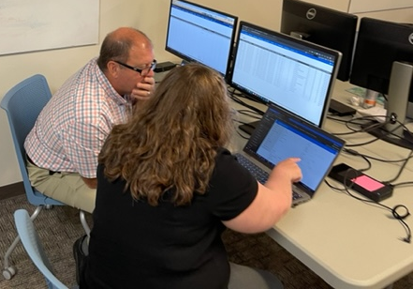
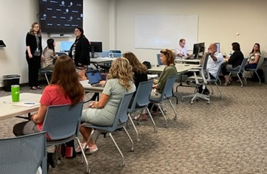
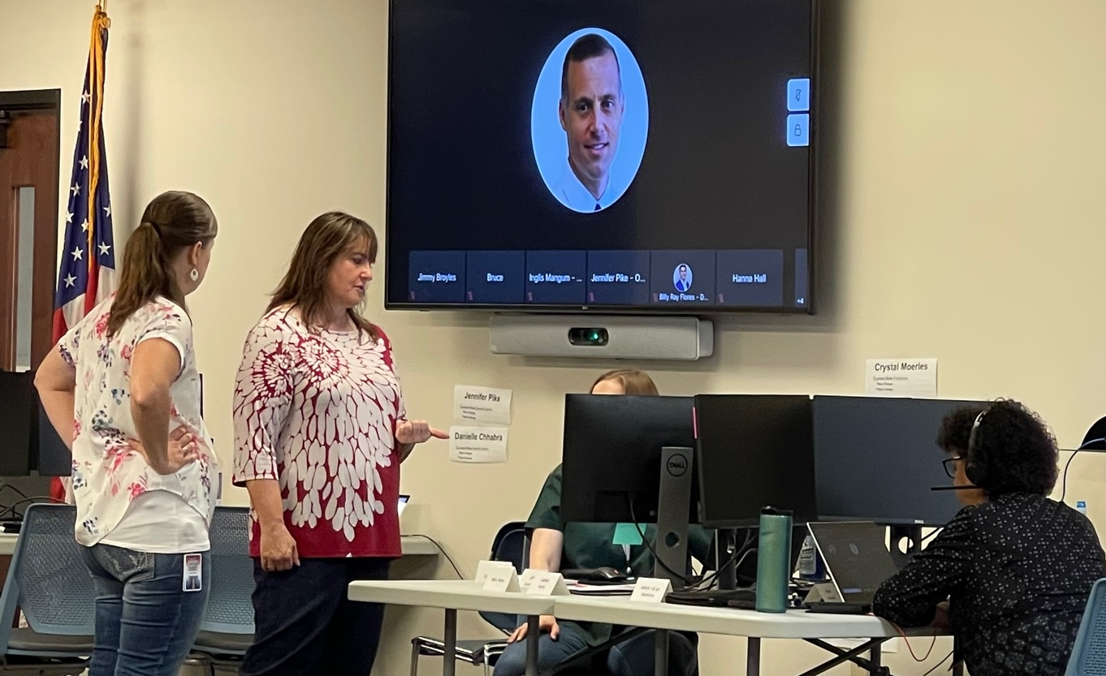
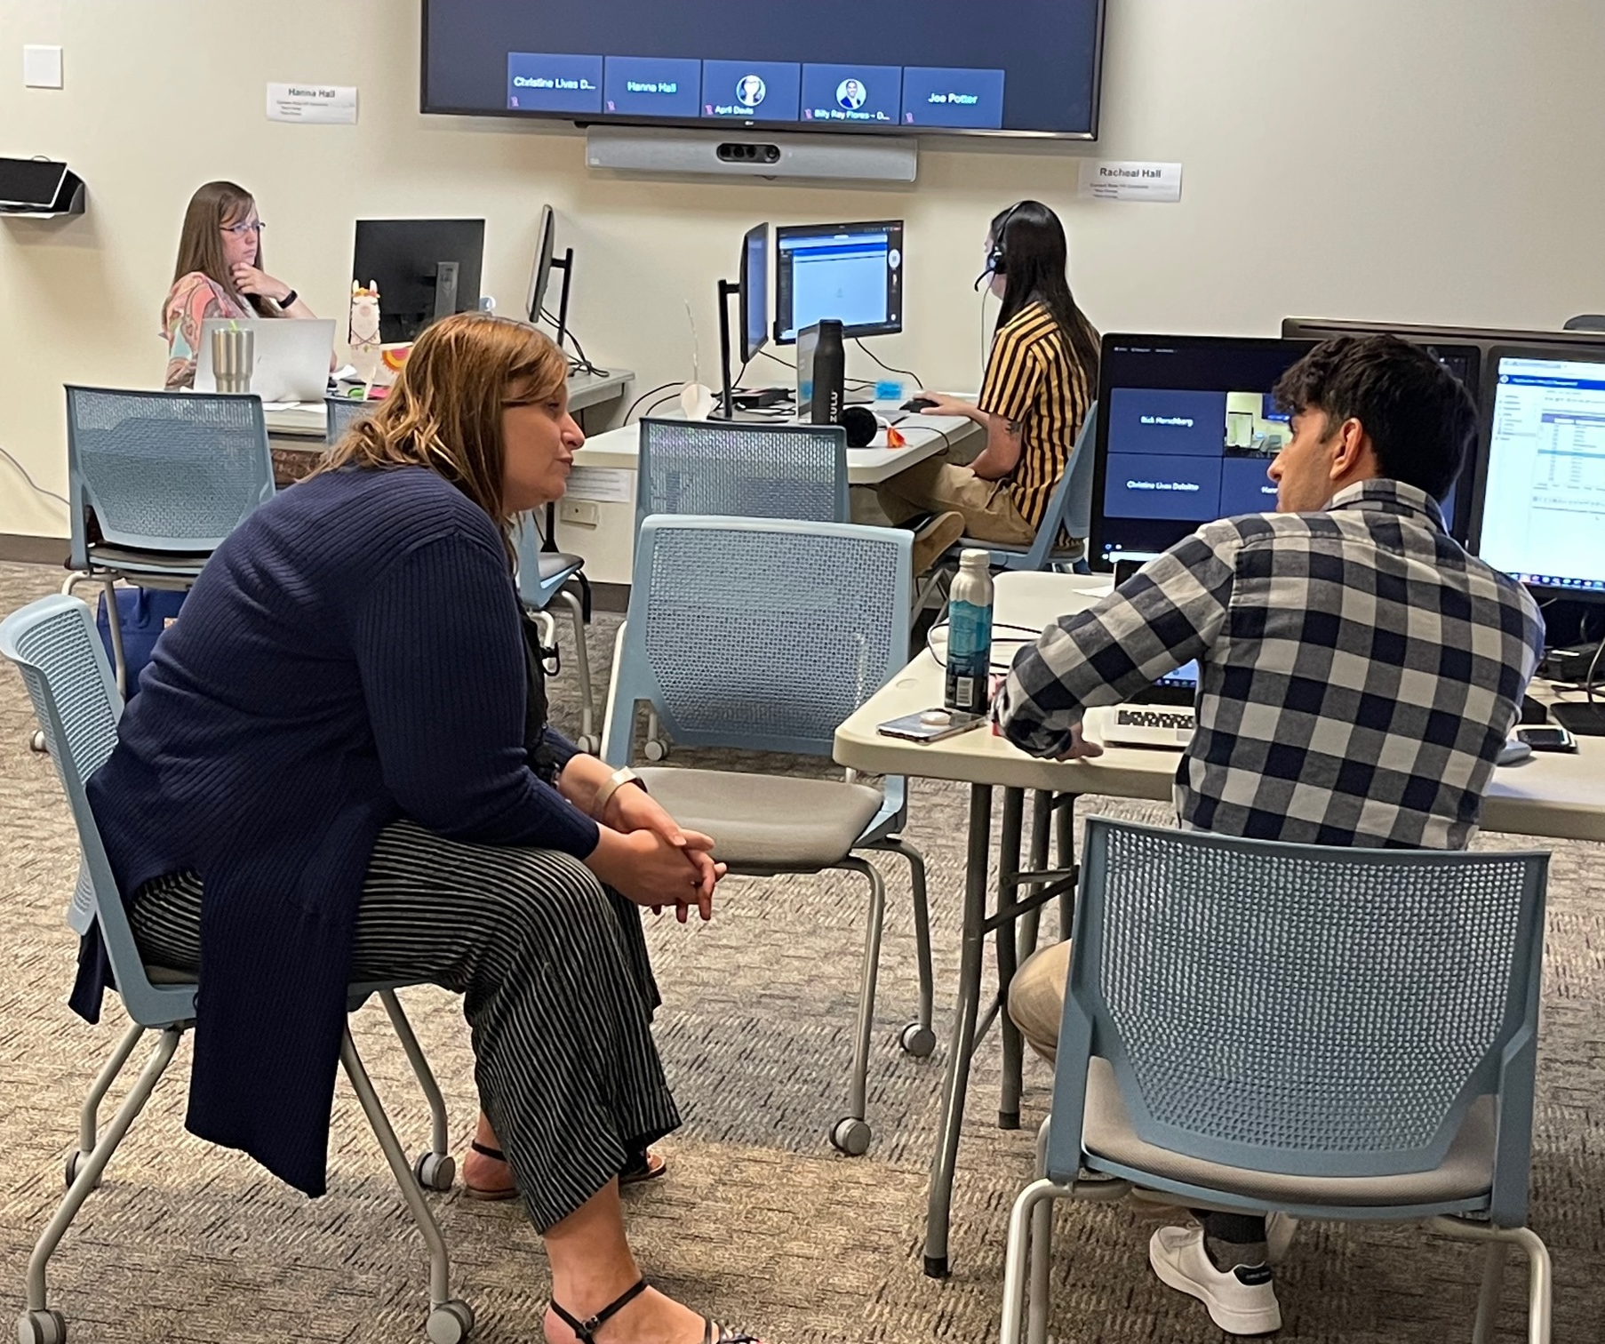
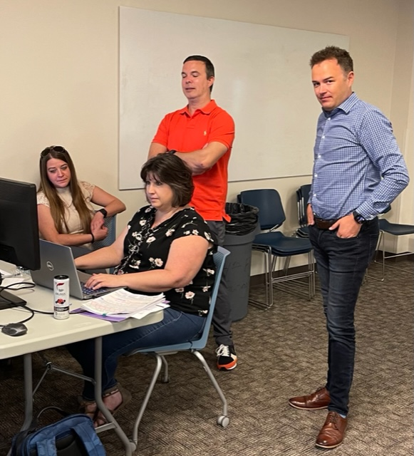
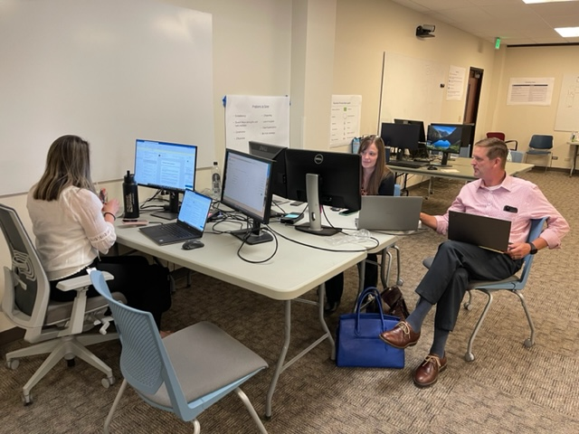
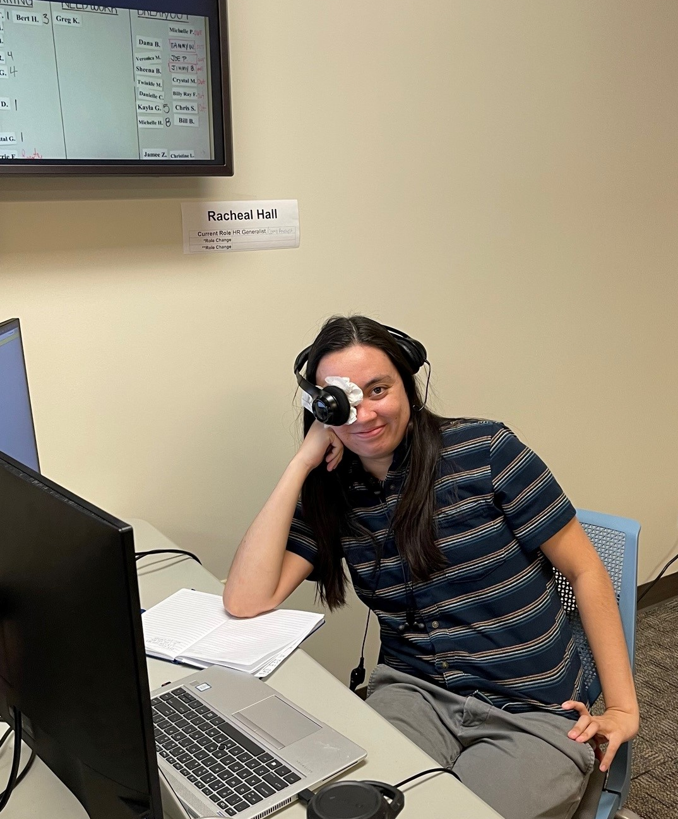
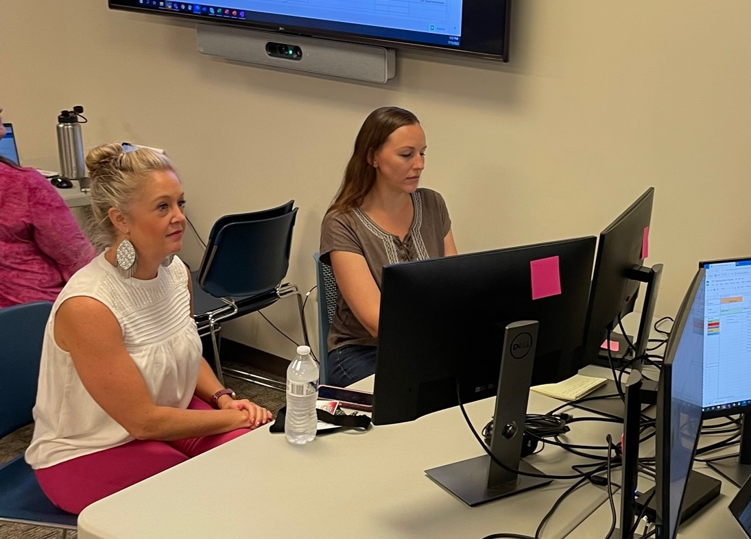
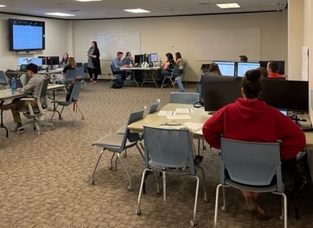
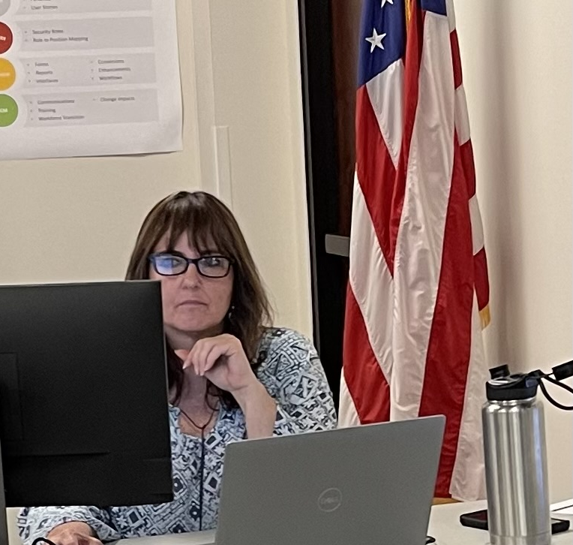

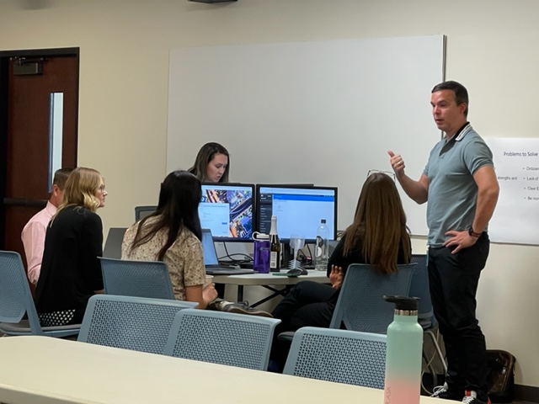
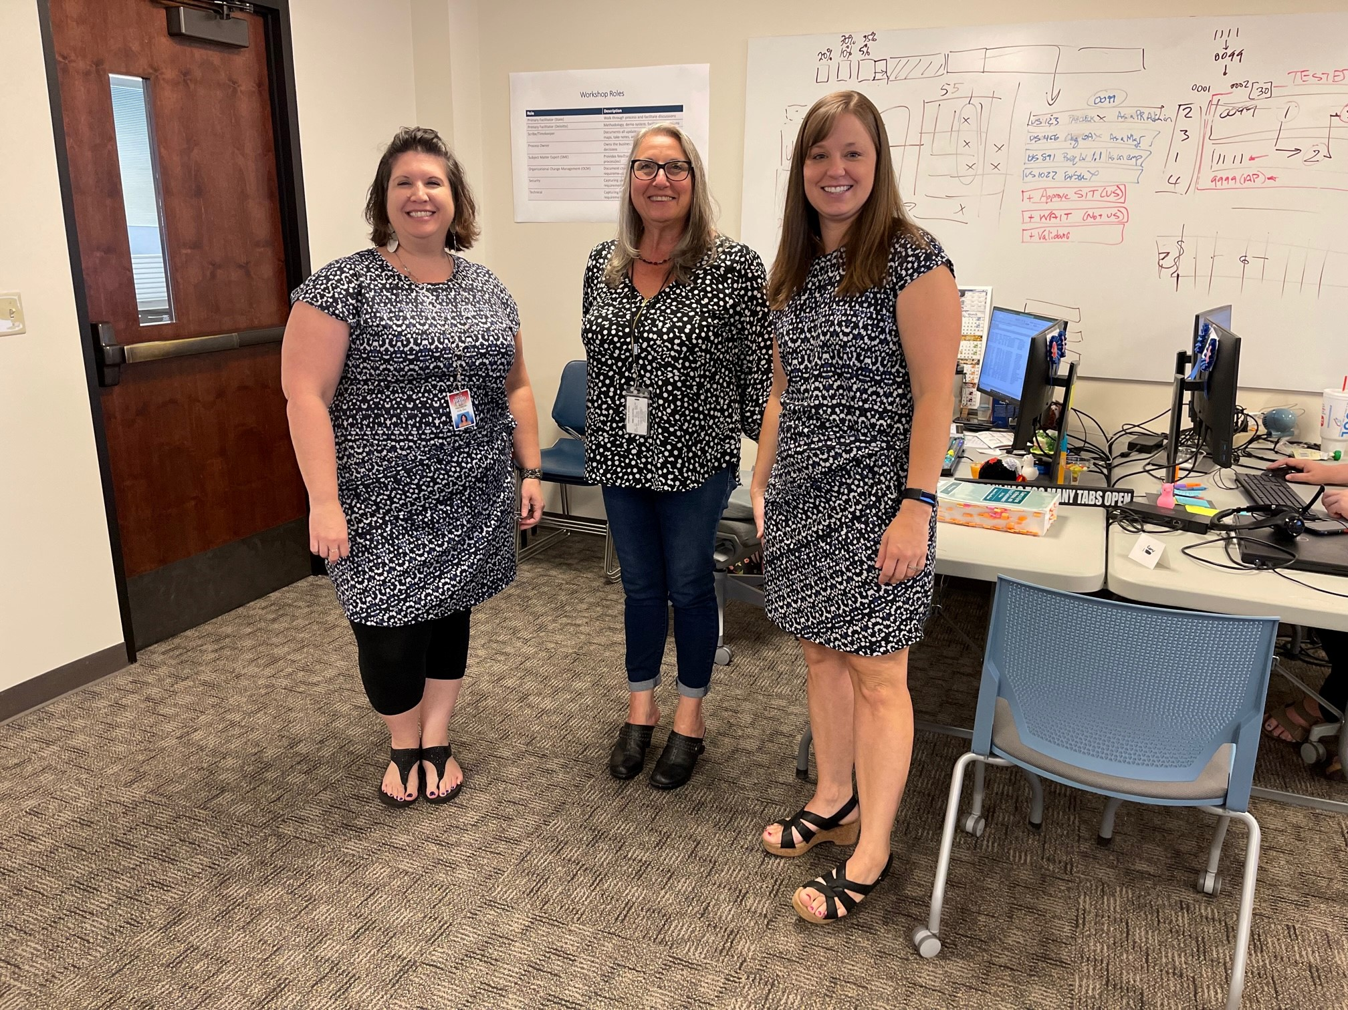
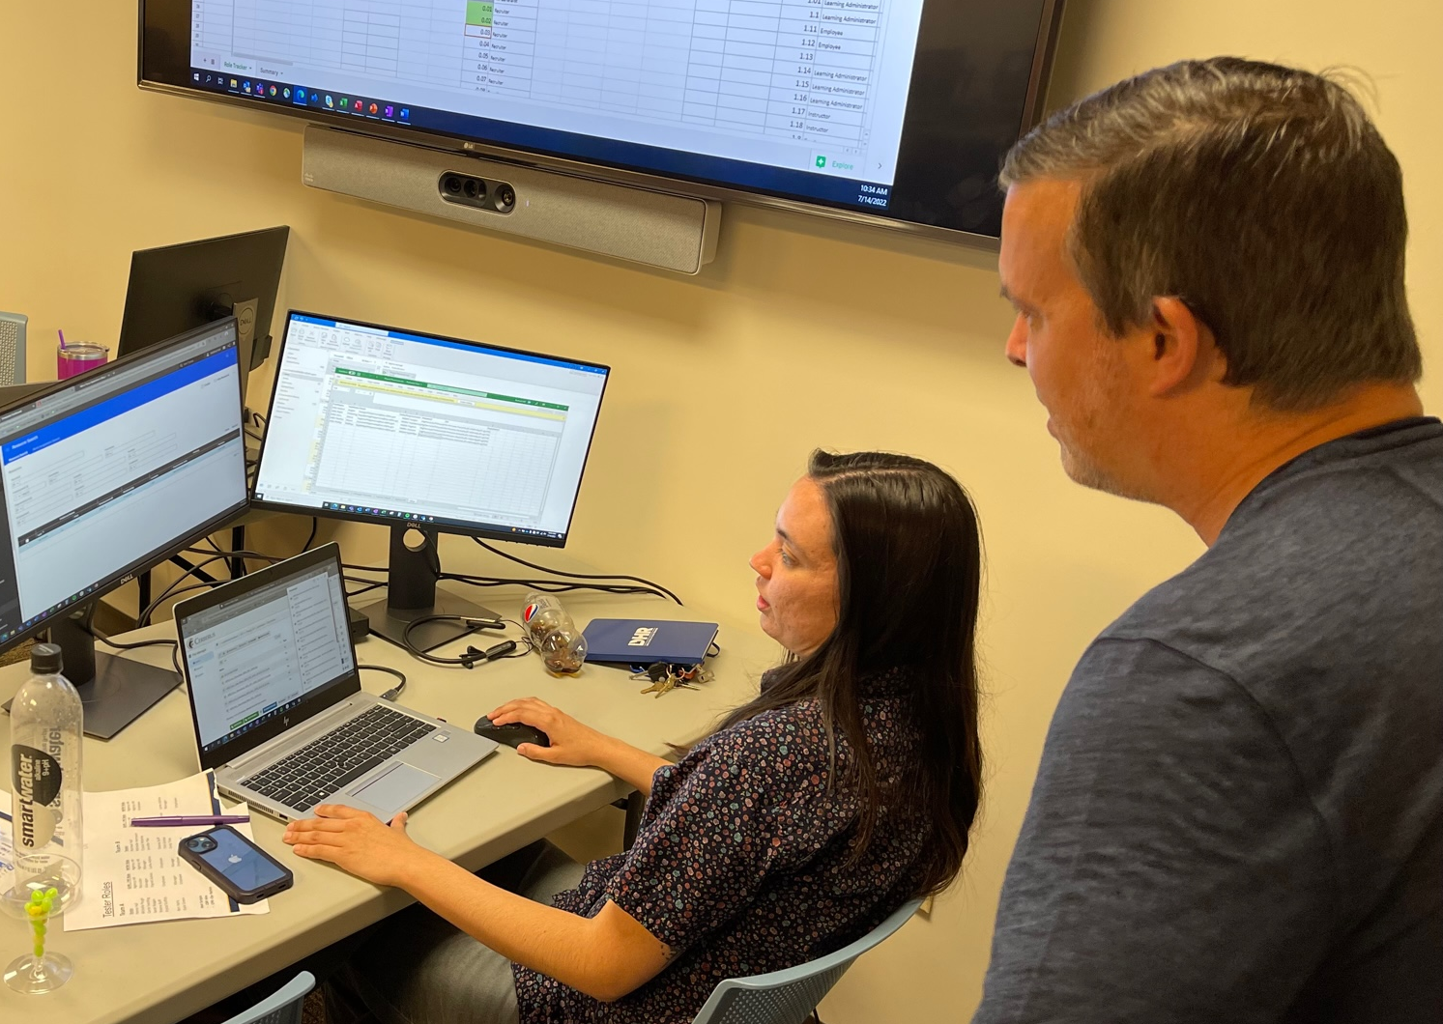
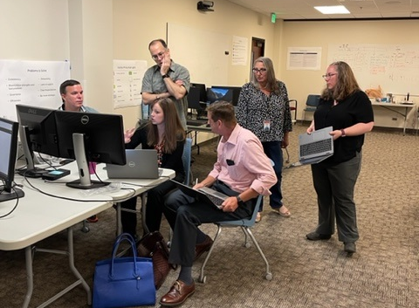
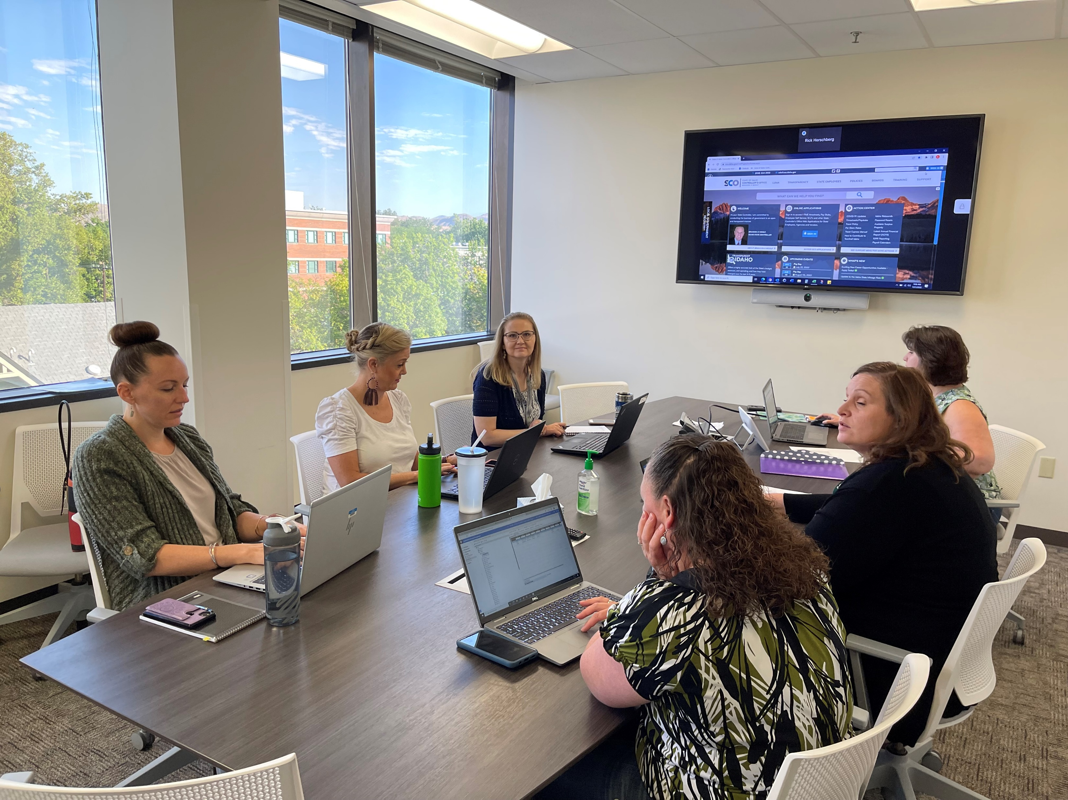

Slide 16
SIT 1 START | SIT1 END | AVAILABLE DAYS * | AS OF | ELAPSED DAYS | REMAINING DAYS | SCHEDULE PERCENT |  | TOTAL SCENARIOS | SCENARIOS STARTED | SCENARIO * START PERCENT | TOTAL TEST STEPS | EXECUTED STEPS | EXECUTED STEPS PERCENT | REMAINING STEPS
Mon July 11 | Fri Aug 19 | 30 | Mon Aug 1 | 16 | 14 | 53% (16/30) |  | 51 | 49 | 96% (49/51) | 1,523 | 1,015 | 67% (1,015/1,523) | 508
ACCOMPLISHMENTS
Created messy, collaborative, problem-finding, and fun work team with face-to-face daily group sessions All employee types that can be tested, have been tested Met state-testing capacity needs with 10 testers and 10 alternate testers; available as needed throughout the first three weeks Able to work around and improve failed and imperfect, first-pass quick reference guides (QRG’s) even as test steps are failing FINDING DEFECTS: Problems, gaps, and the unexpected! WFM has been a challenging component in SIT 1 as multiple data loads and fixes have been required, however, at the end of week 3, WFM migrations are all caught up (entitlements, policies, and balances) Security adjustments have been made almost daily and now LUMA admins can authorize time Successfully ran 4 Payroll Cycles (2 On and 2 Off) by the end of week 3; all have been closed and posted Some Payables Invoices are now ready for Finance; Expense Management Payroll ran for Transportation
IMPEDIMENTS (actively being resolved)
GHR defect resolution slow due to the number of defects and the availability of Deloitte resources to make fixes WFM transaction processing has been a problem, taking 20 minutes each when they should take 30 seconds each Configuration and processes for rehires needed
TEST BURNDOWN OVER TIME
Tests Remaining
PASSED | FAILED | BLOCKED | Not Needed
529 | 332 | 17 | 137
SLOW START (33 tests/day)
RAMPED UP (to >100 tests/day)
508 Remain to test
Performance Targets
Complete ~60 tests / workday [63/day]
Resolve Urgent & Very High Defects by Aug 19
ALL PHASE 2 DEFECTS 7/29
Severity Level | Severity | HR | Payroll | Security | WFM | Total
5 | Urgent | 0 | 0 | 0 | 0 | 0
4 | Very High | 0 | 0 | 0 | 4 | 4
3 | High | 5 | 0 | 0 | 7 | 12
2 | Medium | 69 | 3 | 0 | 14 | 86
1 | Low | 6 | 1 | 1 | 2 | 10
Total | Total | 80 | 4 | 1 | 27 | 112
 | Sprint | SIT 1 | Total
Open | 265 | 112 | 377
Closed | 2 | 109 | 111
In Process | 0 | 21 | 21
Total | 267 | 242 | 509
OPEN SIT 1 DEFECTS 7/29

Slide 17
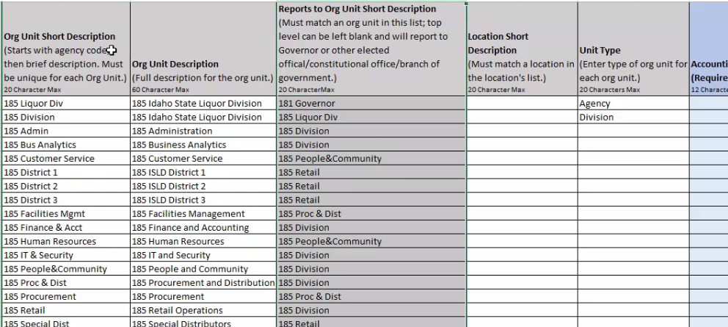
Phase 2 GHR Org Structure Workbook
The workbooks are located in on SFTP
The workbooks will be prefilled with your information: Locations, Org Units, and Manager data was taken from what we have in Luma. Positions are from IBIS and match what you currently have for filled and vacant positions.
Due: August 17th

Slide 18

Training

Slide 19

Training

Slide 20

Key Takeaways

Slide 21

Thank You!
Sheena Coles
SColes@sco.Idaho.gov
208-334-3100
Alex Doench
adoench@sco.Idaho.gov
208-332-8841
Chris Lehosit
clehosit@sco.Idaho.gov
208-332-8887
Elijah Stearns
estearns@sco.idaho.gov
208-332-8871
Danielle Stevens
dstevens@sco.Idaho.gov
208-332-8868

