Slide 1





Change Liaison Meeting
April 6th, 2022

Slide 2
Welcome!
Thank you for being here!
Expectations:
  Please give presenters your full attention.
  Please utilize the chat functionality (bottom right) to ask questions, or wait until the end of the presentation to come off of mute and ask.
  This meeting is being recorded and will be provided in the follow-up email.

Slide 3

We will be having hybrid in-person/virtual meetings starting next month!
Please let your Agency Advocate know if you plan to attend!

Slide 4

Phase 1 Path Forward
Phase 1 Activities
Phase 2 Update and Timeline
Phase 2 Activities
Key Takeaways
AGENDA

Slide 5

Luma Phase 1 Update

Slide 6

Phase 1 Path Forward
Key Points:
The Luma Project team is taking the responsible route and has determined a no-go for the July 1 Phase 1 Launch. This no-go decision will provide us with more runway to prepare state employees for the system go-live.
Our path forward is to clearly lay out the scope of work that needs to be completed prior to choosing a go-live date to ensure the work drives the timeline. The Phase 1 Project Management team is building the future roadmap and the solution will be presented at the next Governance Board meeting.
System functionality and quality remain paramount in our implementation of the Luma system. While this no-go decision is unfortunate, we fully believe it is necessary to provide robust end-to-end testing and focused end-user training required for the successful launch and sustainment of the Luma system in the future.
Please send your Agency Advocate any questions you may have regarding this no-go decision.
Go Live

Slide 7
What to expect next
Following this meeting, your Agency Advocate will provide you with…..
&
an FAQ
Talking Points
…to ensure that you have the information necessary to communicate this delay to other personnel at your agency.

Slide 8
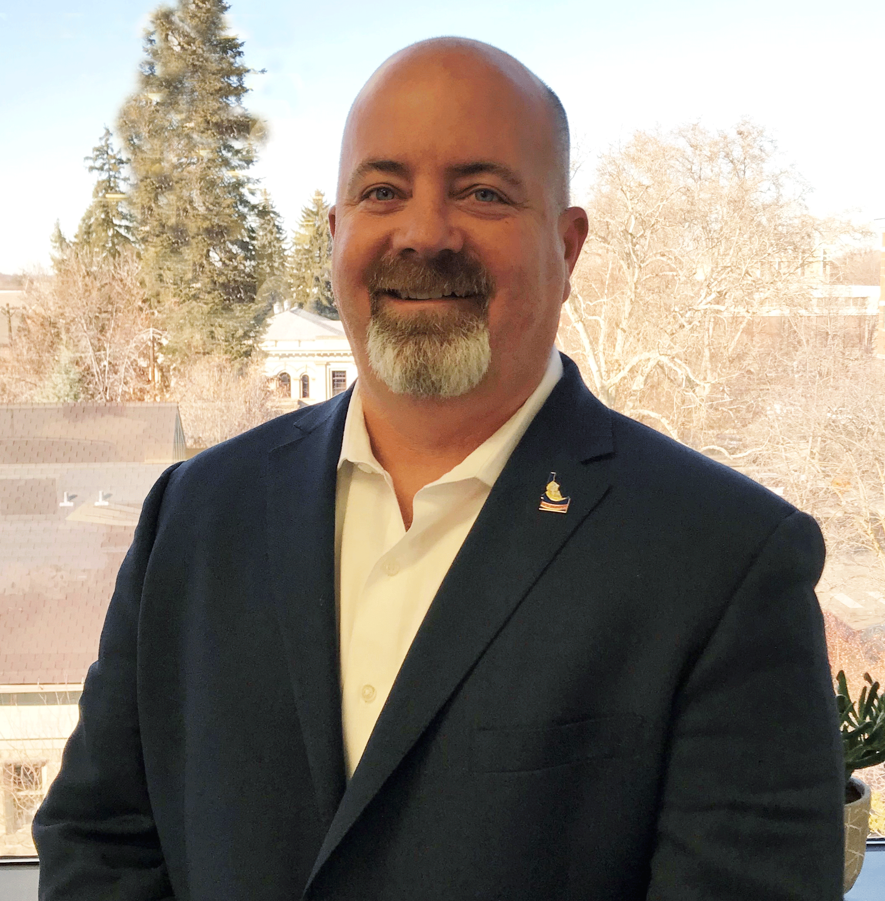
Phase 1 Project Manager Update
Scott Smith

Slide 9

Luma Phase 1 Activities

Slide 10
Workbook Refresh Effort
The Luma team has established an alternative method for submitting updated workbooks via the Secure Web Transfer Portal that can be seen on your Enterprise Dashboard.
Per your request, we will begin migrating the most recent copies of each of your workbooks to the Secure Web Transfer Portal in a designated folder for each agency. We will send a follow-up communication once this is complete.
If your agency does not already have access to this, please reach out to your Agency Advocate to have it set up.

Slide 11
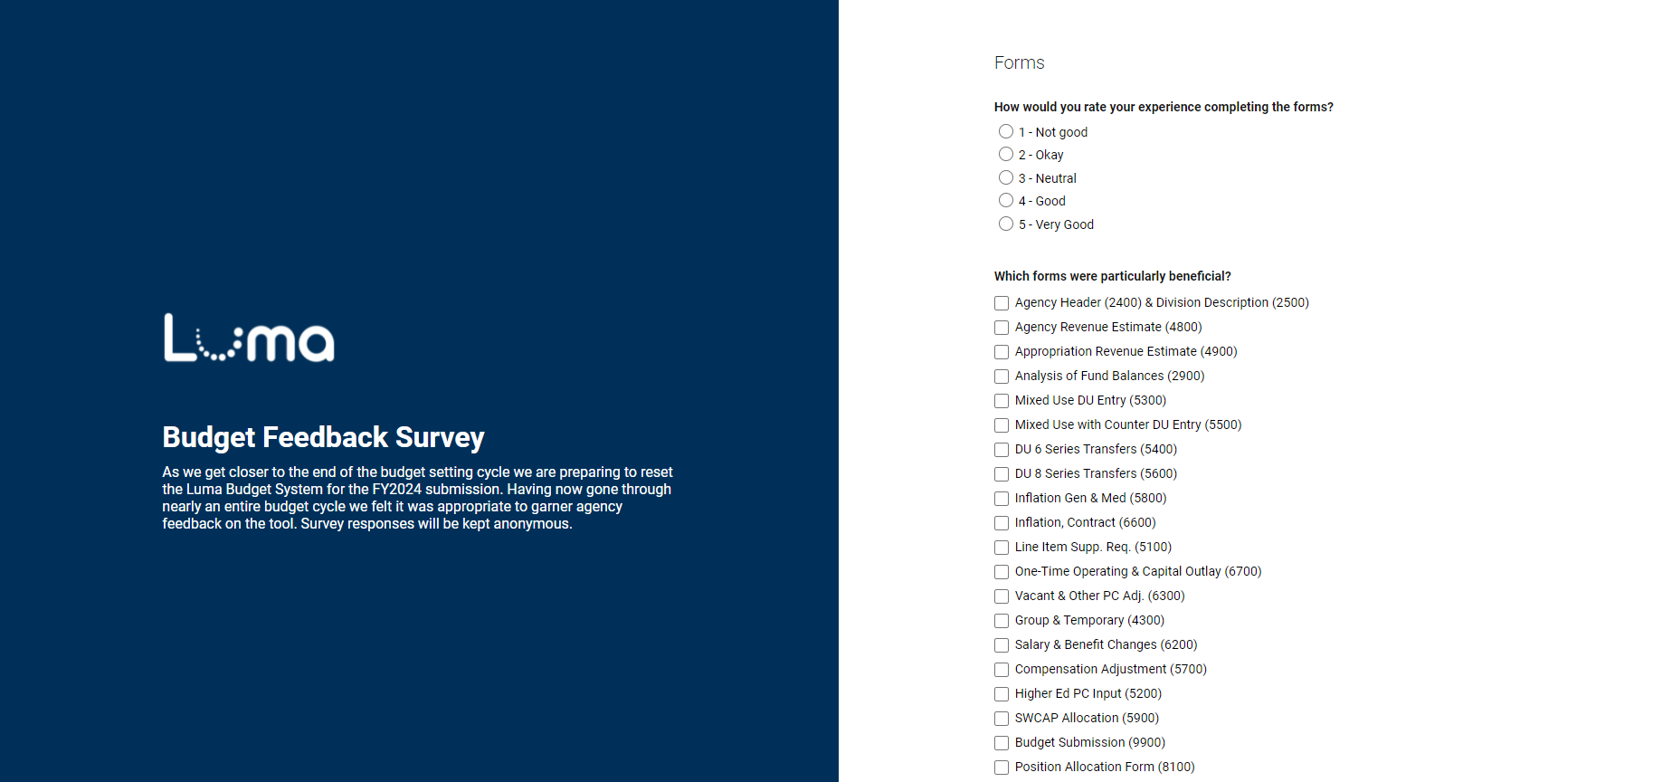
Luma Budget Feedback Survey
The Luma team sent an email out to Agency Budget Personnel on Friday, April 1st to garner feedback on the Luma Budget system.

Slide 12

Luma Phase 2 Update

Slide 13
JUL
AUG
SEP
OCT
NOV
DEC
JAN
FEB
MAR
APR
MAY
JUN
JUL
→
Infor Orientations
50+ BPR sessions
April 6, 2022
Sprints
started
1/18
Phase 2 Luma Base Configure
Schedule Refinements
In Final Review
Configuration
Workshops
Sprint 1
Sprint 2
Sprint 3
User Validation of Luma Functions
Early Phase 1, technical information
gathering, surveys, and analysis
Practice Conversion
Conversion Building
Interface Building
Interface Testing
Get End User Needs/Change Impacts

Slide 14
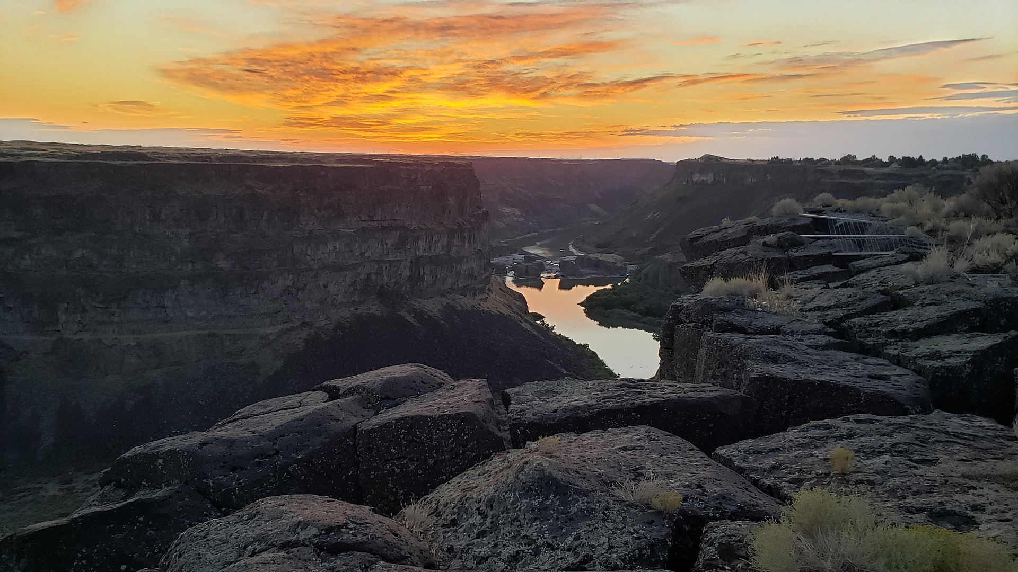
Luma Phase 2 Activities

Slide 15
Phase 2 Agency HR Org Unit Workbooks
Please reach out to your Agency Advocate if you need assistance.
If you are a pilot agency and have not submitted your workbook, please do so as soon as possible.
The Phase 2 HR Org Unit Workbooks were due last Thursday, March 31st for the pilot agencies.

Slide 16

Key Takeaways

Slide 17

Thank You!
Sheena Coles
SColes@sco.Idaho.gov
208-334-3100
Alex Doench
adoench@sco.Idaho.gov
208-332-8841
Tina Fuller
tfuller@sco.Idaho.gov
208-332-8867
Chris Lehosit
clehosit@sco.Idaho.gov
208-332-8887
Elijah Stearns
estearns@sco.idaho.gov
208-332-8871
Danielle Stevens
dstevens@sco.Idaho.gov
208-332-8868

