Slide 1
Change Liaison Meeting
April 7th, 2021
Notes:
Good afternoon everyone!
We glad to that you were able to join us.
Housekeeping
Mute if not speaking
Feel free to pop questions or comments in the chat or come off mute and vocalize if you are comfortable
Emojis
Now that we have housekeeping done – lets dive right in!

Slide 2

Re-defining Phase 1
On-going Activities & Upcoming Activities
Workforce Transition Plan
Showcases
Know Do Share Report (K.D.S.R.)
Resources
Q&A
AGENDA
Notes:
First up we have Chief Deputy Controller Whitworth to share some project updates with us.
Then, Sheena will share some information surrounding re-defining the phase one go live
Next, Danielle will review the on-going activities and share what you can expect to see coming.
After that, we have some information on the upcoming workforce transition plan.
Chris will talk showcases and go over the Know Do Share Report for this month
And we’ll wrap it up by opening the floor to all of you!
So without any further ado, I’ll pass you all over to Chief Deputy Controller Whitworth! Josh the floor is yours

Slide 3
Re-defining Phase 1
Notes:
Alex

Slide 4
Challenges that drove the decision
COVID-19:
Changing the way state government does business in a new ERP is very challenging by itself, having a pandemic thrown into the middle of the project has significantly constrained resources across the state and compounded the difficulty in many respects.
FRICE-W Conversion and Interface Challenges:
Conversions - 41 Total conversions, 63% passed SIT testing.
Interfaces - 167 total interfaces, 14% passed SIT testing.
Full development and successful SIT testing of interfaces and conversions were an entrance requirement for UAT.
Multi-tasking Challenges
Project activities, such as solution development and configurations, FRICE-W, UAT, cut-over planning. Training development were stacking stacked on top of each other. This placed project team members and agency staff at over 100% resource capacity and delayed the completion of project tasks.
RAID / Solution Issues:
There are numerous functionality areas that still require a solution to either be designed, developed, configured, and/or issues/defects resolved.

Slide 5
Luma Budget Go-live
This delay will NOT impact the Budget module training activities nor the projected May 2021 launch.
Please see below for information regarding the upcoming Luma Budget module training:
Weeks of March 29th-April 9th – Access to Luma Budget
  Computer Service Center (CSC) at the State Controller’s office will be uploading security roles into the Luma Budget System.
  Invitation to register for Multi-Factor Authentication tool Cisco Duo Mobile will be sent with instructions on how to complete registration.
  Once this is complete, you should have a new icon for the Luma Budget on the SCO Dashboard.
The training dates were adjusted to accommodate fewer people needing the training. Training Dates are as follows:
  April 12th & 13th Registration closes April 5th
  April 15th & 16th Registration closes April 8th
  April 19th & 20th Registration closes April 12th
  April 22nd & 23rd Registration closes April 15th
  April 26th & 27th Registration closes April 19th
  April 29th & 30th Registration closes April 22nd
Training Registration will close approximately 1 week prior to the start of that training. Once that training registration has closed another email will be sent with the WebEx information for training.

Slide 6
Next Steps
Governance Board Meeting and the vote to delay Phase 1 go-live.
March 30
Re-defining Phase 1 Guiding Principles:
Let the work dictate the timeline, not timeline dictate the work.
UAT conducted as a “full dress rehearsal” with all business processes and user roles.
Must achieve a level of confidence in user readiness through UAT, Training, and Sustainment.
Cutover Planning is timely and encompasses all solution and development requirements.
Communicate delay to agency stakeholders.
March 30
Re-defining Phase 1 planning period.
March 30 – April 20
Governance Board Meeting and the vote to approve the new Phase 1 go-live date.
April 20
Communicate new date to agency stakeholders.
April 20 - 21

Slide 7
Frequently Asked questions about the delay
With the delay of the launch for finance and procurement modules, when will Luma be going live? | At this time, we cannot provide an updated launch date. However, extensive planning has already begun and will span the next three weeks as we work with our partners (Deloitte, Infor, and ISG) to redefine our path to launch. We expect to publish revised plans with a new go-live date immediately following this planning period.
How will this impact the budget module launch scheduled for May 2021? | This delay will not impact the budget module training activities nor the projected May 2021 launch.
What caused this delay, and how is the Project Team mitigating a similar issue with the new plan? | Luma is a once-in-a-generation effort to modernize the state’s financial and operational tools. We are not only modernizing decades-old state systems but also standardizing numerous agency-specific systems to moving them into a standard business practice. This is a monumental change to both people and processes and the unforeseeable pressures of a pandemic delayed critical project-related activities. System functionality and quality remain paramount in our implementation of the Luma system. Each piece of Luma must meet a high set of standards before it is officially deployed to serve the people of Idaho, our planning activities will be guided by these standards to ensure the best product possible is released to the state.
With the launch being delayed, does my agency need to complete items requested by the project team? | Though this delay provides a needed extension for agencies, it requires that everyone continue an urgent pace completing project-related requests moving forward. Several project activities still require agency effort and your support remains critical to the success of Luma.
Who can I contact to get the most up-to-date information about how the delay will impact my agency? | Your Agency Advocate is the best resource for getting the most up-to-date knowledge about timelines and project activities.
For more information, please reach out to Sheena Coles at 208-332-8703 or via email at luma@sco.Idaho.gov

Slide 8
On-going & Upcoming
Activities

Slide 9
On-going Activities
Budget Staging and Workflow Workbook
Budget B11 & B12 Crosswalk Workbook
Projects & Grants Workbooks
COA Default & Payroll Crosswalk Workbooks
Agency Leases Workbook
MHC Workbook
Asset Clean-up
P-card Clean-up
Notes:
Danielle

Slide 10
Upcoming Activities
Luma Budget Module Training
Workforce Transition Plan and Associated Activities

Slide 11
Workforce Transition
Plan

Slide 12
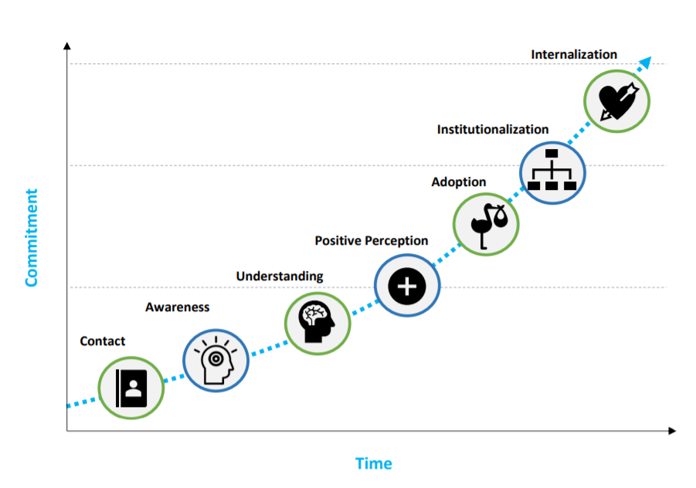
Workforce Transition Plan
Notes:
Discuss where we are in the change management commitment curve.

Slide 13




Workforce Transition Plan
MANAGER’S AWARENESS SESSIONS
LUMA LEARNING LABS
LUMA ROLE MATRIX
BUSINESS READINESS ASSESSMENT
Notes:
The Manager Awareness Workshop Sessions will highlight upcoming business process changes and impacts as result of Luma implementation. The sessions, which will be conducted virtually, will describe to senior managerial positions (e.g. Buyer positions for the procurement session, Finance Director for the finance session) the impacts relevant to specific functional areas: finance, budget, and/or procurement. Those that attend the Manager Awareness Workshop will be tasked to utilize the information to facilitate conversations directly with their employees to support agency business readiness.
I know this is stronger language…but I would argue that the cascade of information is critical to organizational awareness and buy-in
The Luma Learning Labs are designed to supplement the knowledge transfer from agency management to agency employees. The Luma Learning Lab sessions, which will mirror the content from the Manager Awareness sessions, will reinforce the benefits of specific business process changes as a result of the implementation of Luma. While it is ideal for agency employees learn about upcoming changes directly from their manager, the Luma project team recognizes that various challenges and constraints of agency managers may prohibit this within the timeframes required.

Slide 14
Workforce Transition Plan
Change Liaison Ask
We are looking for directors, managers, or other department supervisors to join us in Manager Awareness Sessions.
Who We Are Looking For
Mid- to senior-level employees
Employees who supervise teams
Minimum of one person from each workstream:
  Budget
  Finance
  Procurement
MANAGER’S AWARENESS SESSIONS
Describe upcoming changes based on their workstream.
Explain the benefits of changes.
Identify changes as having low, medium, or high impact.
Utilize information to facilitate business readiness within your agency.
Execute Role Assignments.
Submit names via Workbook
Notes:
Submit names through April so we are ready to go with the Sessions in the May/June timeframe

Slide 15
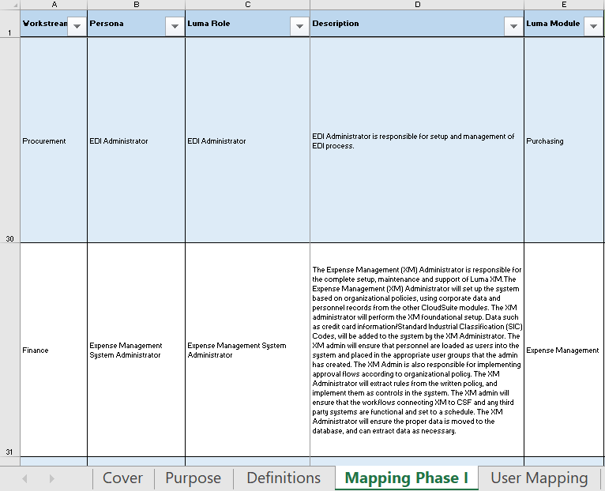
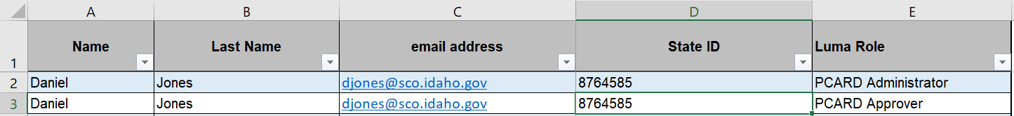
Workforce Transition Plan
2
3
5
Change Liaison Ask
Consolidate your agency’s role mapping into one Excel File.
LUMA ROLE MATRIX
1
4

Slide 16






Workforce Transition TimeLine
START
Attend Manager Awareness Workshop.
Meet with staff to answer any Luma questions.
Staff attend Luma Learning Labs
FINISH
Use the Luma Role Matrix to map your staff to roles.
Luma Phase I
Go-Live (Budget): May 17, 2021
Go-Live (Finance/Procurement): TBD
Sign up for training and encourage your staff to participate in training.
Attend training.

Slide 17
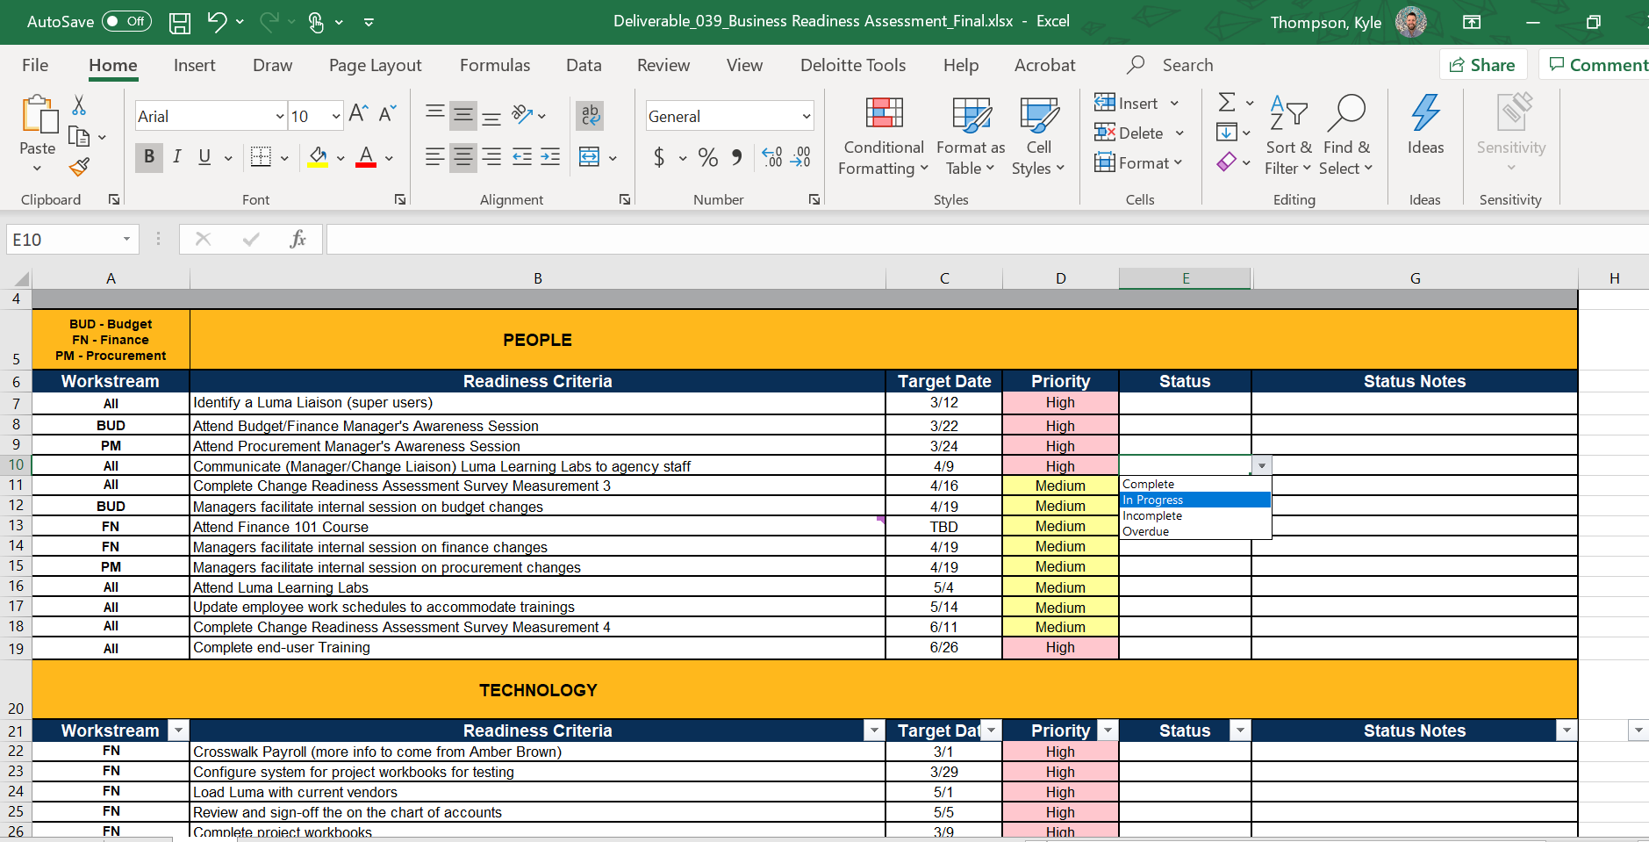
Workforce Transition Plan
BUSINESS READINESS ASSESSMENT
Change Liaison Ask
Update and submit the Business Readiness Assessment to your Agency Advocate.

Slide 18
Luma
Showcases
Notes:
Tina

Slide 19
Statewide Showcases
An opportunity for an overview of Luma topics and demonstrations of modules. Each statewide showcase will be done twice a month from 1:00 – 2:00 PM. The link to RSVP for these showcases will be sent to agency change liaisons from distribution within the agencies as well as in upcoming newsletters. Each statewide engagement/showcase will be recorded. The materials from the meeting will be sent out to agency change liaisons for distribution.
Upcoming Statewide Showcases | Engagement Topics
April 13th & 15th TBD | Reporting & Cutover Plan Overview
May 11th & 13th | Expense Management
Notes:
The Luma Showcases are intended to provide an opportunity for anyone and everyone to get some exposure to the Luma system. The Luma Showcases are intended to be intended for a higher level and less technical in nature so that any State Employee could benefit from attending and getting the information. Hopefully you will be able to help us get the work out so that anyone interested in the topic for the month will know they are happening and how to get signed up to attend!This month the Procurement Team will show off some of the procurement or purchasing related functionality in Luma. The procurement module includes things like requisitions, a really exciting punch out system that is almost like a Amazon- ish tool that State Employees can use to purchase or order or request things like office supplies. It won’t be a free for all ordering system, but it will make a purchasing and requesting items state employees need pretty slick. Agencies will have the ability to set up how this will work – who will be able to use it, the approval process and the like to fit their needs. We might also hear about strategic sourcing, contract management, the supplier portal and inventory control.In April there are two topics that we are hoping there will be a lot of interest in. The Reports Team will be showing some of the reports and reporting capabilities in the Luma System. We will also hear from the Luma Team members working on the plan for when the rubber hits the road and share some of the plans and activities that will be taking place to help us make the cut over on July first turning the lights off on STARs and the lights on in Luma!In May the Expense Management Team will be sharing some or showing off some of the exciting tools, and features related to the XM Module in Luma. XM is the Luma module that will handle things like P-Cards, and Employee Travel – planning, reimbursements, approval processing – all that fun stuff!Lots of fun and exciting things on the horizon – please please please help us get the word out and get as many people as possible on!

Slide 20




K.D.S.R.
Notes:
Danielle

Slide 21




Preparing Agencies for Success Before and After Infor CloudSuite Go-Live
KNOW
DO
SHARE
REPORT
Read Luma Project news and updates in this column.
Meet with employees and leadership in your agency to discuss these messages or action items.
Please share this information or engagement opportunities with your Agency
Report feedback to the project team or complete action items the Luma project team is requesting from your agency.
Redefining Phase 1: Due to the many hardships the pandemic has placed upon the Luma project and state agencies, Luma project leadership has concluded there is no longer adequate time to meet the planned July 1st launch for the Luma finance and procurement modules. With the approval of our Governance Board, the launch of the finance and procurement modules will be delayed. Extensive planning has already begun and will span the next three weeks as project leadership redefines our path to launch. We expect to publish revised plans with a new go-live date immediately following this planning period.
Newsletter: Please share the monthly newsletter with your colleagues!
Welcome to Luma: Please distribute the Welcome to Luma infographics to your agency staff. Find them here:
Luma YouTube Channel:
Can’t make it to a Luma meeting? Don’t worry! Check out the Luma YouTube Channel!
Workforce Transition Plan
Budget Staging & Workflow Workbook
Budget B11 & B12 Crosswalk Workbook
Projects & Grants Workbooks
COA Default and Payroll Crosswalk Workbooks
Agency Leases Workbook
MHC Workbook
Asset Clean-up
P-Card Clean-up
Workforce Transition Plan – Manager’s Awareness Sessions: We are looking for directors, managers, or other department supervisors who supervise teams to have a minimum of one person from each workstream below join us for the Manager’s Awareness Sessions :
Budget
Procurement
Finance
Internal Meetings: Please let us know if you have an upcoming internal meetings that we can present to your staff! We want every state employee to know about the Luma, the changes coming, and exciting benefits of a modern system.
Luma Newsletter #24
Infographics
Luma Budget Module Training: Training for the Luma Budget Module will begin April 12th.
Luma YouTube Channel
Statewide Showcase:
This month’s showcase has been cancelled in order to give our team ample time to focus on redefining go-live.
April 7th, 2021
Notes:
Danielle

Slide 22
Resources
Luma Newsletter:
https://mailchi.mp/0f598f6296ee/luma-system-testing-update
Welcome to Luma Series:
https://www.sco.idaho.gov/LivePages/luma_-welcome-to-luma-series.aspx

Slide 23
Thank You for Coming!
Sheena Coles
SColes@sco.Idaho.gov
208-334-3100
Alex Doench
adoench@sco.Idaho.gov
208-332-8841
Danielle Blackmer
dblackmer@sco.Idaho.gov
Chris Lehosit
clehosit@sco.Idaho.gov
Tina Fuller
tfuller@sco.Idaho.gov
Luma: luma@sco.idaho.gov

Slide 24
Questions

