Slide 1

Luma Change Liaison Meeting
May 2023

Slide 2
Introduction
Thank you for being here!
Expectations:
  Please give the presenters your full attention.
  Please utilize the chat functionality (bottom right) to ask questions, or wait until the end of the presentation to come off of mute and ask.
  This meeting is being recorded and will be provided in the follow-up email.

Slide 3

Agenda
Agenda
Change Readiness Assessment (CRA) 2 Results
Training Update
Supplier Portal Go-live
Hypercare
Cutoff and Freeze Dates
Operational Readiness Program (ORP)
Change Liaison Communications Toolkit
Luma Monthly Showcase
Current Cutover Activity Requests
Upcoming Cutover Activity Requests
Key Takeaways
Notes:
Change Readiness Assessment (CRA) 2 Results - Sheena
Training Update - Sheena
Supplier Portal Go-live - Sheena
Hypercare - Sheena
Cutoff and Freeze Dates - Krystal
Operational Readiness Program (ORP) - Diana
Change Liaison Communications Toolkit - Danielle
Luma Monthly Showcase - Danielle
Current Cutover Activity Requests - Elijah
Upcoming Cutover Activity Requests - Elijah
Key Takeaways - Sheena

Slide 4

Change Readiness
Assessment 2 Results

Slide 5


CRA 2 Results
The results outlined below are for the second CRA administered since the move to comprehensive system implementation in late 2022. It was open from April 17th through April 24th.
Response Rate and Demographics (CRA #1 results)
Insights
Moderate overall average increases in each area
Understanding Role/Function Specific Impacts remains the greatest opportunity
Attendance in 2+ WFT events / Change Liaison translated to slightly higher averages
Eagerness for Luma appears to have lowered as go-live approaches
Plan to continue readiness interventions after go-live
Re-evaluate communications strategies/plans to strengthen clarity and impact
Emphasis on Organizational Readiness Program (ORP)
Establish a “Super User” network
Completion Rate: 36% (74%)
Agency Participation: 42/69 (65/69)
Sub-Group Responses
HR: 42 (63)
Finance: 89 (161)
Change Liaisons: 19 (63)

Slide 6
Survey Items
CRA 2 Results
Overall Average (Change from Last CRA)
168 Total Responses
Adoption Success Factors
Awareness
Where to find helpful information
When is go-live
Programs Luma will replace
Who to contact for support or questions
Where to locate support or information
3.5
( .3)
Change Metric Definitions
Awareness
Employees have heard about Luma and can describe it
3.4
3.3 → 3.8
3.3 → 3.5
3.2 → 3.4
2.9 → 3.3
General Understanding
Employees can identify what the change means to their agency and to the state
General Understanding
Describe objectives and Scope
Describe anticipated benefits of Luma
Comms about Luma have been effective
I feel engaged and informed on Luma activities
I understand the need for change to Luma
3.4
( .1)
Role/ Function Specific Impacts
Employees know how Luma will affect the processes they work in and their day-to-day activities, and when these changes are happening
3.3
3.5 → 3.4
2.5 → 2.7
2.7 → 2.8
4.3 → 3.9
Role/
Function Specific Impacts
Describe how my role/daily activities will change
I am aware of the steps to transition
I understand what is expected of me before, after and during the transition
2.7
( .4)
Readiness to Perform
Employees have the attitude and ability to operate in the new system and processes and to locate resources for help
2.5 → 2.6
2.1 → 2.8
2.0 → 2.6
Readiness to Perform
I understand skills and knowledge required to
use Luma
Employees are looking froward to the changes
Employees are willing to embrace change
My agency has identified and prepared for risks associated with Luma
2.9
( .1)
Leadership Support/ Environment
Employees feel their leadership is supportive of the Luma transition and is creating the environment to ease that transition
2.2 → 2.8
2.9 → 2.6
3.3 → 3.4
3.0 → 3.1
Key
Leadership Support/ Environment
Agency leadership openly supports Luma
Management is encouraging me to engage with Luma
My Supervisor is advocating the need for change
3.8
( .1)
= 1 - 2.9 Area of Concern
= 3 - 3.9 On-Track
= 4 - 5 Strength
3.7 → 3.9
3.8
= Increased a level
4.0 → 3.9
= Decreased a level

Slide 7
Average Scores (arrows indicate comparison to overall average)
CRA 2 Results
Overall Avg
2 + WFT events (70)
Finance (89)
HR (42)
Change Liaisons (19)
Adoption Success Factors
Awareness
3.5
3.7
3.4
3.6
3.7
Group Results
Participation in Events
Respondents who participated in two or more events scored higher, on average, on all metrics compared to the overall pool of respondents
General Understanding
3.2
3.3
3.3
3.5
3.4
Human Resources
Employees within the Human Resource workstream had higher average response scores compared to other stakeholder groups
Role/
Function Specific Impacts
2.7
2.8
2.6
2.7
2.5
Readiness to Perform
2.9
3.0
2.9
3.1
3.0
Finance
Participants with a Finance function reported lowest overall scores out of the four groups examined
Leadership Support/ Environment
3.8
4.0
3.9
3.9
4.0
Change Liaisons
Possibly due to their role as intermediaries between their agencies and the Luma Project, Change Liaisons scored higher than average on all change metrics except role/functional specific impacts

Slide 8

Training Update

Slide 9

Supplier Portal Go-live

Slide 10
Supplier Portal Go-live
More information regarding the Supplier Portal Go-live will be coming in the following days!
May 5
Supplier Portal
Go-live

Slide 11

Hypercare

Slide 12
Hypercare
The main objective of hypercare is to stabilize the solution from a people, process, and technology perspective and transition to permanent production support as soon as possible
It will be supported through hypercare with:
Project resources on-site and off-site
Daily status calls for immediate triage support required
What is Hypercare?
The transition period between go-live and ongoing sustainment operations of the Luma Solution
Business as Usual (BAU) sustainment processes are followed with the addition of centralized reporting, tracking, and communications provided by the Luma Hypercare Command Center
Establish Communication
  Establish consistent communication of status to key stakeholders
  Define escalation path for expedited decision-making
Provide Assistance
  Provide a period of direct assistance with knowledgeable project team members
  Proactively identify potential points of critical failure and take action to mitigate before the issue arises
Issue Management
  Identify, prioritize, solve, and communicate solution issues and gaps
  Facilitate rapid triage and effective management through the hypercare channels
  Provide clear accountability in tracking, prioritizing, driving of issues/actions
Path to Steady State
  Ensure resources are allocated efficiently and are given the right training and support
  Identify any gaps in the above and establish plans & clear owners to close/mitigate
  Provide a tracker to monitor progress toward stabilization using exit criteria
  Regular ticket and issue reporting including resolution/ lessons learned

Slide 13

Cutoff and Freeze Dates

Slide 14
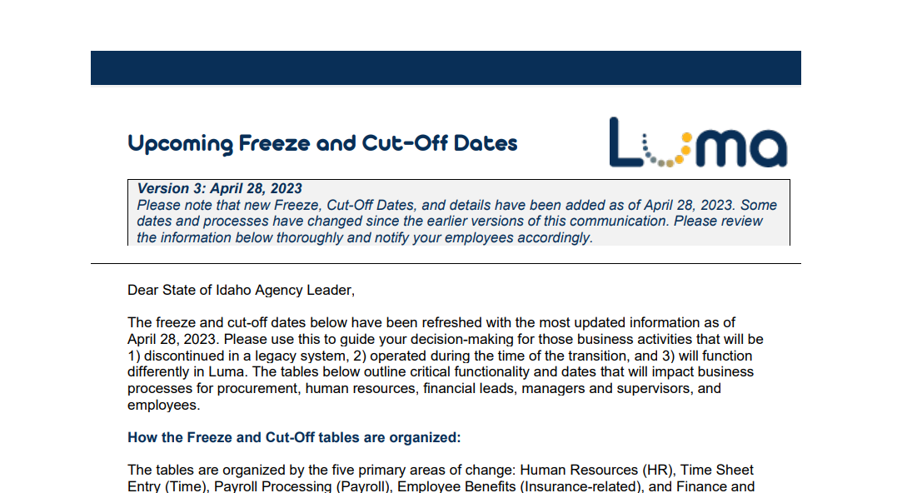
Cut-off and Freeze Dates
The latest updated document now includes information on Interim Processes for all cutoff and freeze dates.
Please continue utilizing the tools in the Service Desk!

Slide 15

Operational Readiness
Program (ORP)

Slide 16

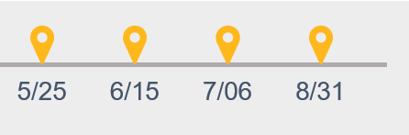
ORP Support Session Debrief/Schedule
April 27th Session at 11 AM
Completed
Over 85 participants
Great questions
Demonstration of the tools:
  Leadership Readiness Checklist
  Operational Readiness Tracker
  Service Desk access to tools
May 25th Session at 11 AM
Upcoming
Review the June/July Readiness Checklist
Readiness Checklists by Role updates
Impact Statement Catalog updates
Upcoming Support
Session Schedule:
Be on the lookout for weekly Leadership Readiness Checklist updates!

Slide 17

Change Liaison
Communications Toolkit

Slide 18
CL Communications Toolkit
Table of Contents
The following tools will be available in the April Change Liaison Communications Toolkit released in the next week. Thank you for sharing them with your agency colleagues!
Tool # | Description | Slide Numbers
1 | Human Capital Management (HCM) Glossary | 3-4
2 | Frequently Asked Questions | 5-6
3 | Luma Training Resources | 7-8
4 | Luma Showcase Timeline | 9-10
5 | ORP: April Readiness Checklist and Support Sessions | 11-12
6 | Luma Supplier Portal Go-live | 13-14
- | Appendix – Resources, Toolkit Instructions

Slide 19

Luma Showcases

Slide 20
Luma Showcases
Due to requests for increased touchpoints and greater visibility into the Luma transition, we are planning a series of Luma Monthly Showcase Sessions for Change Liaisons. Each session will be led by a subject matter expert (SME) who will speak on the topic at hand followed by a Q&A. Although these sessions are designed for CLs, they can bring members of their agency who would benefit from learning more about the monthly topic.
 | March | April | May | June | July
Monthly Topic | Training Showcase | Cutover and Conversion Workbooks | Reports | Technology – Mingle (formerly Enterprise Dashboard) & Service Desk | Sustainment
SME | Training Team | Cutover Team | Luma OCM | CSC | Sustainment Team
Objectives | Build awareness of training schedule and topics. | Cover cutover freeze dates, and procedures. Support for completing conversion workbooks. | Support agencies with report submissions. | Offer tutorial on how to access Mingle and Service Desk. | Post go-live session to support the adoption of the Luma system.
Date | 3/14 Recording up on YouTube | 4/19 Recording up on YouTube | 5/17 | TBD | TBD

Slide 21

Current Cutover Activity Requests

Slide 22
Current Cutover Activity Requests
May 4
May 8
May 12
May 12
Luma Production Custodial Account Management (CAM)
State Treasurer’s Office Receipt Batch and Distribution
Luma Final GHR Org Workbook
Luma Accounts Payable (AP) Defaults Validation/Update
May 12
May 12
May 31
June 15
Luma Cost
Allocations
Workbook
Luma Accounts Receivable, Billing, & Interagency Review
Luma Procurement
Configuration
Workbook
Luma Approval Workflows Workbook

Slide 23

Upcoming Cutover Activity Requests

Slide 24
Upcoming Cutover Activity Requests
TBD
May 22
June 16
Luma FSM/HCM Security Roles
Luma Asset Management
Luma CAM
Beginning Balances

Slide 25

Key Takeaways

Slide 26

Thank you!
Sheena Coles
SColes@sco.Idaho.gov
208-334-3100
Alex Doench
adoench@sco.Idaho.gov
208-332-8841
Danielle Stevens
dstevens@sco.Idaho.gov
208-332-8868
Chris Lehosit
clehosit@sco.Idaho.gov
208-332-8887
Krystal Griffith
kgriffith@sco.Idaho.gov
208-332-8861
Elijah Stearns
estearns@sco.Idaho.gov
208-332-8871

