Slide 1

Luma Change Liaison Meeting
April 2023

Slide 2
Introduction
Thank you for being here!
Expectations:
  Please give the presenters your full attention.
  Please utilize the chat functionality (bottom right) to ask questions, or wait until the end of the presentation to come off of mute and ask.
  This meeting is being recorded and will be provided in the follow-up email.

Slide 3

Agenda
Agenda
Training Update/Timeline
Operational Readiness Program (ORP) Tools
Cutover
Change Liaison Communications Toolkit
Luma Showcases
Outstanding Requests
Luma HR Organization Workbook
Key Takeaways
Notes:
Training (Registration/Timeline) – Julie/Sheena
DUO/Service Desk changes - Sheena
ORP Tools - Diana
readiness checklist by roles (website)
Service desk change (screenshot)
Support session calendar/debrief
Cutover - Elijah
Comms with freeze dates
Cutover plan for conversion/interface/workbooks
Hr org
Luma Showcases - danielle
Key Takeaways – sheena

Slide 4

Training Update/Timeline

Slide 5
Training Timeline
11
Training Registration Opens (for Instructor-Led Training)
22
FSM Training Begins
Thru Apr 10
Build Training Schedules and Prep LMS (Platcore)
28
Training Environment Preparations Complete for HCM Training
30
FSM Training Completed
April
May
1
Priority HCM Training Begins
June
16
Priority HCM Training Completed
Apr 15 – May 19
Trainer Preparation

Slide 6
Training Update
Frequently Asked Questions
When do employees start training?
Training registration begins the week of April 10th.
What training do employees complete?
Pre-Req Training
  Welcome to Luma
  Accessing Luma
  Basic Navigation
  Accessing Luma Training
  Luma Support
All employee training (mass end-user)
Role-specific training
How is training delivered?
VILT (virtual instructor-led training, register to attend the online class)
Self-paced training (complete independently)
What do employees do after they complete pre-req training?
Start on all employee training (micro learnings)
What are the next steps for training?
Look for email communication with the next steps and instructions.
Includes pre-req training, employee training, manager training
How do I get credit for completing the class?
Complete the course evaluation or assessment to get credit for the course.
To get credit for the course, complete the knowledge check or course evaluation – these are automatically sent by and to the Service Portal “My To Dos”

Slide 7

Operational Readiness
Program (ORP)

Slide 8
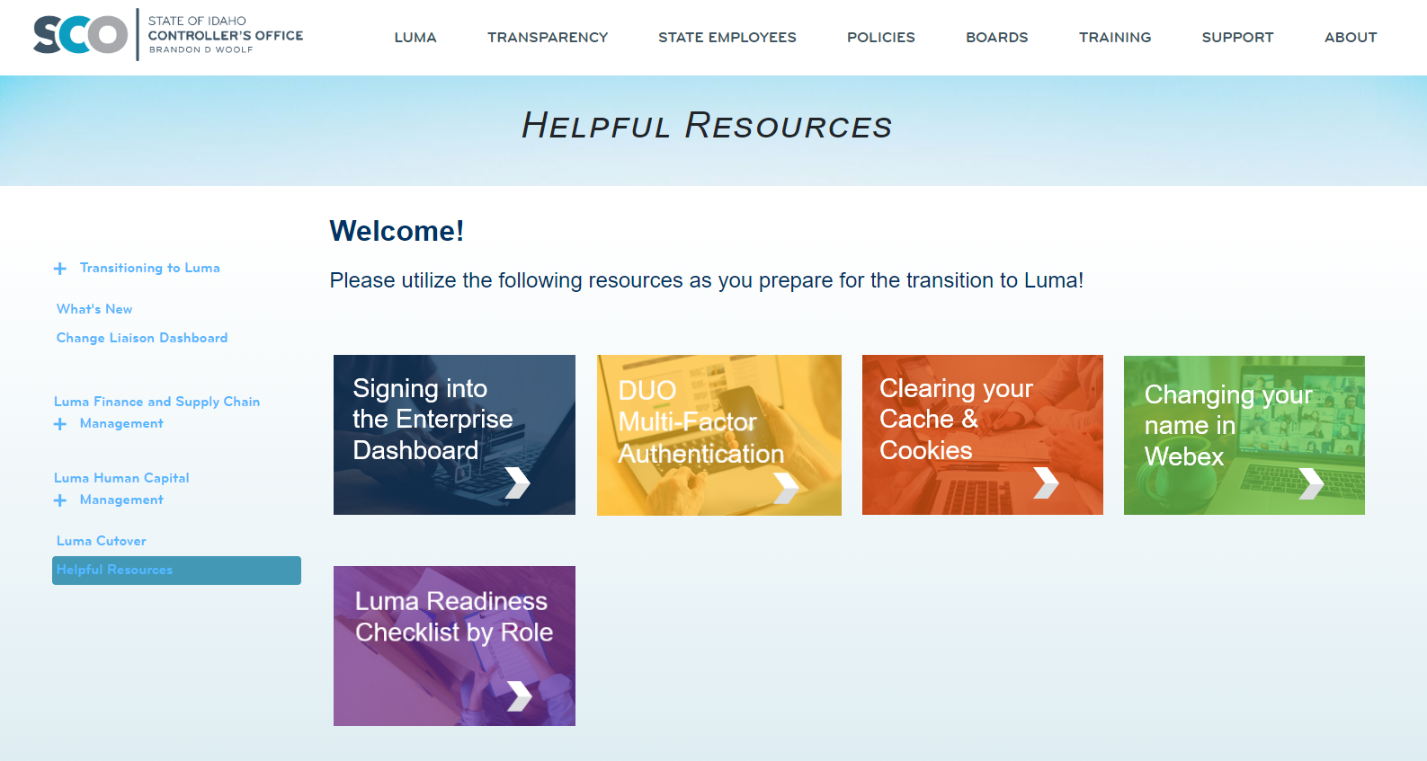
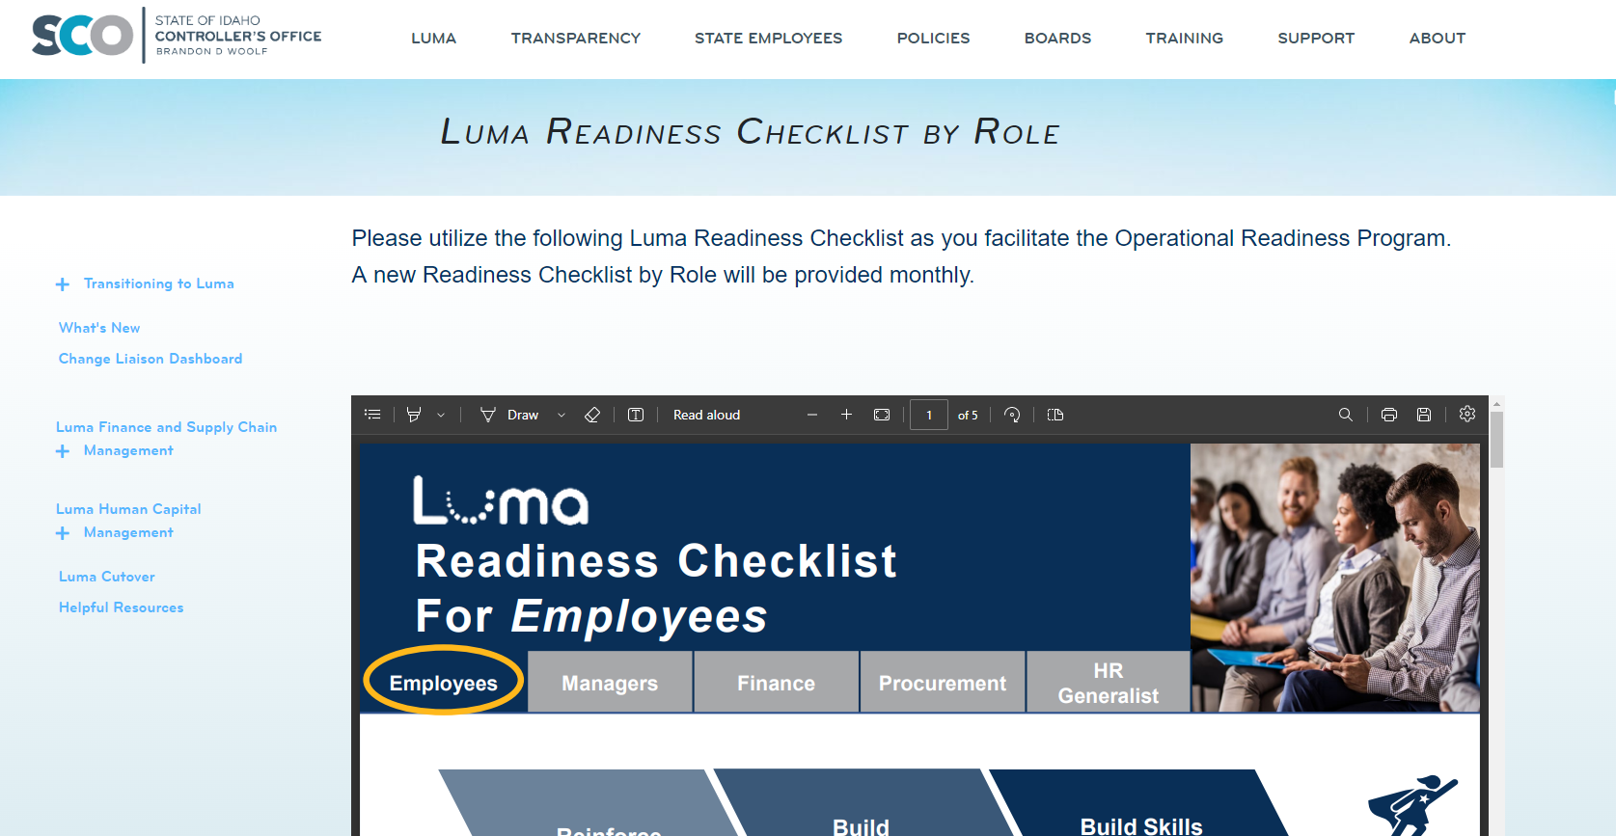
Readiness Checklist by Role
The Luma Readiness Checklist by Role provides customized checklists for the various employee roles within an agency. Since everyone in the state has a role in the success of Luma, the checklists help each person understand what they can do toward the larger success of Luma. These colorful and interactive checklists can be printed and distributed, emailed, reviewed in meetings, and celebrated as a tool for the success of the agency.

Slide 9


ORP Support Session Debrief/Schedule
March 30th Session at 11 AM
Completed
Over 90 participants
Great questions
Demonstration of the tools:
  Leadership Readiness Checklist
  Operational Readiness Tracker
  Service Desk access to tools
April 27th Session at 11 AM
Upcoming
Invites coming April 13th
Updates on Impact Statements
Review the May/June Readiness Checklist
Readiness Checklists by Role available April 20th
Upcoming Support
Session Schedule:
4/27
5/25
6/15
7/06
8/31
The Operational Readiness Program Survey is forthcoming.

Slide 10
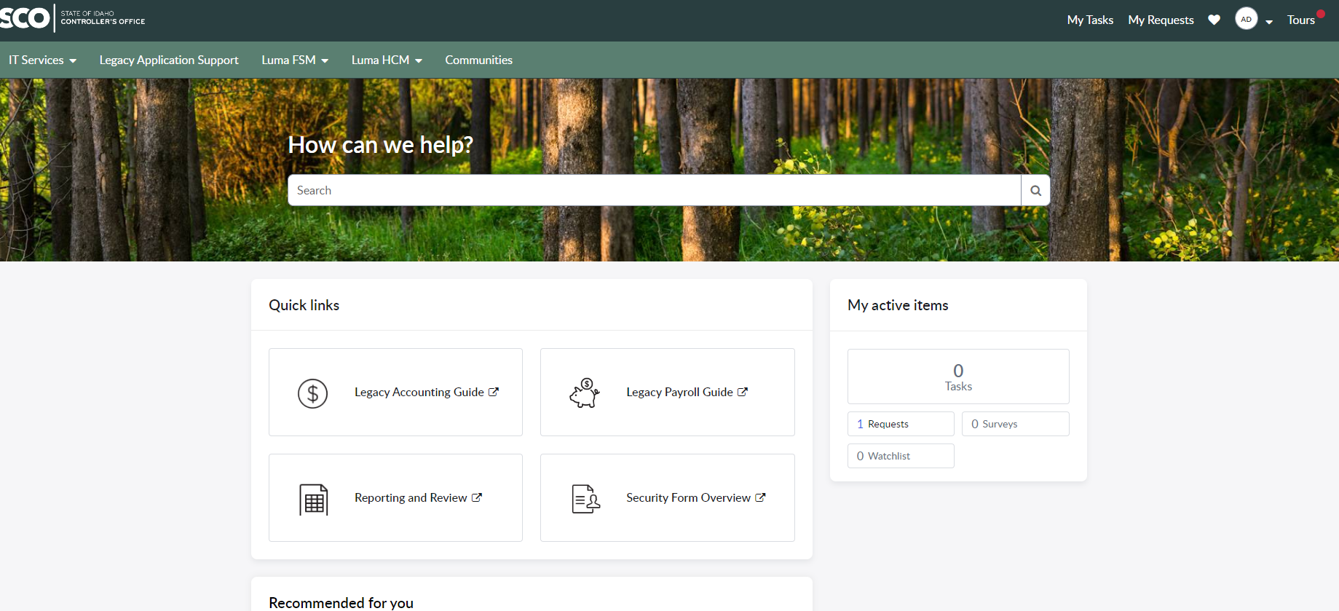
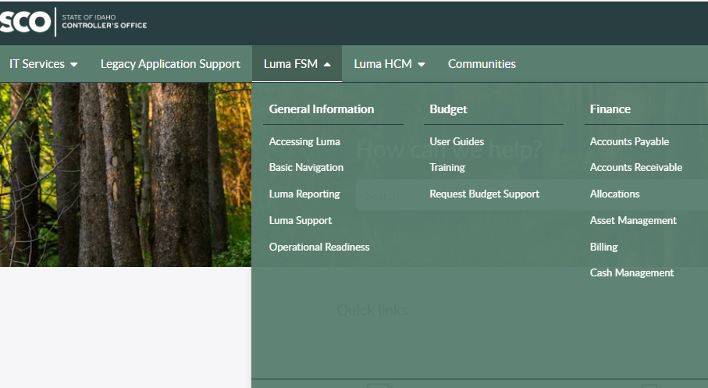
Service Desk Changes

Slide 11

Cutover

Slide 12
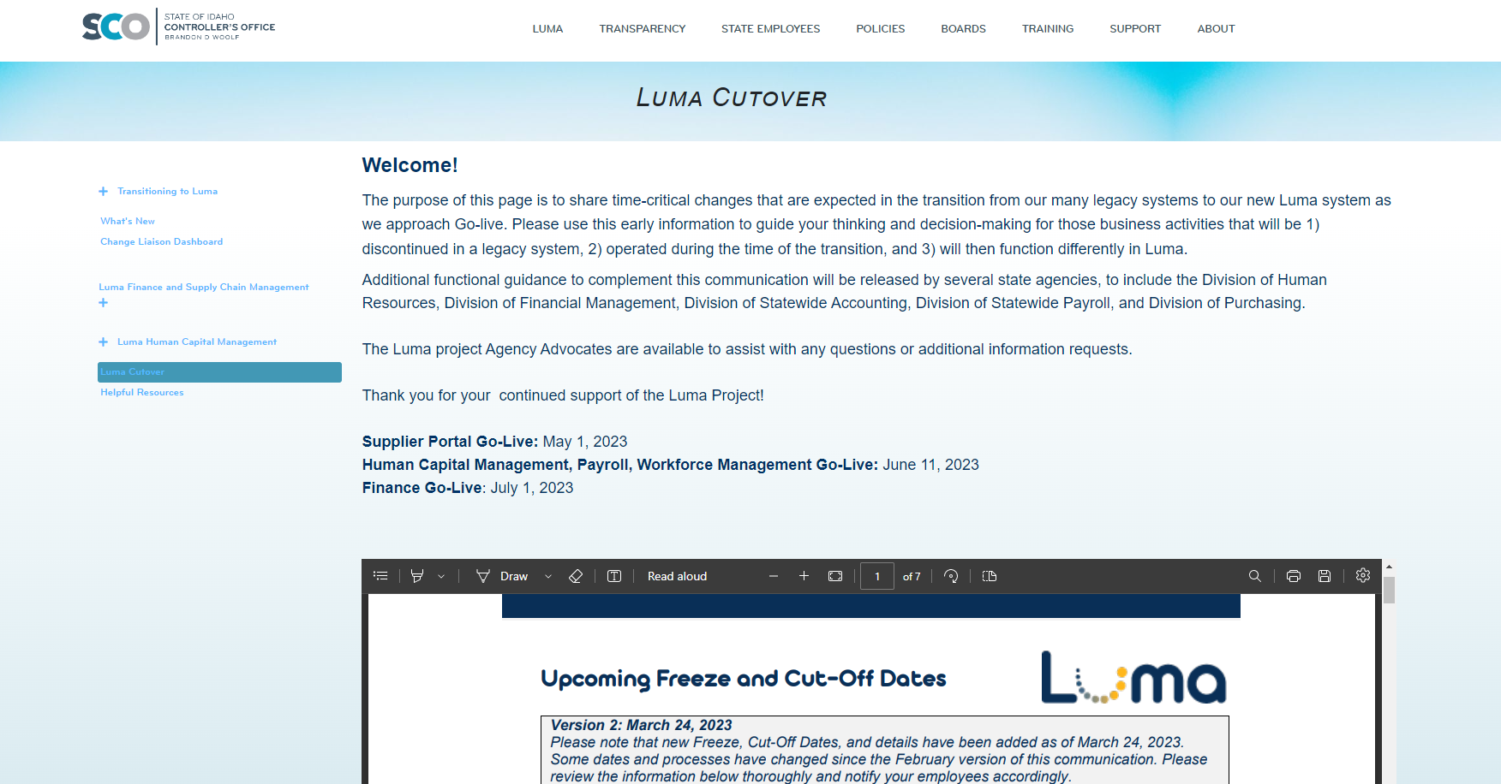
Cutover
The Luma Cutover webpage is continuously updated with more information regarding cutover and freeze dates.

Slide 13
Finance Data Conversions Required for Human Capital Management Go-Live
FRICE ID | Agency Code | File Name | Send Date | Due Date
CFS114 | All | Customers: All Agencies | 04/10/23 | 04/24/23
CFS022 | 140 | Vendors- Controller, Office of the State | 05/02/23 | 05/03/23
CFS105 | 270 | Vendors - Department of Health and Welfare | 05/04/23 | 05/05/23
Finance Data Conversion Requests
FRICE ID | Agency Code | File Name | Send Date | Due Date
CFS101 | 170 | Contract 170- Education, State Department of Idaho State | 06/01/23 | 06/02/23
CFS108 | 187 | Contract 187- Aging, Commission | 06/01/23 | 06/02/23
CFS099 | 245 | Contract 245- Environmental Quality, Department of Idaho State | 06/01/23 | 06/02/23
CFS065 | 270 | Contract 270- Health and Welfare, Department | 06/01/23 | 06/02/23
CFS107 | 330 | Contract 330- Police, Idaho State | 06/01/23 | 06/02/23
*This is a draft and an updated formal document is forthcoming

Slide 14
Finance Data Conversion Requests
FRICE ID | Agency Code | File Name | Send Date | Due Date
CFS008 | 200 | Contract 200- Administration, Department of Idaho State | 06/01/23 | 06/02/23
CFS110 | 290 | ITD Prior Year Encumbrance | 06/02/23 | 06/11/23
CFS114 | All | Customers: All Agencies | 06/05/23 | 06/15/23
CFS063 | 270 | Customers - Department of Health and Welfare | 06/10/23 | 06/20/23
CFS029 | 230 | Inventory 230- Department of Correction | 06/07/23 | 06/16/23
CFS116 | 285 | Inventory 285 - Department of Juvenile Corrections | 06/07/23 | 06/16/23
CFS031 | 330 | Inventory 330- Police, Idaho State | 06/07/23 | 06/16/23
CFS032 | 444 | Inventory 444 - Veterans Services | 06/07/23 | 06/16/23
CFS092 | 954 | Inventory - 954 - Health District 4 | 06/07/23 | 06/16/23
CFS113 | All | P-Card Numbers and Users - Semi-Automated | 06/12/23 | 06/13/23
CFS064 | 270 | Open AR- DHW - Automated | 06/30/23 | 07/12/23
CFS090 | 330 | Open AR- ISP : Send request for data extraction | 06/30/23 | 07/12/23
*This is a draft and an updated formal document is forthcoming

Slide 15
Finance Data Conversion Requests
FRICE ID | Agency Code | File Name | Send Date | Due Date
CFS098 | 290 | Open AR - ITD - Automated | 06/30/23 | 07/12/23
CFS112 | 285 | Open AR - 285 - DEPARTMENT OF JUVENILE CORRECTIONS | 06/30/23 | 07/12/23
CFS095 | 231 | Open AR - 231 - CORRECTIONAL INDUSTRIES | 06/30/23 | 07/12/23
XXX | 290 | Open AR - ITD Inter agencies conversion | 06/30/23 | 07/12/23
XXX | 177, 200, 522, 951 | Open AR | 06/30/23 | 07/12/23
XXX | 245 | Open AR | 06/30/23 | 07/12/23
XXX | 190 | 190 | 06/30/23 | 07/12/23
CFS048 | 240 | Assets - 240 - LABOR, DEPARTMENT OF IDAHO STATE - Assets Conversion - Automated | 06/30/23 | 07/14/23
CFS055 | 185 | Assets - 185 - LIQUOR DIVISION, IDAHO STATE - Assets Conversion- Automated | 06/30/23 | 07/14/23
CFS076 | 183 | 183 - (PERSI) PUBLIC EMPLOYEES RETIREMENT SYSTEM OF IDAHO | 06/30/23 | 07/14/23
*This is a draft and an updated formal document is forthcoming

Slide 16
Finance Data Conversion Requests
FRICE ID | Agency Code | File Name | Send Date | Due Date
CFS089 | 957 | Assets - 957 - HEALTH DISTRICT 7 (EASTERN) | 06/30/23 | 07/14/23
CFS087 | 955 | Assets - 955 - HEALTH DISTRICT 5 (SOUTH CENTRAL) | 06/30/23 | 07/14/23
CFS085 | 953 | Assets - 953 - HEALTH DISTRICT 3 (SOUTHWEST) | 06/30/23 | 07/14/23
CFS084 | 952 | Assets - 952 - HEALTH DISTRICT 2 (NORTH CENTRAL) | 06/30/23 | 07/14/23
CFS083 | 951 | Assets - 951 - HEALTH DISTRICT 1 (PANHANDLE) | 06/30/23 | 07/14/23
CFS082 | 440 | Assets - 440 - LOTTERY COMMISSION, IDAHO STATE | 06/30/23 | 07/14/23
CFS054 | 100 | Assets - 100 - SENATE, IDAHO | 06/30/23 | 07/14/23
CFS051 | 300 | Assets - 300 - INDUSTRIAL COMMISSION | 06/30/23 | 07/14/23
CFS046 | 285 | Assets - 285 - DEPARTMENT OF JUVENILE CORRECTIONS | 06/30/23 | 07/14/23
CFS042 | 231 | Assets - 231 - CORRECTIONAL INDUSTRIES | 06/30/23 | 07/14/23
CFS056 | 352 | Assets - 352 - Tax Commission | 06/30/23 | 07/14/23
*This is a draft and an updated formal document is forthcoming

Slide 17
Finance Data Conversion Requests
FRICE ID | Agency Code | File Name | Send Date | Due Date
CFS086 | 954 | Assets - 954 - Health District 4 | 06/30/23 | 07/14/23
CFS045 | 270 | Asset – 270 – Department of Health and Welfare | 06/30/23 | 07/14/23
CFS010 | 140 | GL Balances - SCO | 07/14/23 | 07/14/23
*This is a draft and an updated formal document is forthcoming

Slide 18
GL Chart of Accounts
The cutoff for any updates to be made to the GL Chart of Accounts (Org Cost Center, Program, Location, and Additional Reporting plus Org and Program defaults) before go-live will be April 28, 2023.
You may still submit requests for changes through the form, but they will not be made until after go-live.

Slide 19

Change Liaison
Communications Toolkit

Slide 20
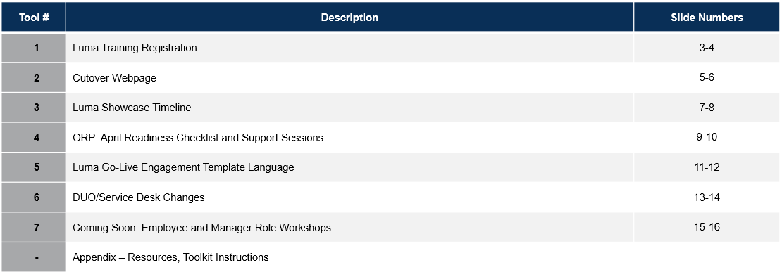
CL Communications Toolkit
Table of Contents
The following tools will be available in the April Change Liaison Communications Toolkit. Thank you for sharing them with your agency colleagues!

Slide 21

Luma Showcases

Slide 22
Luma Showcases
Due to requests for increased touchpoints and greater visibility into the Luma transition, we are planning a series of Luma Monthly Showcase Sessions for Change Liaisons. Each session will be led by a subject matter expert (SME) who will speak on the topic at hand followed by a Q&A. Although these sessions are designed for CLs, they can bring members of their agency who would benefit from learning more about the monthly topic.
 | March | April | May | June | July
Monthly Topic | Training Showcase | Cutover and Conversion Workbooks | Reports | Technology – Mingle (formerly Enterprise Dashboard) & Service Desk | Sustainment
SME | Training Team | Cutover Team | Luma OCM | CSC | Sustainment Team
Objectives | Build awareness of training schedule and topics. | Cover cutover freeze dates, and procedures. Support for completing conversion workbooks. | Support agencies with report submissions. | Offer tutorial on how to access Mingle and Service Desk. | Post go-live session to support the adoption of the Luma system.
Date | 3/14 Recording up on YouTube | 4/19 | TBD | TBD | TBD

Slide 23

Outstanding Requests

Slide 24
Outstanding Requests
Agency to Fund Validation:
Due April 7th
Custodial Account Management (CAM):
Due April 7th
Interface Priority Contact Update:
Due April 7th

Slide 25

Luma HR Organization Workbook

Slide 26
HR Org Workbook
The Luma Human Capital Management (HCM) team is ready to kick off the final iteration of the HR Organization Workbook. We will be hosting an hour-long meeting on April 17th to showcase the final workbooks to agency personnel. This is our third and final cycle before Luma goes live.
Some of you may have worked on previous versions of the workbook, some of you may have participated in HCM’s Luma Lab and seen how Luma works with your Agency’s workbook data, and some of you may be new and don’t know anything about this. Regardless, we want you to save the date for this final HCM workbook activity. Your participation will be critical to the accurate representation of your organization in Luma.
Action (WHAT) | WHEN | WHO
Put workbook files into Agency SFTP folders | EOD Sunday 04/16 | Luma Team
Attend HR Org workbook with Agencies: 2:00 - 3:00 PM | 2:00 to 3:00pm Monday 4/17 | All Agencies
Send HR Org written instructions and meeting recording to invitees | EOD Monday 4/17 | Luma Team
Work on and complete your Agency's HR Org workbook | Monday 4/17 --> Friday 5/12 | All Agencies
Ask for help, resolve questions, get needed Agency Org approvals | Monday 4/17 --> Friday 5/12 | All Agencies
Save your Agency's master HR Org workbook on the SFTP server | Before EOD Friday 5/12 | All Agencies
Reach out to Agencies on questions/issues for any workbook discrepancies | Monday 05/17 --> Friday 5/19 | Luma Team
Create master conversion file (to upload to Luma Production) | Saturday 5/18 --> Sunday 5/19 | Luma Team
Provide file for Luma upload into Luma Production | Monday 5/20 | Luma Team
Luma is live for use by State of Idaho employees | Week of June 19 | Everyone

Slide 27

Key Takeaways

Slide 28

Thank you!
Sheena Coles
SColes@sco.Idaho.gov
208-334-3100
Alex Doench
adoench@sco.Idaho.gov
208-332-8841
Danielle Stevens
dstevens@sco.Idaho.gov
208-332-8868
Chris Lehosit
clehosit@sco.Idaho.gov
208-332-8887
Krystal Griffith
kgriffith@sco.Idaho.gov
208-332-8861
Elijah Stearns
estearns@sco.Idaho.gov
208-332-8871

